Slide 1
Scientific Insights into the Atlas Dark Sky Reserve
Zouhair Benkhaldoun, Hamza Ait Abdelali & Abdelkrim Boskri
Cadi Ayyad university, Oukaimeden Observatory
zouhair@uca.ac.ma

Slide 2
Outline:
Part I: Atlas Dark Sky Reserve Project
Survey and ALAN Measurements in the preselected reserve area
Modeling Light Pollution at Oukaimeden Observatory
Artificial Component: Impact of nearby cities and lighting infrastructures
Natural Component: Contribution of celestial sources using the GAMBONS model
Conclusion: Key findings
Part II: Pollution from Satellite Constellations
Oukaimeden Observatory: A Key Player in Satellite Observations
Observation Facilities & Tracking Tools for monitoring satellites
Data Processing & Impact Analysis on astronomical observations
Conclusion: Challenges and mitigation strategies

Slide 3
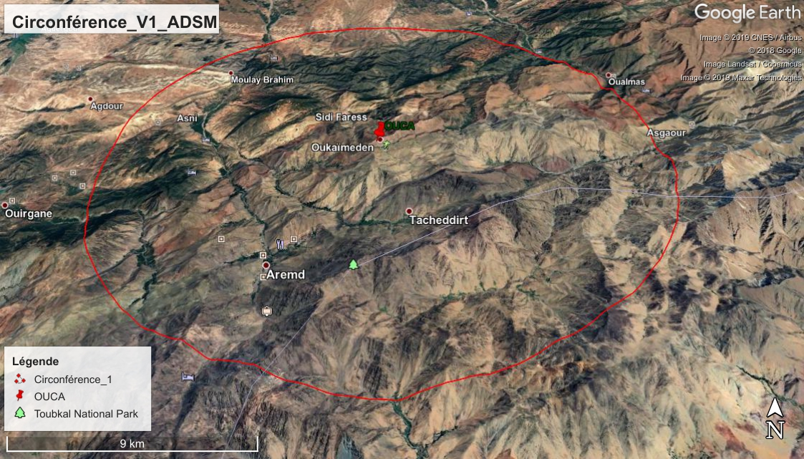
The Atlas Dark Sky Reserve
The Atlas Dark Sky Reserve project is a unique project in the region. It consists in creating an international dark sky reserve covering a large territory including the Toubkal National Park.
The first zone of ADSR PROJECT

Slide 4
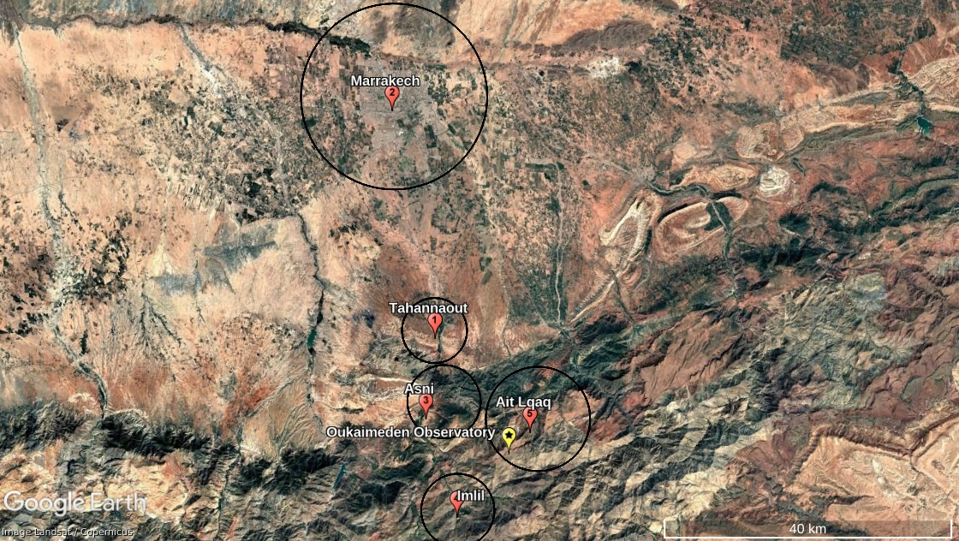

Slide 5
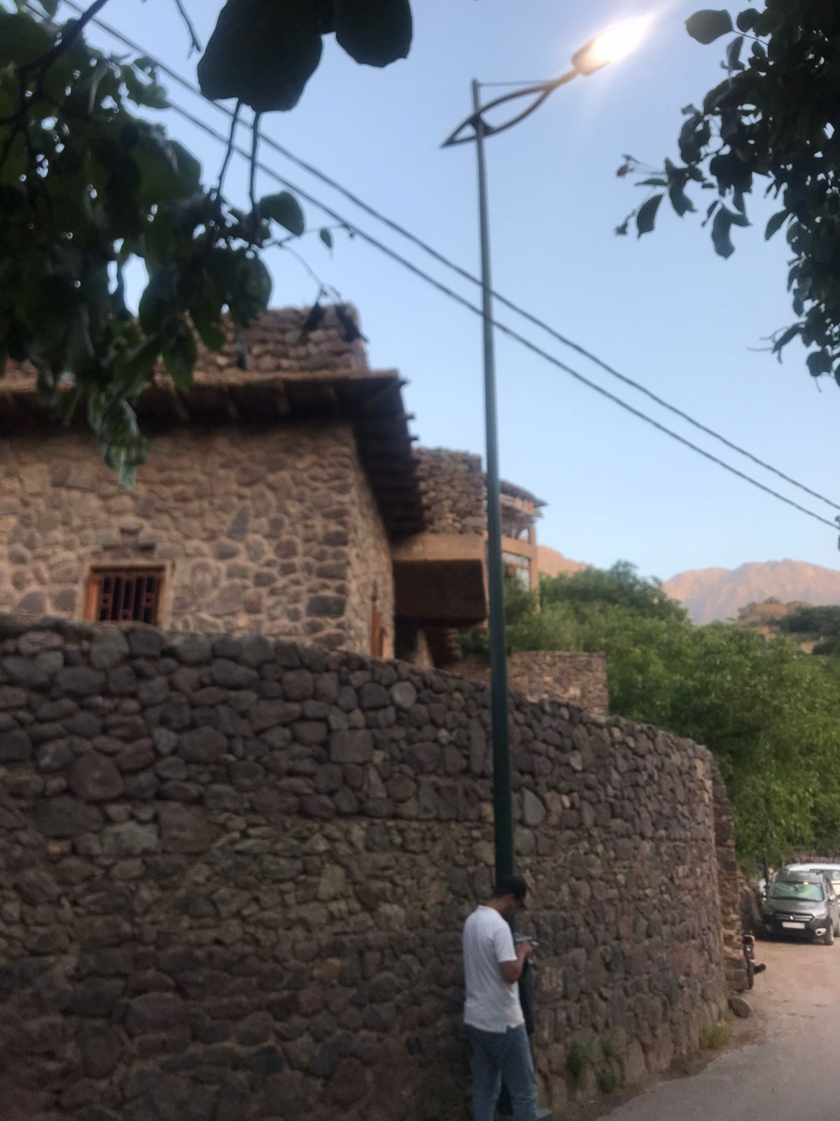
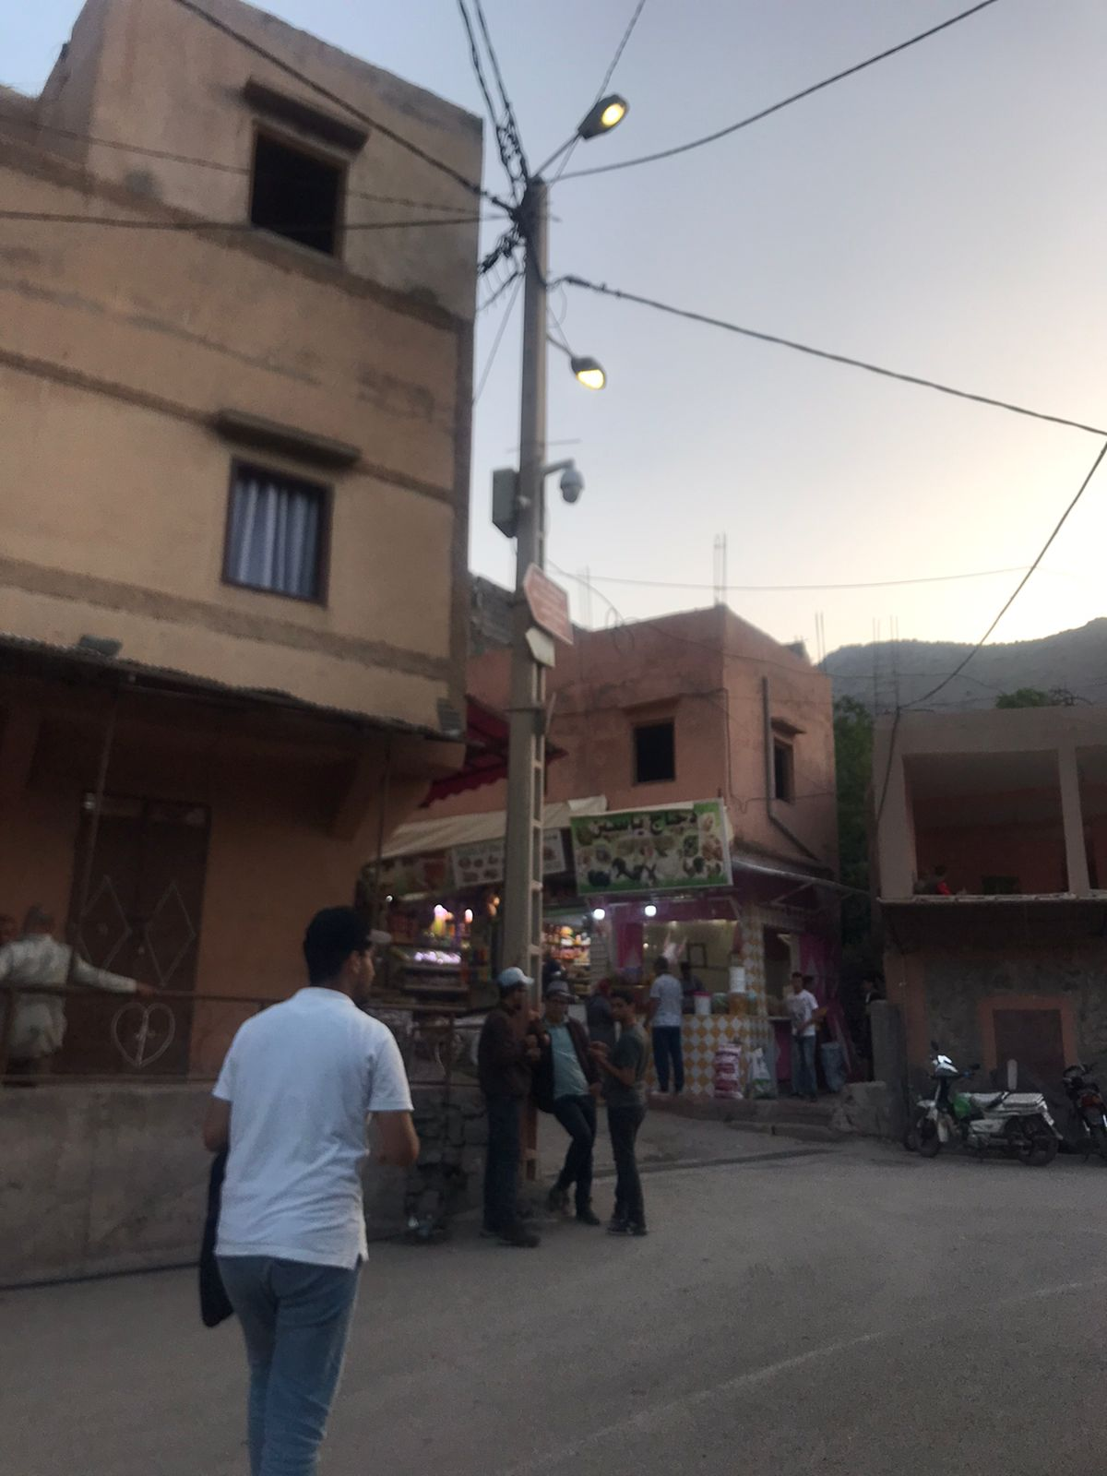
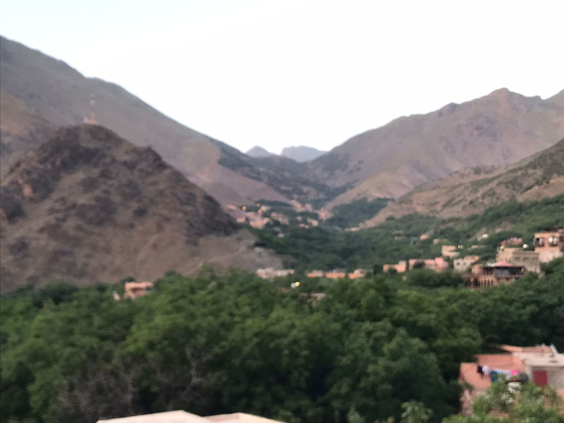
Pictures from a survey in Asni village June 2021

Slide 6
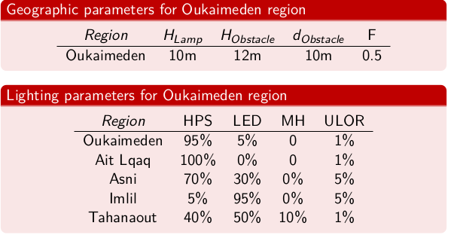
Survey conducted at Oukaimeden Region

Slide 7
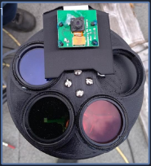
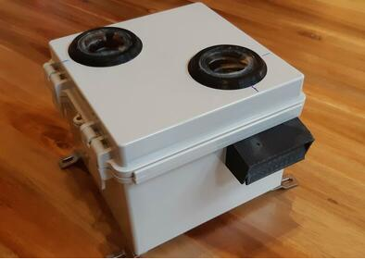
NSB measurements at the Oukaimeden Observatory
To measure the zenith night sky brightness (ZNSB), we have used the multispectral Color Sky Quality Meter.
Version 2 (CoSQM) photometer.It is composed of a filter wheel with 4 different spectral transmittances in the visible range (clear, red, blue, green) that is standing on a step motor in front of a Unihedron Sky Quality Meter (SQM).The instrument operated remotely via the SSH protocol and the data can be accessed via an integrated web server.

Slide 8
Utilizing CoSQM for ZNSB Measurements at Oukaimeden Observatory
SQM-LE Model of CoSQM: Ensures compatibility with global SQM data.
High Sensitivity & Resolution: Measures night sky brightness with good accuracy.
MPSAS Scale:
Inverted logarithmic scale representing brightness per solid angle.
Higher values indicate darker skies and lower light pollution.
Observation Period:
Data collected at Oukaimeden Observatory from 2022 to now.
Figure Below: Displays Zenith Night Sky Brightness (ZNSB) variations over about one year (20024).

Slide 9
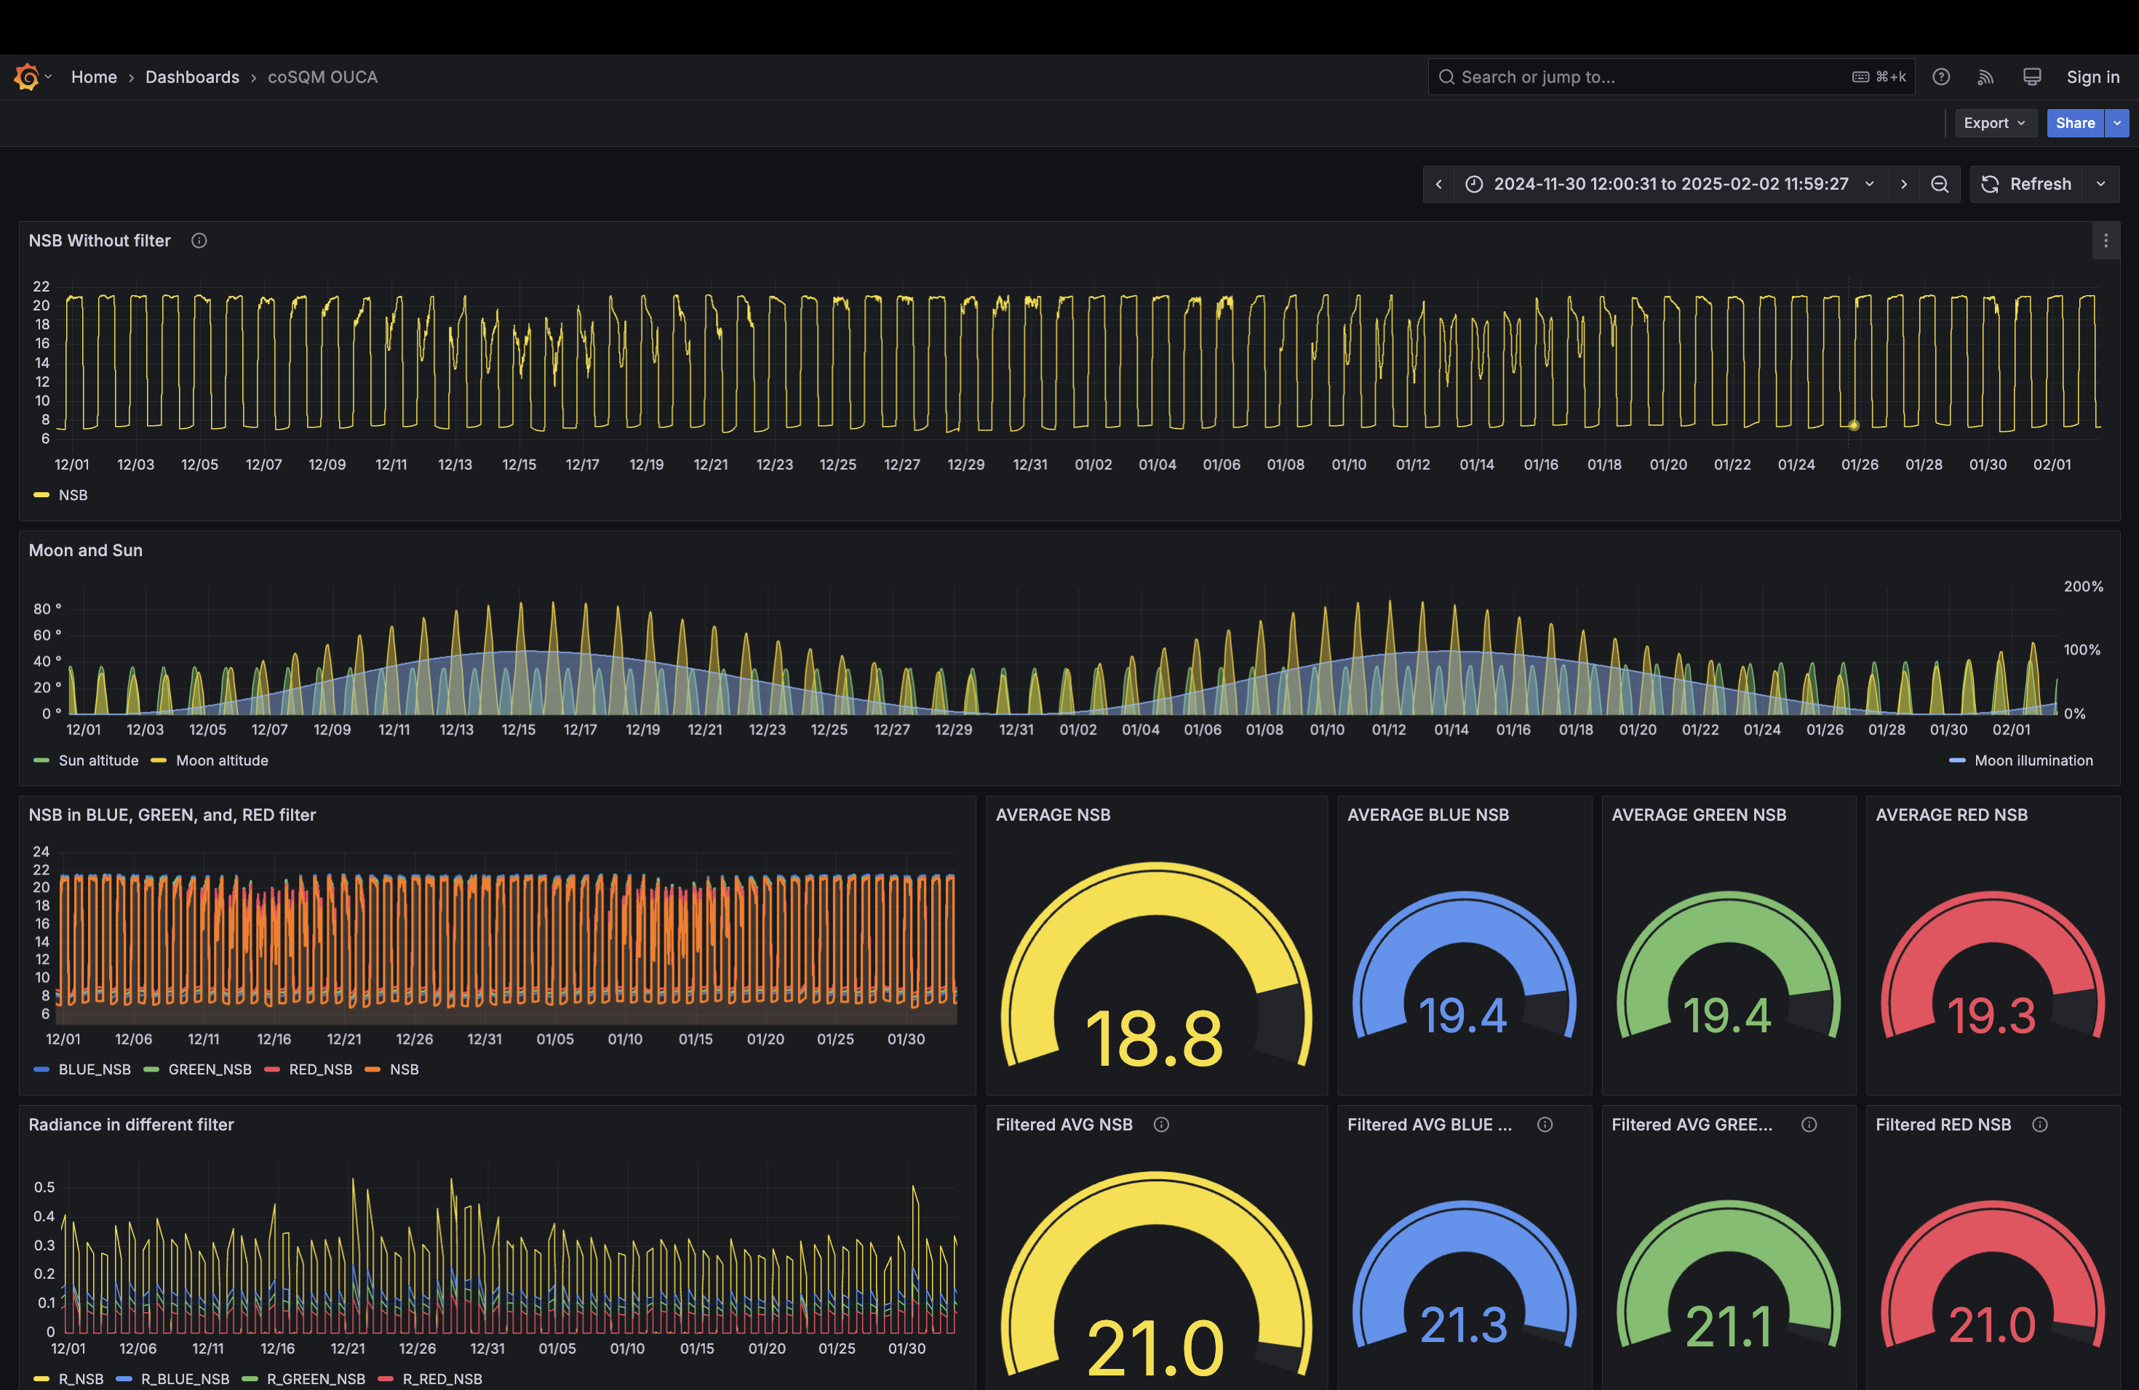

Slide 10
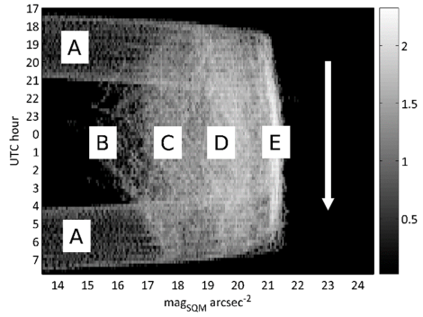
Visualizing ZNSB Distribution with Densitograms
For the aims of monitoring the ZNSB, they are several graphic representations can be instrumental to obtain some insights into the NSB distribution, One particularly useful one is the densitogram (or ‘jellyfish diagram’, according to Posch et al.) . In this matricial representation showed in figure below, the horizontal axis corresponds to the time of the day (with, e.g., 10-min bin resolution), and the vertical one to the NSB measured in the magnitudes per square arcsecond scale (with, e.g., 0.05 mag/arcsec2 resolution bins). The value of each pixel is the number of measurements recorded along the year within each time-magnitude bin.
The different features visible in the densitogram like :
A : twilight periods
B : moon within the field of view
C : scattered moonlight,
D : cloud reflections
E : atmospheric scattering artificial light in clear and moonless periods.

Slide 11
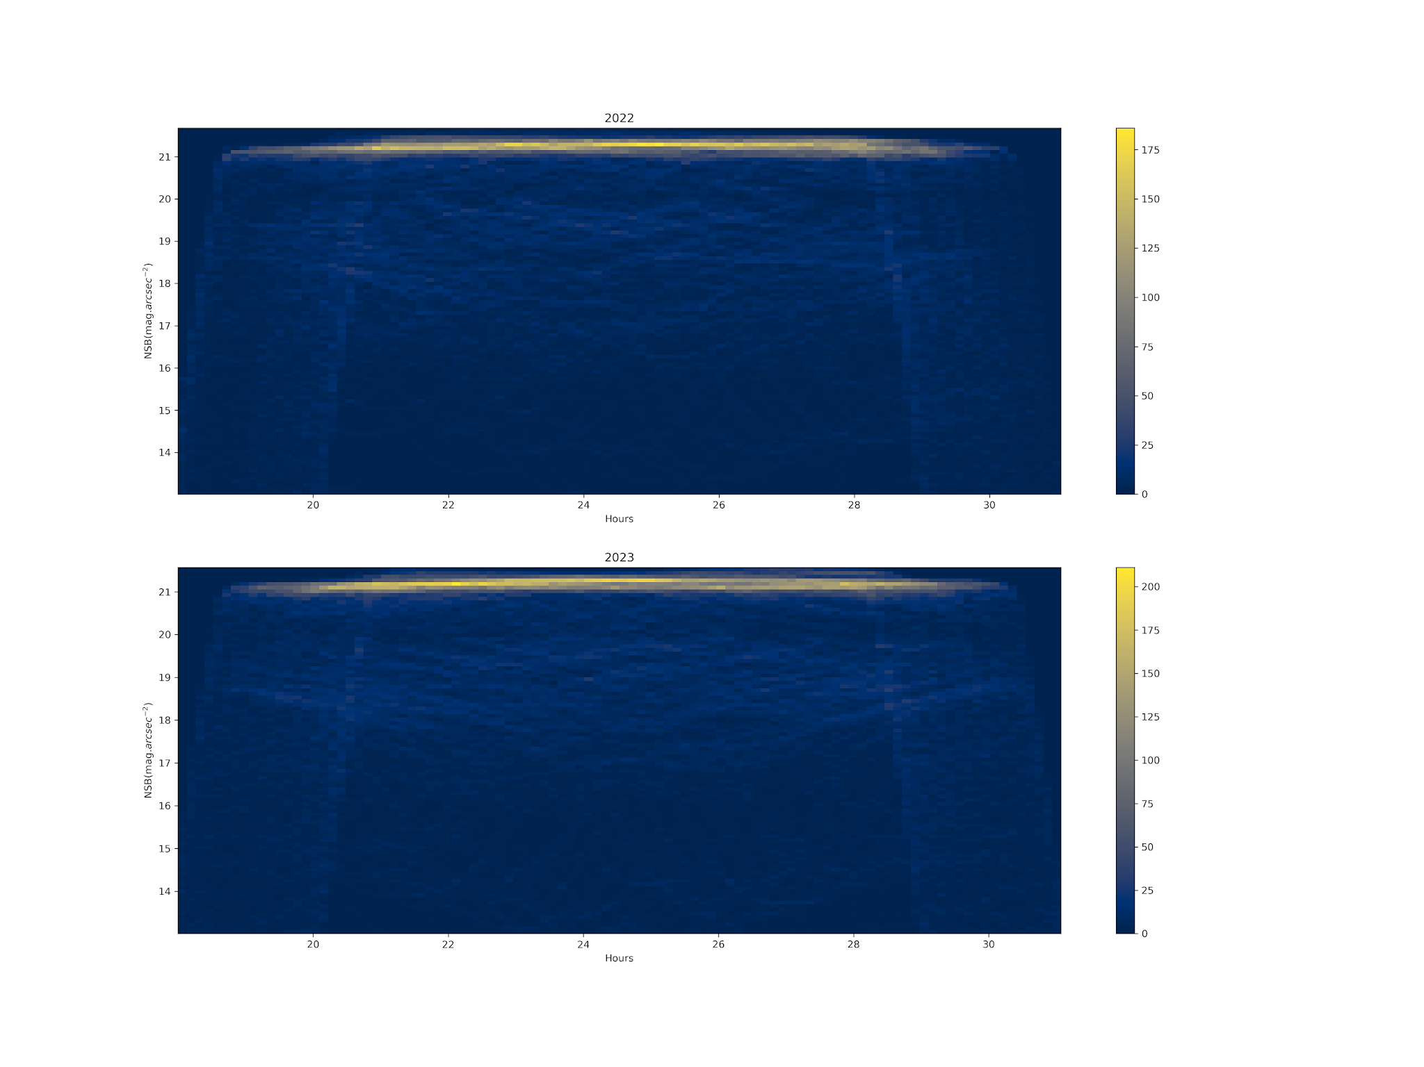
Densitogram of Oukaimeden observatory

Slide 12
Modeling Light Pollution at Oukaimeden Observatory
Monitoring the main sources of light pollution affecting the observatory requires evaluating both artificial and natural light pollution.
Artificial light pollution is assessed using the ILLUMINA Model, which simulates human-induced sky radiance.
Natural light pollution is analyzed using the Gambon Model, which accounts for atmospheric and celestial contributions.

Slide 13
Numerical simulation of ANSB using ILLUMINA model
ILLUMINA Model: Advanced numerical model for simulating human-induced sky radiance.
Scattering Consideration: Accounts for both first and second-order scattering, including direct emission and ground reflection.
Light Source Representation:
Cities and towns modeled as multiple circular areas.
Each area characterized by homogeneous spectral properties, light output distribution, lamp height, and obstacle dimensions.
Geographical & Atmospheric Factors:
Integrates elevation and ground reflectivity using a digital elevation model and satellite spectral albedo data.
Uses multiple parameters to define atmospheric conditions.
Simulation Output:
Designed to model light scattered back to a spectrometer.
Provides spectral radiance output in (W.nm⁻¹.sr⁻¹).
Focuses exclusively on artificial light contributions to night-sky glow.

Slide 14
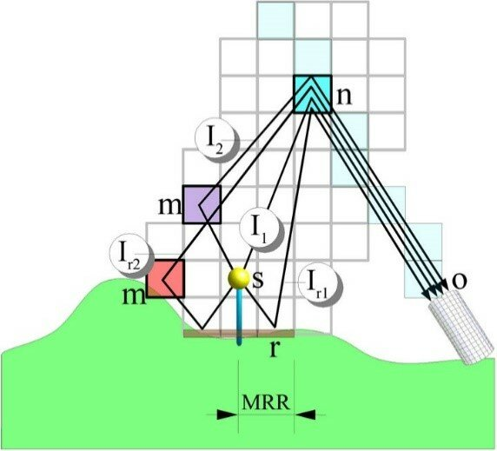
ILLUMINA Model Schematic
Illustration of the computational model used by ILLUMINA to determine the flux received in each direction.
Key Elements:
S – Light source
O – Observer’s location
n – Any 3D cell along the observer's line of sight
Scattering Paths:
I₁ – First-order scattering path
I₂ – Second-order scattering path
Ir₁ – Reflection combined with first-order scattering
Ir₂ – Reflection combined with second-order scattering
Reflection Considerations:
r – Ground reflection
MRR – Maximum radius considered for reflection
Image source: Aubé et al. (2005).

Slide 15
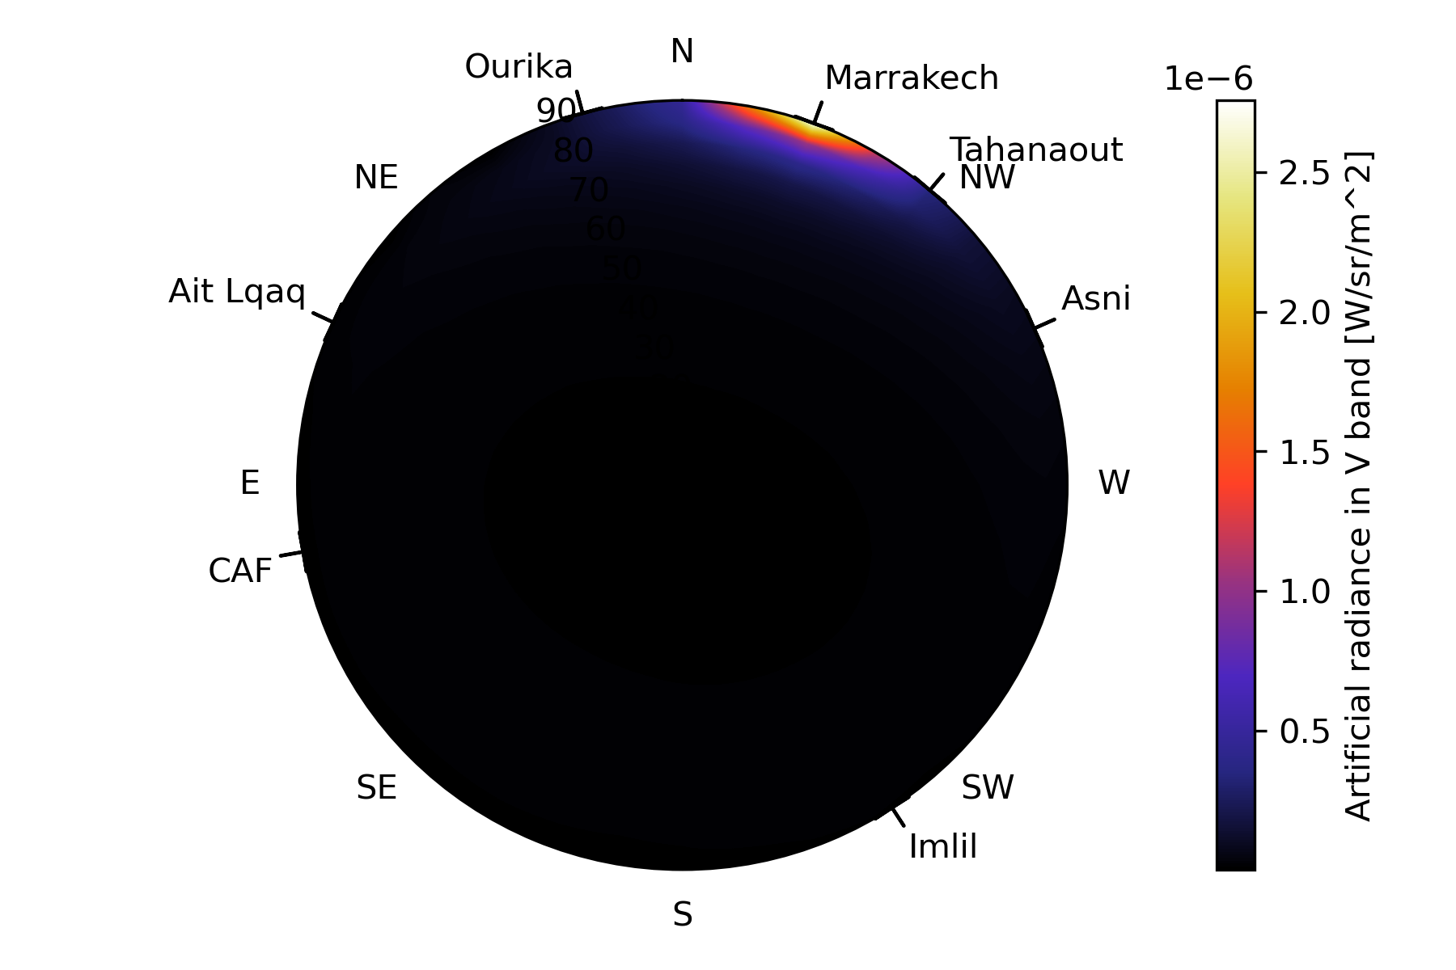
Results from Illumina model
The figure illustrates the artificial component of the zenithal radiance in the V-band at Oukaimeden Observatory.
As expected, the most impacted lines of sight are directed towards Marrakesh city.
The effect is particularly pronounced at low elevation angles, especially up to 20°.

Slide 16
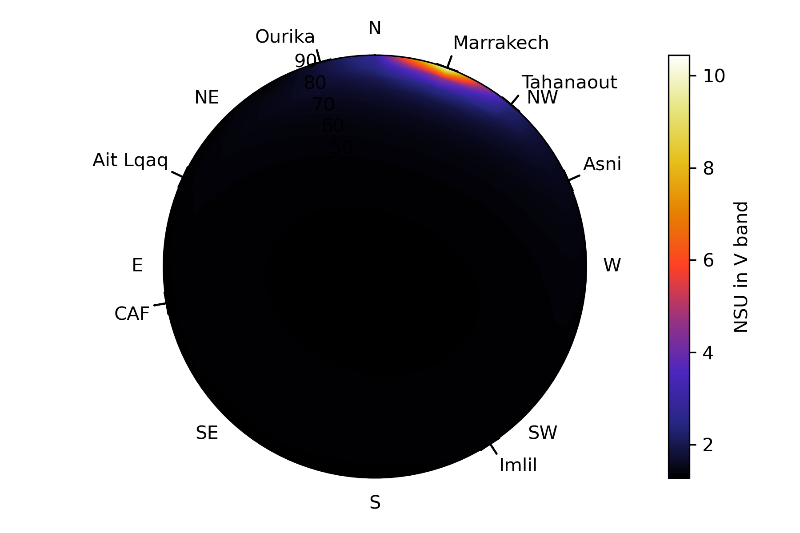
Results from Illumina model
This figure presents the simulated night sky brightness in Natural Sky Units (NSU).
The NSU scale is used to provide an intuitive and clear interpretation of how much brighter or darker the night sky is compared to its natural state.
Different NSU thresholds are defined based on environmental conditions:
Pristine areas (e.g., national parks): 1–2 NSU
Rural areas: 2–5 NSU
Suburban areas: 5–10 NSU
Urban areas: 10–20 NSU
The Oukaimeden area falls within the pristine category.

Slide 17
Introduction to the GAMBONS Model: Estimating Natural Night Sky Brightness
GAMBONS (GAia Map of the Brightness Of the Natural Sky) is a model designed to estimate the natural night sky brightness during cloudless and moonless nights. It is based on extra-atmospheric star radiance data derived from the Gaia catalogue, providing a detailed representation of the sky’s intrinsic brightness in the absence of artificial light.

Slide 18
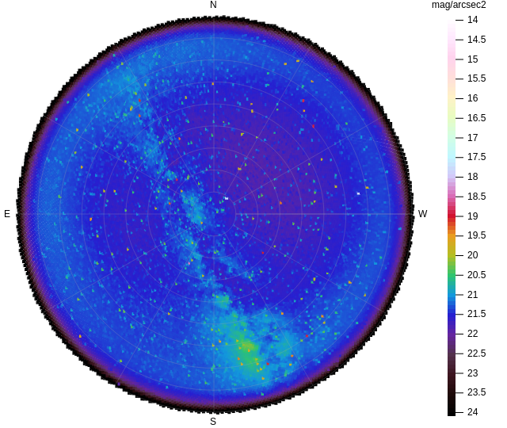
Contribution of Natural Brightness (Moonlight, Galaxies, etc.) at Oukaimeden Observatory Using the GAMBONS Model
This figure illustrates that natural light, including moonlight and celestial objects such as galaxies, is the sole source of brightness at the Oukaimeden Observatory. This is a positive outcome that should be maintained. To preserve these conditions, it is crucial to manage and control artificial light pollution around the observatory in the future.

Slide 19
Natural Light Pollution at Oukaimeden Observatory: Insights from the GAMBONS Model
The GAMBON model provides the natural component of light pollution, and in our study, the results indicate that the sources of pollution are primarily from galaxy and Moon. This is a positive outcome for the Oukaimeden Observatory, as it aligns with our objectives for the ADSM project.
Using the GAMBON model, we obtained a magnitude of night sky brightness (NSB) of 21 mag/arcsec², which matches the values typically measured with an CoSQM.
The preliminary conclusion is that the Oukaimeden Observatory's sky qualifies as a Class 1 dark site, making it an excellent location for astronomical observations.

Slide 20
Conclusion: Part I
Source/Model | Radiance (W/m^2/str)
Artificial Light (Illumina) | 5,33085 e -14
Natural Light (Gambons) | 3,750 e -7
As highlighted in the previous slides, the results from both models confirm that the contribution of artificial light is minimal, while the natural light component predominates. This is a positive outcome for the observatory and supports the objectives of the ADS Reserve project.

Slide 21
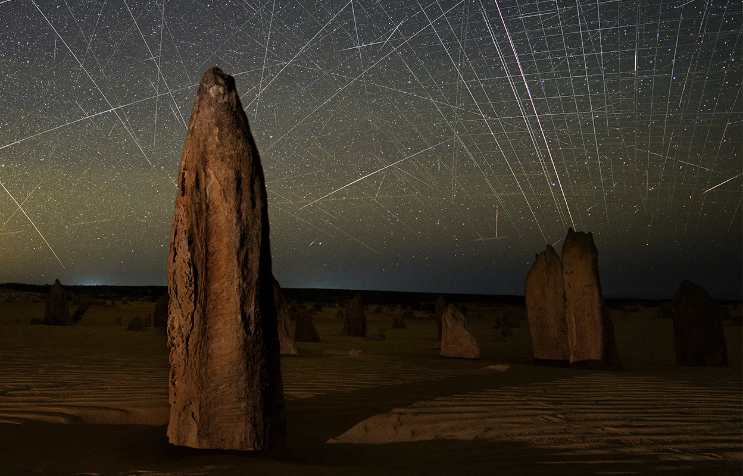
Satellite streaks appear in a photograph taken above the Pinnacles in Nambung National Park, Western Australia. Credit: Joshua Rozells

Slide 22
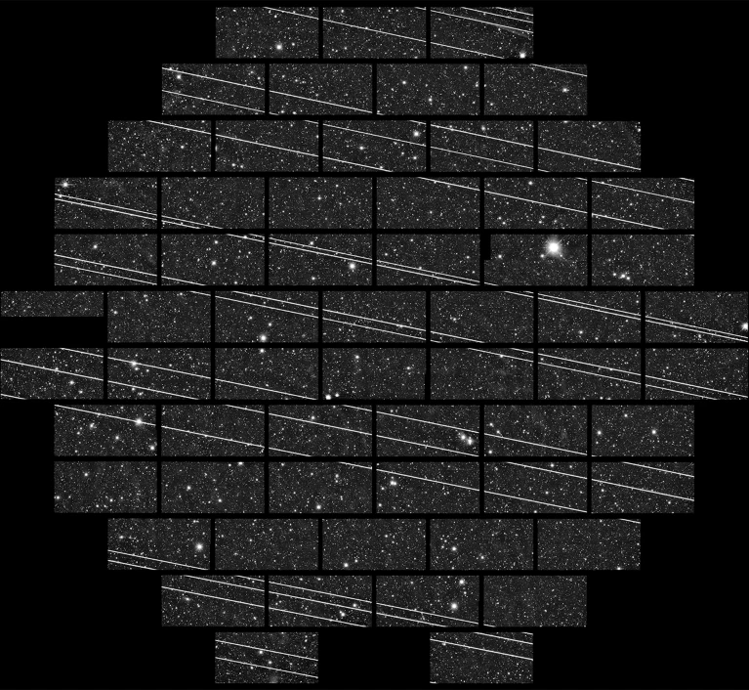
WHAT TO DO ABOUT SATELLITES HARMING ASTRONOMY
SpaceX and other companies plan to launch tens of thousands of satellites, which could mar astronomical observations and pollute the atmosphere. By Alexandra Witze
Nature | Vol 639 | 20 March 2025
Starlink satellites leave streaks in a 2019 image taken by a 4-metre telescope at the Cerro Tololo Inter-American Observatory in Chile.
Credit: CTIO/NOIRLab/NSF/AURA/DECam DELVE Survey

Slide 23
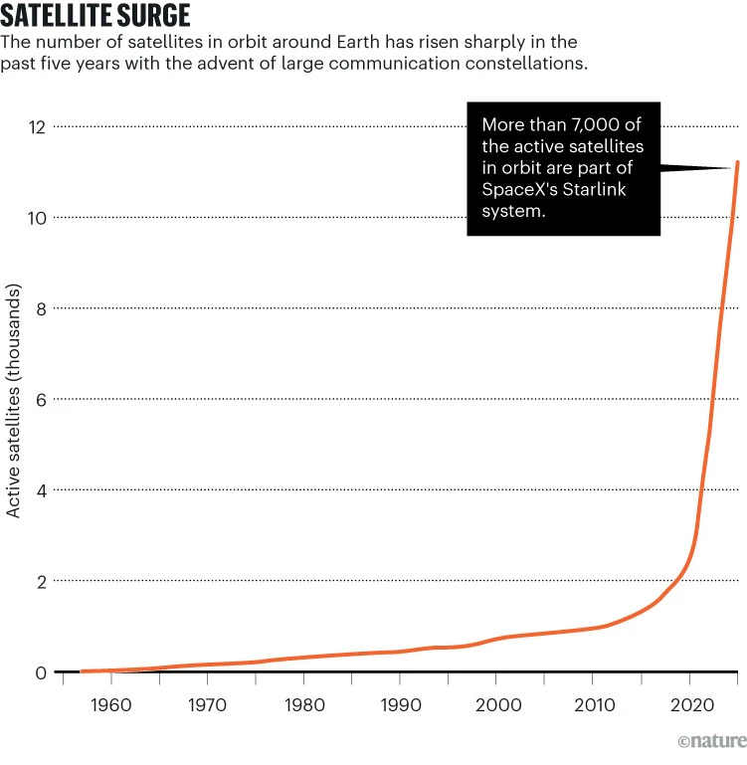
Sources: Jonathan’s Space Pages (https://go.nature.com/4IV22FD; https://go.nature.com/4225MKX)

Slide 24
Oukaimeden Observatory: A Key Player in Satellite Observations
As a partner of the IAU-CPS center, the Oukaimeden Observatory plays a crucial role in satellite observations. Equipped with a diverse array of telescopes, it provides essential observation services, conducts daily monitoring, and fosters international collaboration. Its advanced orbital data processing capabilities enhance mission planning and optimize scientific contributions.

Slide 31
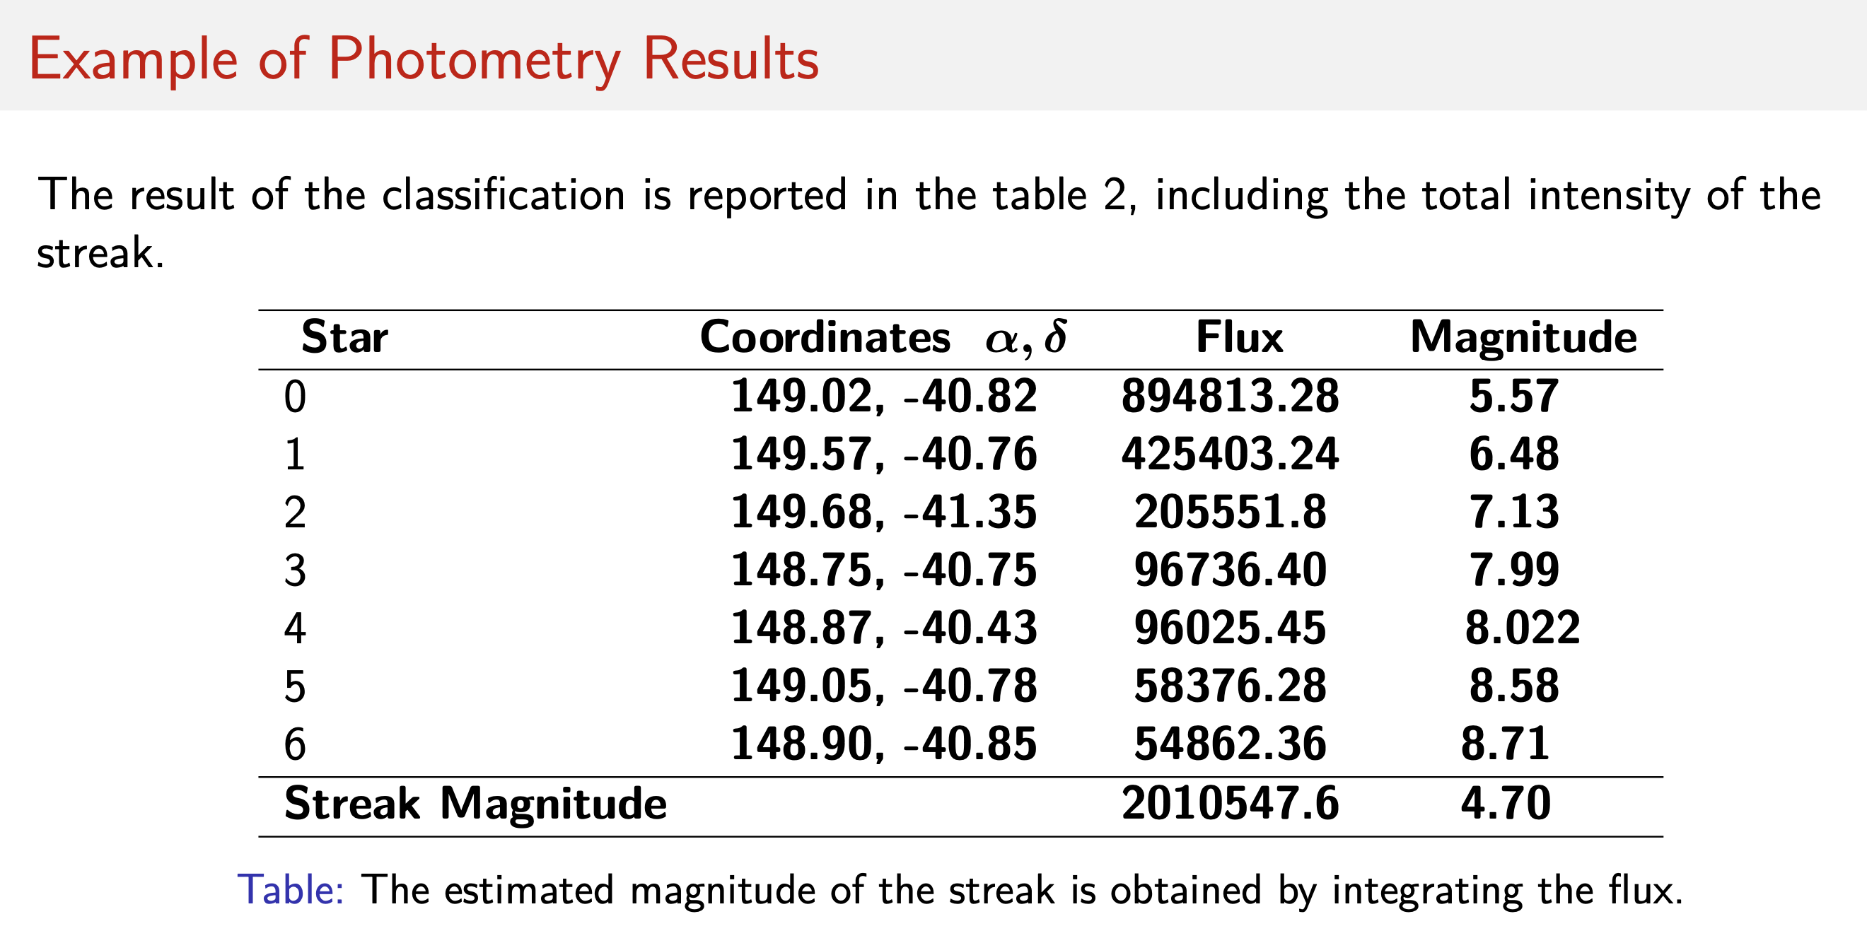

Slide 34
Part II

Slide 35
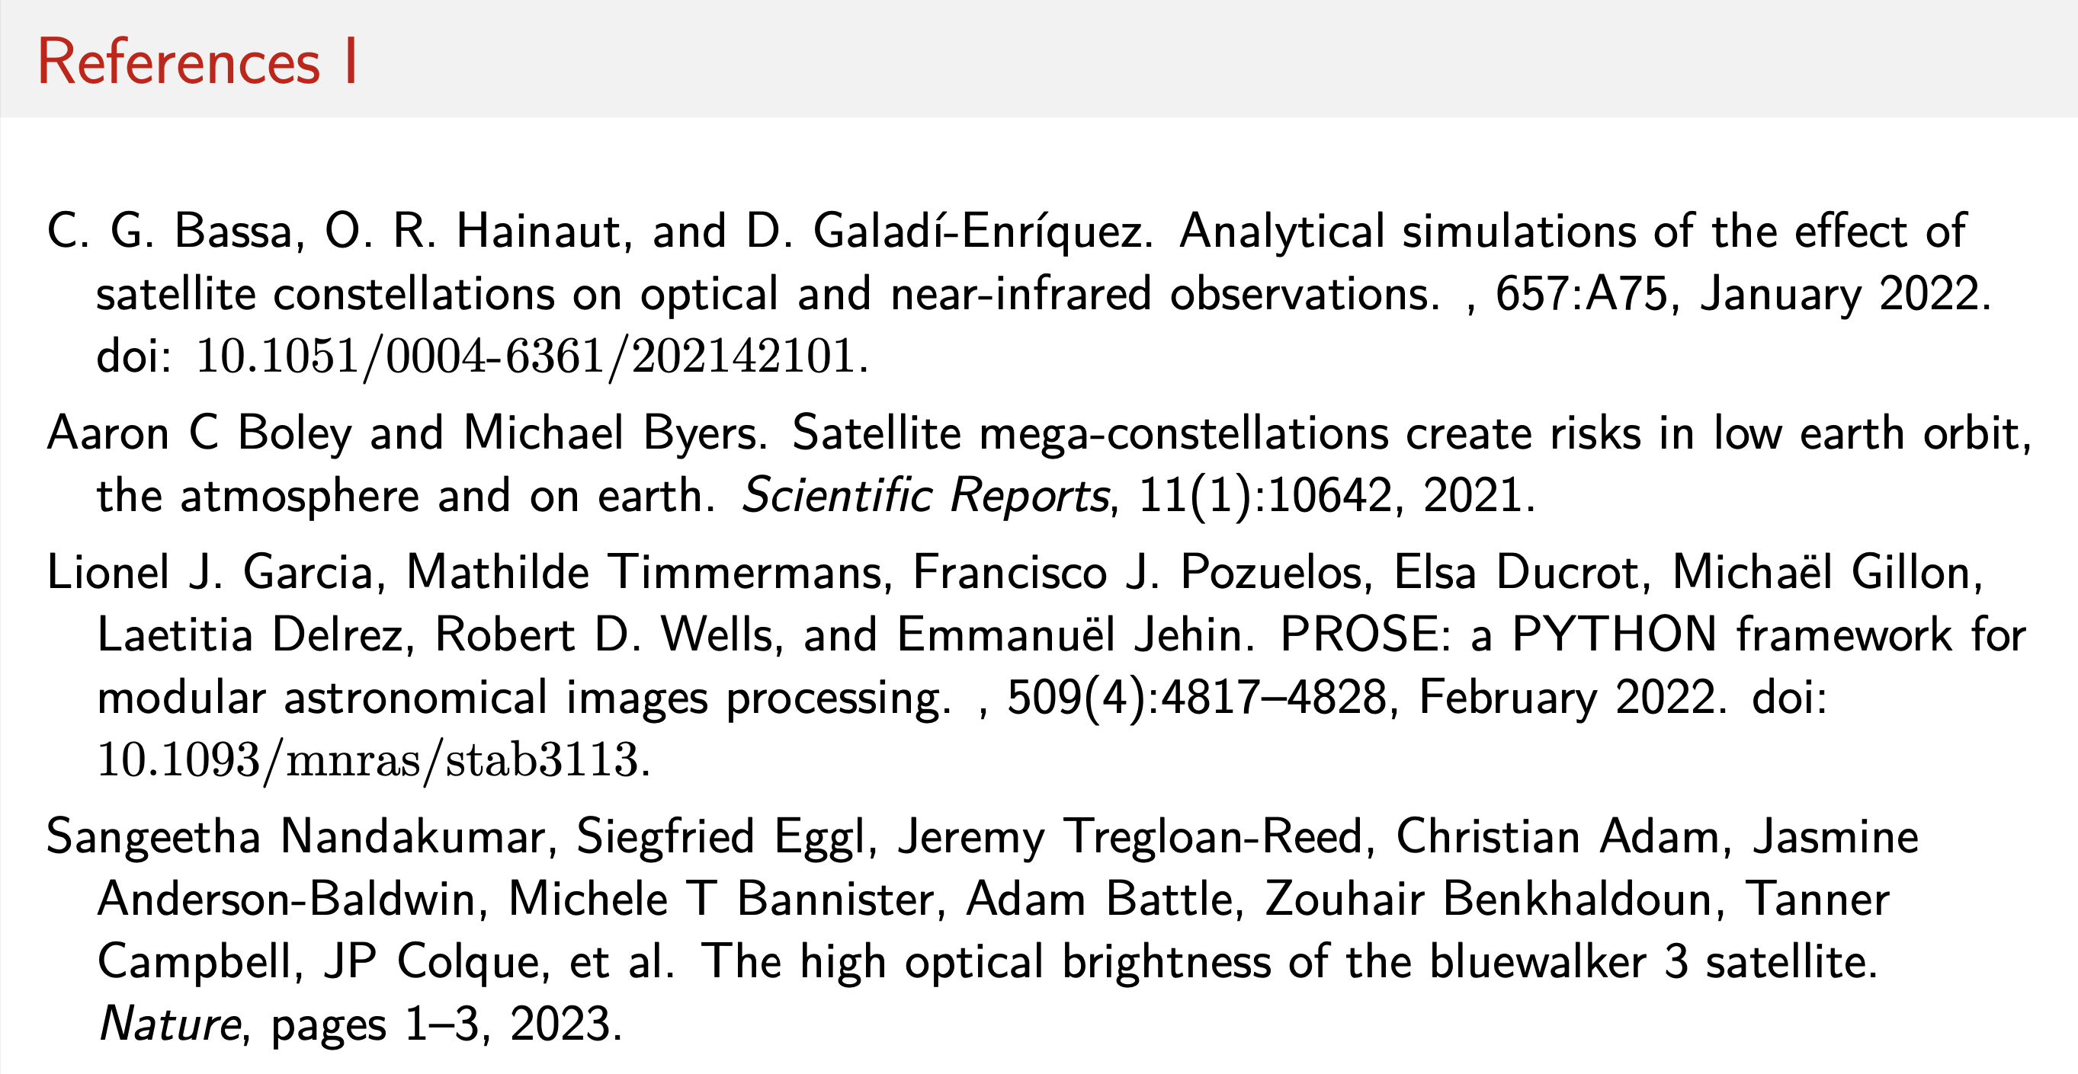

Slide 37
Thank you for your time and attention

