Slide 1
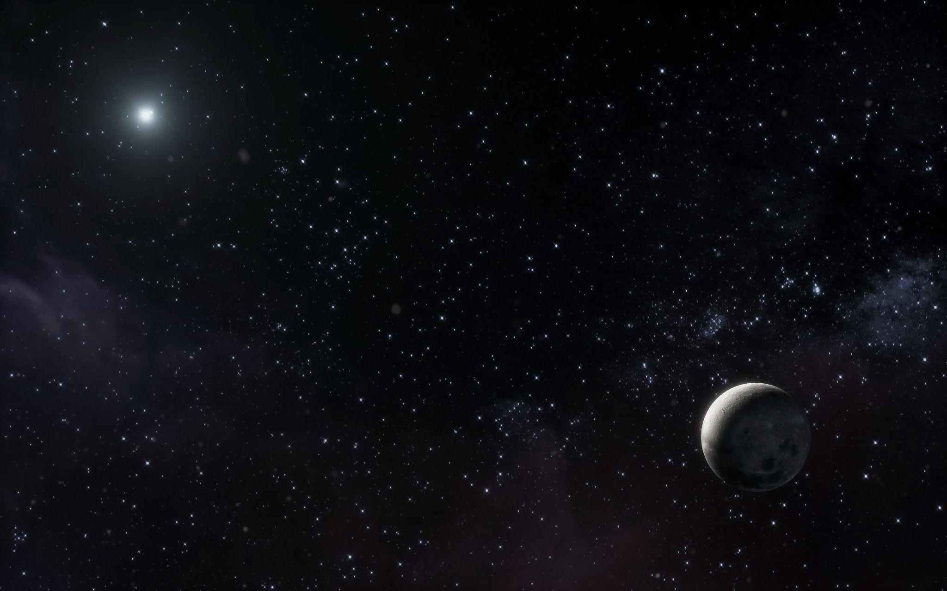

High-resolution analysis of recent Martian impact craters
AfAS-2025 Conference
Mayssa Daldoul

Slide 2
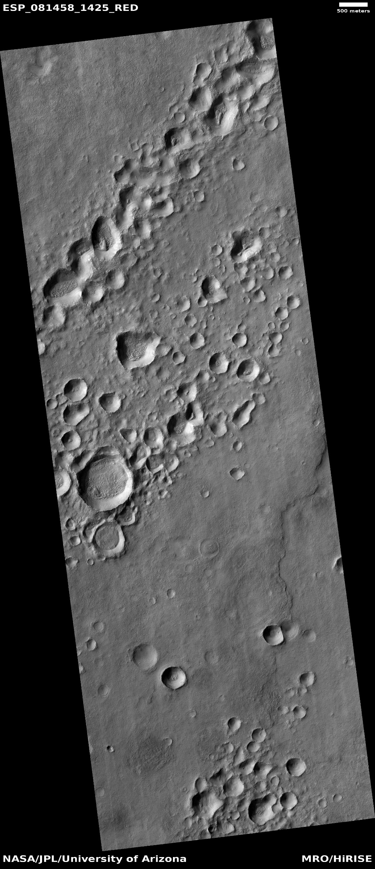
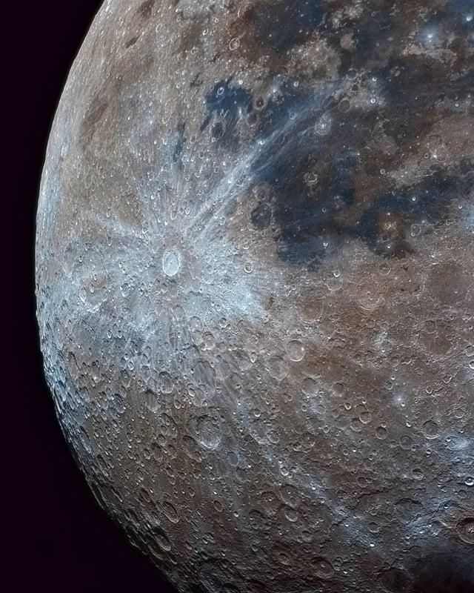
The indicator of freshness
Lobate ejecta morphology
Rays
The clusteres of secondaries crateres

Slide 3
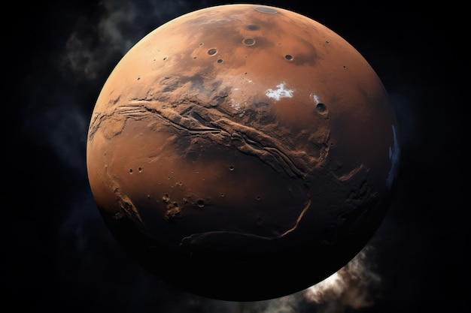
Find the most recent craters on Mars

Slide 4
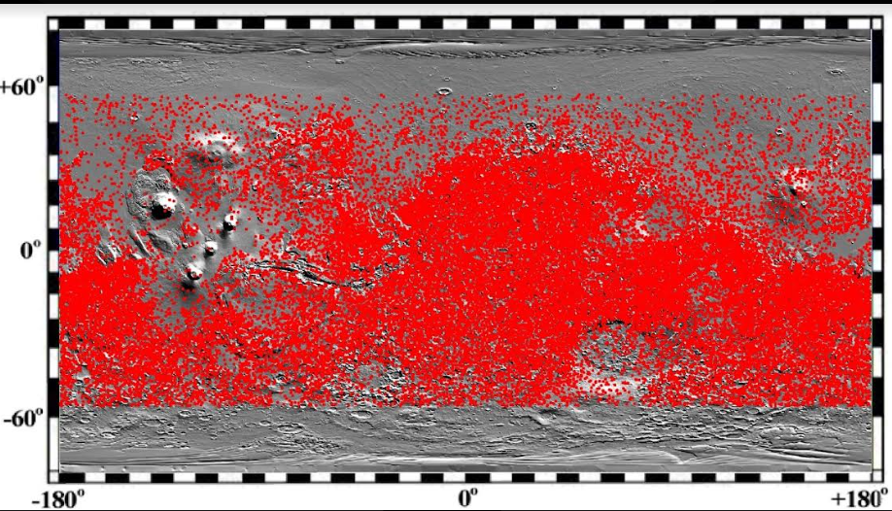
Map of all craters with a diameter greater than 4 km
N.Barlow

Slide 5
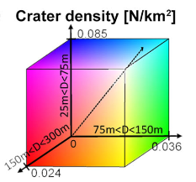
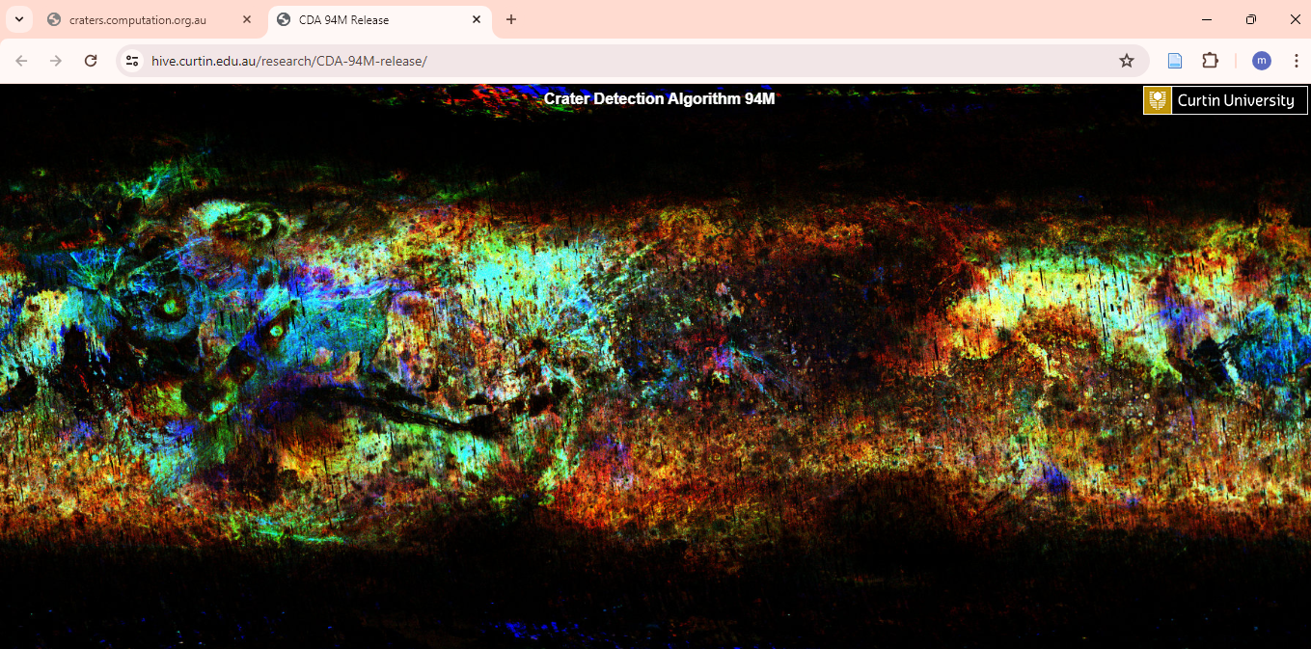
Crater Density map
90 million impact crater >100m
There are three ranges of sizes for the density of secondaries visualized mapping using red, blue and green
A.Lagain et al., 2019

Slide 6
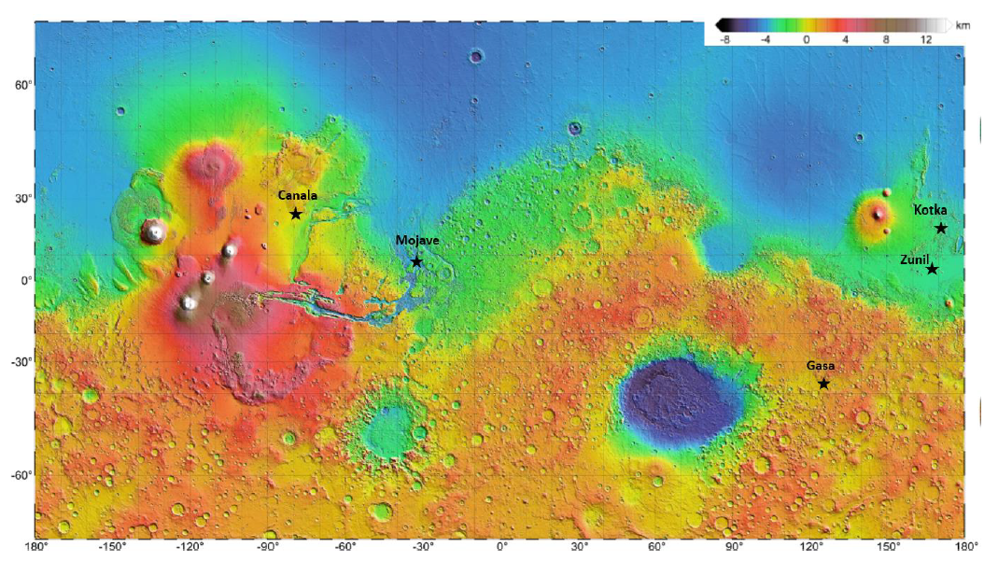
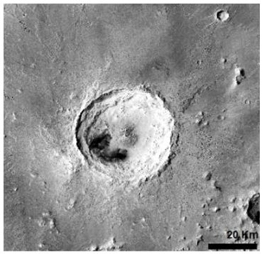
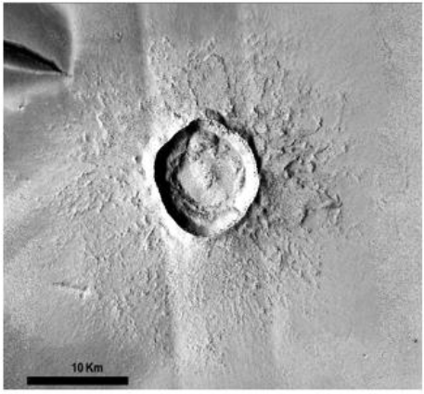
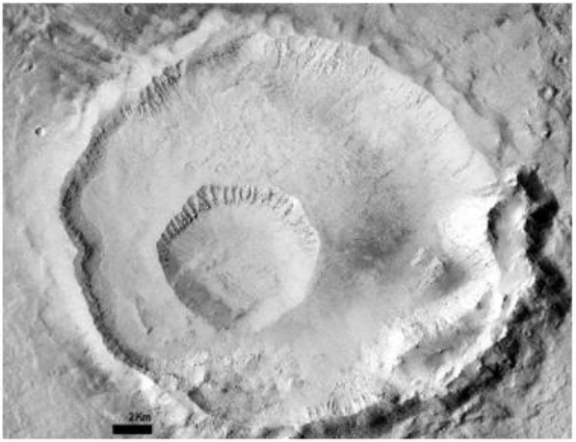
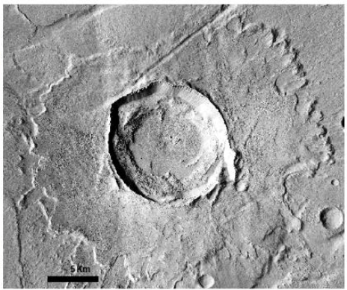
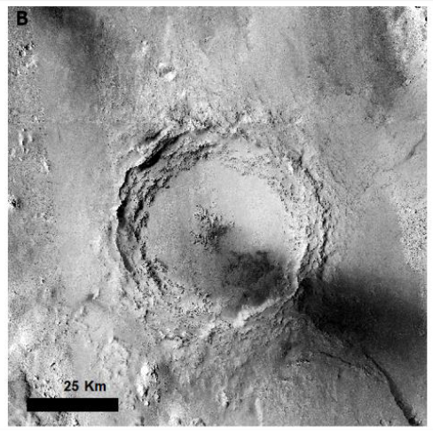
Five mapped impact crater
Diameter: 39km
Location: ELYSIUM PLANTIA
Diameter: 10km
Location: CERBERUS PLAINS
Diameter: 11km
Location: Tharsis Montes
Diameter: 58km
Location: Xanthe Terra
Diameter: 7km
Location: Eastern Promethei Terra

Slide 7
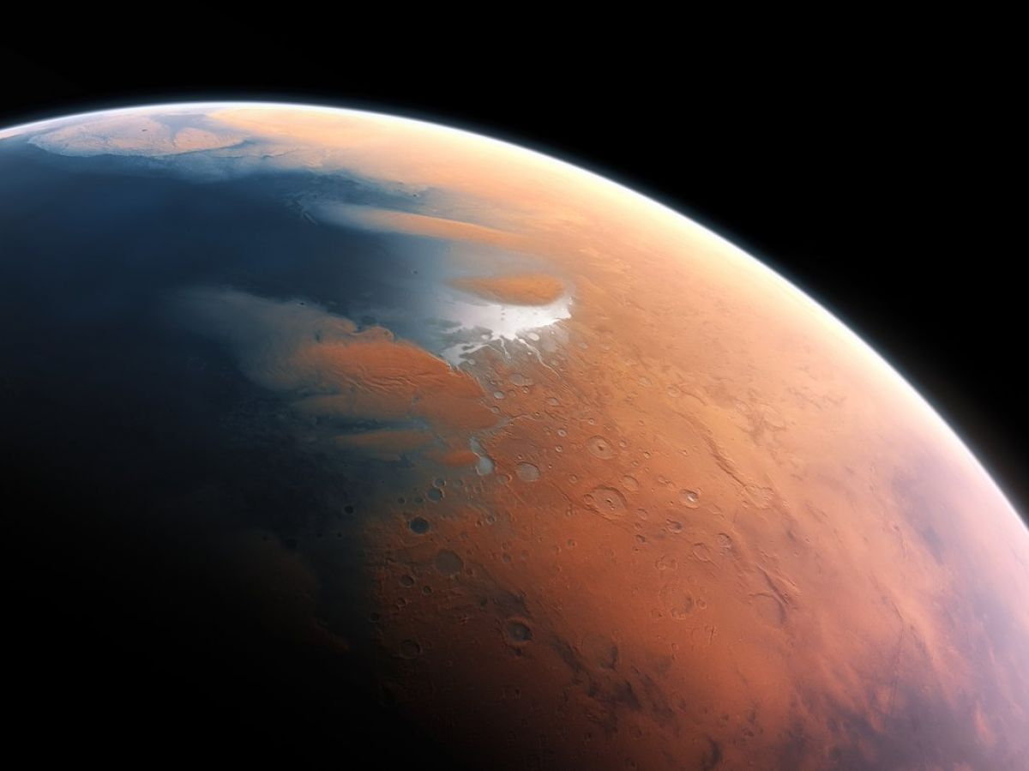
What are the results obtained from the processing of these data?

Slide 8
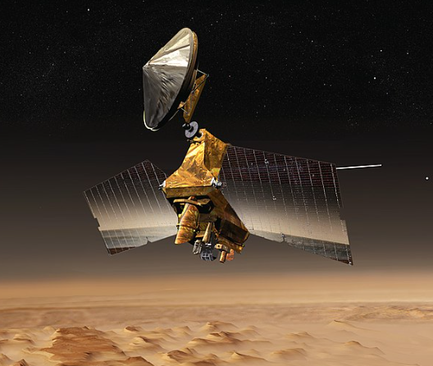
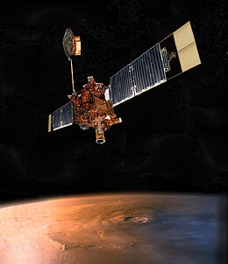
The data used for processing
IMAGERY
RESOLUTION/PIXEL
THEMIS Thermal infrared
100m
HiRISE (High-Resolution imaging Science Expriment)
25cm
CTX (Context Camera)
5m
DTM
RESOLUTION/PIXEL
Mola(Mars Orbiter Laser Altimeter)
460m
HiRISE
1m

Slide 9
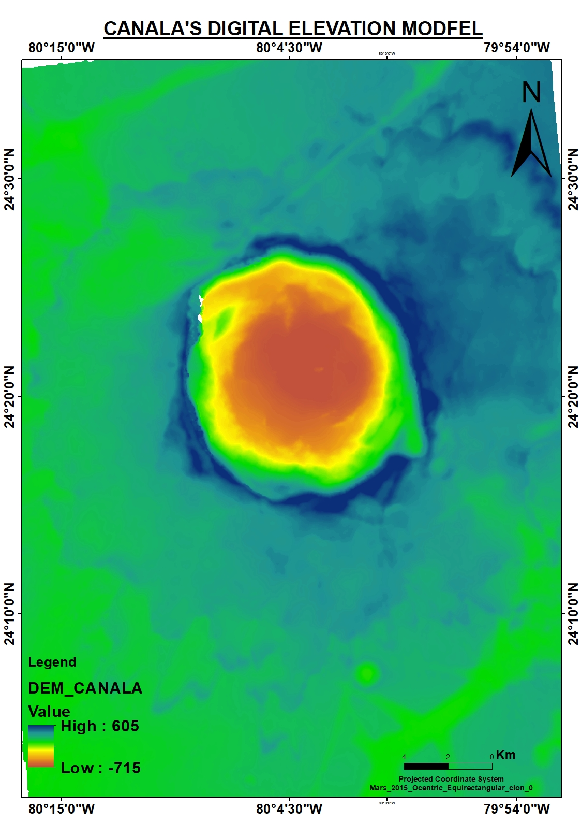
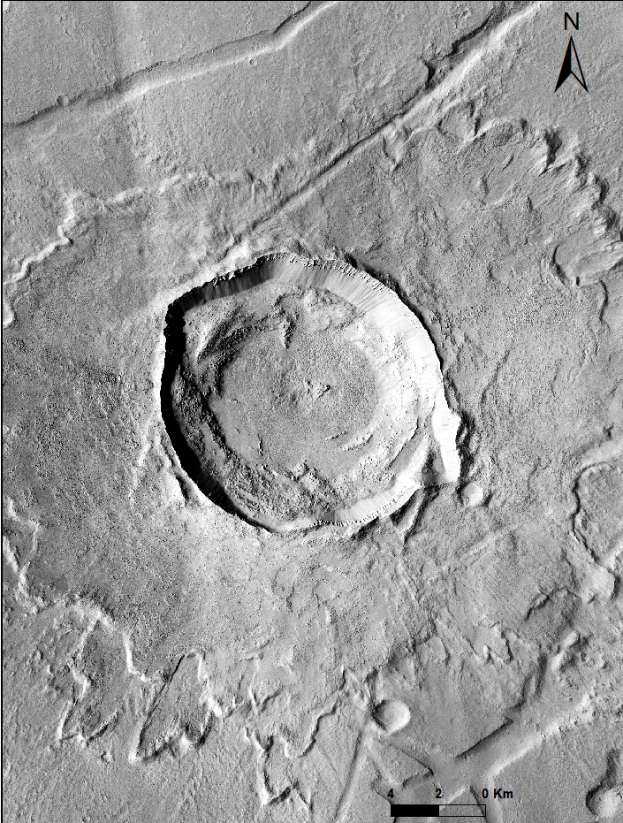
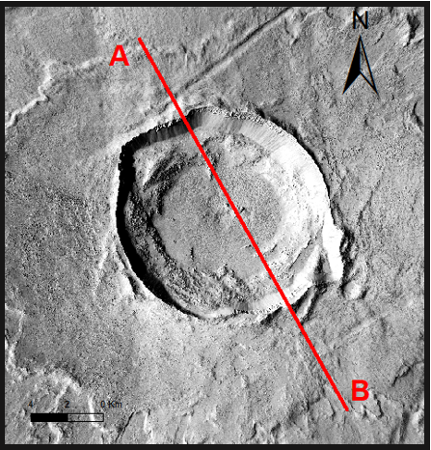
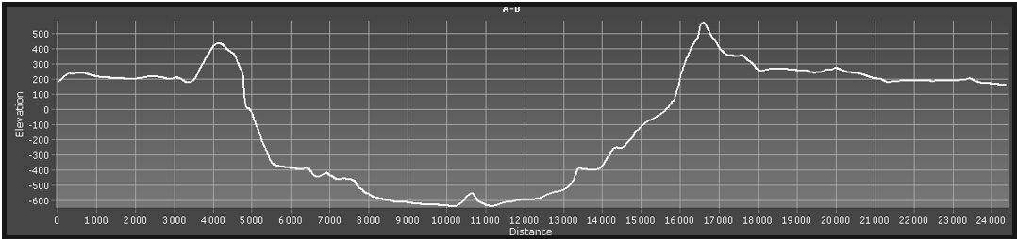
Topographic profile
Digital elevation model « DEM »

Slide 10
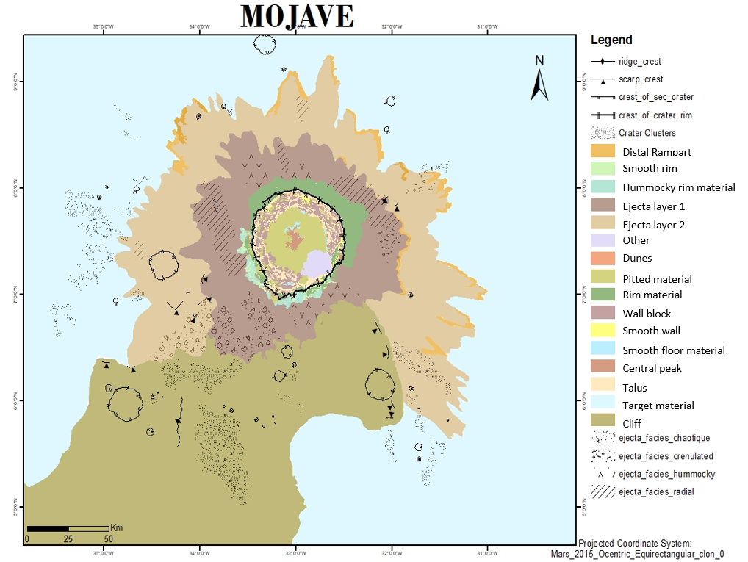
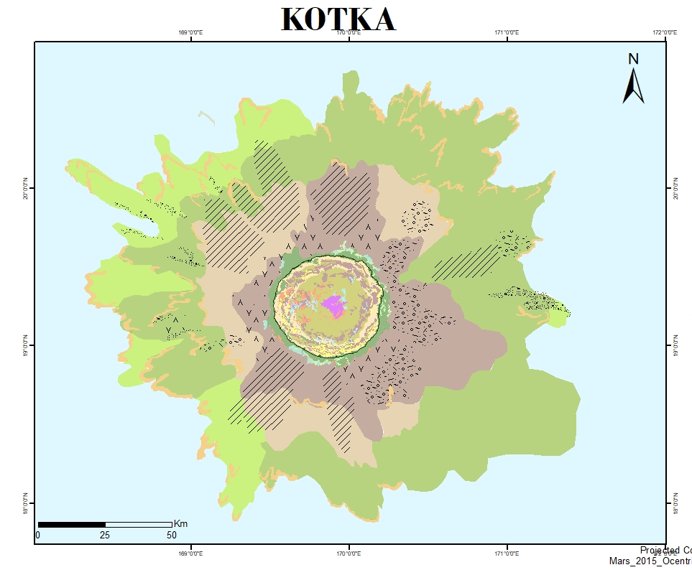
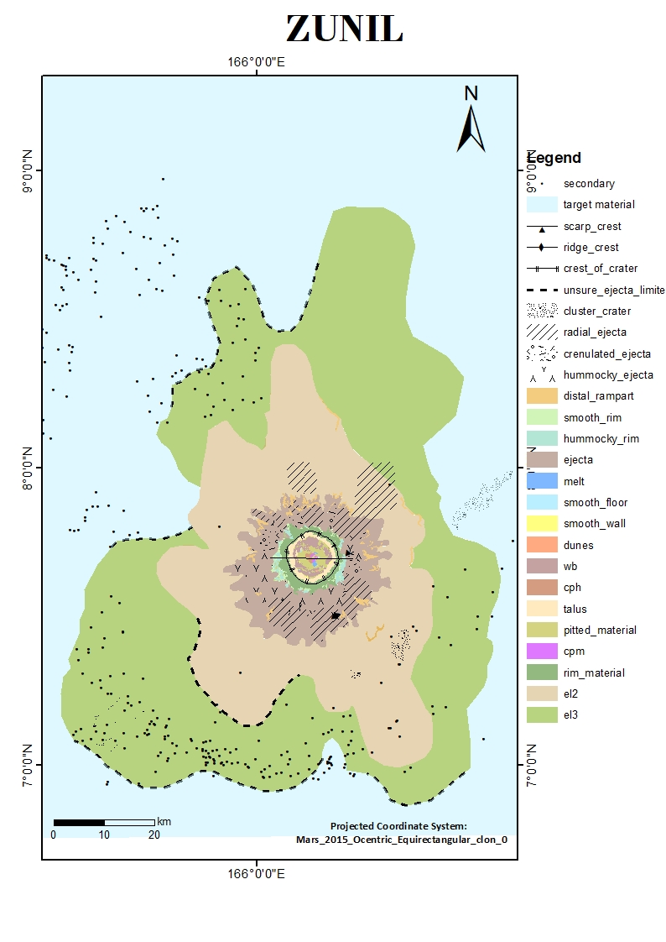
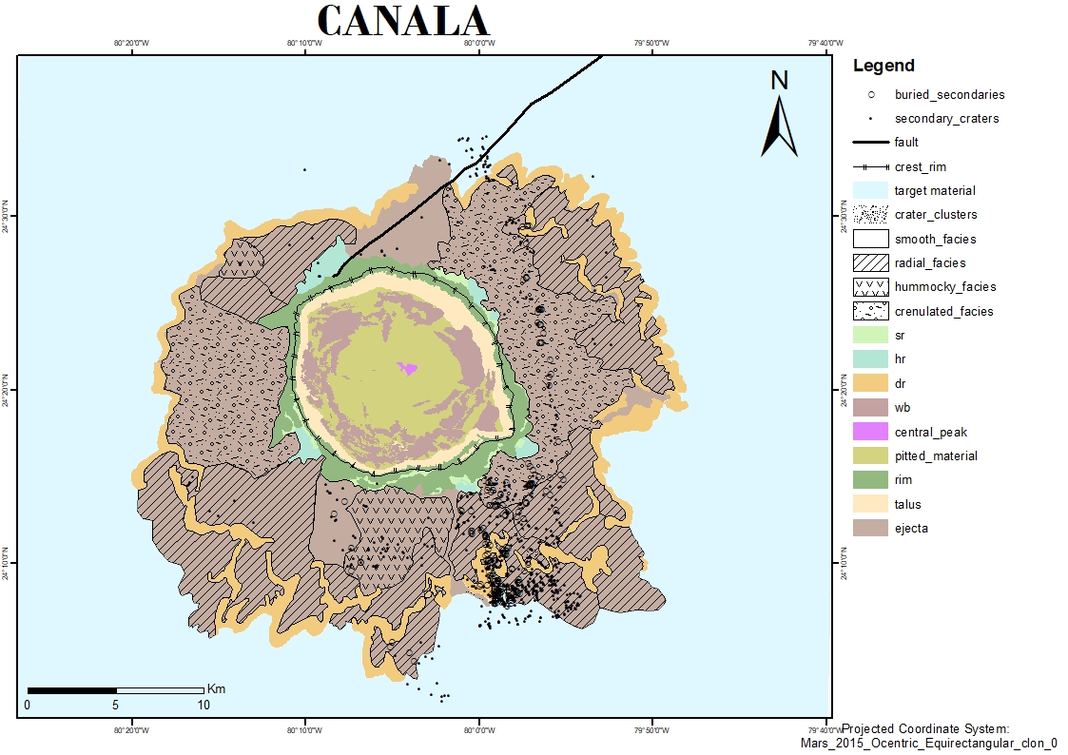
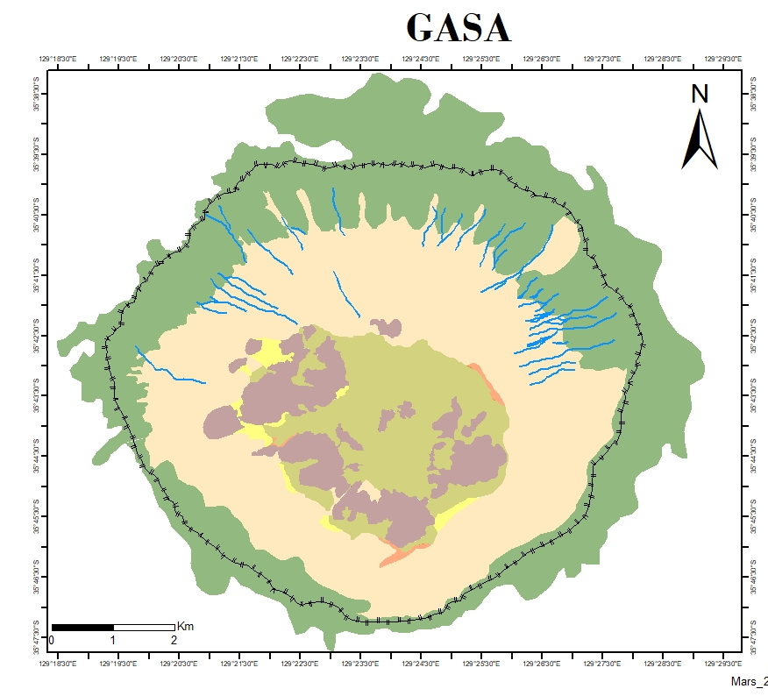
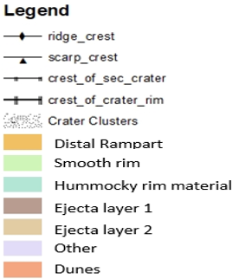
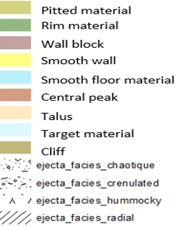
M.Daldoul, 2024

Slide 11
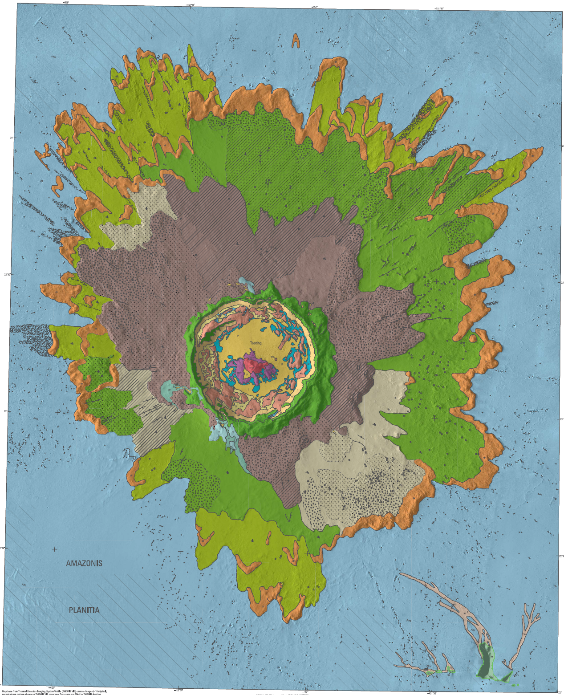
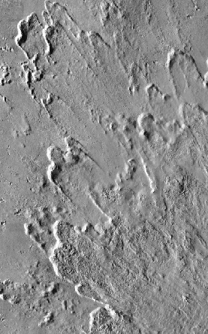
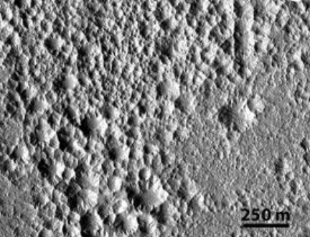
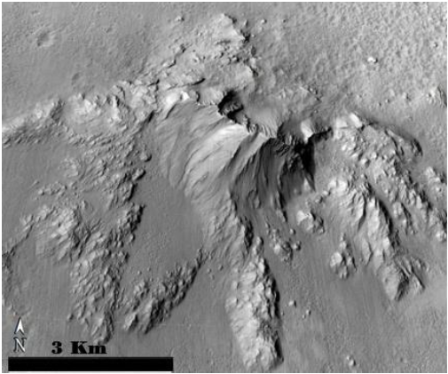
Similarities and particularities
Ejecta layers lobated ending with rampart materials
Pitted terrains
Central peak
TOOTING
Diameter: 27Km
Location: Amazonis Planitia
Coord: 23°N,152°E

Slide 12
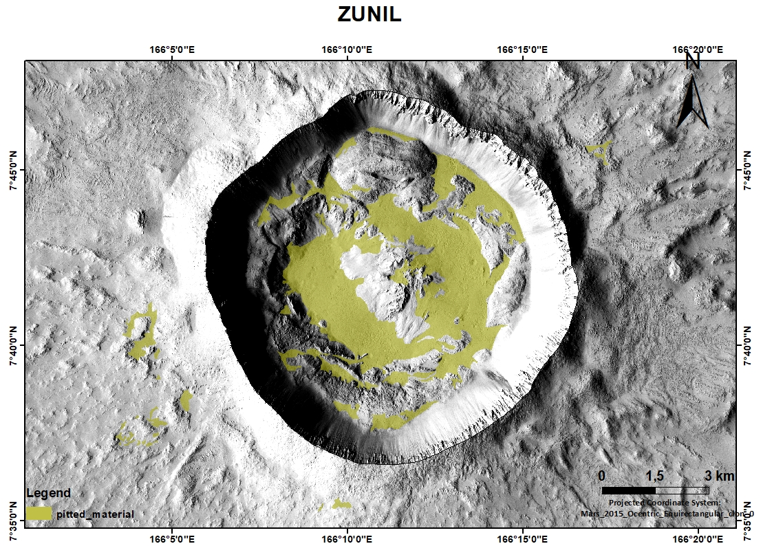
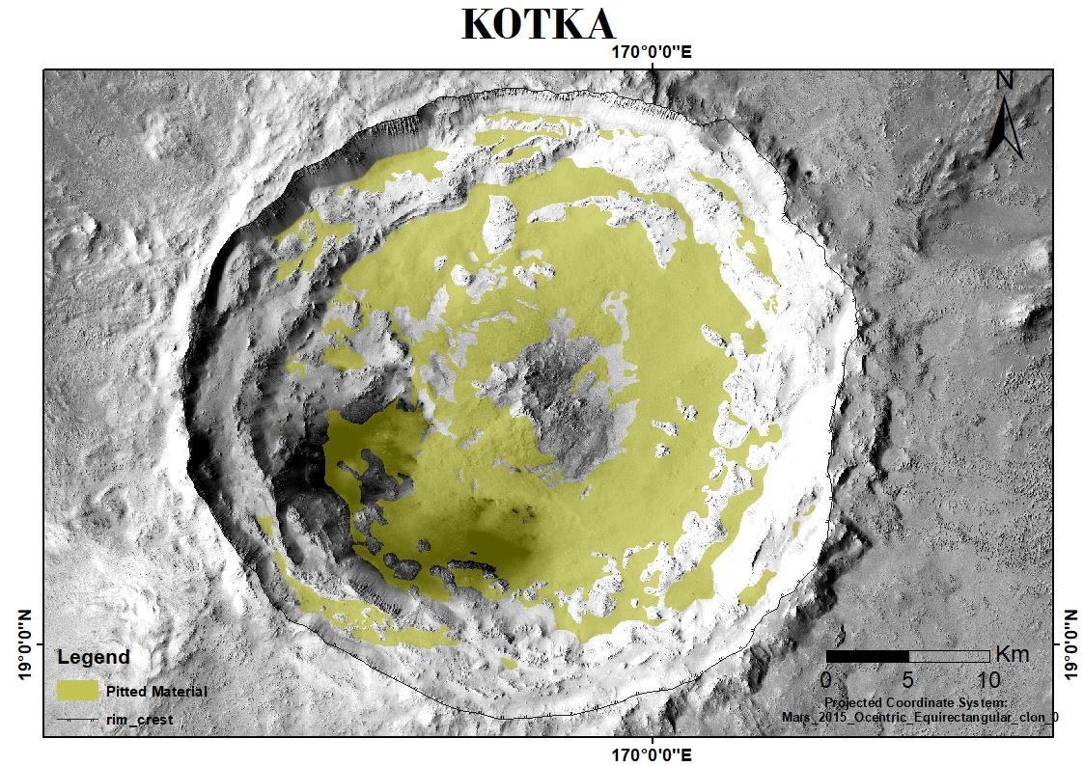
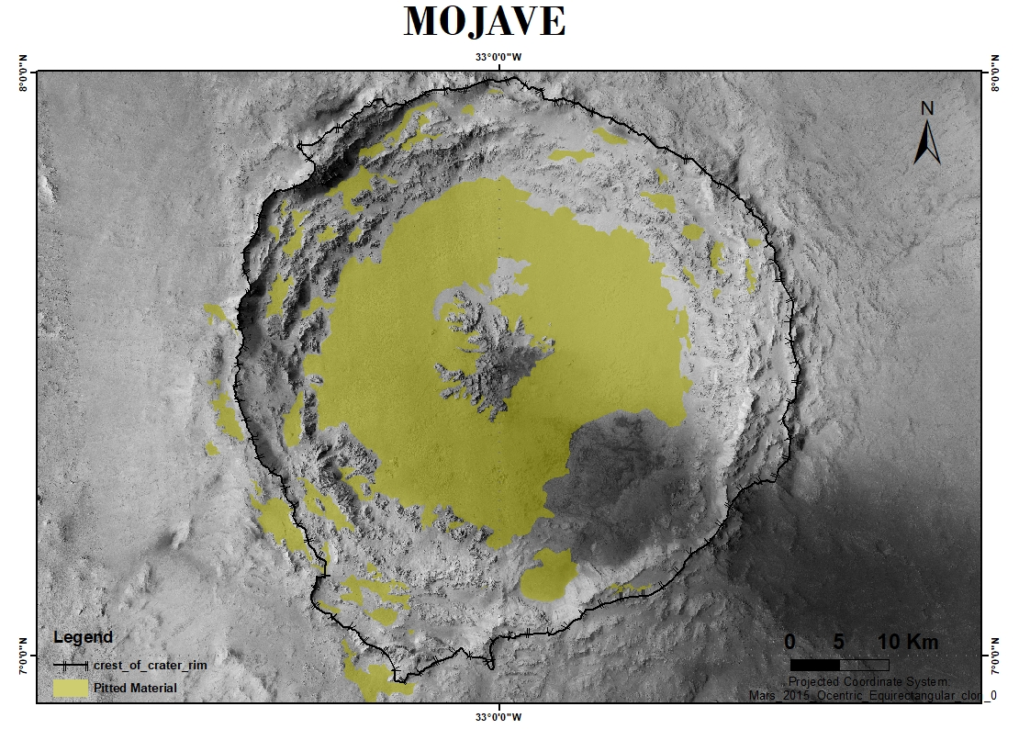
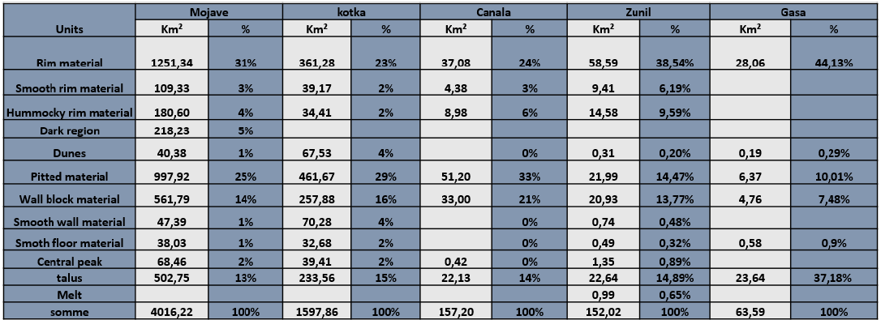
The different geological units found within recent craters

Slide 13
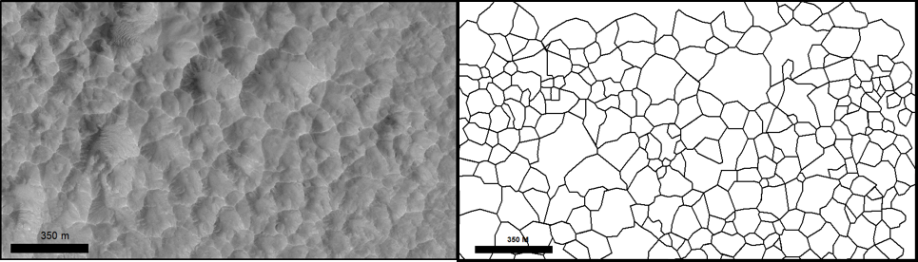
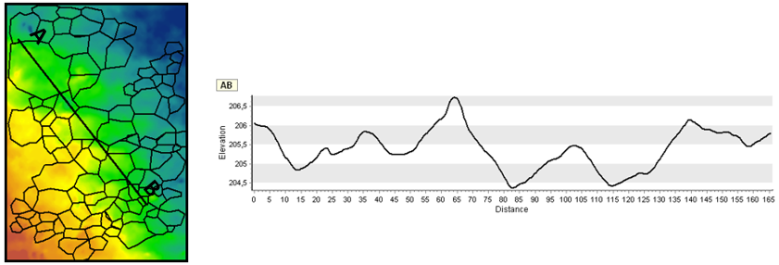
Pits are represented in the form of quasi-circular polygons. They are generally irregular in shape, with bowl-shaped cavities, sharing the same walls

Slide 14
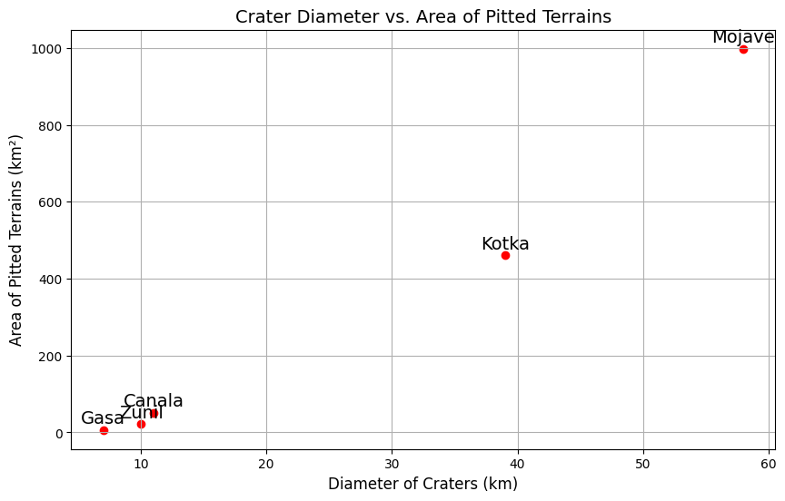
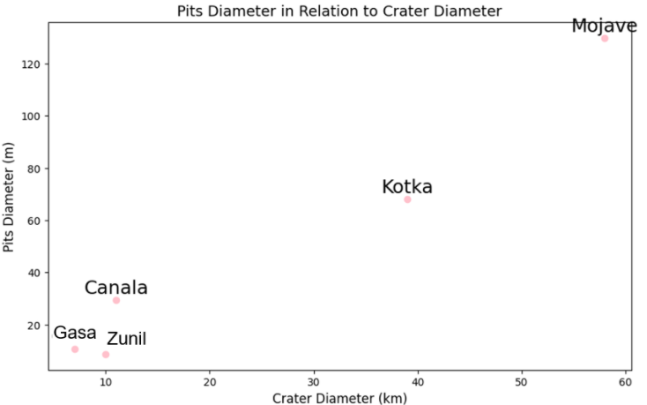
The larger the crater, the more extensive the surface area occupied by pit units and the greater the pit diameters tend to be

Slide 15
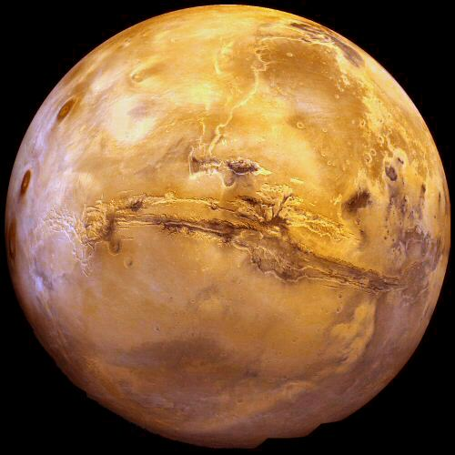
Thank you for your attention!

