Slide 1


NEW INSIGHTS ON INTERACTING DARK ENERGY FROM DESI DR2
AFAS 2026
MARCEL VAN DER WESTHUIZEN
SUPERVISOR: PROF AMARE ABEBE

Slide 2
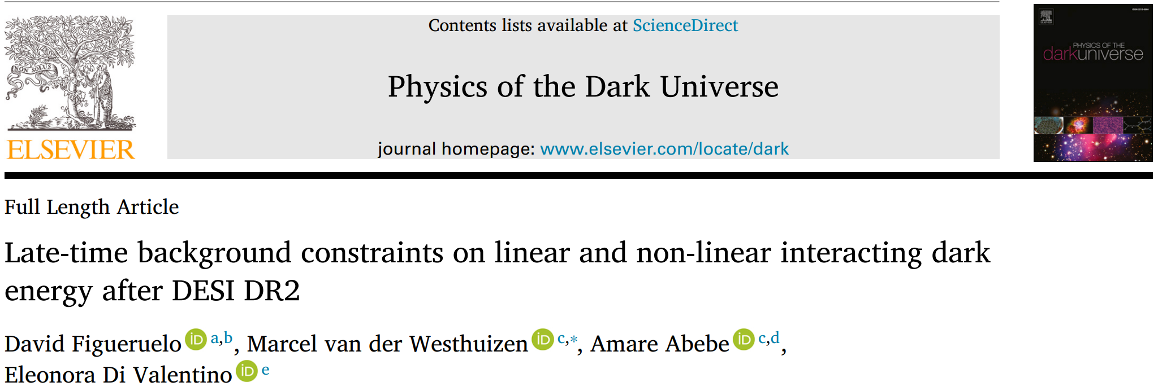

SEE PAPER FOR DETAILED RESULTS
SCAN FOR PAPER

Slide 3
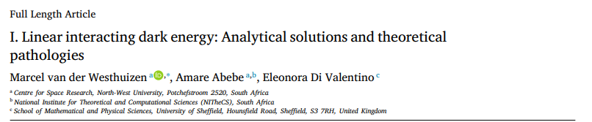

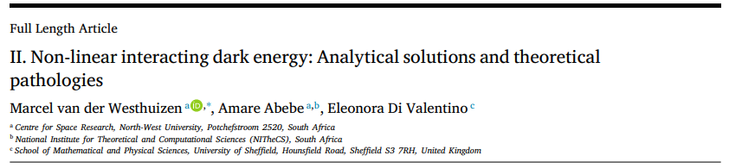
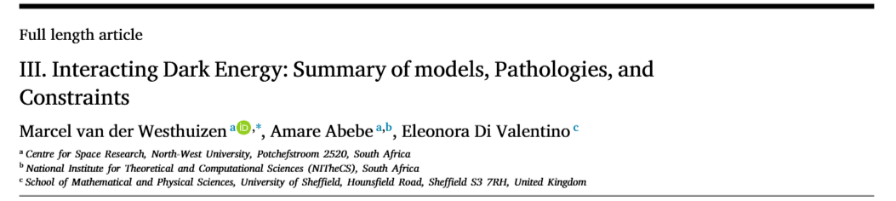
OVERVIEW OF BACKGROUND THEORY OF MODELS

Slide 4



Wait a minute…
Is dark matter even real? (Like yeti?)
Is dark energy even a thing? (Like big foot?)
Interactions between dark matter and dark energy =
love between yeti and bigfoot?
Maybe…
lets look at the argument

Slide 5







1. FIVE REASONS FOR DARK INTERACTIONS BEYOND $Λ$CDM
$$r$$
$$H_{0}$$
$$S_{8}$$
$$Λ$$
$$w_{a}$$

Slide 6




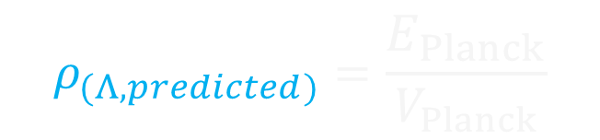
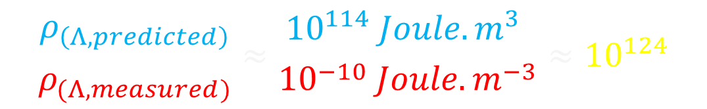
1. COSMOLOGICAL CONSTANT PROBLEM
Cosmological constant predicted from QM as energy of empty space
$E≠0 → ΔE=0$(Violates Heisenberg’s uncertainty principle)
$$ρ_{(Λ,predicted)}=\frac{E_{Planck}}{V_{Planck}}$$
$$≈{10}^{114} Joule.m^{−3}$$
$$l_{planck}$$
$$Λ$$
$$ρ_{(Λ,measured)}={10}^{−10} Joule.m^{−3}$$
Comparing the two values gives the worst prediction in all of physics…
$$\frac{ρ_{\left(Λ,predicted\right)}}{ρ_{(Λ,measured)}}≈\frac{{10}^{114} Joule.m^{3} }{{10}^{−10} Joule.m^{−3}}≈{10}^{124}$$
Motivates research for dark energy beyond the cosmological constant.

Slide 7







2. COINCIDENCE PROBLEM
Consider expanding volume with dark energy and dark matter
$$r_{Distant Future}=\frac{ρ_{(dm,Future)}}{ρ_{(de,Future)}}≈0$$
$$r_{Planck}=\frac{ρ_{(dm,Planck)}}{ρ_{(de,Planck)}}≈{10}^{95}$$
$$Λ$$
$$Λ$$
$$Λ$$
$$Λ$$
$$Λ$$
$$r_{ΛCDM}=\frac{ρ_{dm}}{ρ_{Λ}}=\frac{2}{1}=2$$
$$r_{ΛCDM}=\frac{ρ_{dm}}{ρ_{Λ}}=\frac{2}{4}=0.25$$
DM dilutes fast, $ρ_{dm}∝a^{−3}$ and DE remains constant $ρ_{Λ}=constant$
Why are we alive when the density is approximately equal? $(r_{0}≈0.4$)

Slide 8




2. COINCIDENCE PROBLEM
Analogy: Imagine you fly past an island.
half the people are busy drinking away all their money,
other half have buried their money safely.
$$ρ_{dm}$$
$$ρ_{Λ}$$
You hear this has always been the case for the last 1 000 generations.
You happen to fly past at a time when both groups have the same amount of money.
Is this a coincidence?
Theft?
Taxes?

Slide 9















DARK INTERACTIONS: THE BASIC IDEA
What happens if dark matter and dark energy decay into each other?
DE $→$ DM
DM $→$ DE
(Taxing the rich)
(Taxing the poor)
$$Λ$$
$$Λ$$
$$Λ$$
$$Λ$$
$$Λ$$
$$Λ$$
$$Λ$$
$$Λ$$
$$Λ$$
$$r_{ΛCDM}=\frac{ρ_{dm}}{ρ_{Λ}}=\frac{2}{1}=2$$
$$r_{ΛCDM}=\frac{ρ_{dm}}{ρ_{Λ}}=\frac{4}{2}=2$$
$$r_{ΛCDM}=\frac{ρ_{dm}}{ρ_{Λ}}=\frac{2}{1}=2$$
$$r_{ΛCDM}=\frac{ρ_{dm}}{ρ_{Λ}}=\frac{1}{5}=0.2$$
If DE decays into DM (iDEDM regime) we alleviate Coincidence Problem
If DM decays into DE (iDMDE regime) we worsen Coincidence Problem

Slide 10
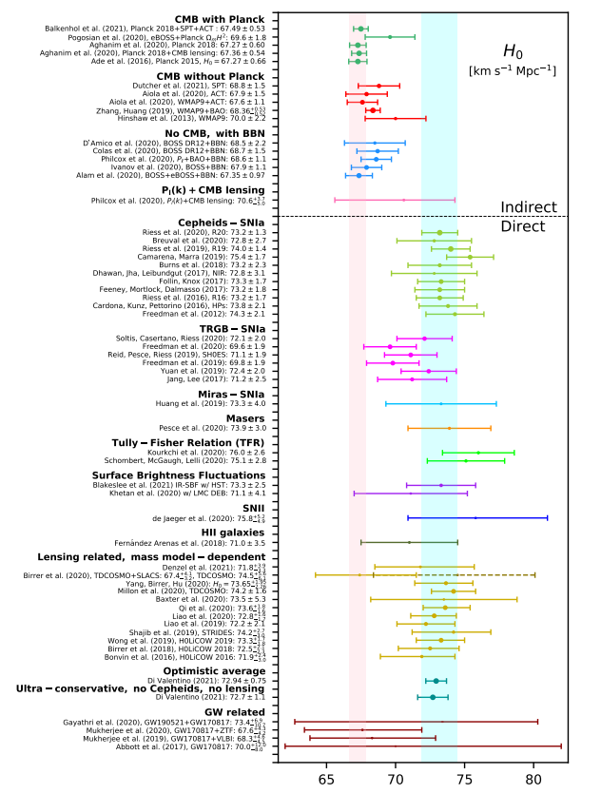
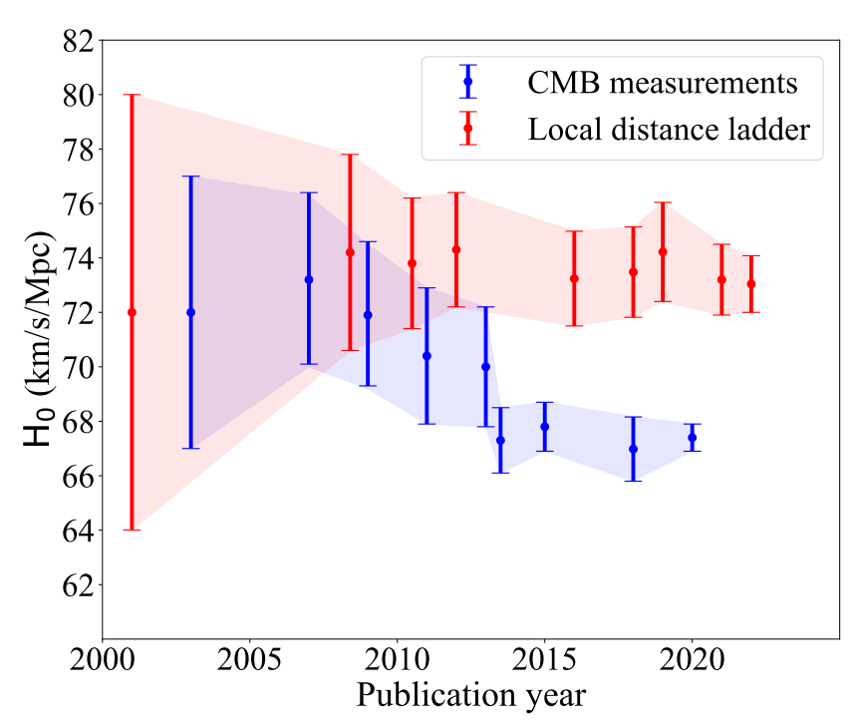
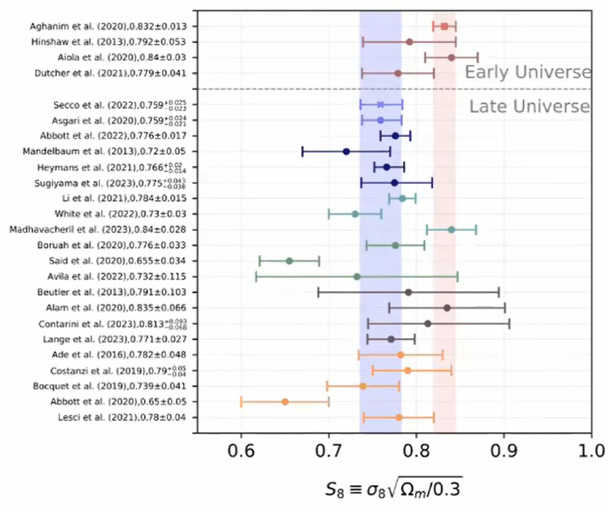


3. & 4. THE $H_{0}$ and $S_{8}$ TENSION
Early (CMB) and late time (SN, LSS) measurements of the expansion $H_{0}$ and clustering $S_{8}$ rates differ by $3−5 σ$, depending on the source

Slide 11
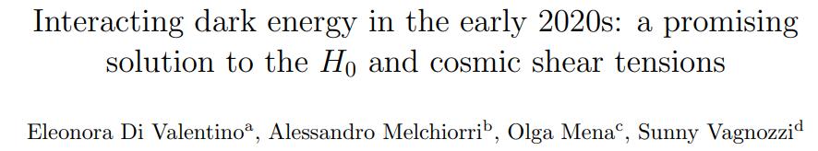
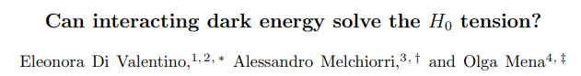
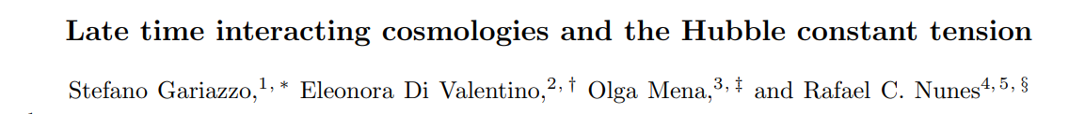
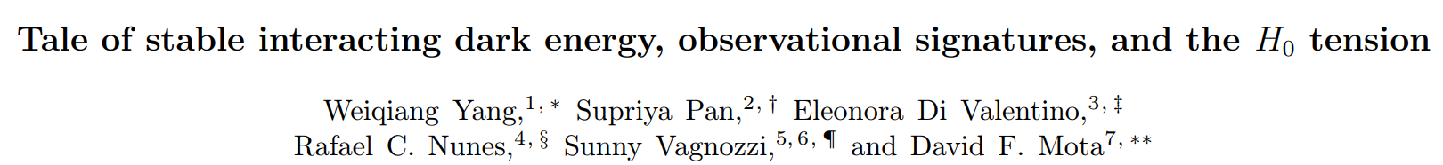
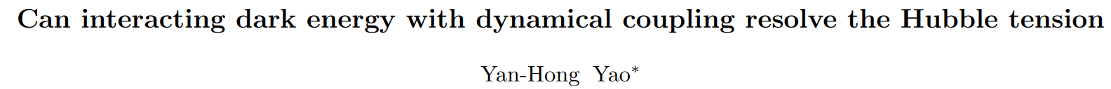

$H_{0}$ and $S_{8}$ TENSION = INTERACTION?
IDE models introduce new physics to address either one or both of these issues. For example

Slide 12
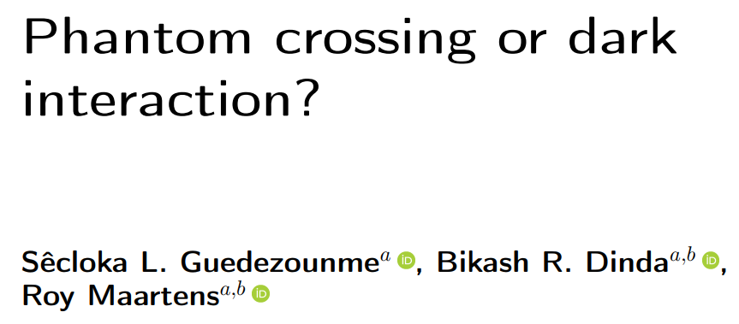
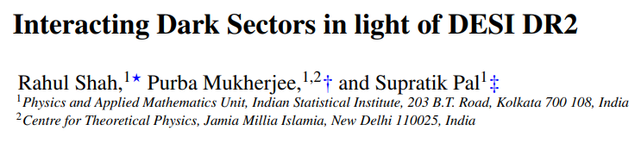
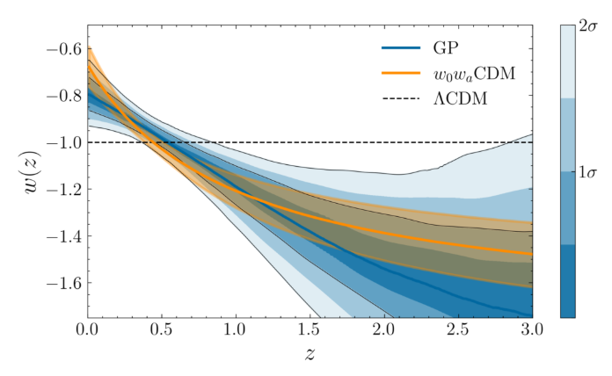
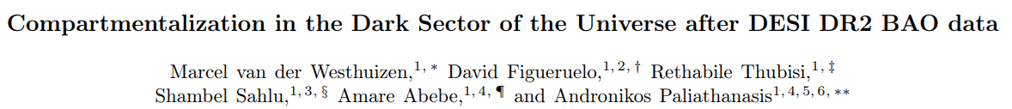



5. COSMOLOGICAL (NOT SO) CONSTANT
2025: DESI collaboration released data on Baryonic acoustic oscillations
BAO with CMB, SN1a combined prefers dynamical dark energy
($2.8−4.2σ$)
Dark energy increasing in distant past, decreasing at present?
New data released next year…
IDE models provide a mechanism?
$$DE↓$$
$$DE↑$$

Slide 13
INTERACTIONS SOLVE ALL PROBLEMS?
42
NO, OF COURSE NOT…

Slide 14
3. NEGATIVE ENERGIES

Slide 15



CONSERVING THE DARK SECTOR
In interacting dark energy models, the total dark sector is conserved. Energy lost $Q$ by DM is gained by DE, and vice versa.
$\dot{ρ_{dm}}+3Hρ_{dm}=Q$ ;
$$\dot{ρ_{de}}+3Hρ_{de}\left(1+ω_{de}\right)=−Q$$
$Q$ must have units: energy per volume per second
$$Ansatz:Q∝δ H ρ_{dm/de}$$
$>0$ Dark Energy $→$ Dark Matter (iDEDM regime)
$$Q$$
$<0$ Dark Matter $→$ Dark Energy (iDMDE regime)

Slide 16



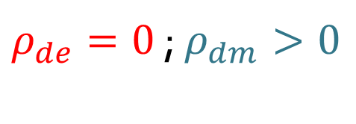

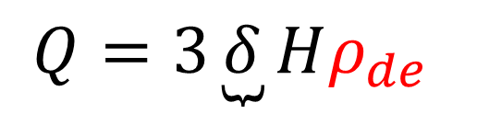



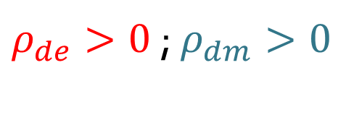





ENERGY TRANSFER BRAKING MECHANISM
Consider a volume element for a model where Q is proportional to DE:
$$Present$$
$$Universe expands (H>0)$$
$$Future$$
$ρ_{de}>0$ ; $ρ_{dm}>0$
$ρ_{de}=0$ ; $ρ_{dm}>0$
$ρ_{de}=0$ ; $ρ_{dm}>0$
$Q>0 (DE→DM)$
$Q=0 (no transfer)$
$Q=0 (no transfer)$
$Q=3\underbrace{δ}Hρ_{de }$
$$=volume element$$
$${=ρ}_{de}$$
$${=ρ}_{dm}$$
$$>0 (iDEDM)$$
Since there is a braking mechanism, DE never becomes negative!

Slide 17














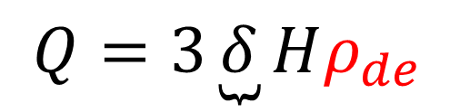
NO TRANSFER BRAKING MECHANISM
Consider a volume element for a model where Q is proportional to DE:
$$Present$$
$$Universe expands (H>0)$$
$$Future$$
$ρ_{de}>0$ ; $ρ_{dm}>0$
$ρ_{de}>0$ ; $ρ_{dm}=0$
$ρ_{de}>0$ ; $ρ_{dm}<0$
$Q<0 (DM→DE)$
$Q<0 (DM→DE)$
$Q<0 (DM→DE)$
$Q=3\underbrace{δ}Hρ_{de }$
$${=+ρ}_{de}$$
$${=+ρ}_{dm}$$
$$=volume element$$
$$<0 (iDMDE)$$
$${=−ρ}_{dm}$$
Since there is no braking mechanism, DM becomes negative!

Slide 18









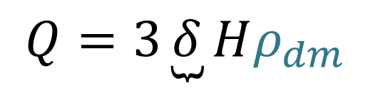





NO TRANSFER BRAKING MECHANISM
Consider a volume element for a model where Q is proportional to DM:
$$Present$$
$$Universe contracts (H<0)$$
$$Past$$
$ρ_{de}>0$ ; $ρ_{dm}>0$
$ρ_{de}=0$ ; $ρ_{dm}>0$
$ρ_{de}<0$ ; $ρ_{dm}>0$
$Q>0 (DE→DM)$
$Q>0 (DE→DM)$
$Q>0 (DE→DM)$
$Q=3\underbrace{δ}Hρ_{dm }$
$${=+ρ}_{de}$$
$${=+ρ}_{dm}$$
$$=volume element$$
$$<0 (iDMDE)$$
$${=−ρ}_{de}$$
Similar arguments can show negative DE in the past for other models

Slide 19
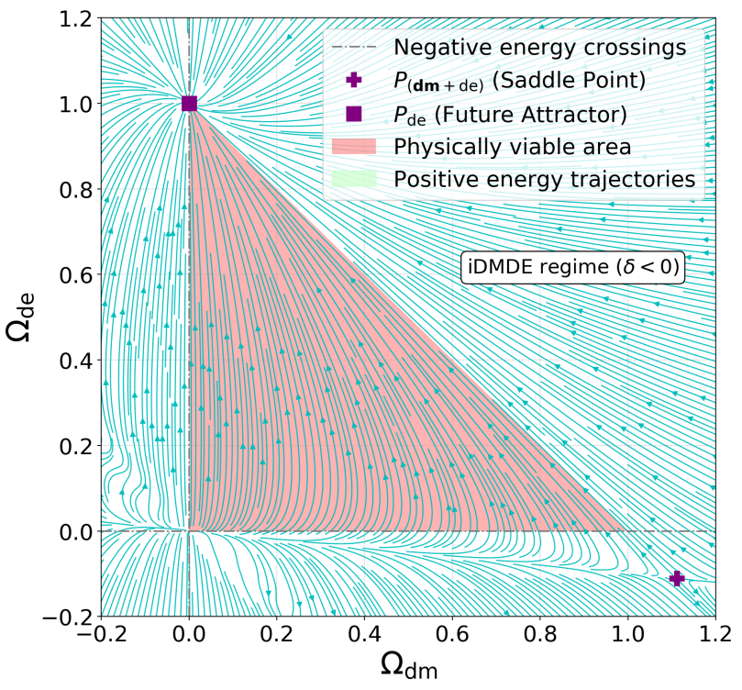
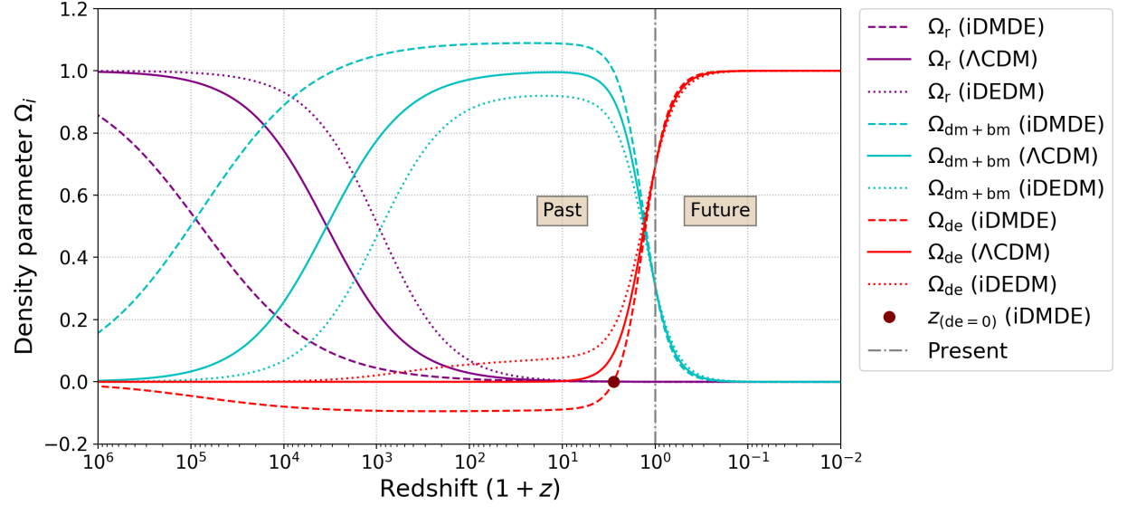

NEGATIVE DARK ENERGY IN PAST…
We thus predict negative DE densities in the past if $δ<0 (DM→DE)$
For IDE model $Q=3δHρ_{dm }$, DE<0 in past
Dynamical system analysis
Plotting analytical solutions

Slide 20
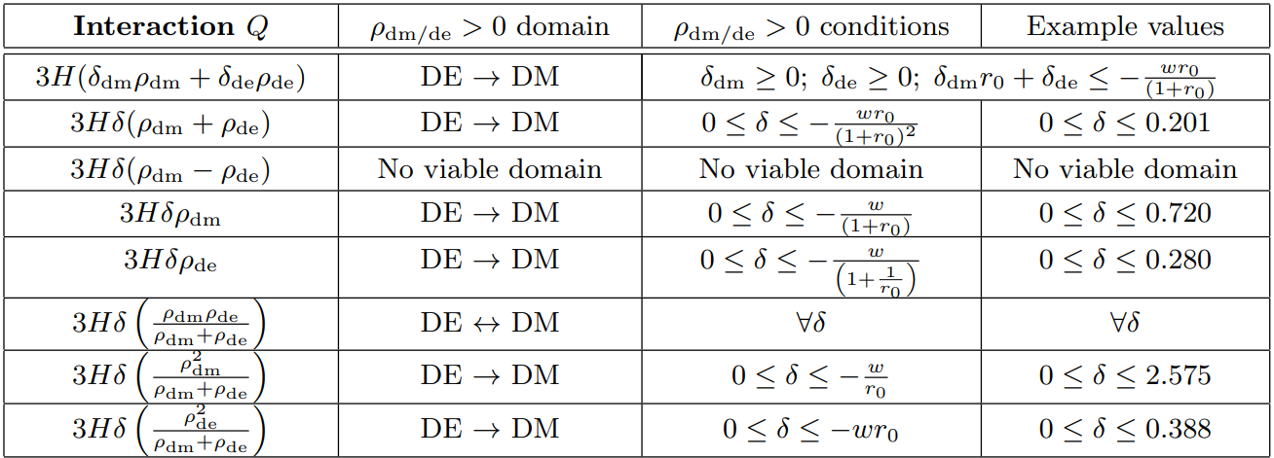
POSITIVE ENERGY CONDITIONS
Similar analysis was done for a total of 8 interactions
FINDING OBSERVATIONAL POSTERIORS PREDICTS BEHAVIOUR

Slide 21
5. OBSERVATIONAL
CONSTRAINTS

Slide 22
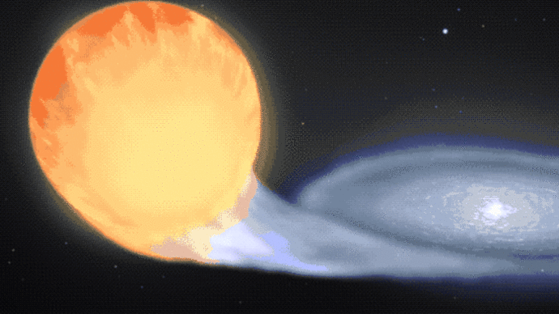
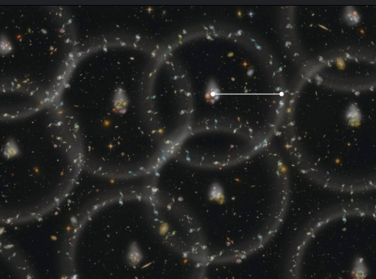
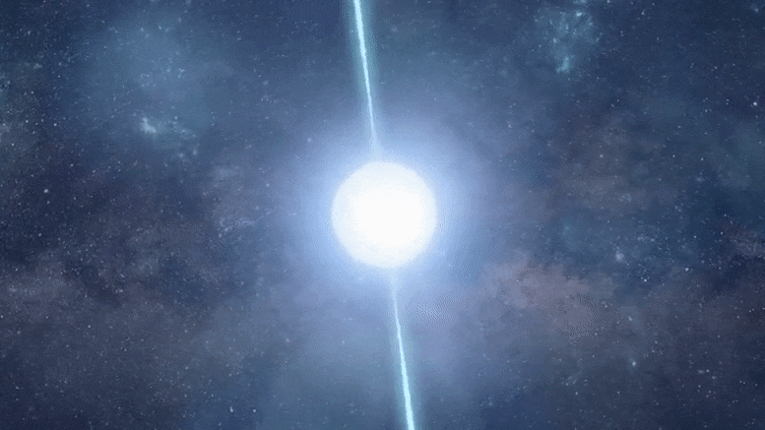
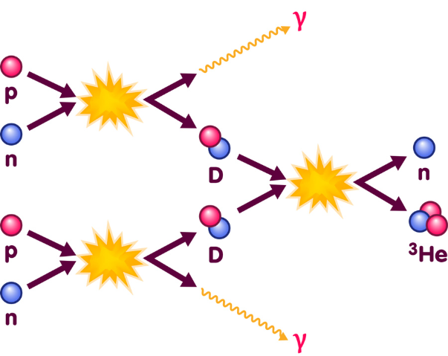

LATE TIME BACKGROUND CONSTRAINTS
We constrained 8 IDE models using public MCMC code MontePython
Used analytical $H(z)$ describing background expansion for all models
We used combinations of four datasets:
Pantheon+ Type Ia supernova data, calibrated with SH0ES Cepheid data.
DESI DR2 Baryon Acoustic Oscillation data.
Cosmic Clock measurements.
Big Bang Nucleosynthesis as a prior on $Ω_{b}h^{2} = 0.02218 ± 0.00055$
(same prior is used in the DESI DR2 papers to break degeneracy in $H_{0}r_{d}$)

Slide 23
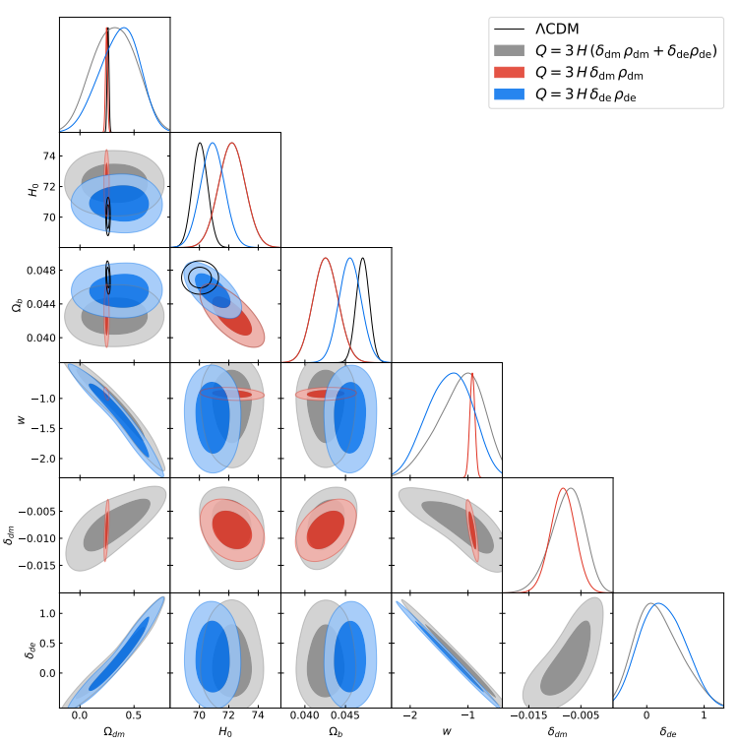
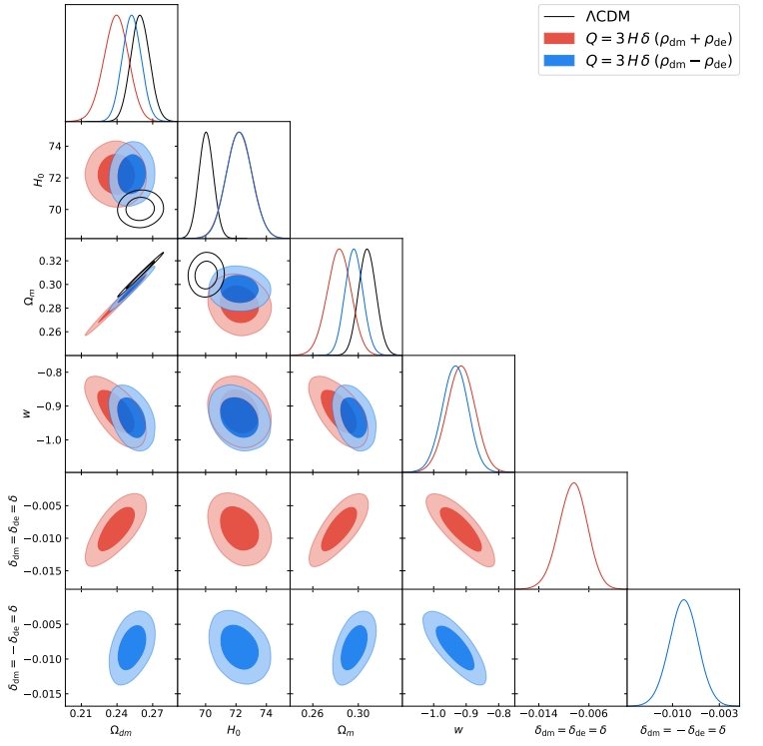
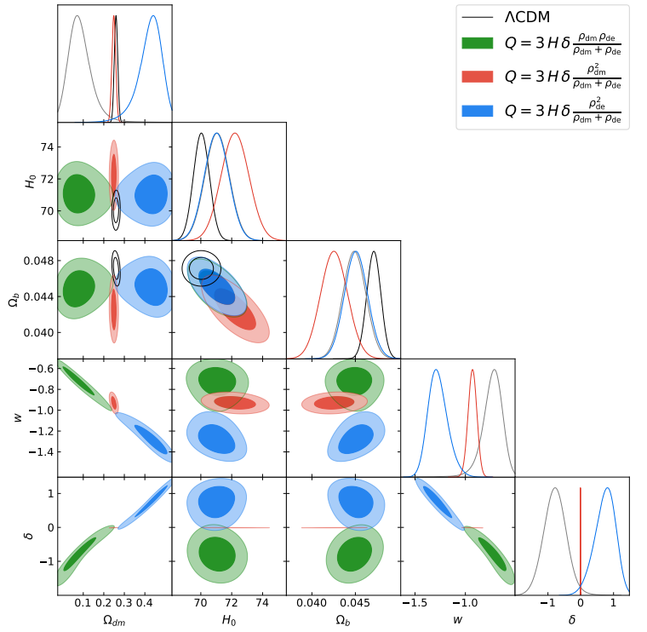
LATE TIME BACKGROUND CONSTRAINTS
Our analysis resulted in the following corner plots for 8 IDE models
Check our paper for a closer look at these and posterior Tables

Slide 24
6. Statistical Analysis and Cosmological Implications

Slide 25
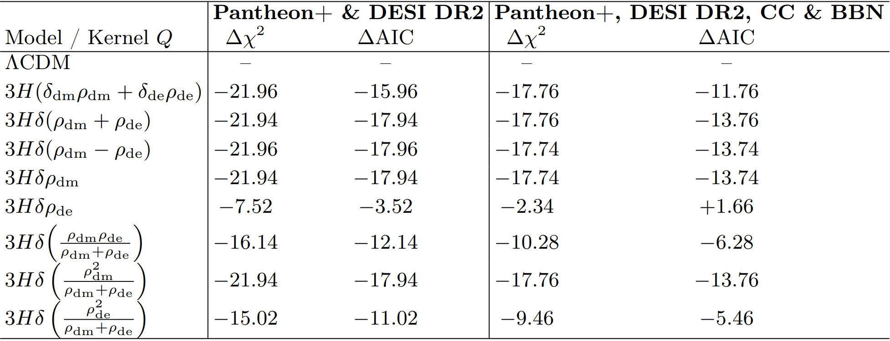
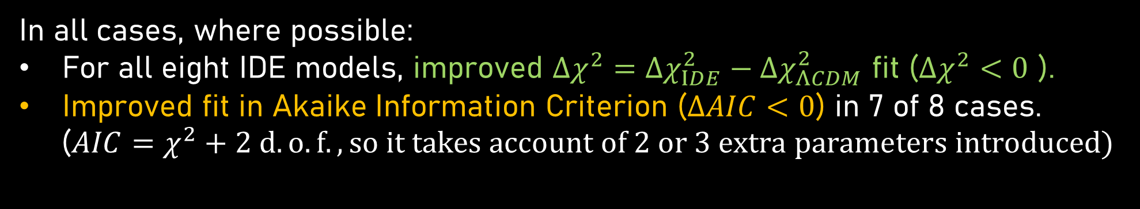
IDE HAS BETTER STATISTICAL FIT
In all cases, where possible:
For all eight IDE models, improved $Δχ^{2}=Δχ_{IDE}^{2}−Δχ_{ΛCDM}^{2}$ fit ($Δχ^{2}<0$ ).
Improved fit in Akaike Information Criterion ($ΔAIC<0$) in 7 of 8 cases.
($AIC=χ^{2}+2 d.o.f., so it takes account of 2 or 3 extra parameters introduced)$
NB. Perturbation equations and CMB not used yet

Slide 26
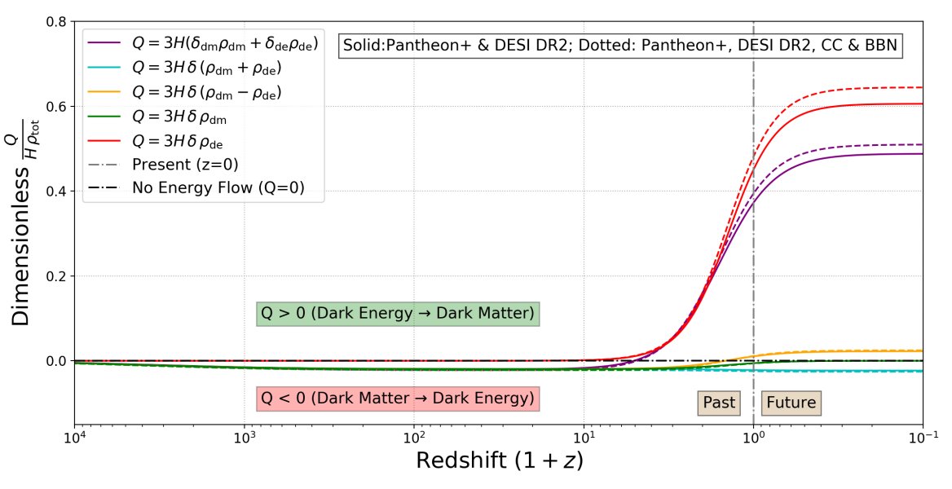
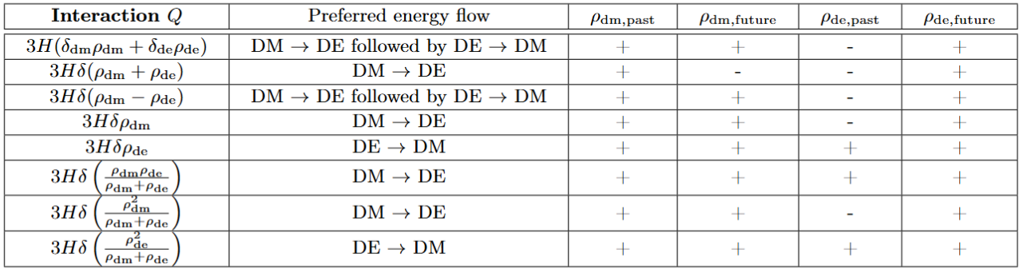




BACKGROUND CONSTRAINTS = DE<0?
Constrained 8 IDE models with DESI DR2, PANTHEON+ and Cosmic Clocks
In all cases, where possible, a preference was found for:
Negative DE (in past for models without transfer braking mechanism)
Sign switching behaviour (DM to DE at high z, DE to DM at low z)
$$DE↓$$
$$\left(DE to DM?\right)$$
$$DE↑$$
$$\left(DM to DE?\right)$$

Slide 27
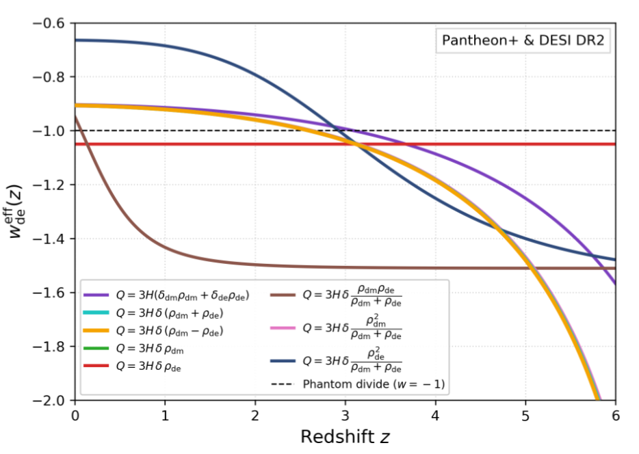
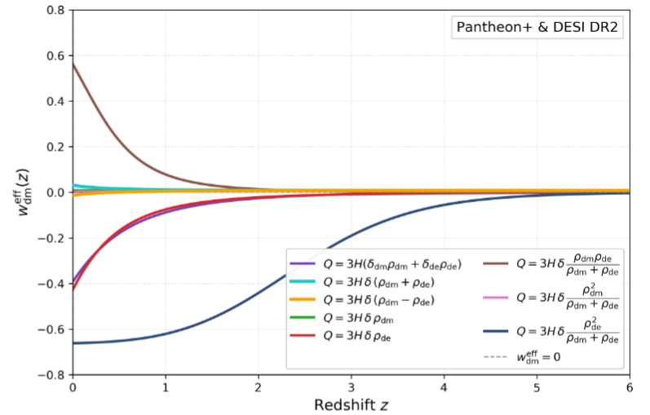





BACKGROUND CONSTRAINTS = DE<0?
Constrained 8 IDE models with DESI DR2, PANTHEON+ and Cosmic Clocks
In all cases, where possible, a preference was found for:
Negative DE (in past for models without transfer braking mechanism)
Sign switching behaviour (DM to DE at high z, DE to DM at low z)
Phantom crossing for $w_{ de}^{eff}$ observed when possible
$$DE↓$$
$$\left(DE to DM?\right)$$
$$DE↑$$
$$\left(DM to DE?\right)$$
Dark sector interaction mechanism for dynamical dark energy?

Slide 28
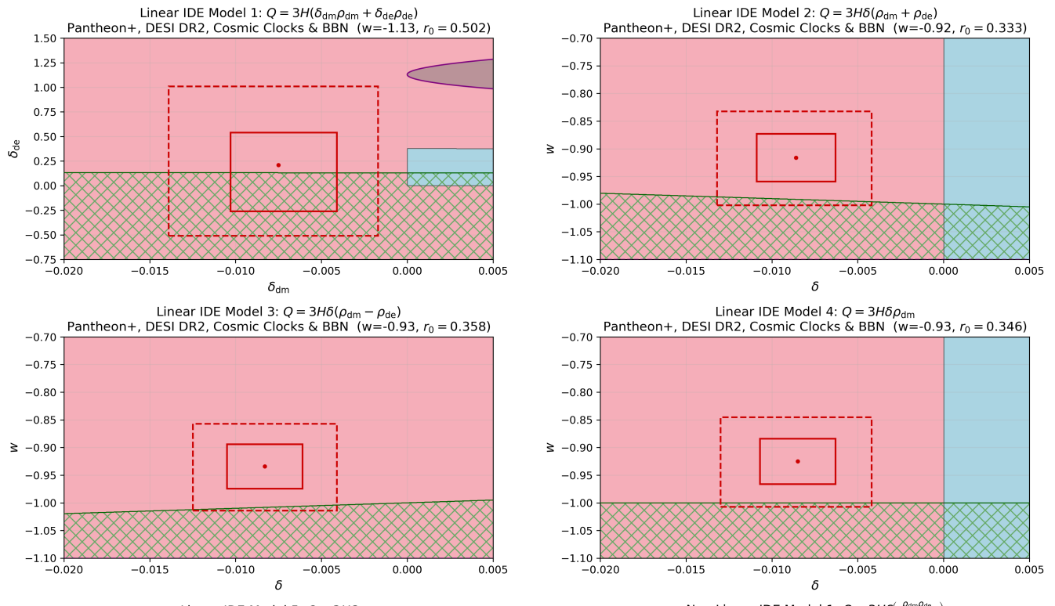
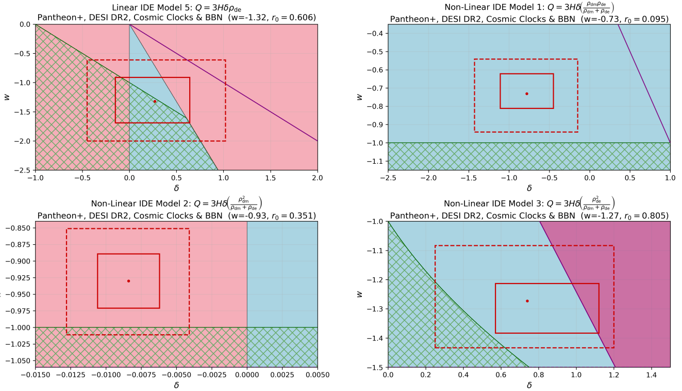
IDE PARAMETER SPACE
Be careful about the cost of new problems to solve old problems

Slide 29
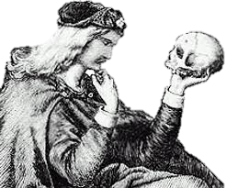


TO ACCEPT OR NOT TO ACCEPT
$$ρ_{de}<0$$
Other negative energy models gained attention:
$Λ_{s}$CDM models
AdS-dS transition
Please feel free to share your thoughts afterwards!

Slide 30
6. CONCLUSIONS

Slide 31


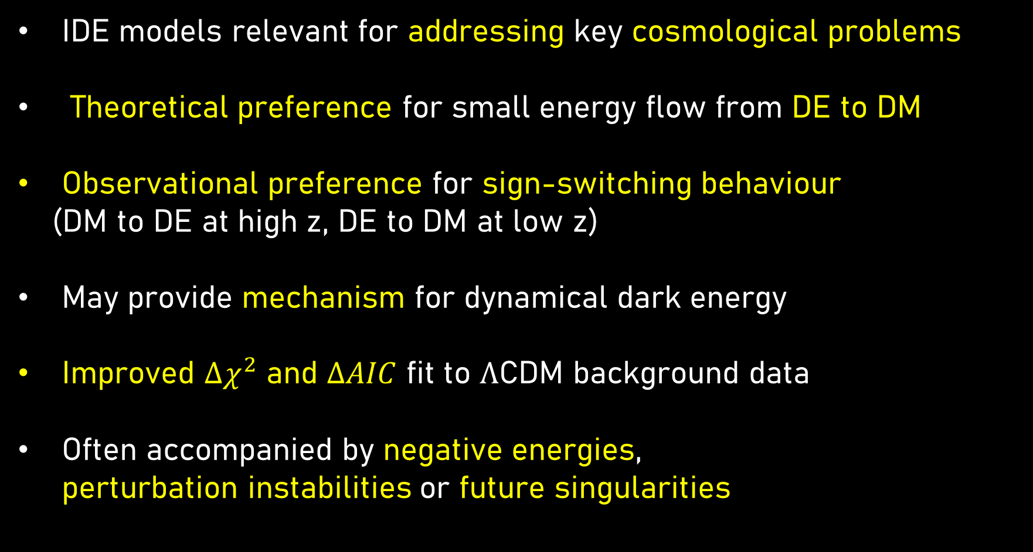



PROMISING BUT PROBLEMATIC
IDE models relevant for addressing key cosmological problems
Theoretical preference for small energy flow from DE to DM
Observational preference for sign-switching behaviour
(DM to DE at high z, DE to DM at low z)
May provide mechanism for dynamical dark energy
Improved $Δχ^{2}$ and $ΔAIC$ fit to $Λ$CDM background data
Often accompanied by negative energies, perturbation instabilities or future singularities
$$r$$
$$H_{0}$$
$$S_{8}$$
$$Λ$$
$$w_{a}$$

Slide 32
FUTURE WORK
Combine background analysis with perturbation and stability analysis
These models need to be constrained with more cosmological data, especially CMB. Can these address tensions?
These need a more developed microphysical description, so that we do not only rely on phenomenological interactions.
Rule out IDE models and move on to more promising ideas?

Slide 33
THE END

Slide 34
QUESTIONS?

Slide 35





PERTURBATIONS AND STABILITY
Perturbations for IDE models often lead to instabilities, and need for choice of DM or DE frame
Common approach introduce doom factor $d$
$$d=\frac{Q}{3Hρ_{de}(1+w)}$$
$d>1 →$Unstable regime
if
$d<0 →$ apriori free of instabilities
Two safe regimes:
$Q>0$ (DE $→$ DM) with $w<−1$ (Phantom DE)
$Q<0$ (DM $→$ DE) with $w>−1$ (Quintessence DE)
DETAILS CONSIDERED IN FUTURE WORK

Slide 36
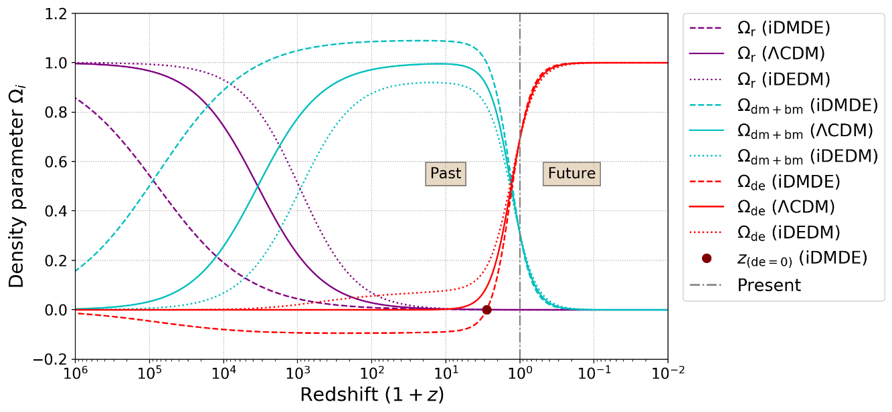
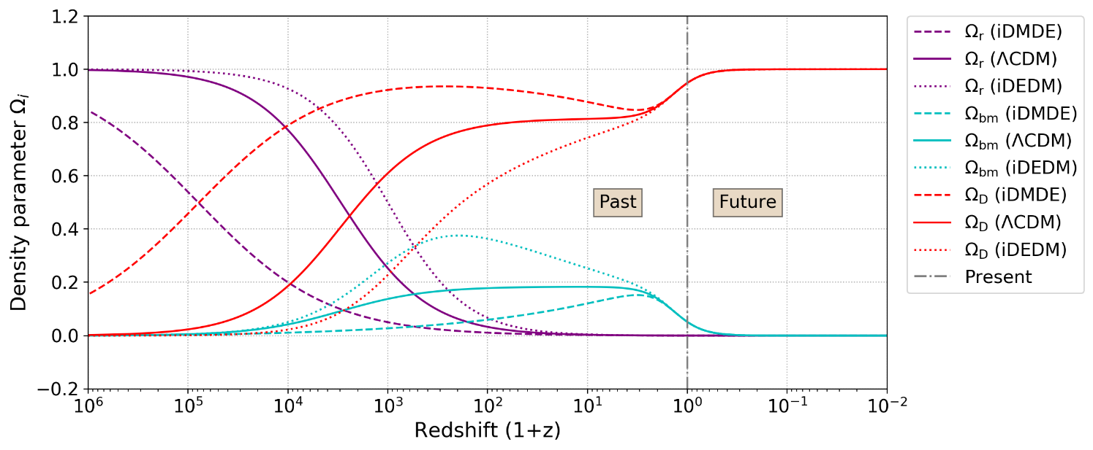

AVOIDING NEGATIVE ENERGIES
Set priors to avoid negative energies, i.e. DE $→$ DM: $δ [0 ;0.3]$
Only use models where DM and DE always positive .i.e. $Q∝ρ_{dm}ρ_{de}$
Allow that domain of applicability small, so pathologies will not occur
Non-fluid DE description i.e. scalar field or holographic principle
Conserved total dark sector i.e. Unified Dark Fluid or Chaplygin Gas

