Slide 1


Multi-Frequency Millimetre Monitoring of Blazars with Metsähovi and ALMA: Prospects for the Africa Millimetre Telescope
Hiiko I. Katjaita¹, Michael Backes¹, James O. Chibueze²
¹University of Namibia, Dept. of Physics, Chemistry & Material Science
²University of South Africa, Centre for Astrophysics and Space Science
March 2026

Slide 2
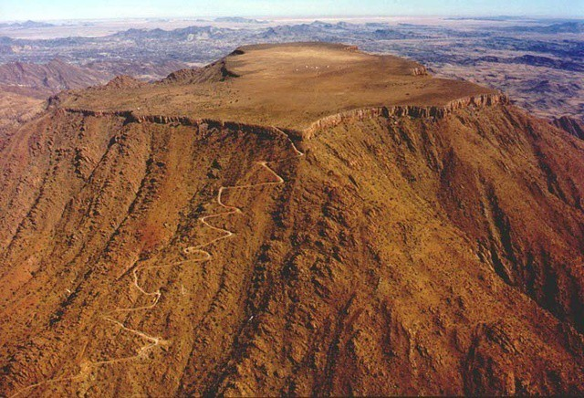
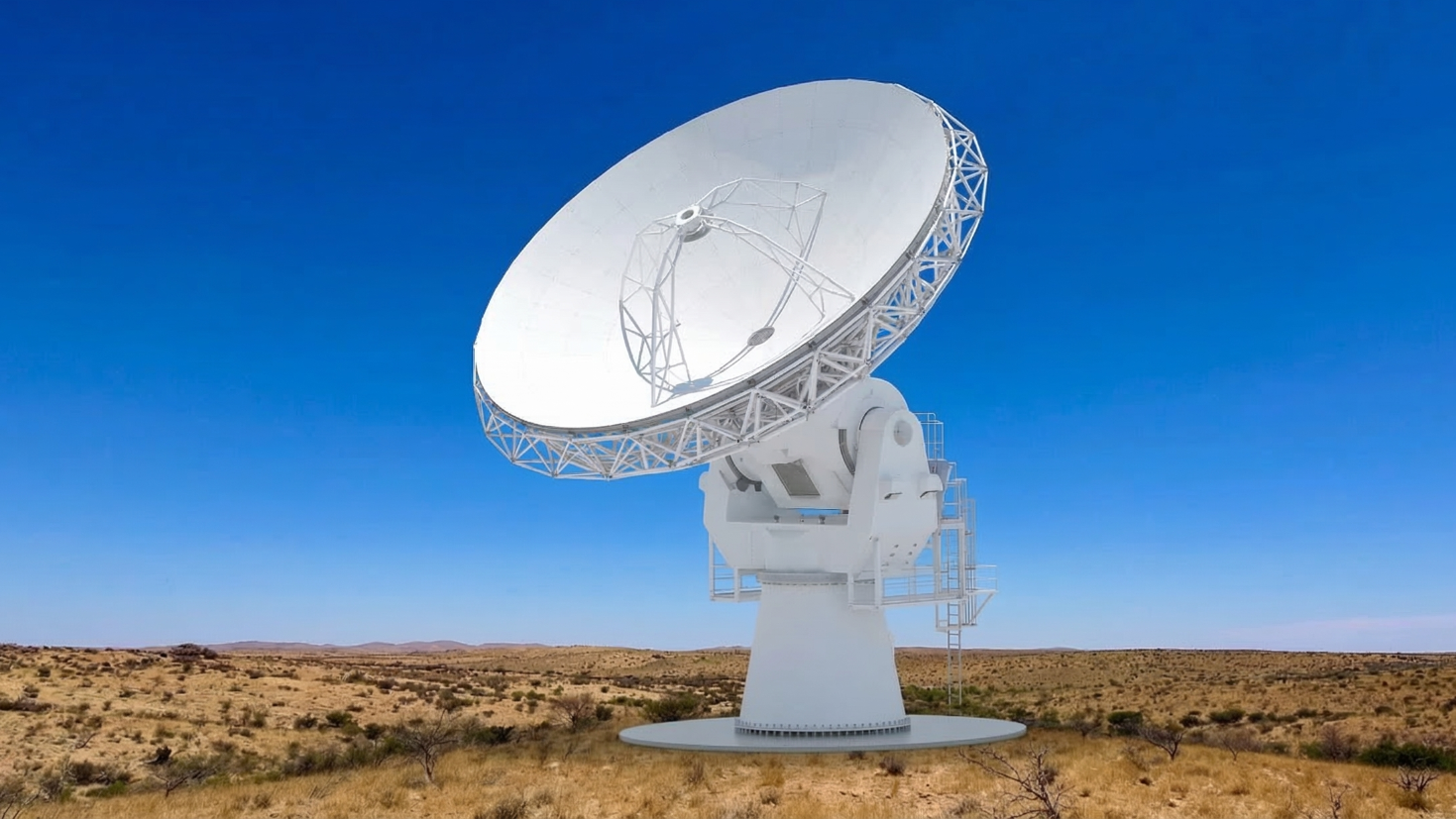
Blazar monitoring with the AMT
The AMT
A 14-m millimetre telescope on Gamsberg, Namibia, joining the EHT network.
Key Science
Multi-frequency monitoring of blazars to study variability across the jet.
Why This Matters
Different frequencies probe different jet regions, allowing us to track how disturbances propagate outward.
This Study
A demonstration of time-lag analysis, showcasing the science the AMT will enable.

Slide 3
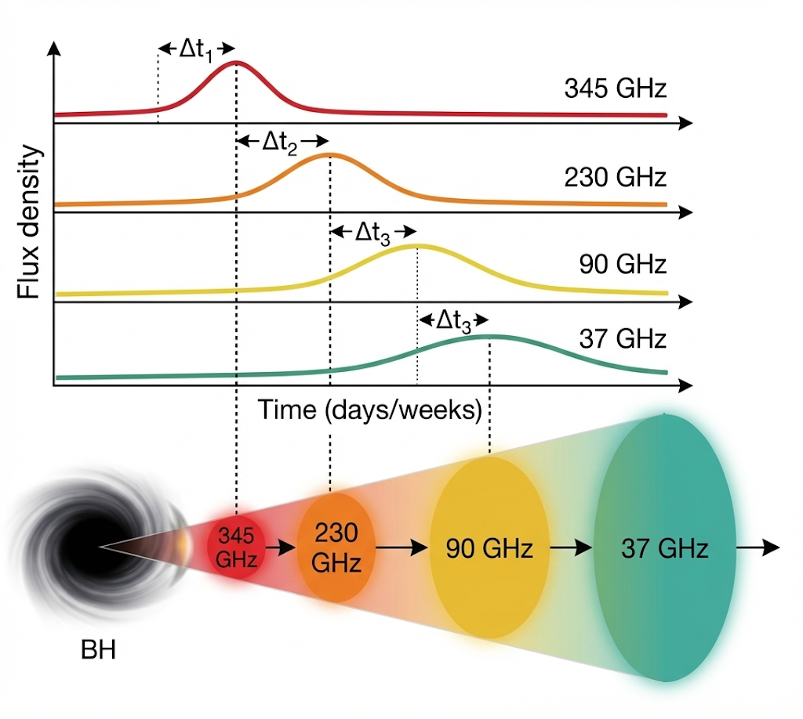
What we’re testing
Shock-in-Jet Model
A disturbance forms near the black hole and moves outward along the jet.
As it propagates, it produces emission at different locations along the jet.
Frequency Ordering
The jet becomes more optically thin with distance, so
higher frequencies (e.g. 345 GHz) appear first, followed by lower frequencies further downstream
Expected Lag Behaviour
Two key expectations from the model:
• Higher-frequency emission appears earlier in time • Larger frequency gaps → larger time delays (e.g. 230–345 GHz < 37–345 GHz)
So the key question is: do all blazars follow this expected behaviour?

Slide 4
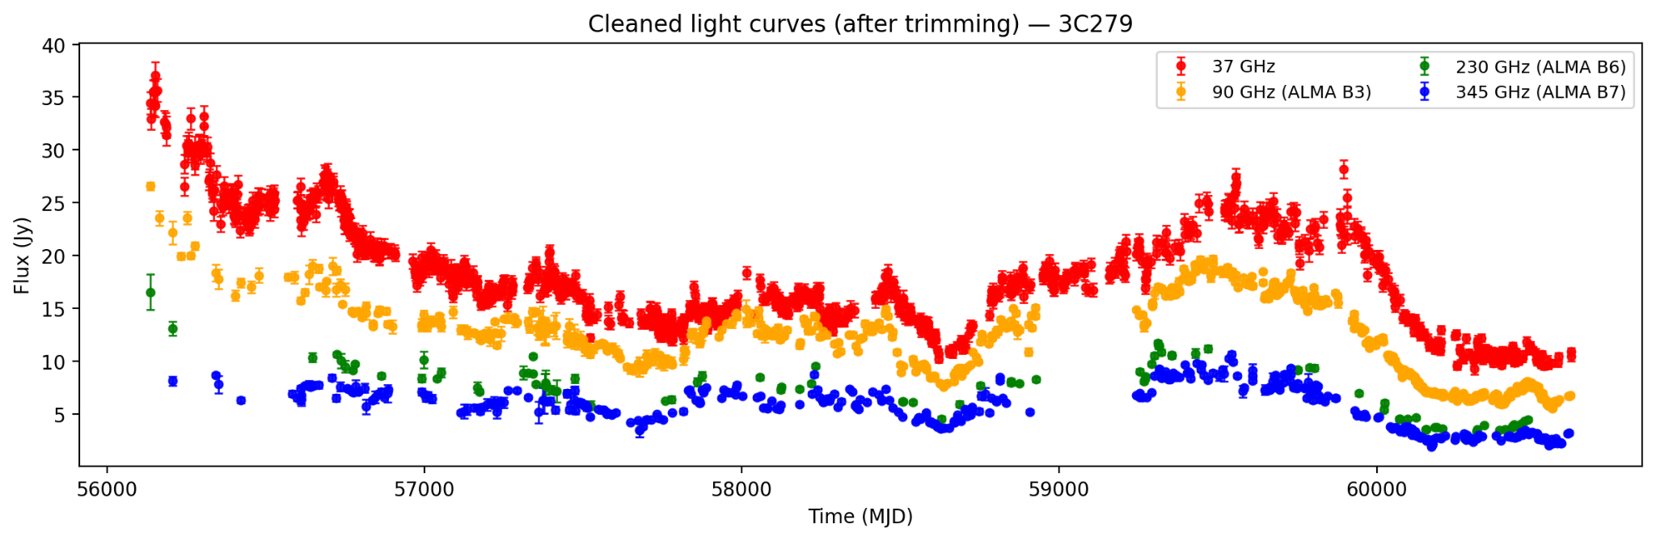
Multi-Frequency Light Curves and Data Preparation
Multi-Frequency Data
Light curves from Metsähovi (37 GHz) and ALMA (90, 230, 345 GHz)
Some sources only have 90, 230, and 345 GHz (no 37 GHz)

Slide 5
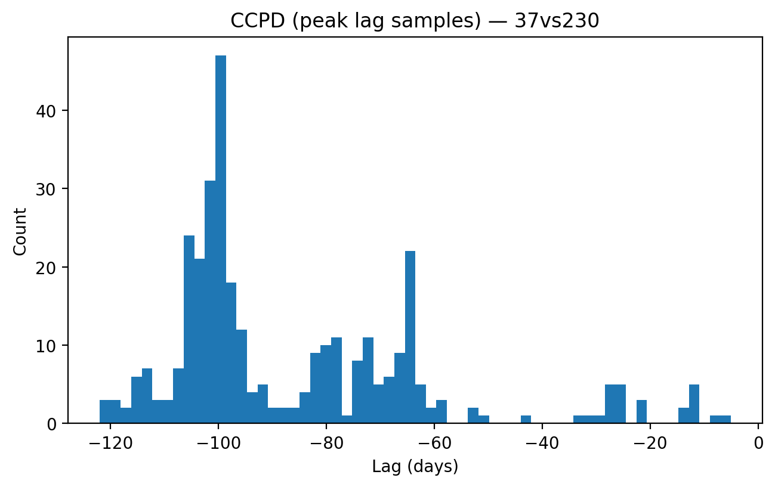
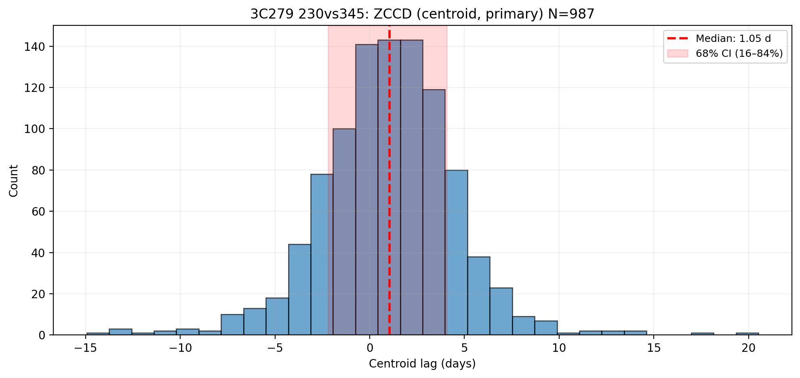
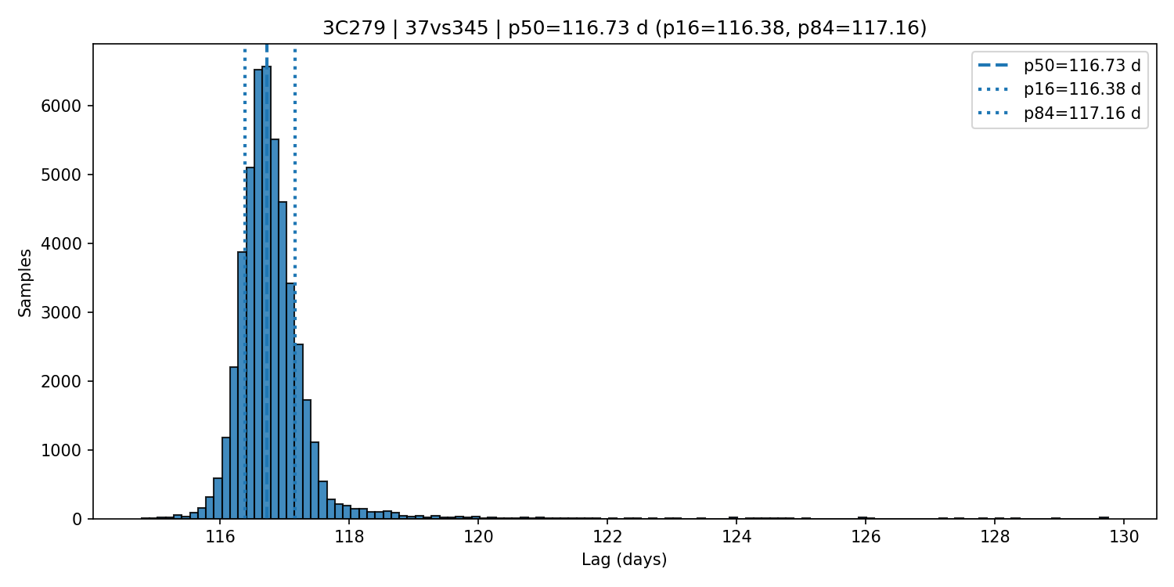
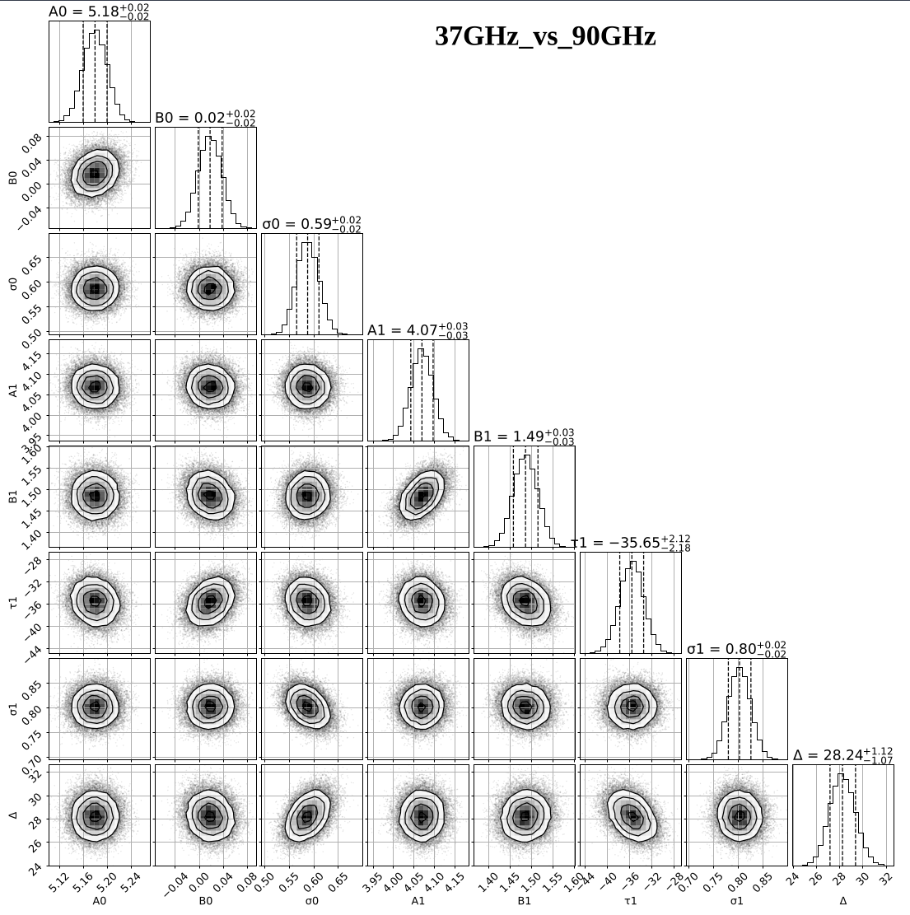
Time lag extraction methods
ICCF: Linear interpolation with Monte Carlo bootstrapping | ZDCF: Equal-population binning (highly robust for irregular cadences)
JAVELIN: Damped random walk modeling via MCMC | PyROA: Bayesian running optimal average

Slide 6
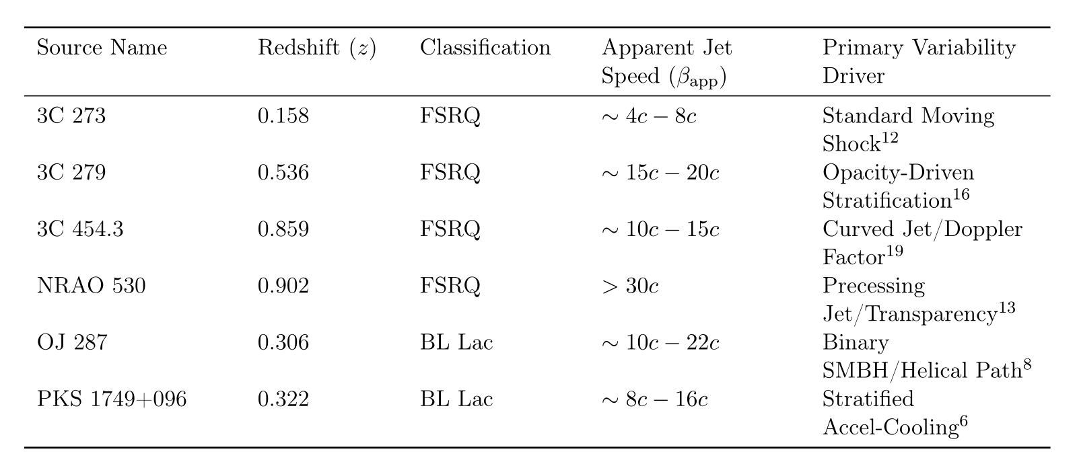
Blazar sample

Slide 7
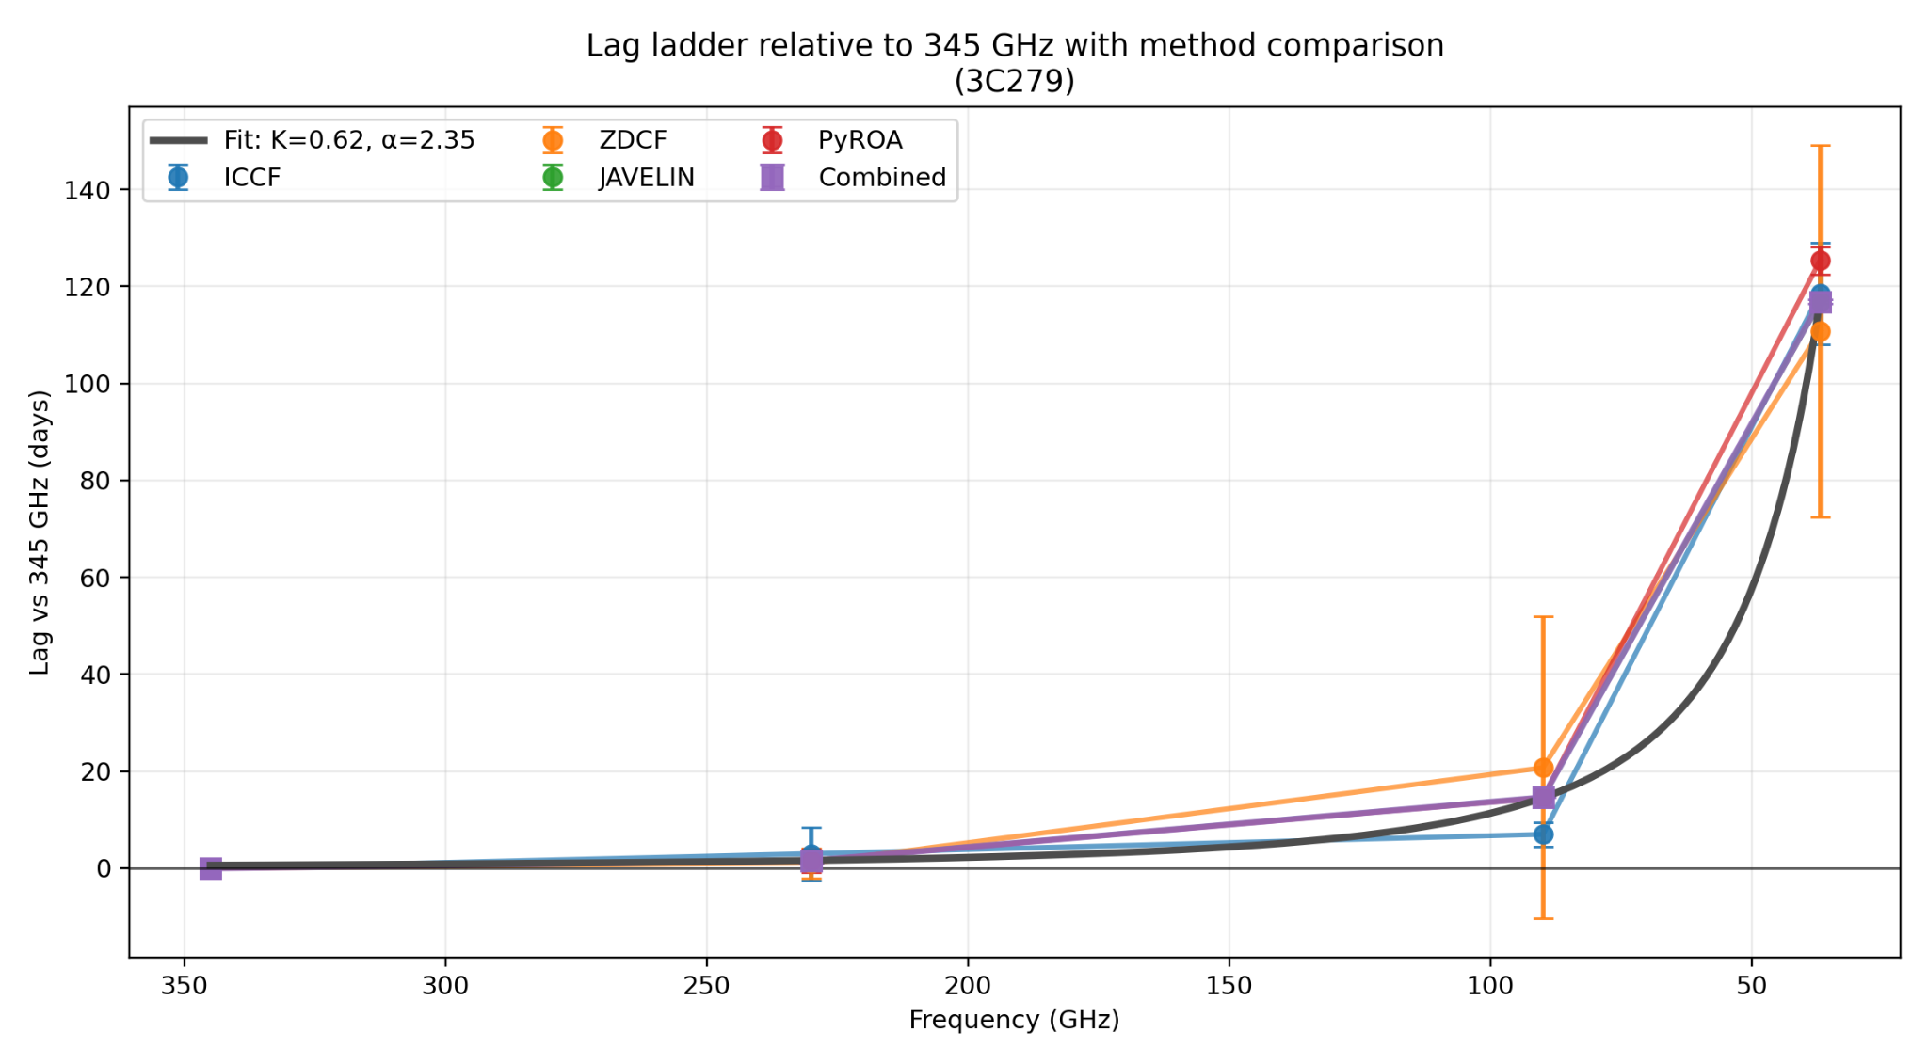
Results: Sources Consistent with the Shock-in-Jet Model
Clean Signatures:
3C273, 3C279, 3C454.3 show strong agreement with the expected behaviour
Consistent across multiple lag methods
Monotonic Lag Ladder:
Lag increases as frequency decreases
345 → 230 → 90 → 37 GHz
Clear evidence of outward propagation along the jet

Slide 8
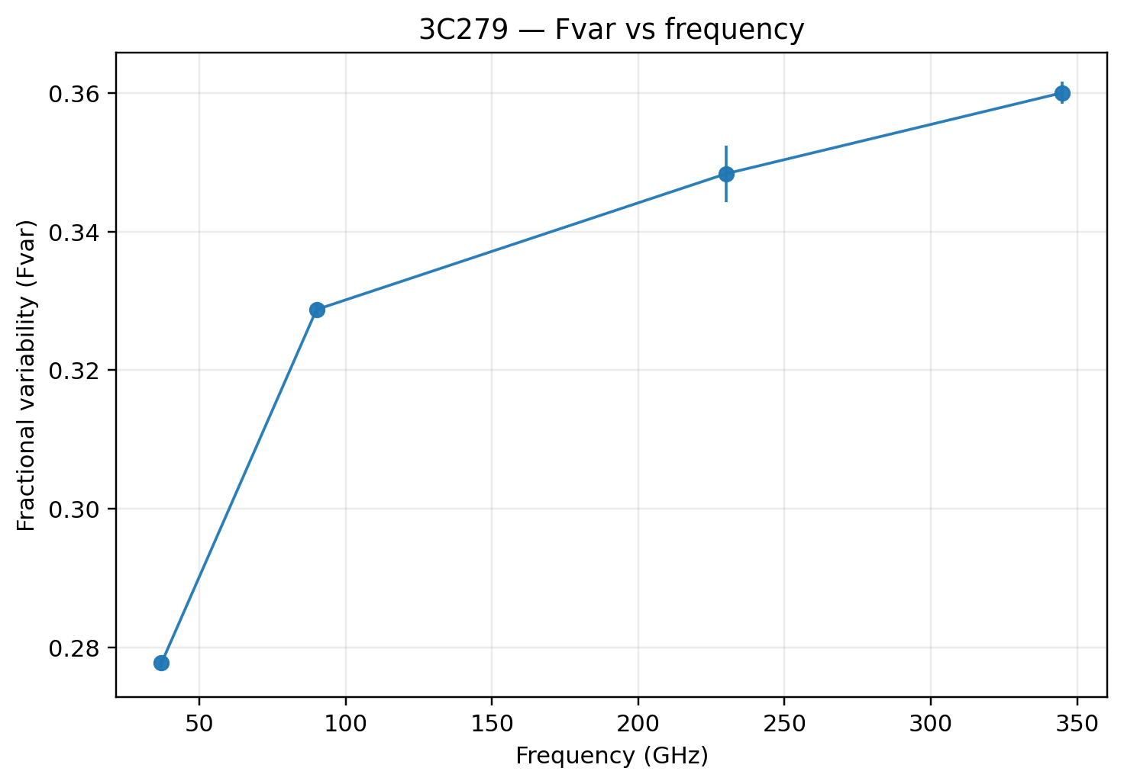
Results: Sources Consistent with the Shock-in-Jet Model
Fractional Variability (Fvar):
Variability increases with frequency
e.g. ~0.28 (37 GHz) → ~0.36 (345 GHz) for 3C279
Higher frequencies trace more active regions
Physical Interpretation:
High-frequency emission originates closer to the black hole
Emission then propagates downstream along the jet
Jet becomes optically thin at lower frequencies

Slide 9
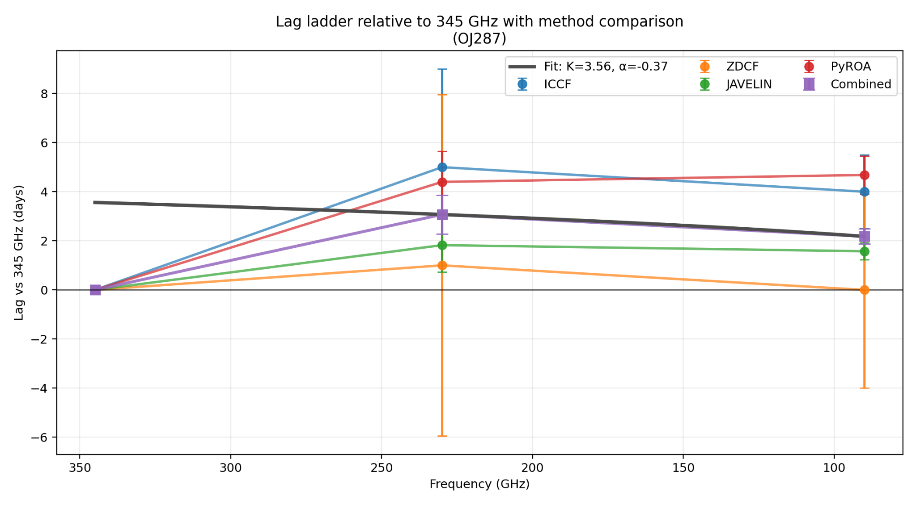
Results: Sources Revealing Complex Jet Behaviour
Compressed / Distorted Lag Ladders:
NRAO530, OJ287, PKS1749+096 do not show a clear monotonic ladder
Lag spacing is compressed, weak, or even non-monotonic
Lag behaviour:
Higher frequencies still lead lower frequencies
But larger frequency gaps do not always produce larger delays
Indicates deviations from a simple, monotonic lag ladder

Slide 10
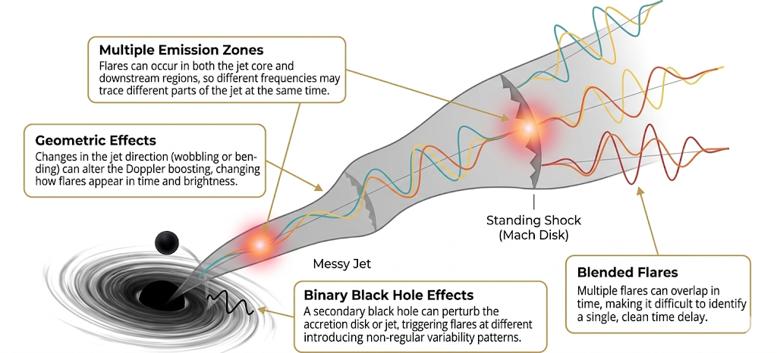
Results: Sources Revealing Complex Jet Behaviour
Physical Interpretation

Slide 11

Summary and Outlook
Key Results: Higher frequencies lead lower frequencies across all sources. Clear lag ladders observed in 3C273, 3C279, and 3C454.3. Some sources show compressed or distorted lag structures.
Physical Interpretation: Findings strongly support the shock-in-jet / opacity model. Emission originates near the jet base and propagates outward. Deviations indicate complex jet structure (multi-zone, geometry).
Future Work: Extend analysis with additional Metsähovi monitoring data Apply the method to more blazar sources Compare lag behaviour with detailed variability studies (ongoing work)
Delight's Ongoing Work Variability Characterization Delight is currently characterizing the variability properties of these specific target sources. Her work includes rigorous analysis of variability patterns and precise source classification. This will help link lag behaviour directly with physical source properties.

Slide 12

Thank You

