Slide 1
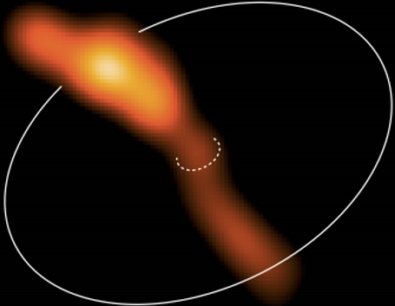


MeerKAT S-band Study of Massive Protostellar Jets
Willice Obonyo
M.G Hoare¹, S.L Lumsden¹, J.O Chibueze²
¹School of Physics & Astronomy, University of Leeds, Leeds – UK
²UNISA Centre for Astrophysics and Space Science, SA

Slide 2
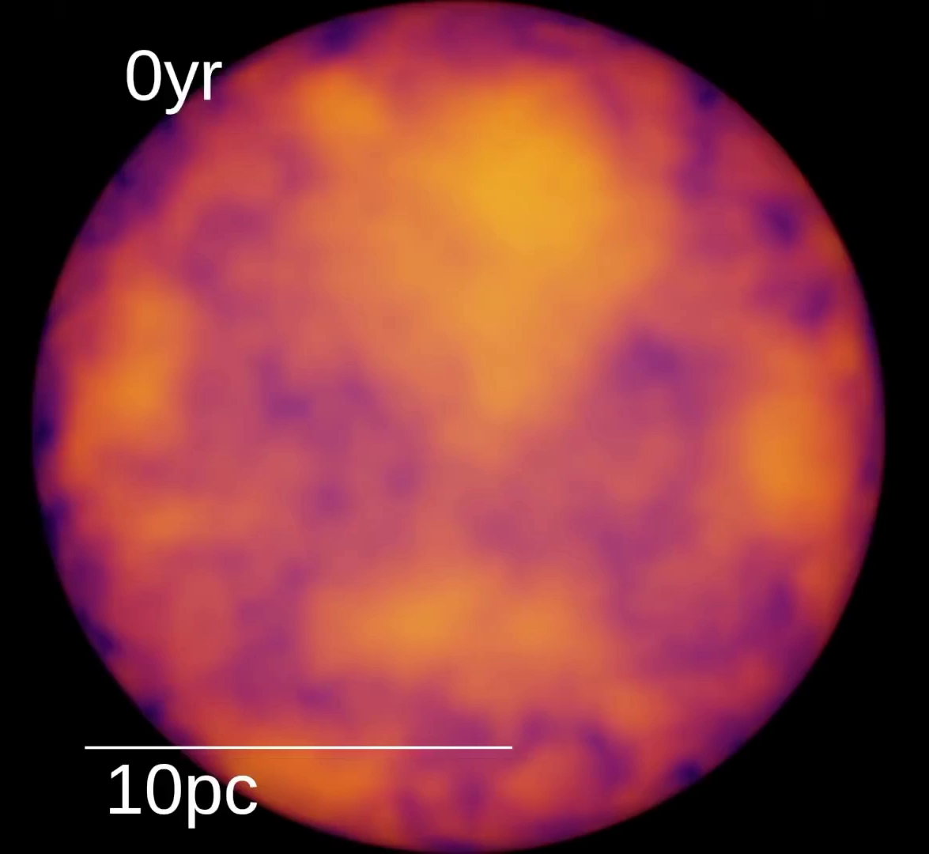
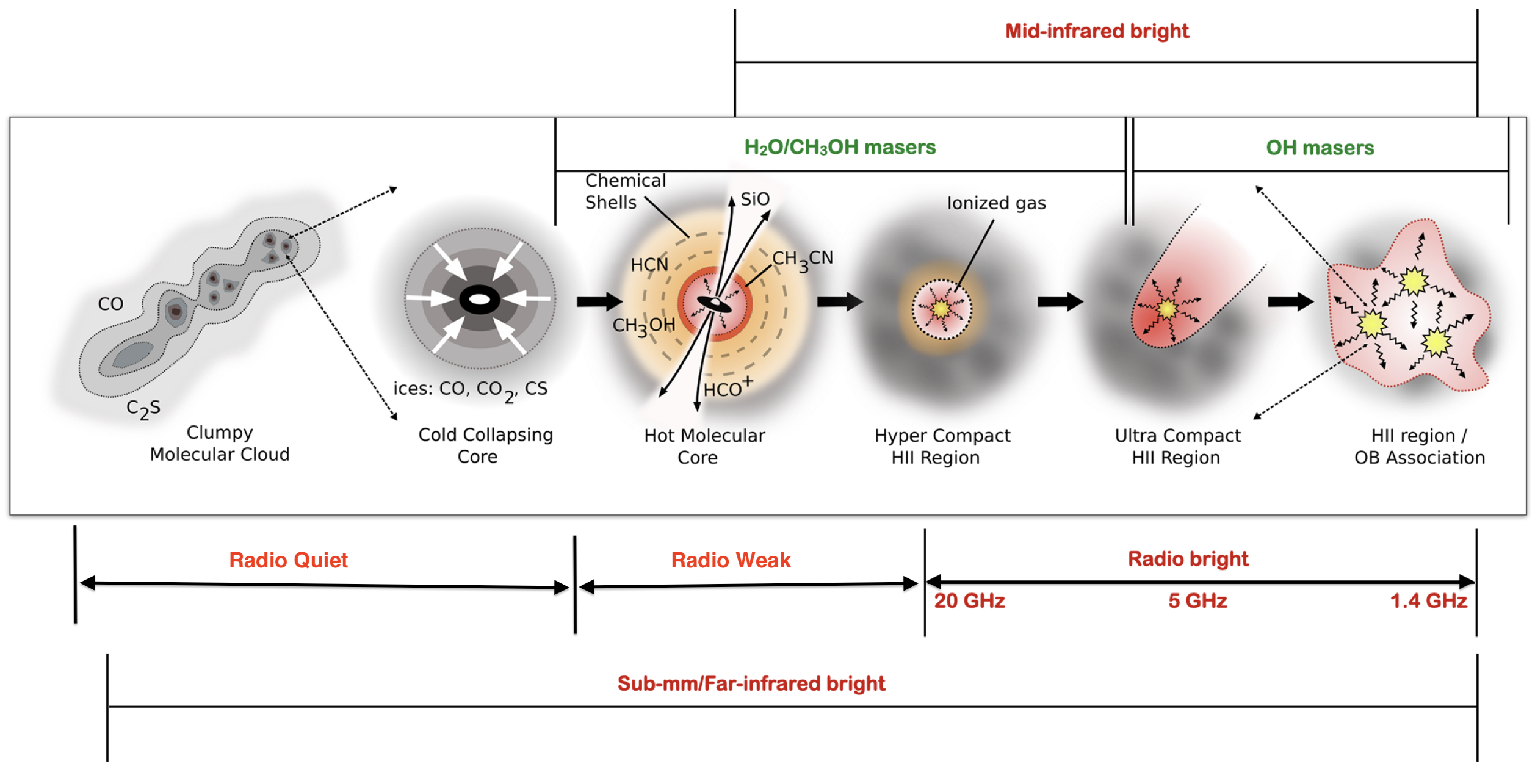
Massive Star Formation
The Evolutionary Sequence Model of Massive Protostars (Urquhart 2024)
Jets turn on at the Hot Molecular Core phase and turn off after HCHII
2

Slide 3
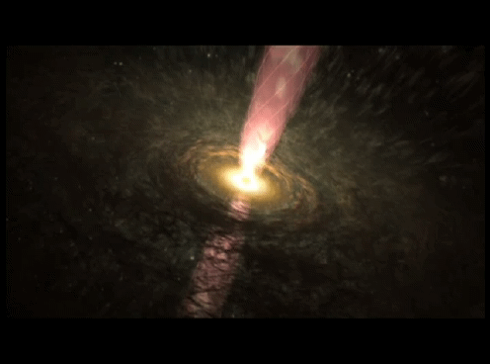
Why study jets of protostars?
Releases part of radiation pressure (Kuiper+ 2010).
Transport angular momentum from a protostar, e.g, the rotating jet in HH 212 (Lee+ 2017).
Tracers of Accretion History (Cesaroni+ 2018)
Signatures of disk-fed accretion (Caratti o Garatti +2017, Cesaroni+ 2018)
Indicators of star formation sites
Movie by Carrasco-Gonzalez
3

Slide 4
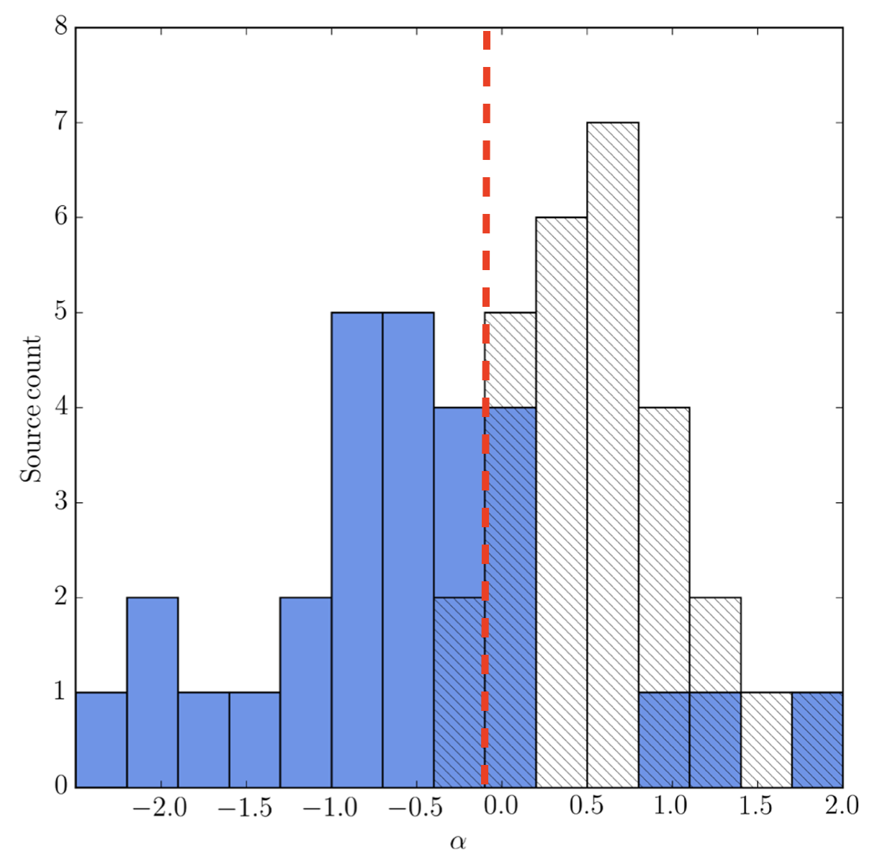

Radio Continuum Emission Mechanisms
Spectral index is defined as $S_{ν}∝ν^{α}$
Thermal (Free-Free emission)
  Ionized gas
  Spectral index α ∼ −0.1 to +2
  Typically α ∼0.6
Non-thermal (Synchrotron emission)
  Shock-accelerated electrons
  Spectral index α < −0.1
  Typically α ∼-0.6
(Purser+2016,2021; Obonyo+2019,2024,2025)
Purser+2016)

Slide 5
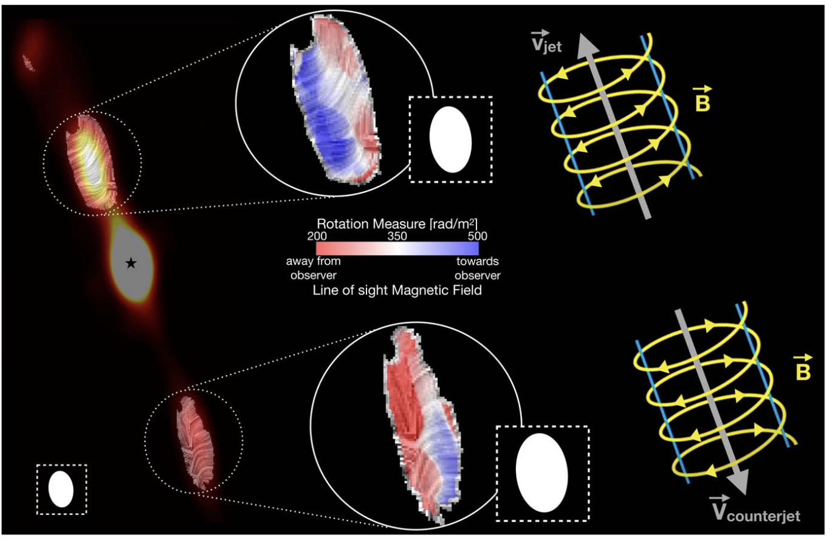
Radio Properties of Massive Protostars
Magnetically Driven, e.g., HH 80-81
Stratified Helical Magnetic Field: Toroidal near the axis, becoming increasingly poloidal toward the edges (Rodríguez-Kamenetzky+ 2025).
Polarized synchrotron emission.
(Carrasco-Gonzalez+ 2010)

Slide 6
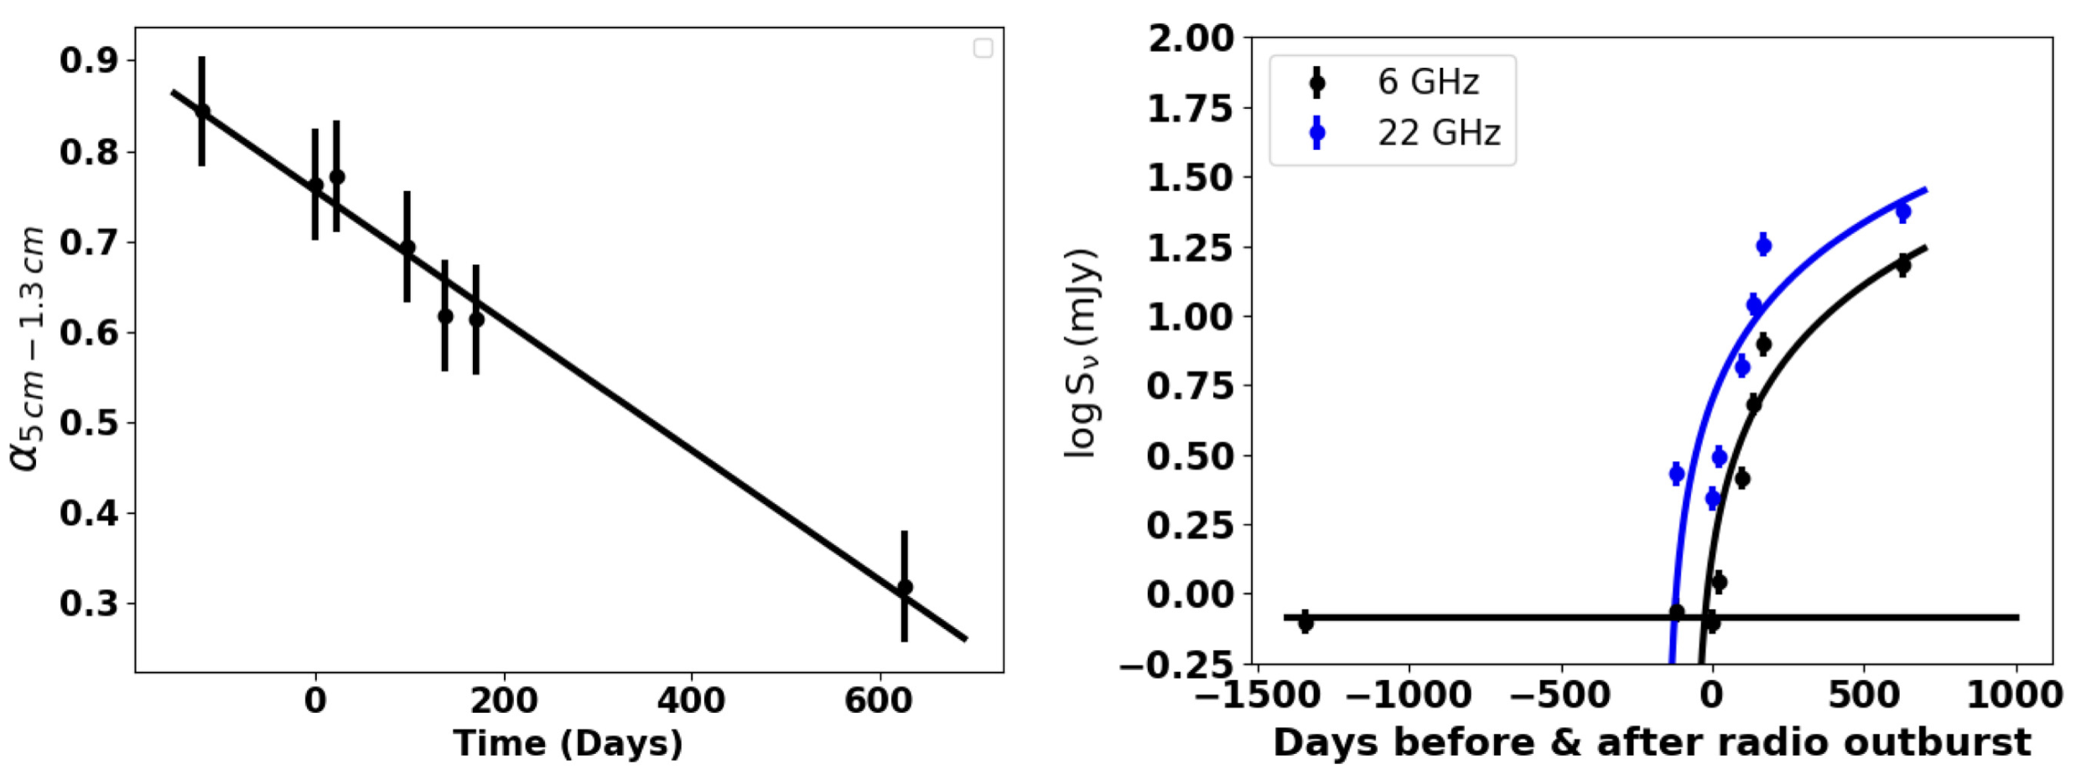
Episodic Accretion– S255 NIRS 3
Radio Properties of Massive Protostars
Free-free emission from Core
Radio Outburst - evidence of episodic accretion (Cesaroni+ 2018, Obonyo+2021).

Slide 7
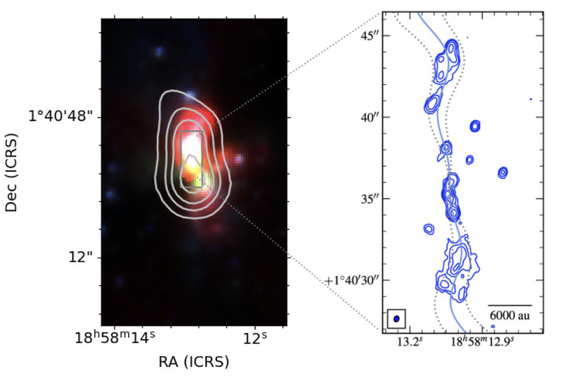
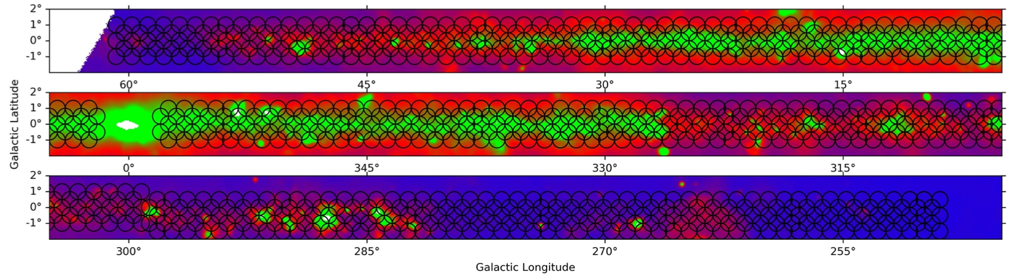
Sample Selection
Selected from MeerKAT Galactic Plane Survey (1.28 GHz; Goedhert+ 2024)
11 Massive Young Stellar Objects (MYSOs)
Criteria:
  Extended radio morphology at 1.3 GHz
  Alignment with infrared sources
G035.1979−00.7427 (Purser+2021;Obonyo+2024)
Observed at 3.1 GHz, Resolution 3.1 arcsecs

Slide 8
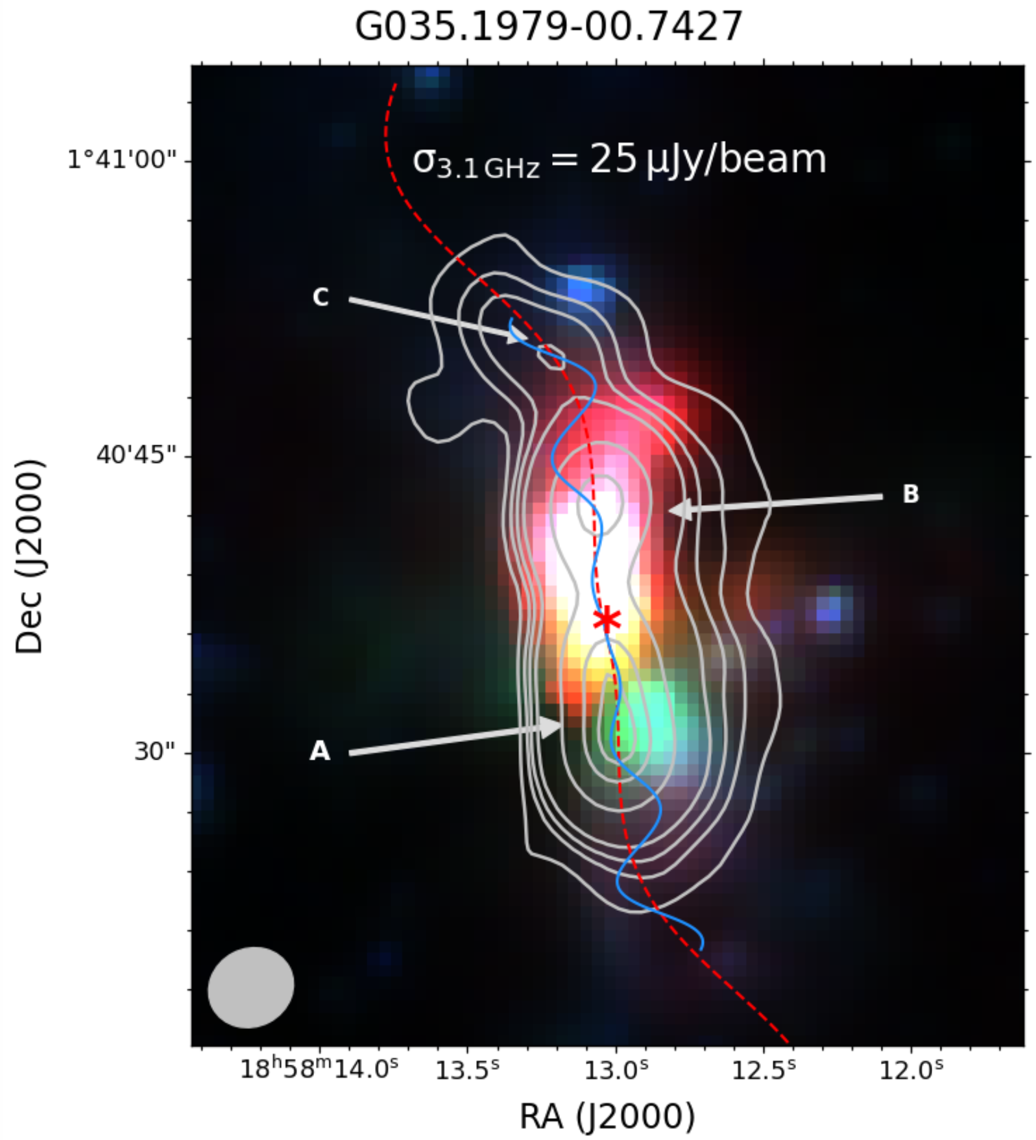
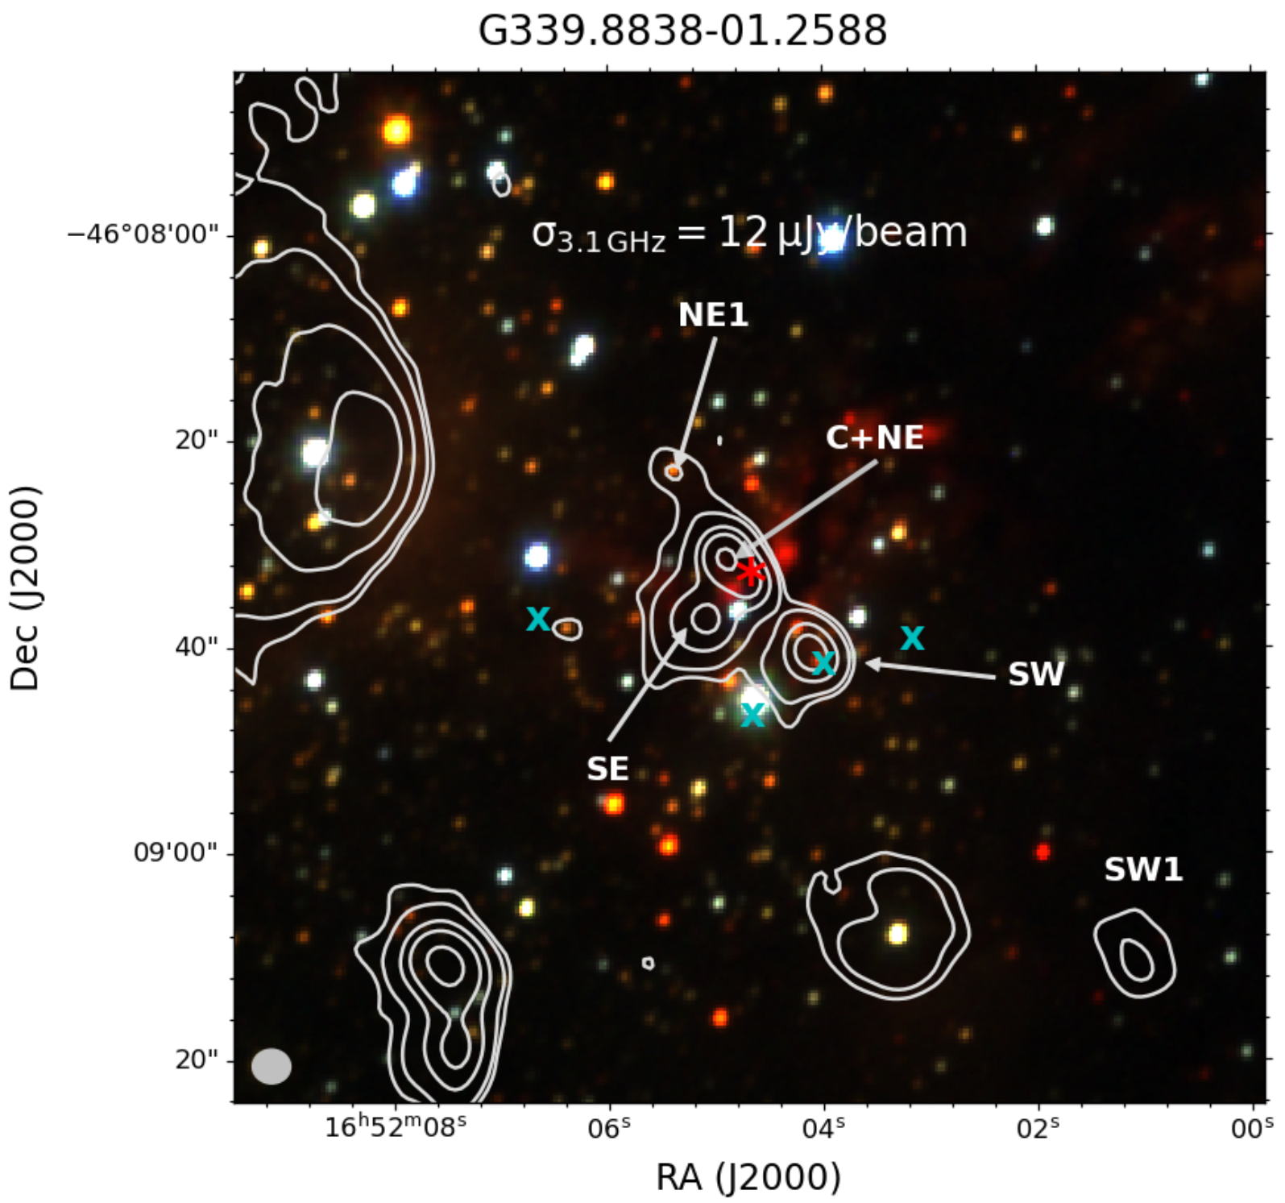
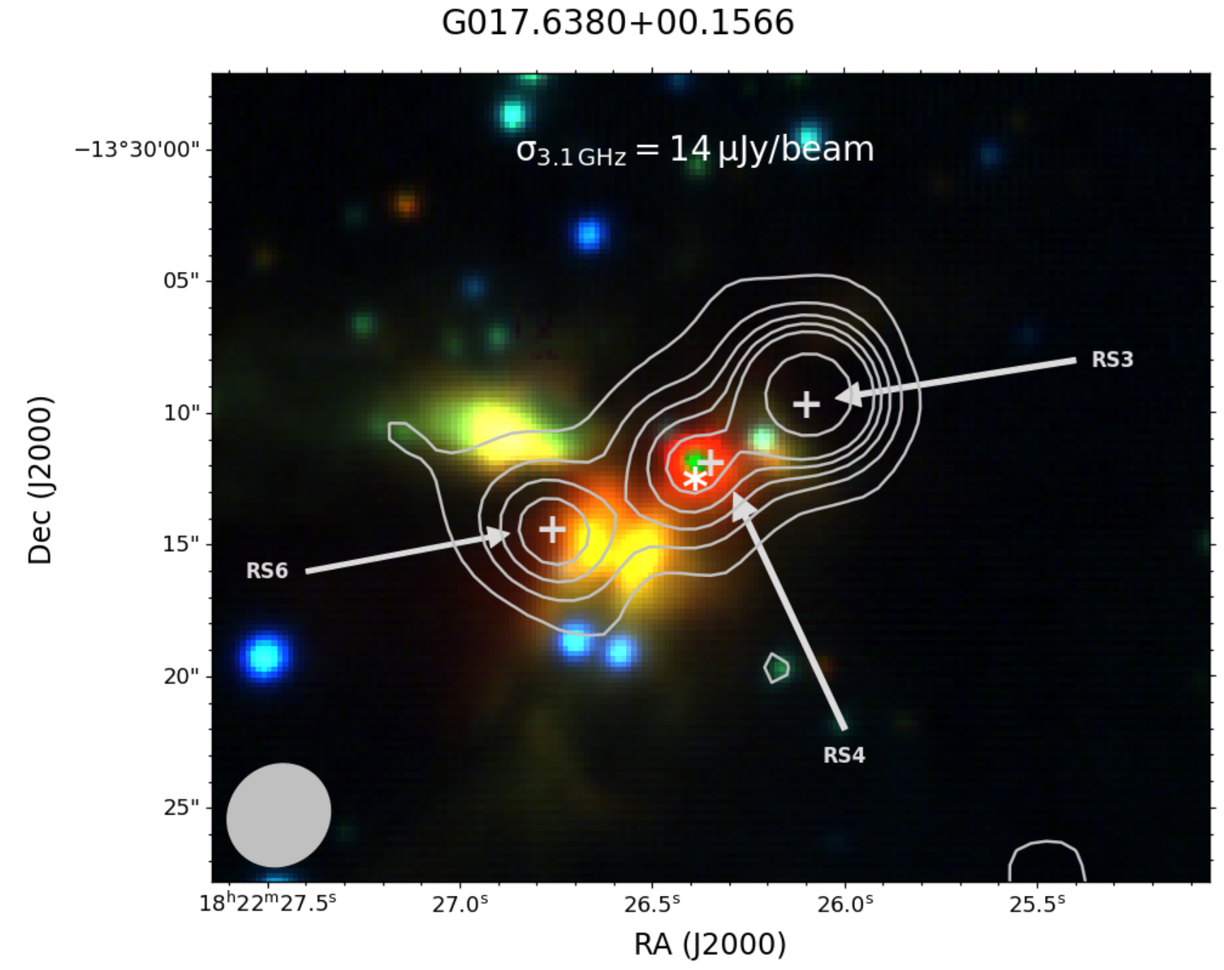
Jet Morphology
41 radio components detected/resolved at the 3.1 arcseconds resolution
  31 identified as jet structures
Observed morphologies
Bipolar jets
Asymmetric lobes
Branched structures
Detected new radio lobes, e.g, RS6 and C.

Slide 9
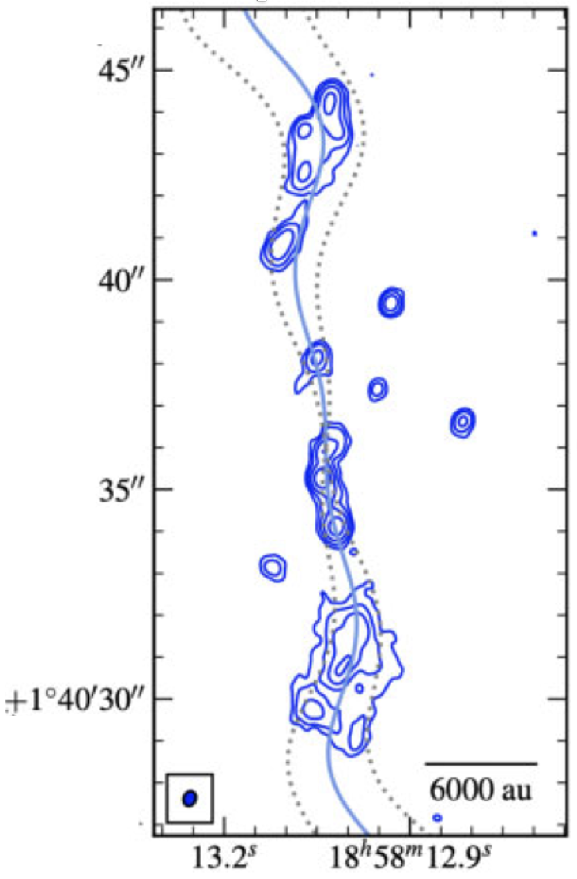
Evidence for Jet Precession
Five sources show curved or bending jets.
  Indicates jet precession
  Estimated precession periods: 150 − 800 years
Possible causes:
  Binary companions
  Disk instabilities
(Sheikhnezami & Fendt 2015)

Slide 10
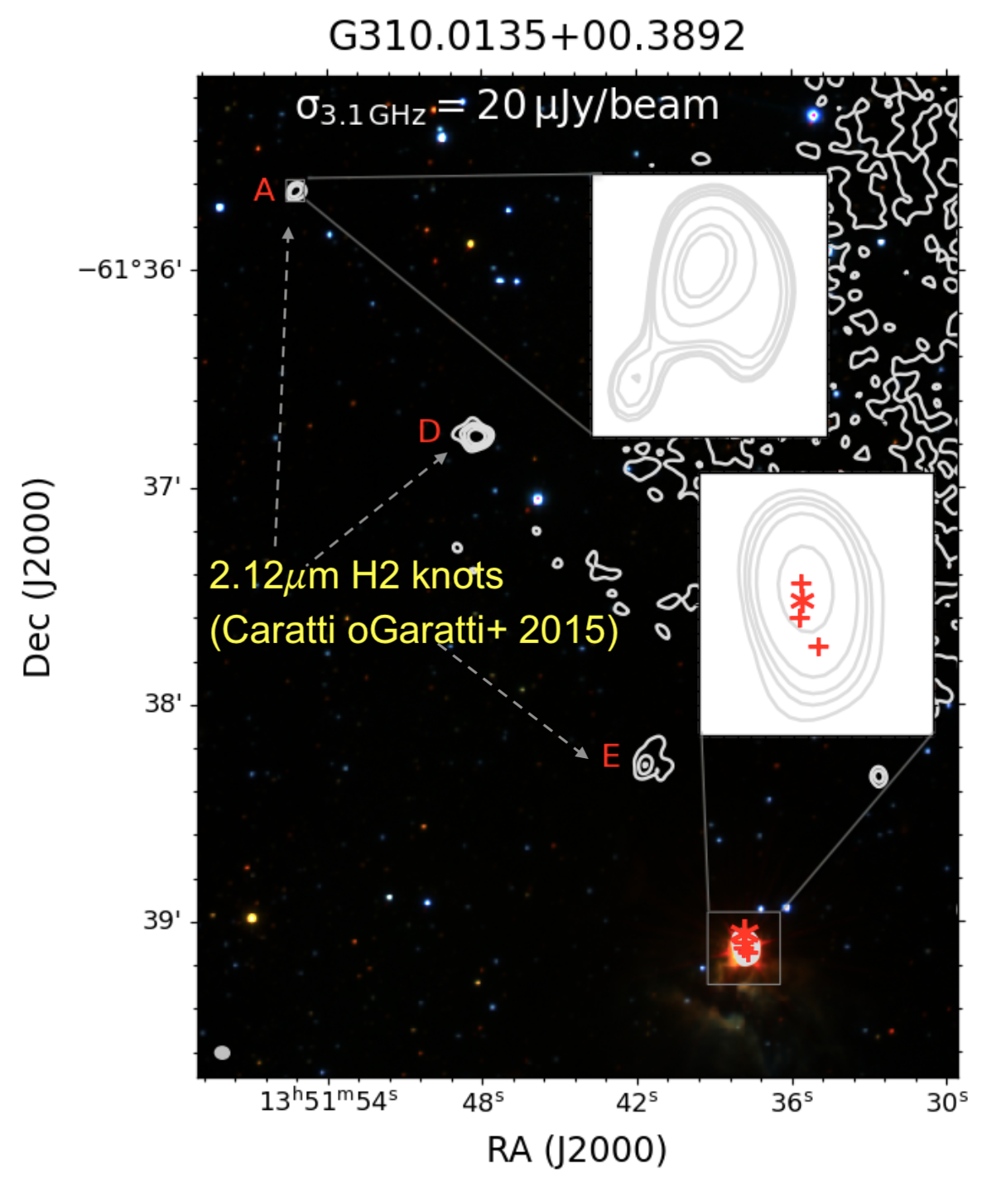
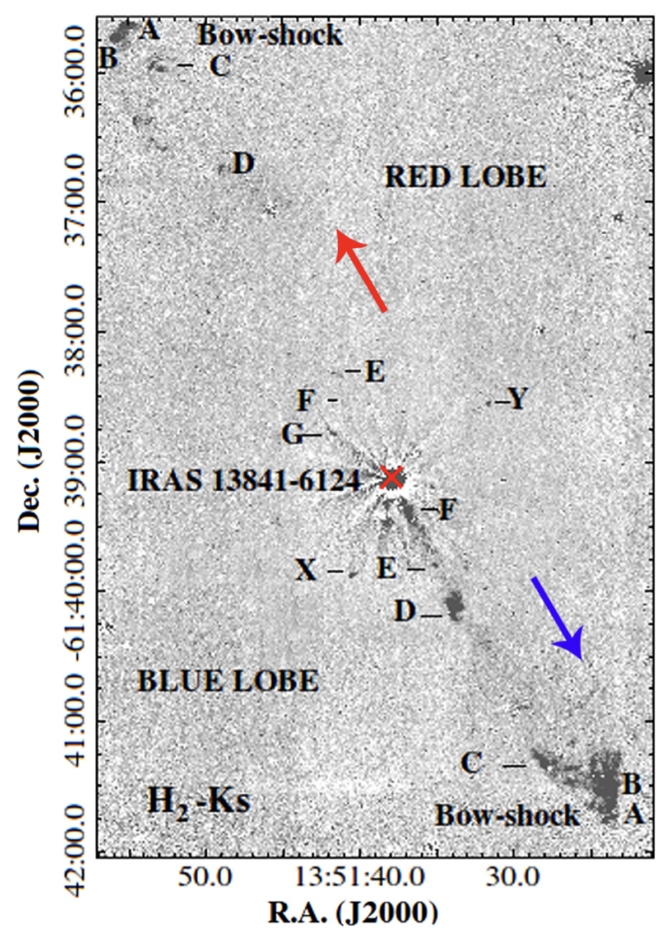
Evidence for Jet Precession
(Caratti O Garatti+ 2015)
Primary and secondary bow-shock hotspots, indicating possible jet precession (Horton et al. 2023).

Slide 11
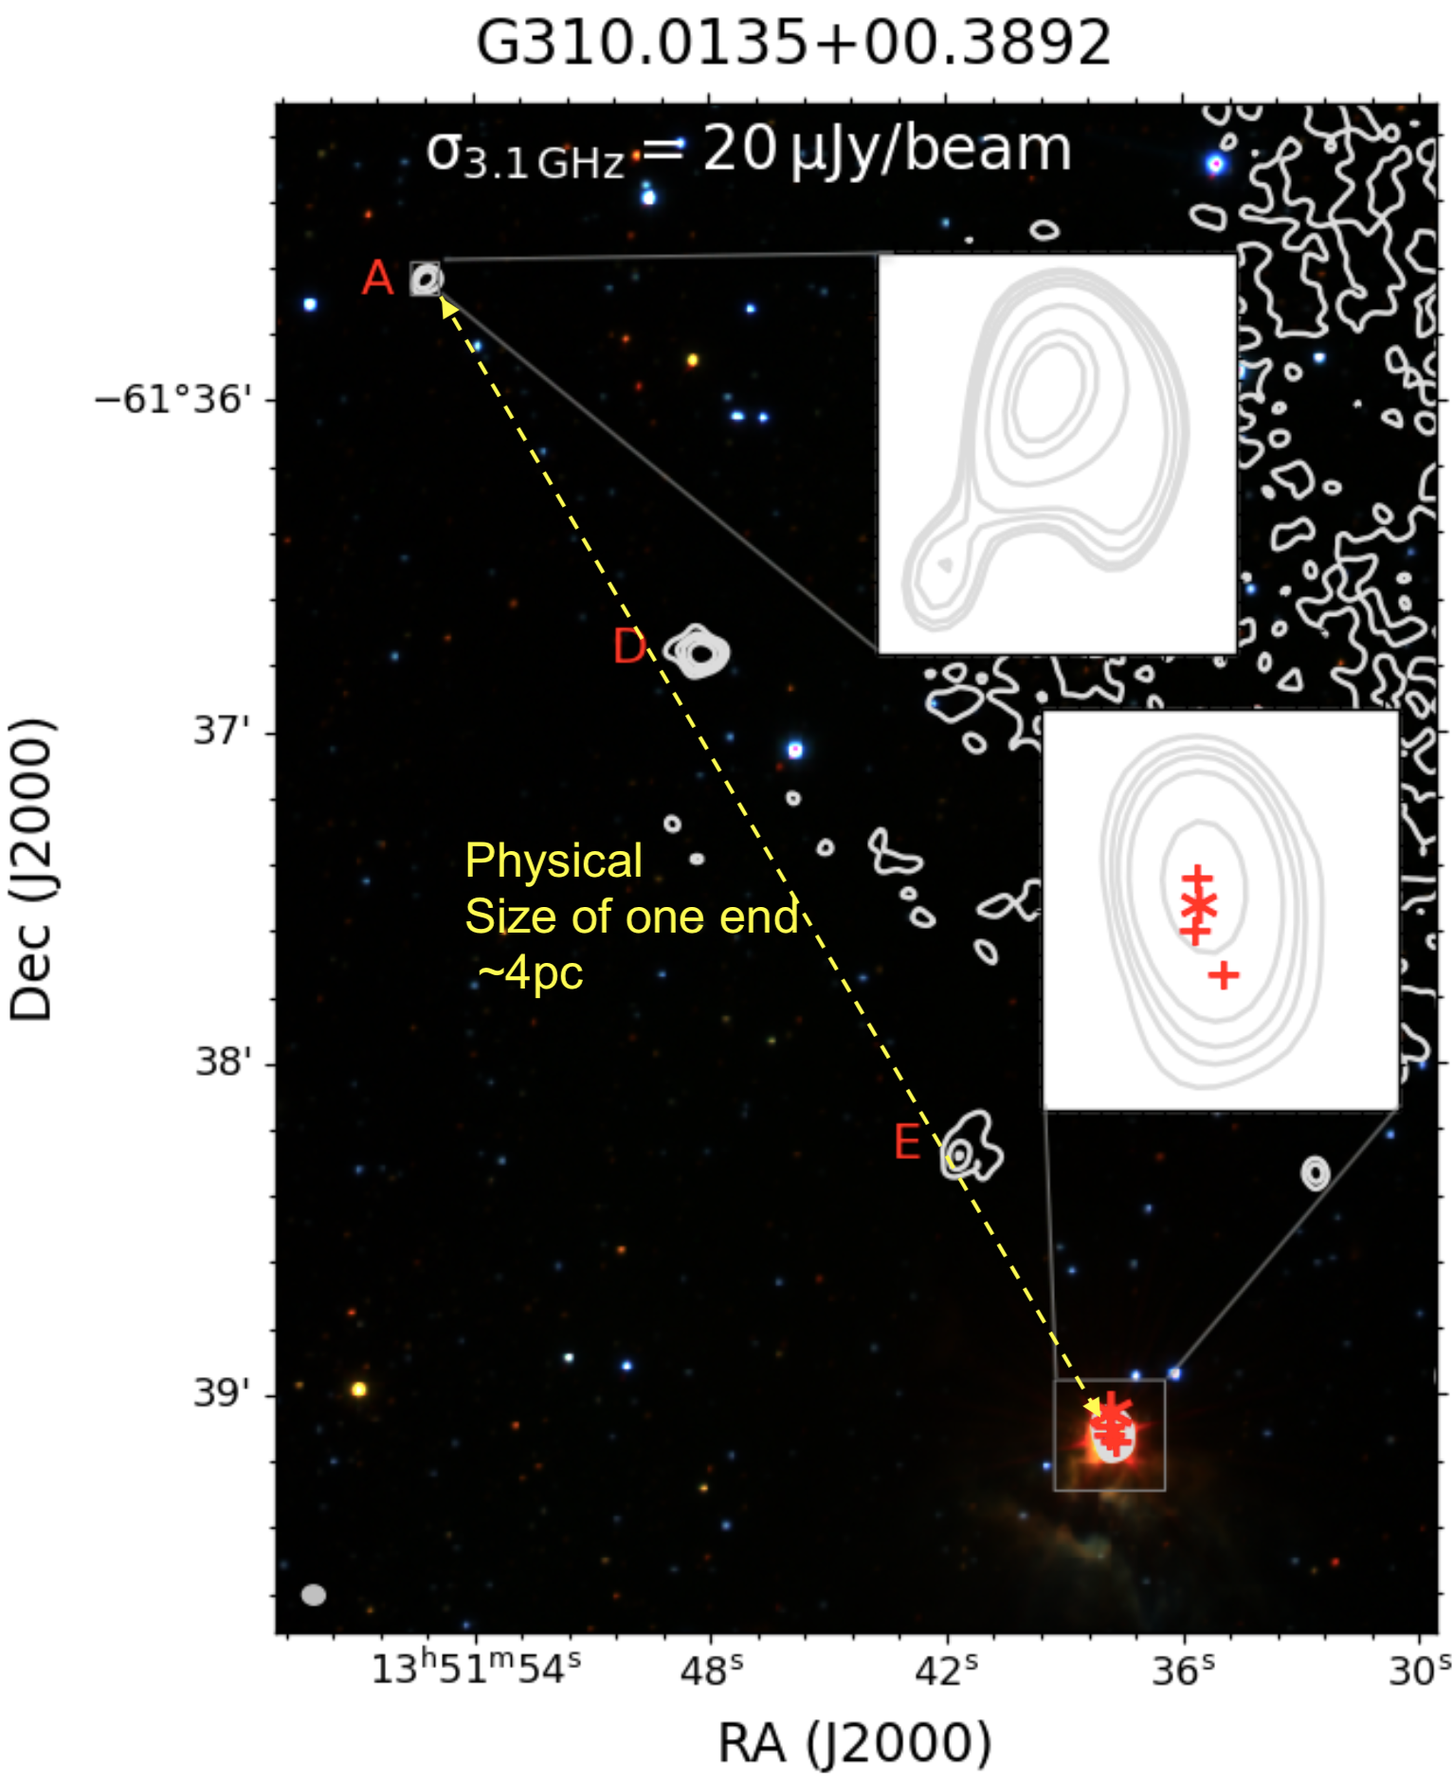
Parsec Scale Radio Jet
Example: G310.0135+00.3892
Terminal bow shock on one side of the jet at ∼242″ (∼4 pc at 3.4 kpc), indicating a parsec-scale protostellar outflow.
For comparison
HH 80–81 protostellar jet
  Radio jet from HH 80N to HH 80S: 5.3 pc (Martí et al. 1993)
  Jet extent revised to ~10 pc based on new Hα observations (Bally & Reipurth 2023)
Implication:
  Jets inject momentum into molecular clouds
  Influence surrounding star formation

Slide 12
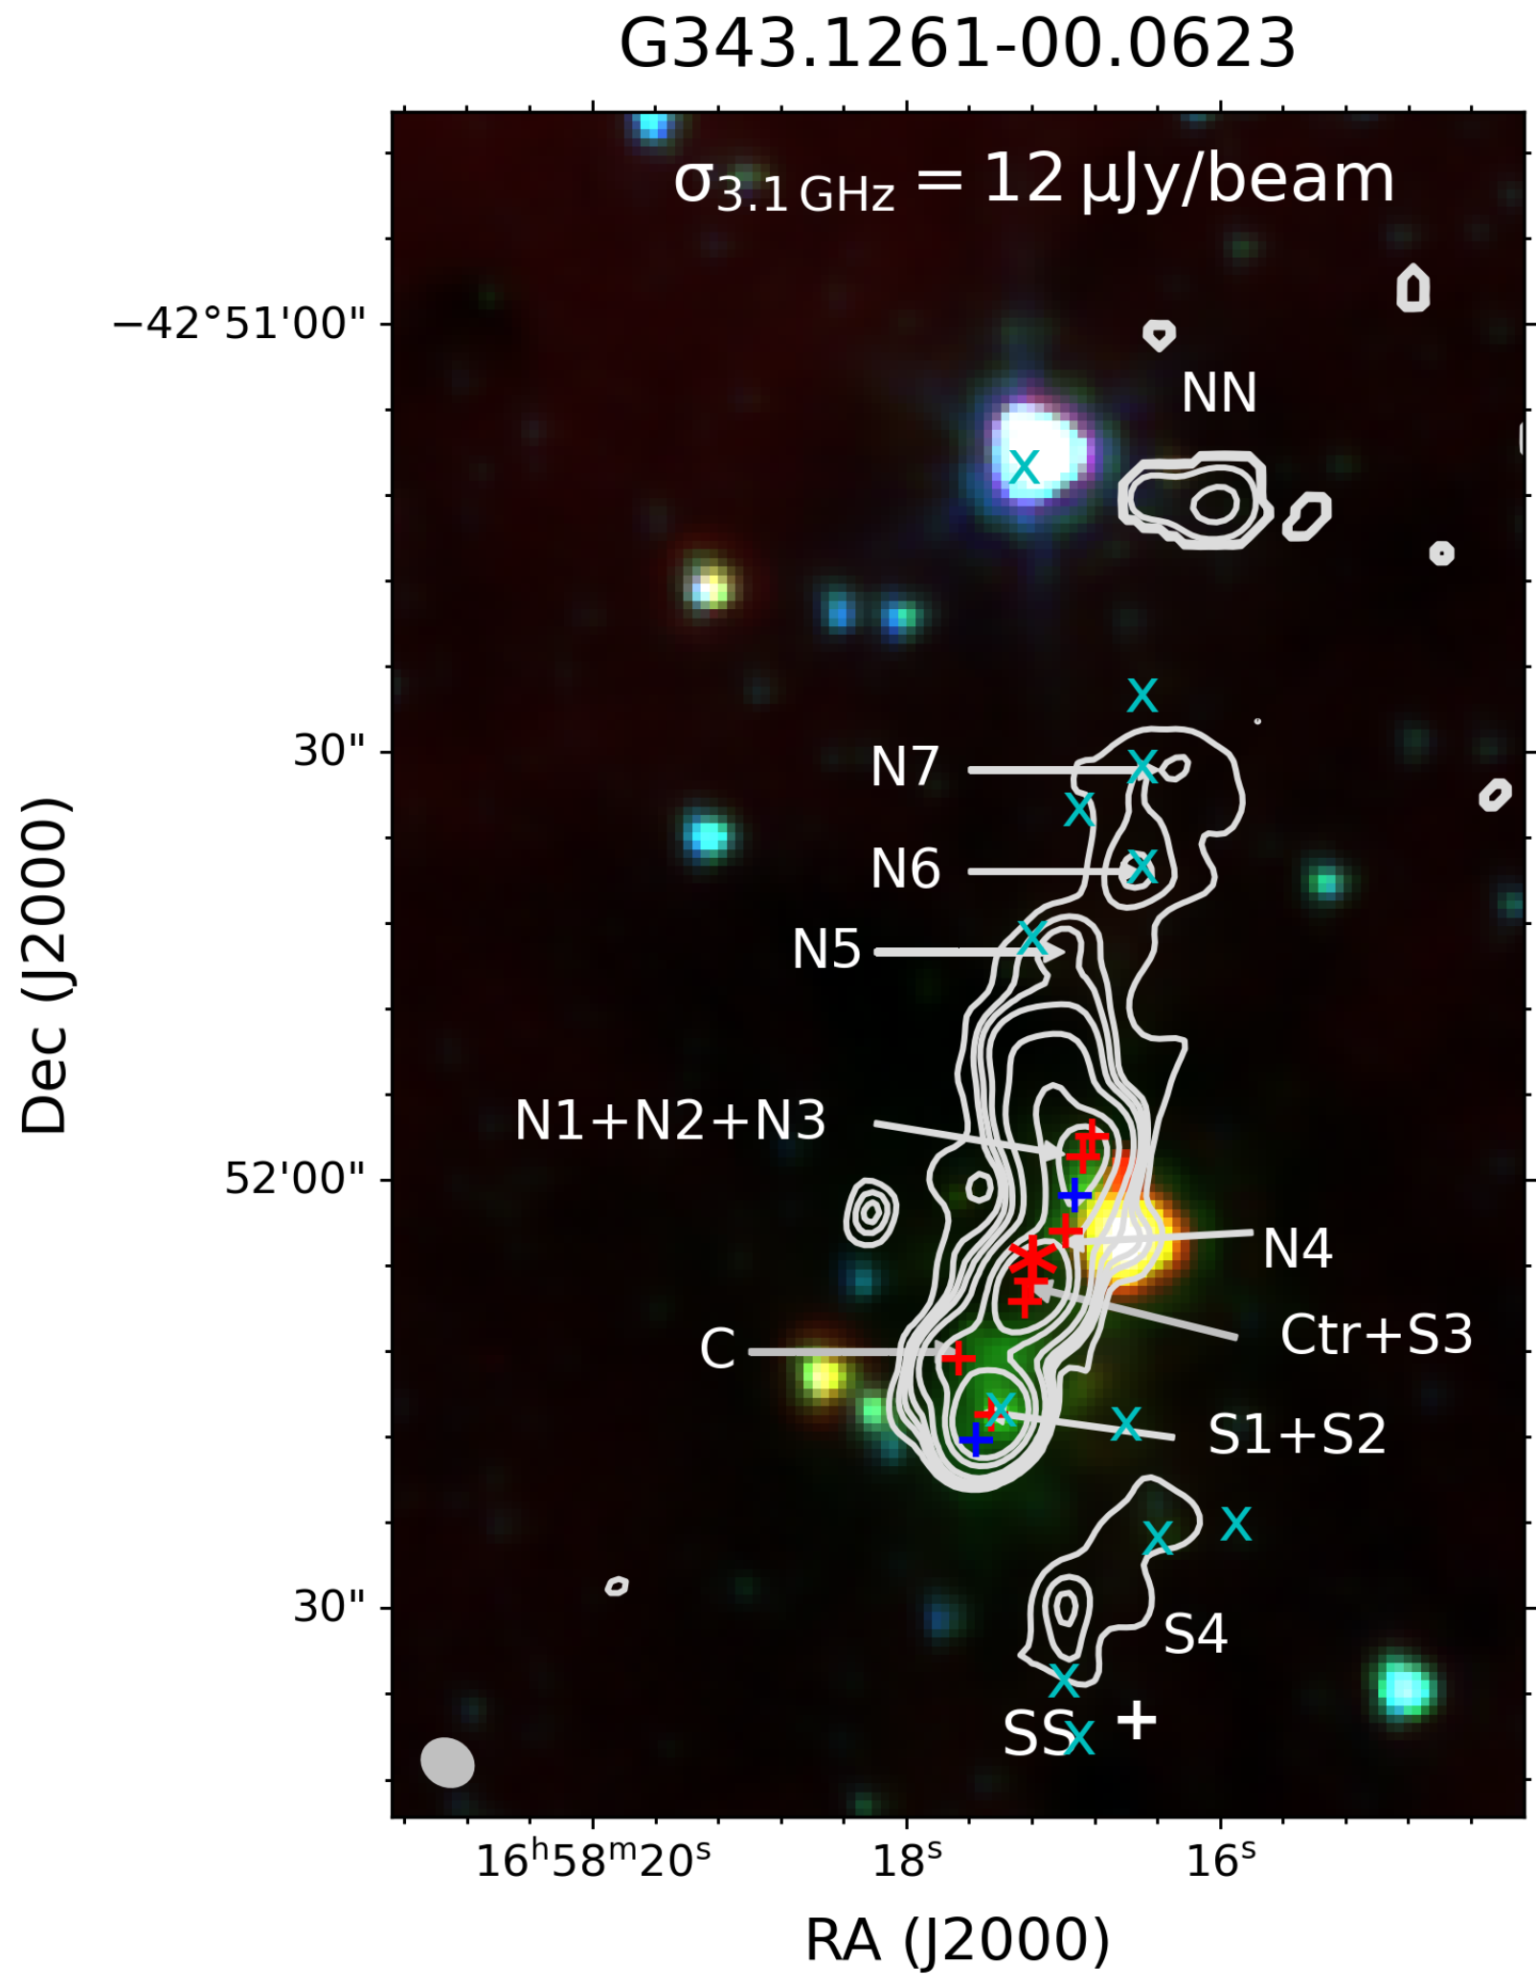
Diffuse Emission
MeerKAT sensitivity reveals:
  Diffuse emission connecting jet knots
  Cocoon-like structures
  N5-N7 New knots
Interpretation:
  Jet entrainment of ambient gas
  Energy injection into molecular cloud
+ signs: radio sources (Purser+ 2016, Rodríguez+ 2005)
x represents the locations of 2.12𝜇m H2 knots in Brooks et al. (2003).

Slide 13
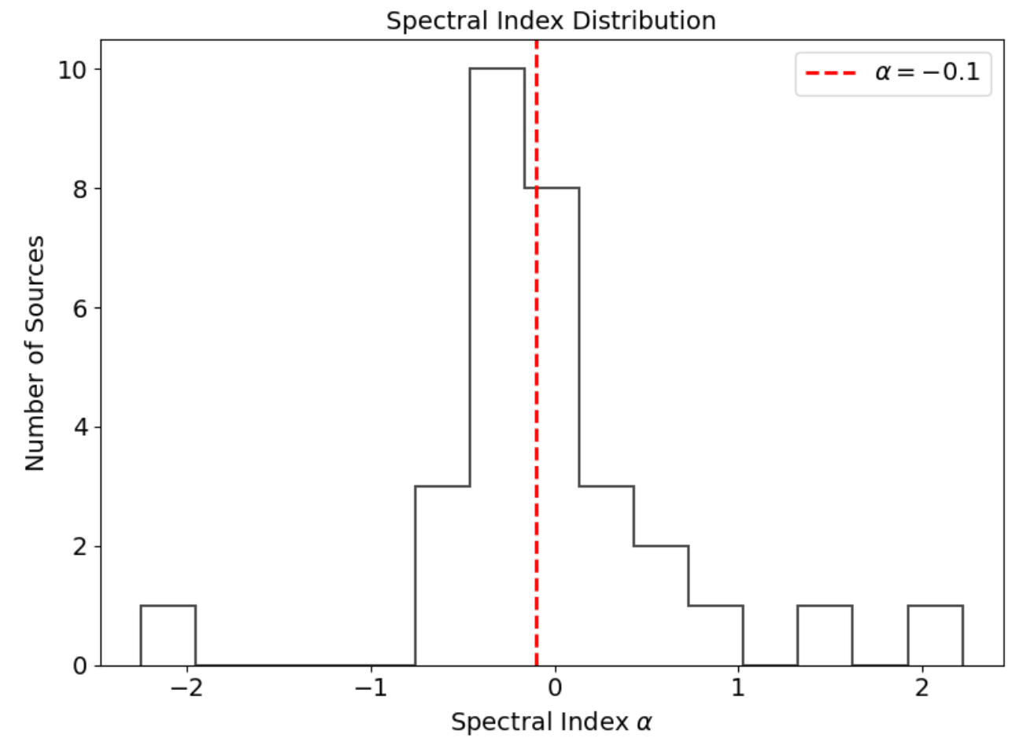
Spectral Index Distribution
Measured for 30 jet components.
  Range: α ≈ −2.25 to + 2.22
  Peak distribution: α ≈ −0.3 to − 0.6
Indicates significant synchrotron emission.
Non-thermal emission detected in:
  ∼ 82% of MYSO systems
  ∼ 63% of resolved jet components
Implications:
  Particle acceleration in jets
  Magnetic fields play a key role

Slide 14
Summary
MeerKAT S-band observations reveal complex jet morphologies
Jets exhibit precession and episodic ejections
Diffuse emission fills inter-shock regions, tracing jet–environment interactions
Synchrotron emission is widespread in massive young stellar object (MYSO) jets

