Slide 1



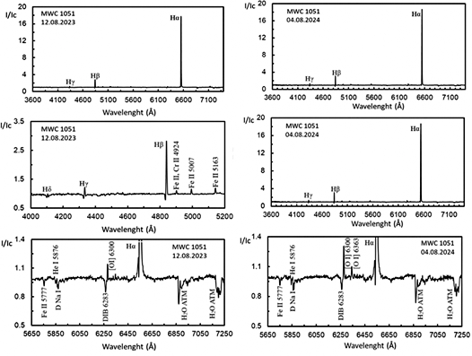
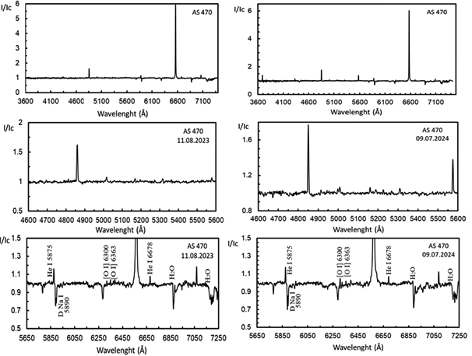
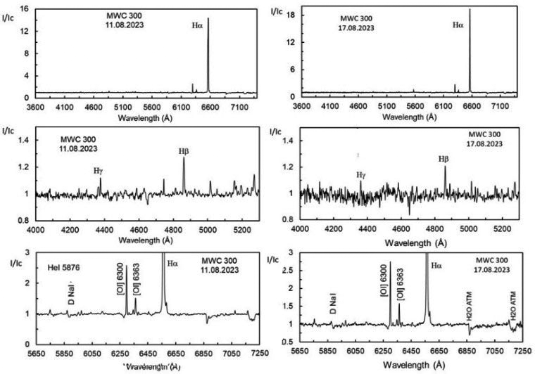
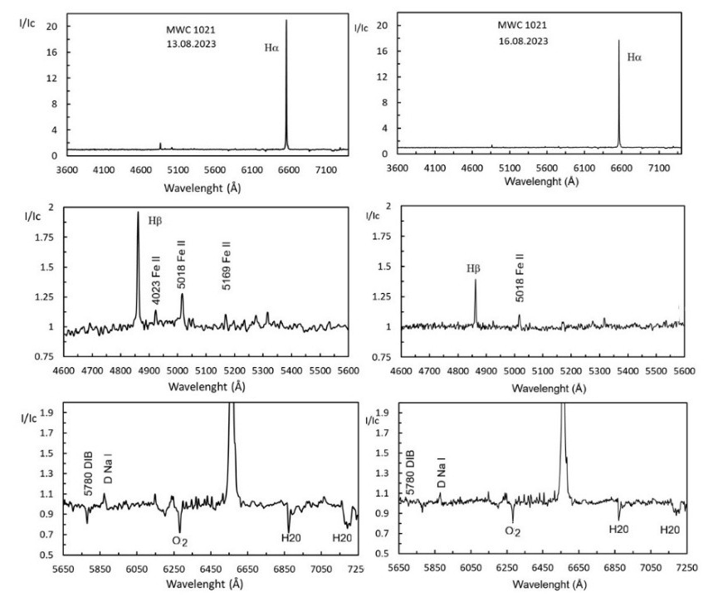
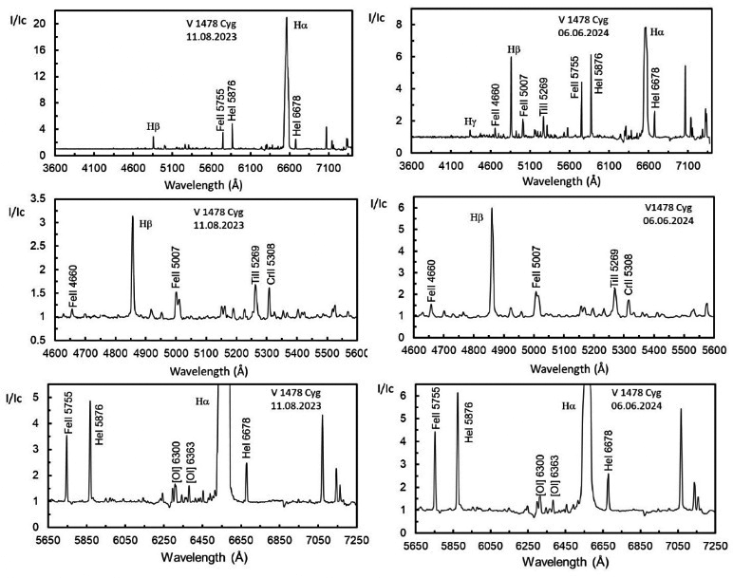
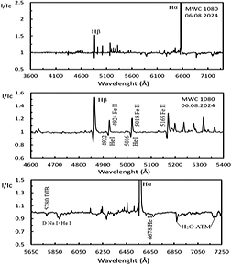

SPECTRAL PROPERTIES OF SELECTED MASSIVE HERBIG AEBE STARS
F. S. Huseynova¹, N. Z. Ismailov², U. S. Veliyev¹
¹ Batabat Astrophysical Observatory, Nakhchivan State University
² Tusi Shamakhy Astrophysical Observatory, Ministry of Science and Education of Azerbaijan faidahuseynova@gmail.com
International conference, 22-27 March 2026, Kasane, Botswana
Abstract
The results of spectral and photometric analyses of six chosen massive Herbig AeBe stars for the years 2023–2024 are presented in this research. Spectral investigations show that the emission spectra varies significantly across time intervals between one month and one year. The circumstellar disk's condition was described by an energy distribution curve. Two of the six stars are seen to have evolved debris disks with weak residual dust radiation. The stars' primary physical characteristics were computed, and their evolutionary status was determined. Due to its binarity, MWC 300 is a more developed star with significant excess infrared radiation.
For the spectrum of standard stars, the standard deviation in measurements for the radial velocities (Rv) of strong lines is ± 5 km/s, and for the equivalent widths (EW) of hydrogen lines for A0-A6 type stars is ± 0.5 Å.
Table 2. Log of spectral observations of program stars
Target | Spectra | Date | UT | Exp(sec) | S/N
V1478 Cyg | KUA1541-42 | 11.08.2023 | 21:21 | 1600 | 28
V1478 Cyg | KUA1600-01 | 13.08.2023 | 23:59 | 1500 | 24
V1478 Cyg | KUA1653-54 | 16.08.2023 | 00:05 | 1500 | 22
V1478 Cyg | KUA1713-14 | 06.06.2024 | 21:24 | 1800 | 13
V1478 Cyg | KUA1744-45 | 05.07.2024 | 17:59 | 3000 | 15
MWC 1051 | KUA1577-78 | 12.08.2023 | 00:08 | 1500 | 31
MWC 1051 | KUA1787-88 | 04.08.2024 | 17:43 | 3000 | 32
MWC 300 | KUA1524-25 | 11.08.2023 | 18:36 | 2000 | 25
MWC 300 | KUA1667-68 | 17.08.2023 | 19:55 | 1800 | 22
AS470 | KUA1546-47 | 11.08.2023 | 22:43 | 900 | 30
AS 470 | KUA1754-55 | 09.07.2024 | 18:55 | 2700 | 26
AS 470 | KUA1248-49 | 08.09.2024 | 18:56 | 2400 | 36
MWC 1080 | KUA1817-18 | 06.08.2024 | 19:18 | 1200 | 93
MWC 1021 | KUA1535-36 | 11.08.2023 | 20:22 | 600 | 109
MWC 1021 | KUA1596-97 | 13.08.2023 | 22:48 | 900 | 105
MWC 1021 | KUA1649-50 | 16.08.2023 | 23:08 | 1200 | 112
Table 1. Physical characteristics of program stars collected from literature
Target | Av | D,pc | L/L⨀ | Teff,K | R/R⨀ | M/M⨀ | t, Myr | Sp type | EWH_{α}(A)
MWC 1051 | 2.84 | 4530 | 4.03 | 20,000 | 9 | 10.8 | 0.08 |  | -157.7
MWC 1080 | 4
 | 4.84
 | 1.01 |  |  |  | 4 | 10.59
 |  | 2500
 |  |  |  |  |  | 16.08 | 0.04 | B0pb
 | 5.4
 | 8.24 |  |  | 31500
 | 5.3 | 1000
 |  | 1000
 | 5.3 | 1000 |  |  | 7 | 20.6
 | 8.24 |  | 6.53 |  |  | >6 | <0.01
AS 470 | 1.67
 |  | 4040 |  |  |  | 7 | 0.1 |  | -49.2
 | 2.27 |  | 3.01 | 8200
MWC 300 |  | 700 |  |  |  | 9.36 | 0.1 | B1Ia+e
 |  |  |  |  |  | 9.36 | 0.1 | B1Ia+e
 | 4.23 |  |  |  | 3.33 | 7.37
MWC 1021 |  | 3650 |  |  |  | 32 | 0.01 | Bpe
V1478 Cyg | 8.8
 | 3.1
 |  |  |  |  |  | 28.3 | 0.01 | Bep
Figure 5. Normalized spectra of the star AS 470 for the dates 11.08.2023 and 09.07.2024 are shown. The panels below show a larger-scale representation of the spectrum on those dates in region of λ 4600-5600 Å, and λ 5650-7250 Å
Figure 2. The same as in Fig.1 for the star MWC 1051
Figure 3. The same as in Fig.1 for the star MWC 300
Figure 6. The same as in Fig.1 for the star MWC 1021
The entire process of observation and data reduction was performed using the DECH program (Galazutdinov G., 2025 http://www gazinur.com/DECH-software.html ). Table 2 presents the average UT time for the acquisition of two spectrograms per star. After calibration and processing, all spectra were averaged and normalized to the continuum. Our spectral observations executed for 11.08.2023-08.09.2024. Table 2 presents observation log. The columns, from left to right, list the target name, observation date, exposure time, UT, binning, and signal-to-noise relation S/N at the Hα line region in the spectrum. After calibration and processing, all spectrum averaged for the nights and normalized to the continuum.
CONCLUSION
1.All program stars show variations in their emission spectrum and brightness. Disk activity in massive stars may be the result of accretion in the outer part of the disk and high-temperature radiation from the central star.
2.The weak excess IR emission from AS 470 and MWC 1021 indicates that the circumstellar disks of these stars have lost their gas component and have weak dust emission, which is also characteristic of Vega-type stars.
3.Despite its young age, MWC 300 has already reached the main sequence in its physical parameters. Despite this, the star possesses powerful disk radiation, rather which is formed within the ring-shaped circumstellar envelope.
Figure 1. Comparison of continuum-normalized spectrograms of V1478 Cyg obtained in 2023 and 2024. The top panels show the entire range of the obtained spectrum. The middle panels show the zoomed-in region of λ 4600-5600 Å, and the bottom panel shows the region of λ 5650-7250 Å
Figure 4. The same as in Fig.1 for the star MWC 1080

