Slide 1



Multiwavelength studies of X-ray binaries
Itumeleng Monageng
et al.

Slide 2
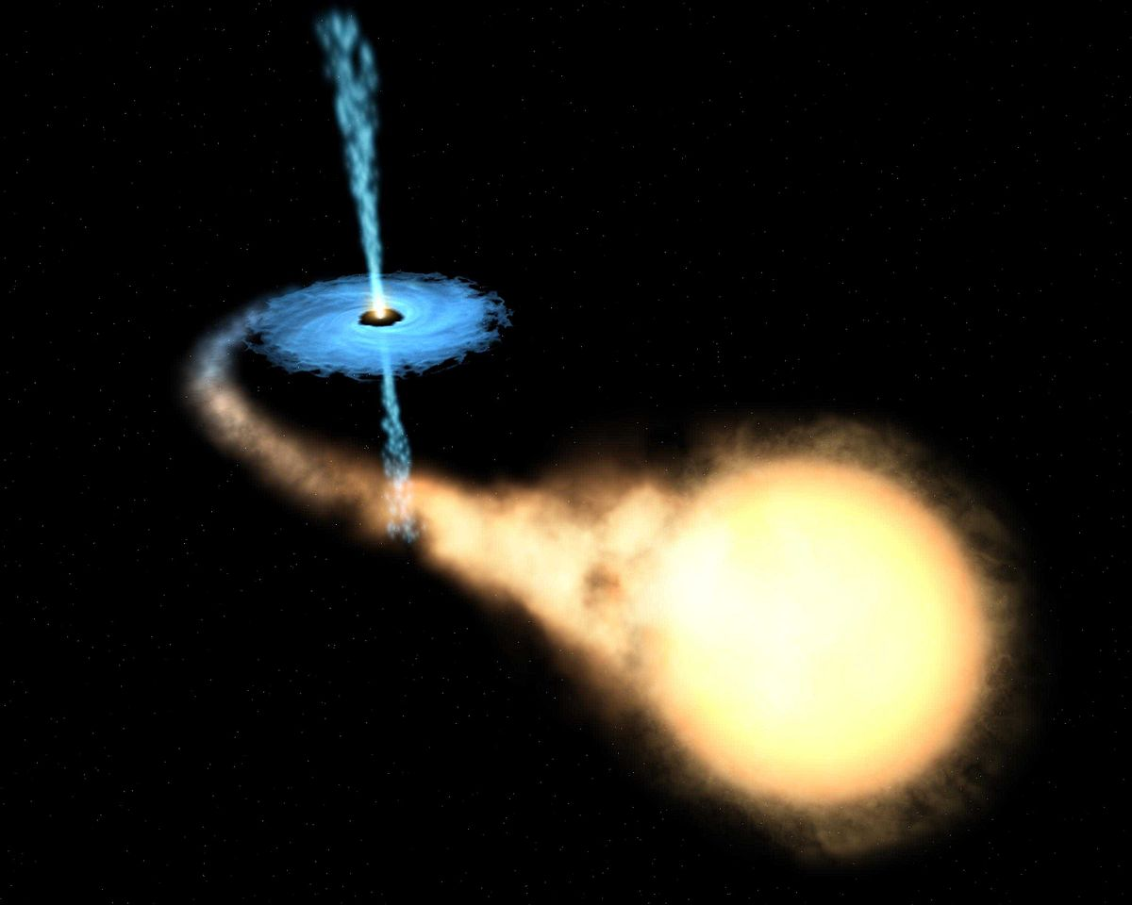
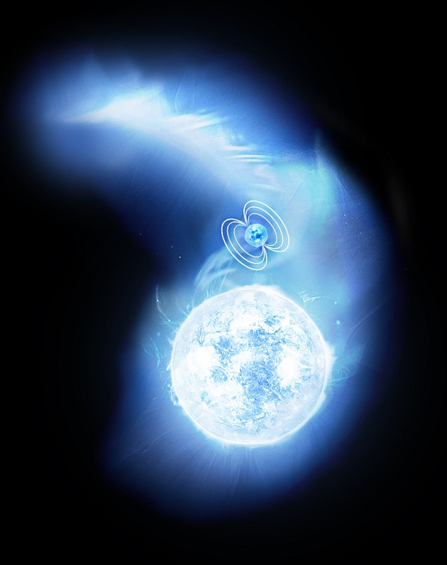
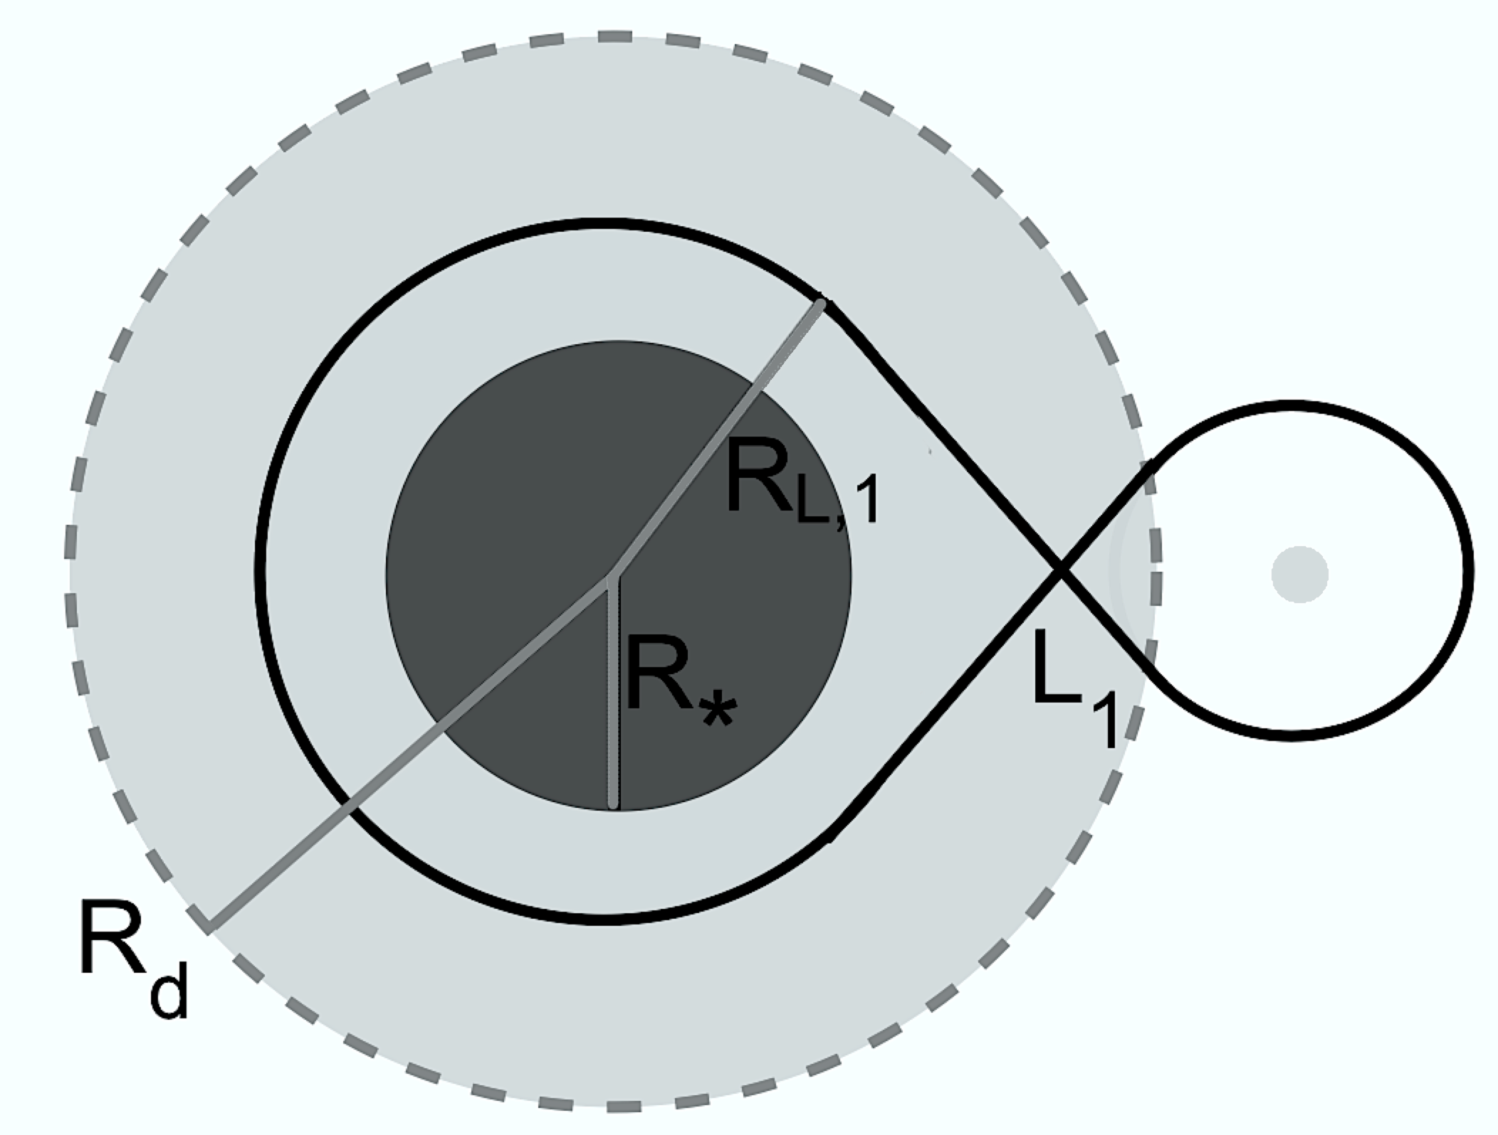
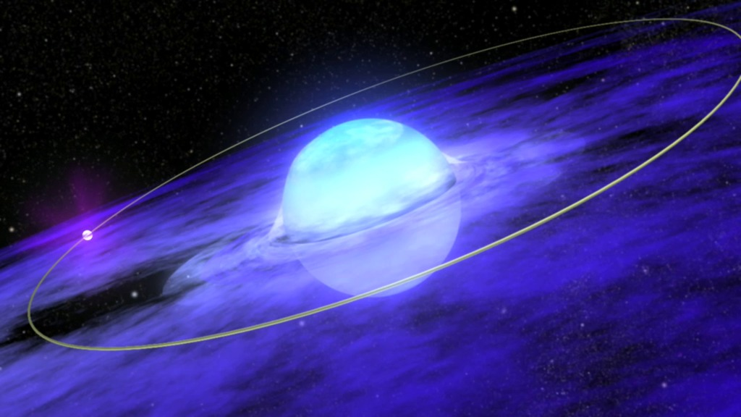
Mass transfer in X-ray binaries
Roche lobe overflow
Wind accretion
Wind-Roche lobe overflow
Disc accretion

Slide 3
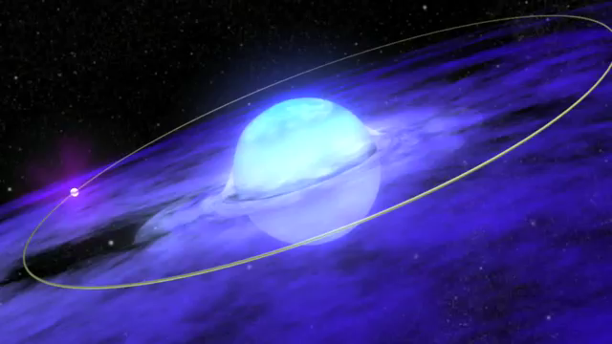
Be X-ray binaries

Slide 4
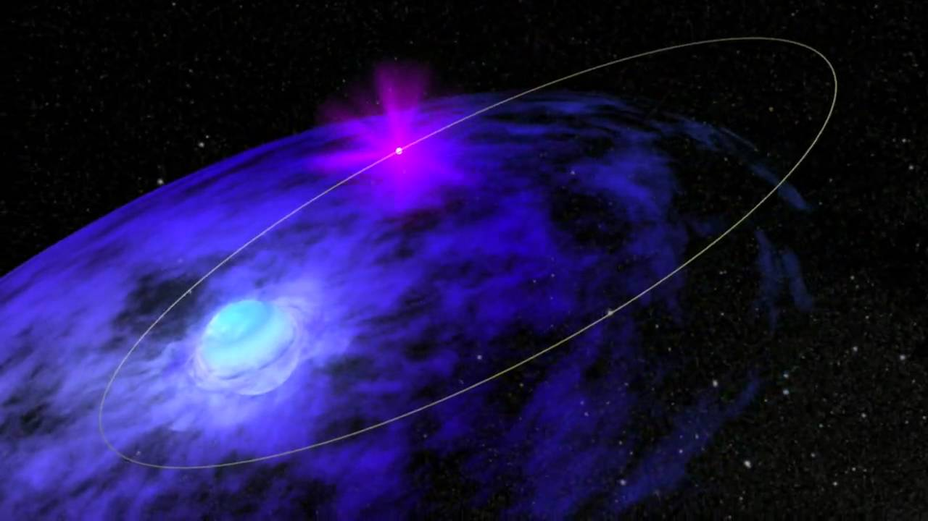
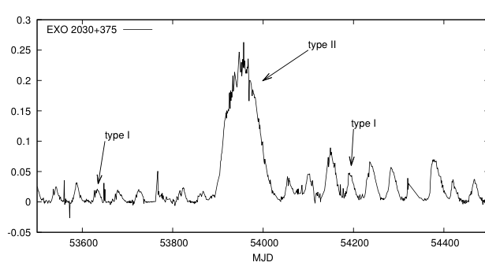
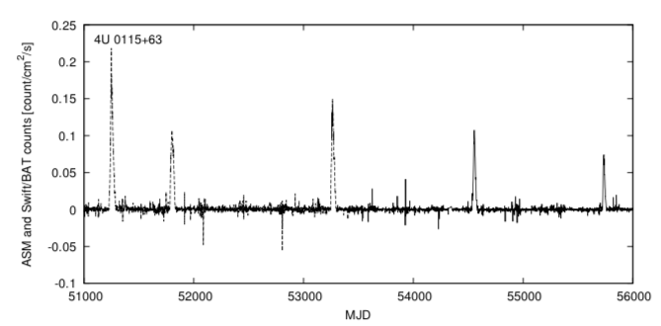
Be X-ray binaries
Type I (normal) outbursts:
- regular in occurrence and
generally associated with periastron passage of neutron
star.
- X-ray luminosity below 10³⁷ erg/s
Type II (giant) outbursts:
- appear less frequently and not associated with any
particular orbital phase.
X-ray luminosity > 10³⁷ erg/s
Last longer
Notes:
X-ray outbursts come in 2 flavours: type I and type II. Two example lightcurves from well-studied Galactic sources showing them:
Type I: - lower luminosities (order of 10^37 erg/s)
Regular in occurrence (typically on the timescales of the P_orb), so they’re associated with the periastron passage of the NS
Type II: - larger luminosities (> 10^37 erg/s)
They last longer as well, sometimes even last for several orbits of the NS and aren’t necessarily associated with any specific orbital phase
Different systems exhibit different behaviour when it comes to the occurrence of these outbursts – they depend on different factors (intrinsic Be disc properties and orbital parameters). These are two extreme examples here, where the 1 system shows regular occurrences of T1 outbursts with rare T2 outbursts and the other one does vice-versa (more T2 than T1s). Can get anything in between.

Slide 5
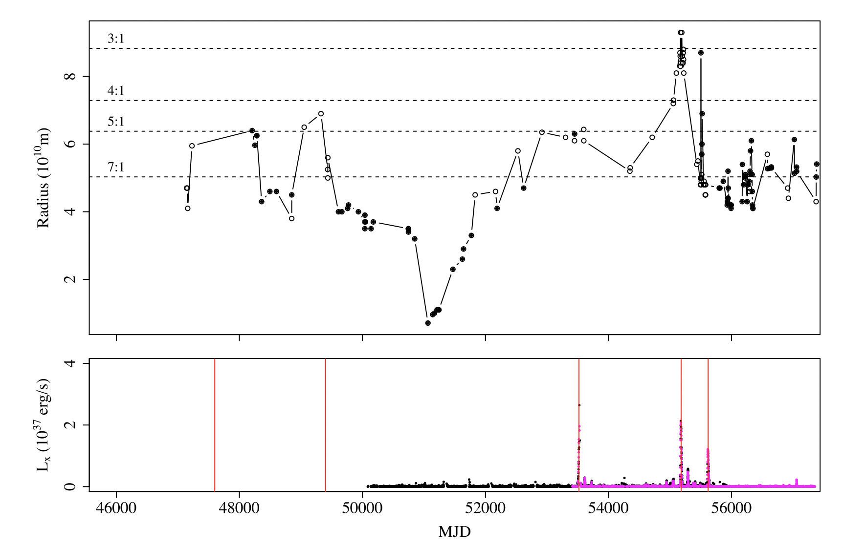
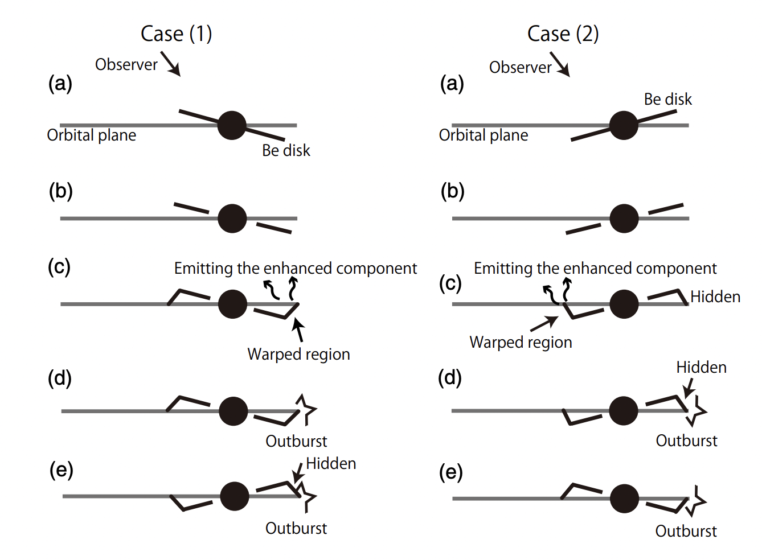
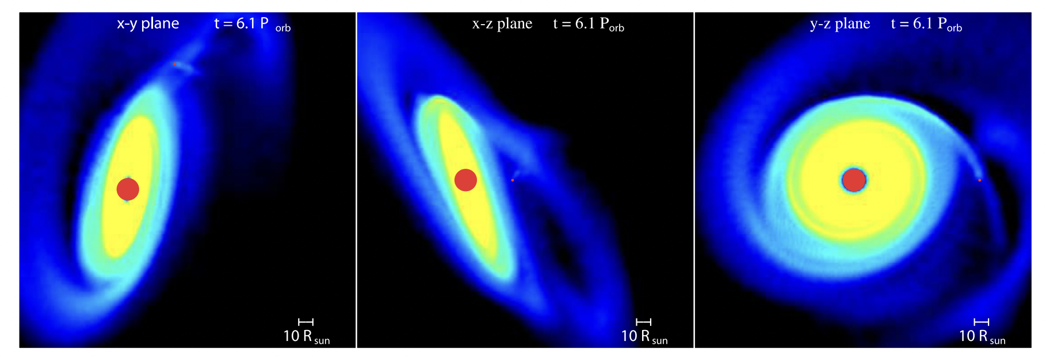
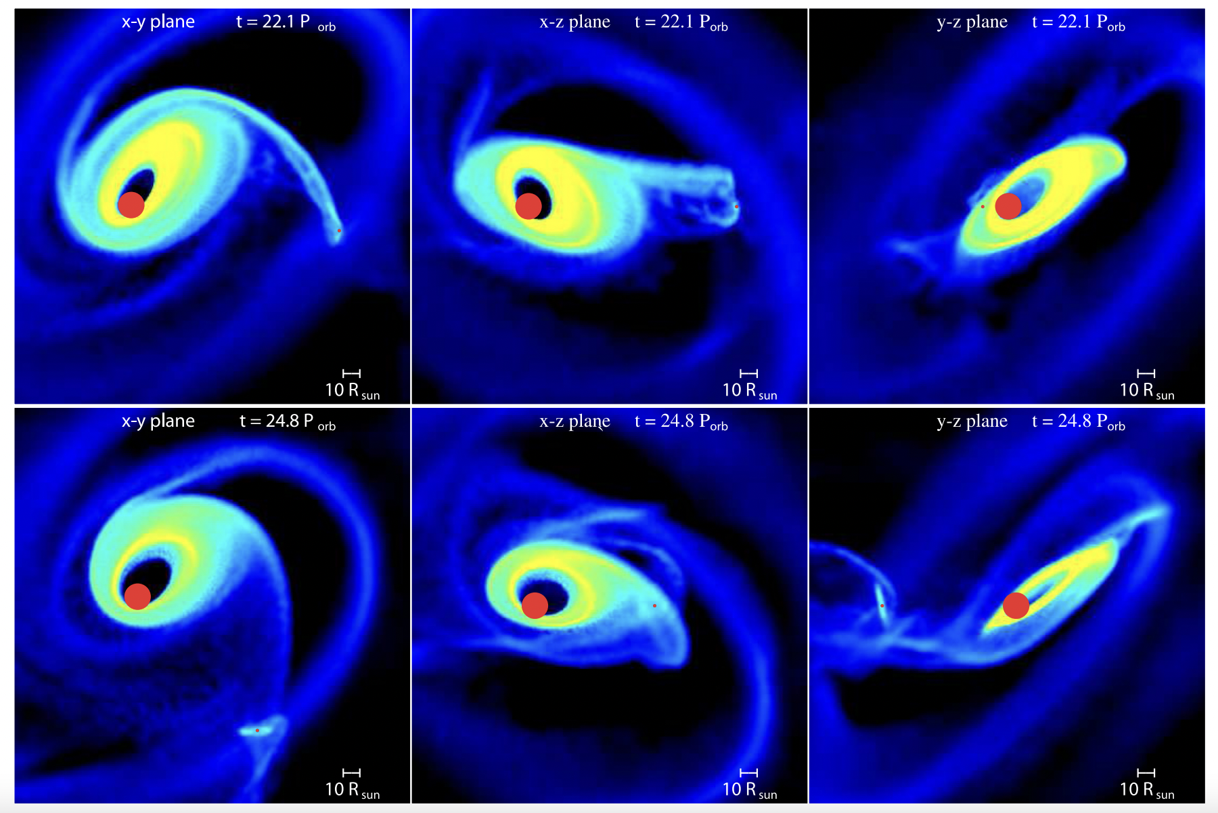
Origin of Type II/Giant outbursts?
Monageng et al. (2017)
Moritani et al. (2013)
Warped Be disc?
Eccentric Be disc?
Martin et al. (2014)

Slide 6
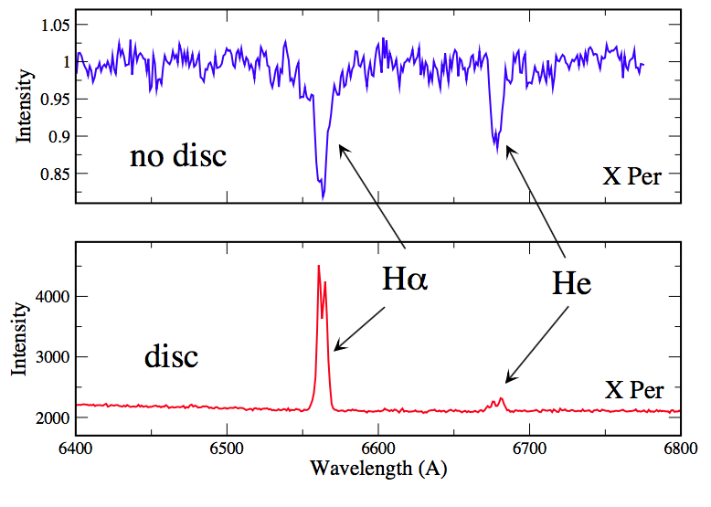
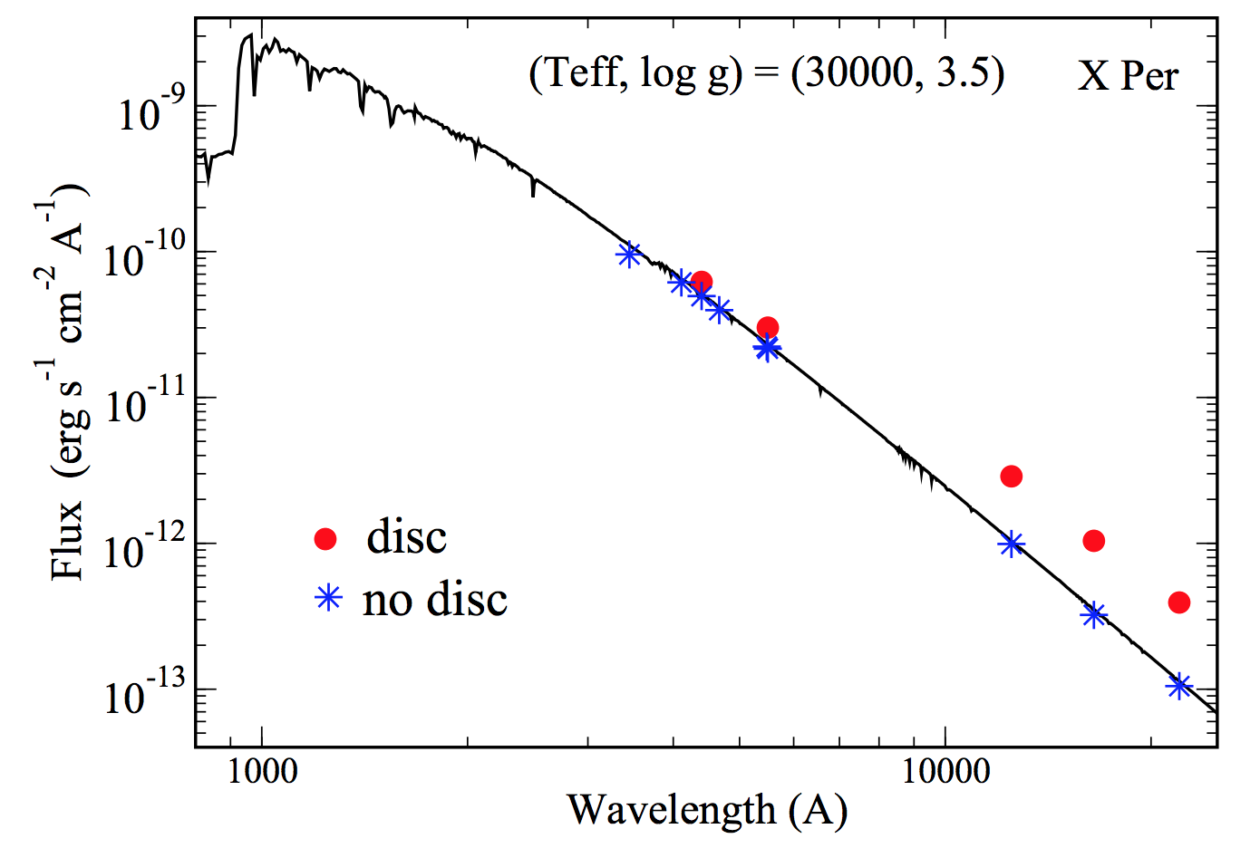
Be stars

Slide 7
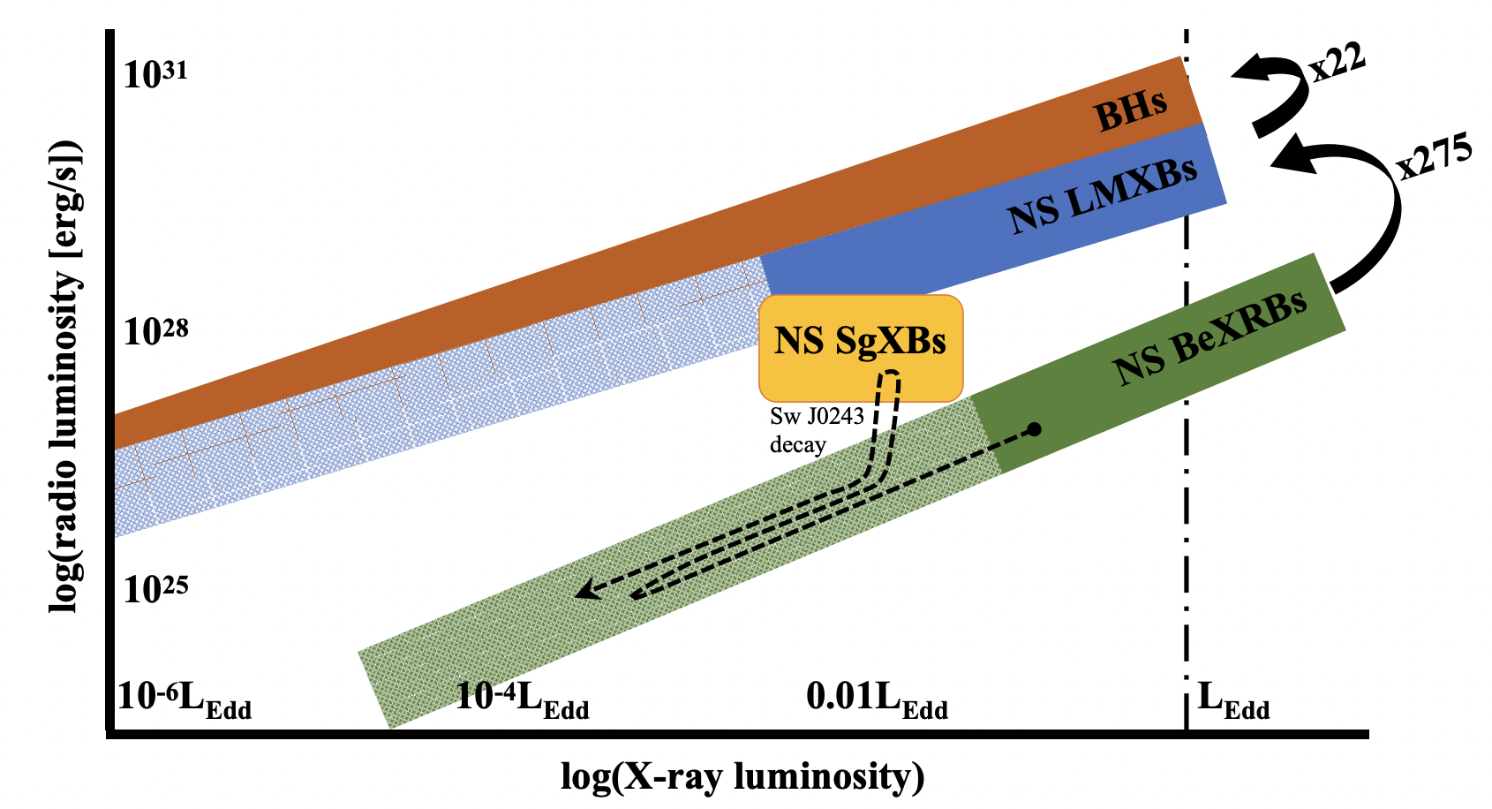
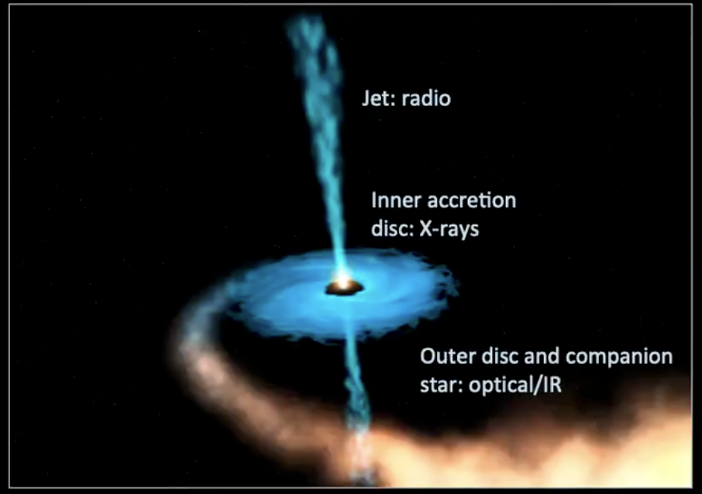
Radio emission from Be X-ray binaries
Radio detections from Galactic objects undergoing Type II outbursts
Quasi-simultaneous radio and X-ray observations show a consistent luminosity correlation
Similar to BH and NS LMXBs → coupling between inflow (X-ray) and jet outflow (radio).
Radio luminosity observed during Type II outbursts is weaker at the same X-ray luminosity than in LMXBs.
Radio emission interpreted as jet emission (alternative models proposed)
van den Eijnden et al. (2022)

Slide 8
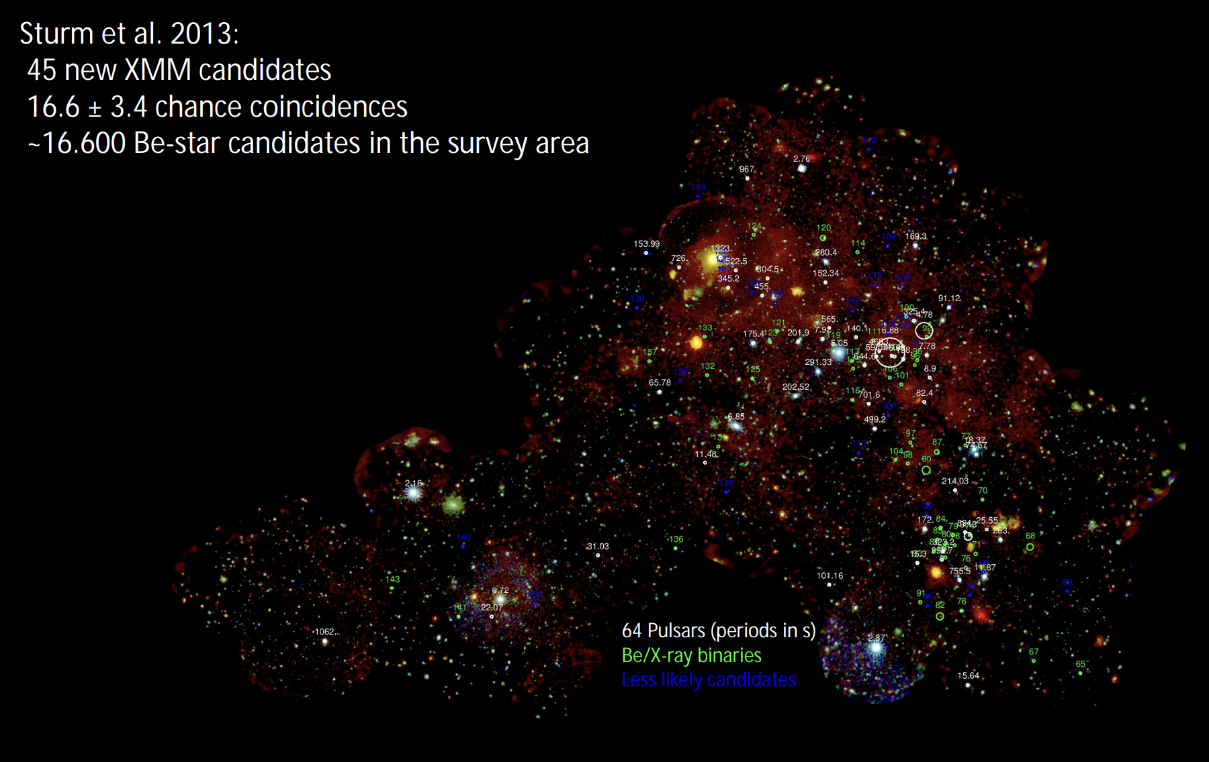
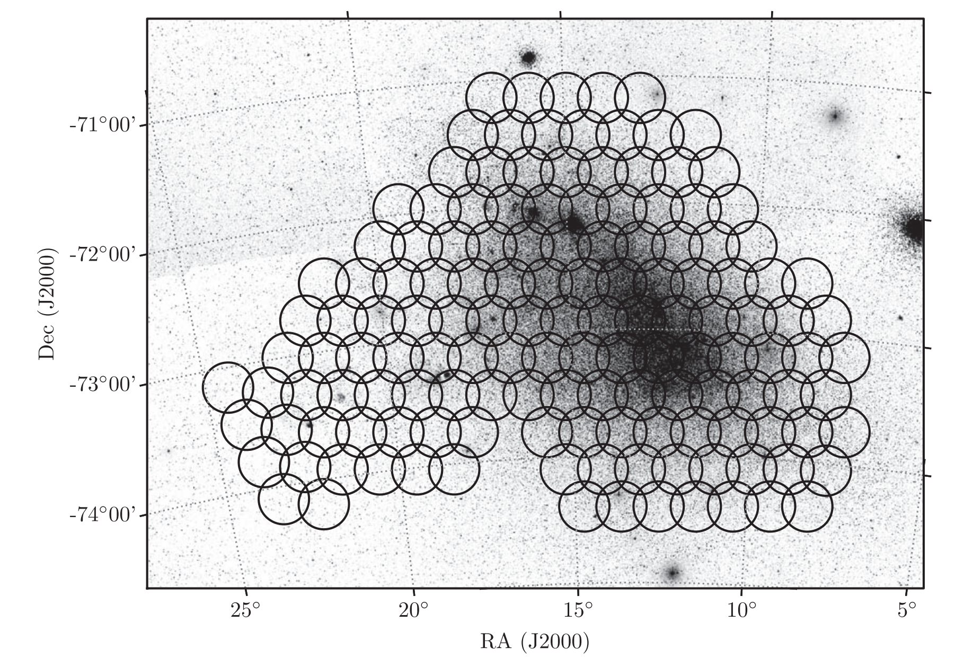
Be X-ray binaries in the SMC: S-CUBED
High-cadence, shallow X-ray survey.
142 tiles every week (60 s exposures per tile).
Discovery and monitoring of X-ray outbursts.
Kennea et al. 2018

Slide 9
The 2025 near-Eddington double X-ray outburst of SXP 31.0
Orbital period of 90.53±0.07 days and unknown eccentricity.
Pulse period of 31.0 s
Discovered in 1998 using RXTE during a Type II outburst.
Optical counterpart identified as a B0.5V – B1Ve star with IR excess.
H-alpha images revealed extended structure:
Supernova remnant?
Bow shock?
Ionised HII region?
Multiwavelength campaign using Swift XRT, UVOT, OGLE and SALT during a period of X-ray activity

Slide 10
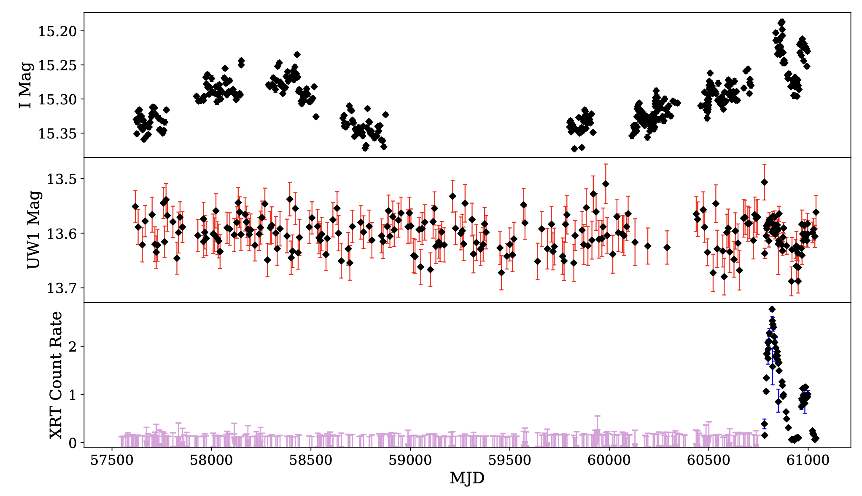
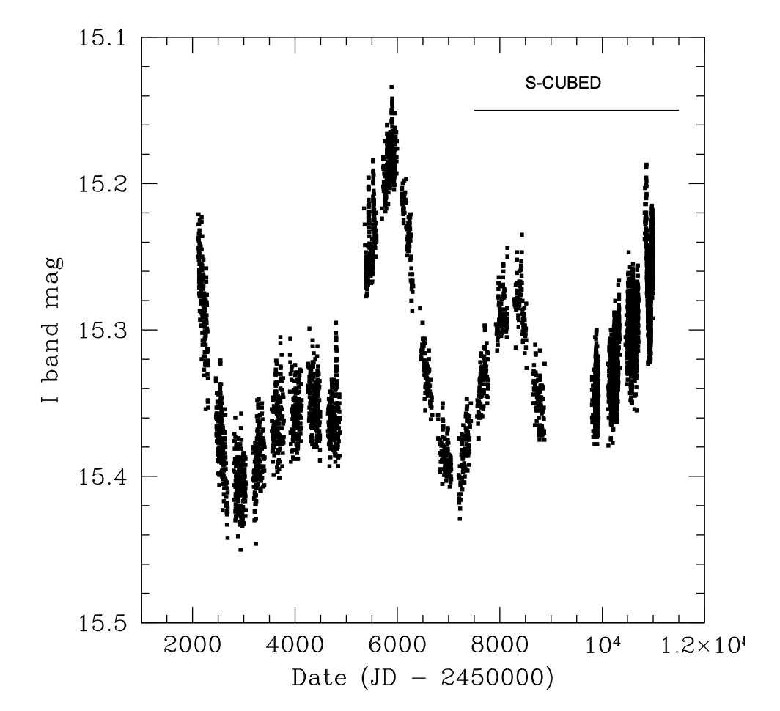
X-ray/UV/Optical photometric variability
Detected for the first time with SCUBED monitoring (after 9 years of monitoring). ToO requests followed with exposure times 1ks – 5ks.
UV and IR/optical brightness trace structural changes in inner and outer regions of the Be disc.
24 years of monitoring with OGLE I-band:
Long-term variability on timescales on years
Surprising lack of UV variability:
Non-global disc variability.

Slide 11
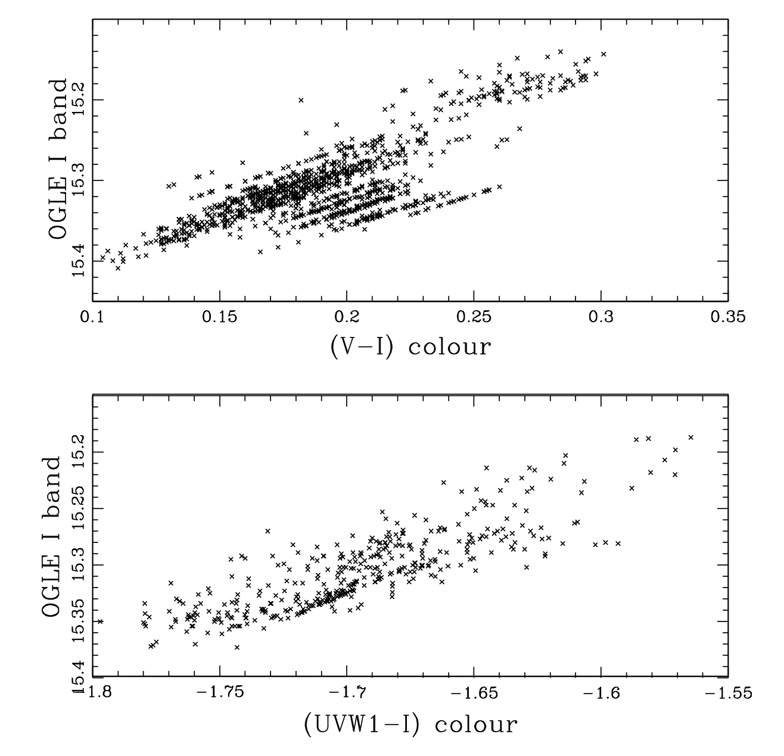
UV/Optical photometric variability
Long-term colour changes over time → Be disc temperature profile changes.
Strong correlation between colour and magnitude → intermediate/low inclination angle of the Be disc
Steeper rate of change of colour in (UVW1-I) than in (V-I) plot.

Slide 12
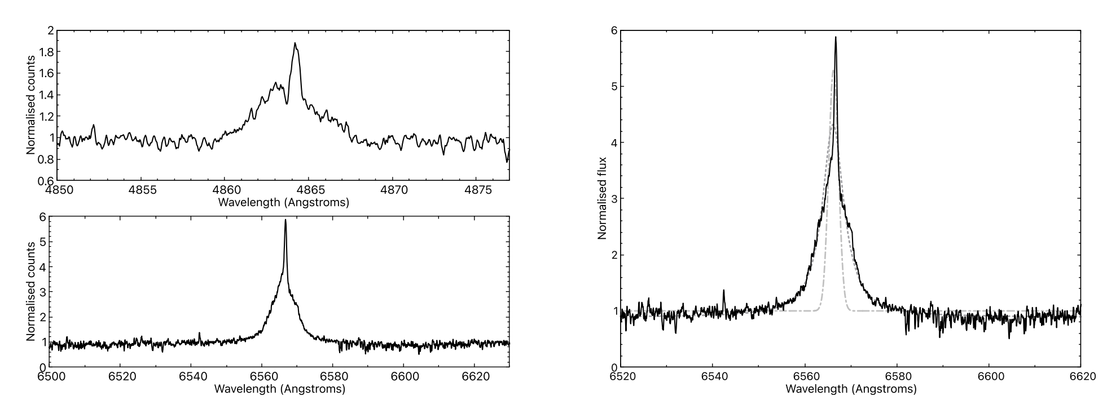
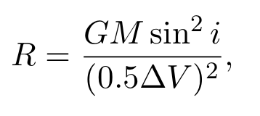
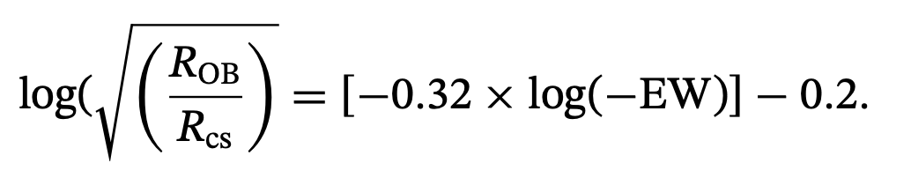
Spectroscopic variability (SALT)
Multicomponent emission line :
Narrow emission superimposed on broader component
Narrow emission likely originates from surrounding extended emission while the broad component is likely from the Be disc.
Disc size is comparable to neutron star semi-major axis:
Direct physical interaction between NS and Be disc
Tidal interaction temporarily enhances the disc surface area

Slide 13
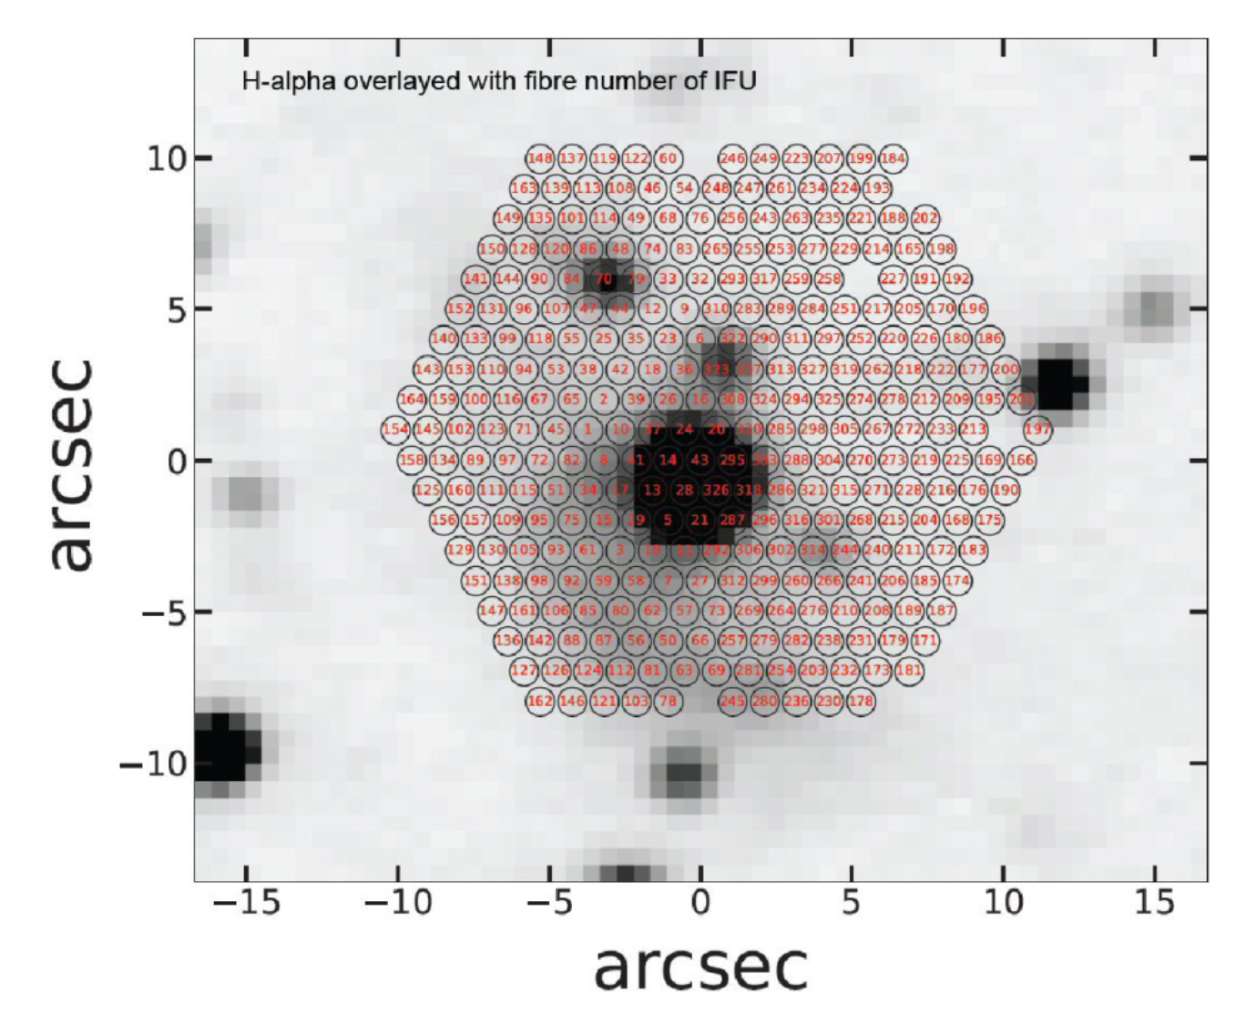
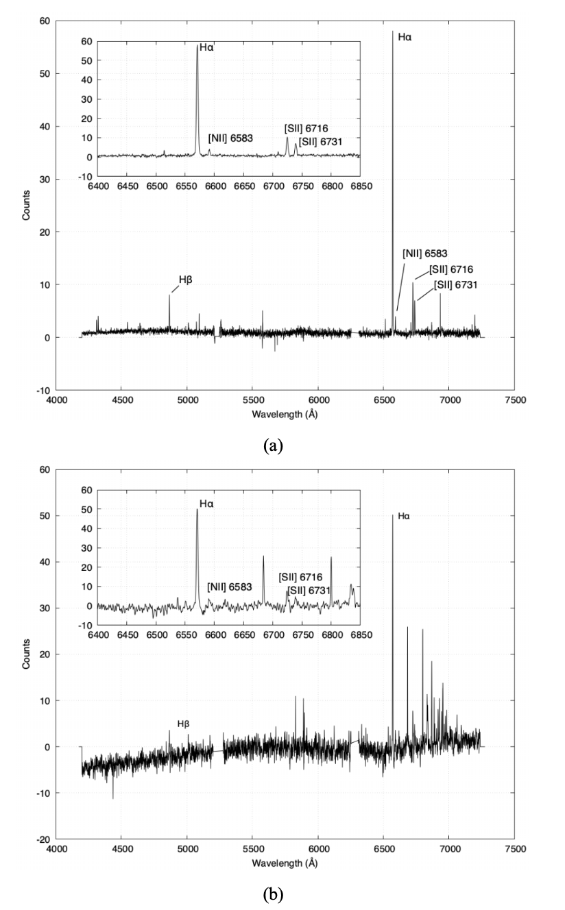
SALT imaging
Extended halo that dominates the SW of SXP 31.0
Slit Mask Integral Field Unit observations to investigate the nature of the extended halo:
Comparison of the [S II] and H-alpha emission lines.
[S II]/H-alpha ratio of 0.2 – 0.3, which strongly indicates that the emission is from an HII region (photoionisation) instead of supernova remnant or bow shock (shock excitation).

Slide 14
Summary
Enhanced X-ray activity of the SMC Be X-ray binary, SXP 31.0, for the first time in 26 years!
Unusual back-to-back Type II outbursts:
Possible multiple epochs of mass outflow from the Be star.
Accretion from an eccentric Be disc due to Kozai-Lidov oscillations?
Nature of the extended surrounding halo:
Chance coincidence with HII region (not due to SNR or bow shock)

