Slide 1
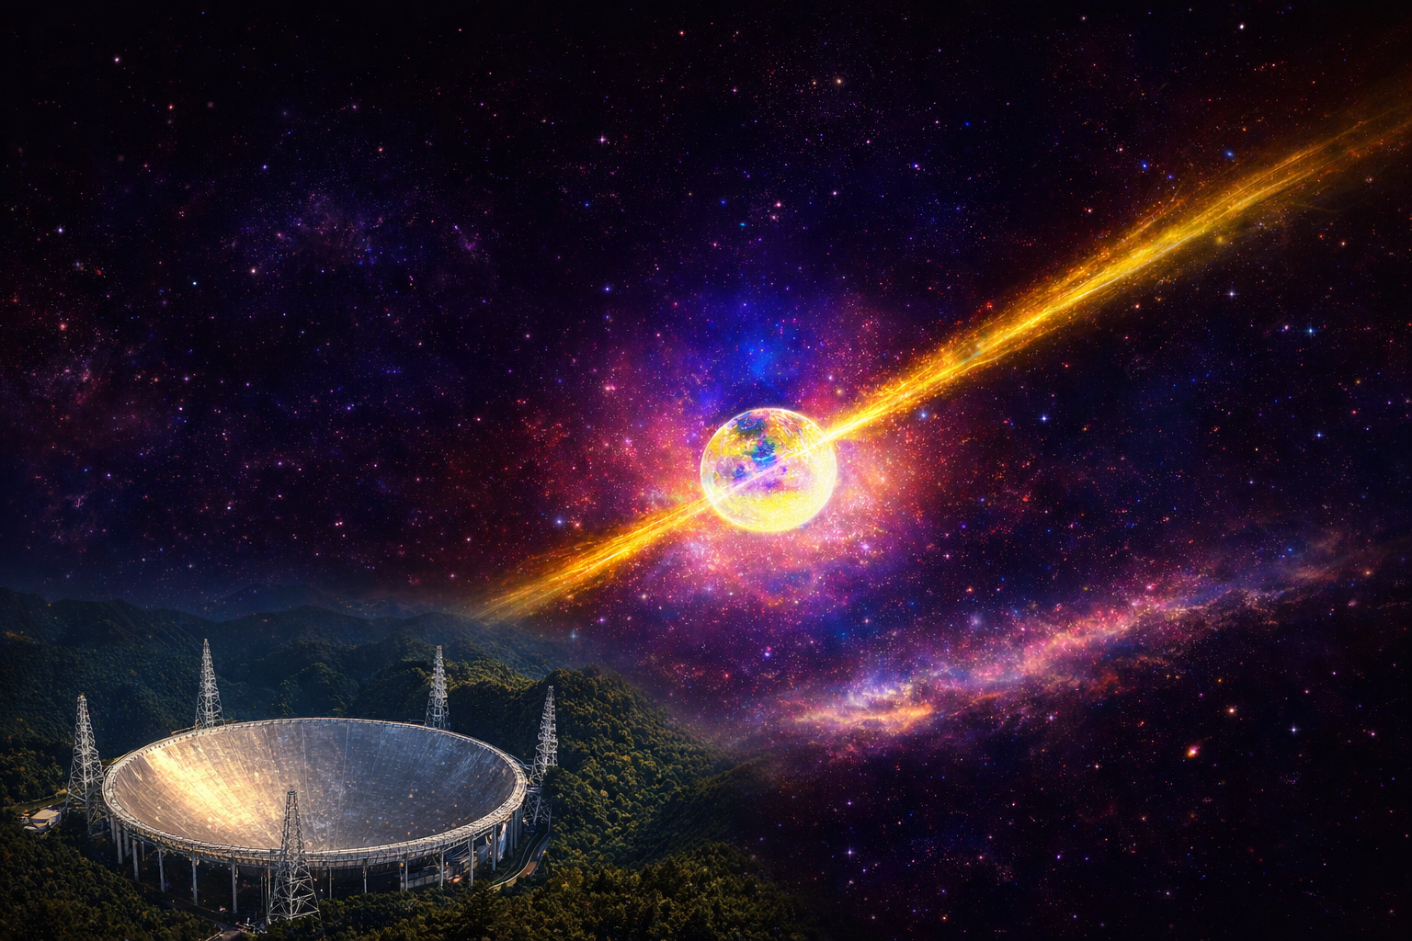
Multi-Faceted Emission Properties of PSR J2129+4119
Observed with FAST
Habtamu Menberu Tedila (Postdoc)
2026 - AfAS- Conference
Kasane, Botswana| March 25, 2026

Slide 2
Outline
Overview of the FAST Survey
Scientific Background and Motivation
Key Results
Summary

Slide 3
1. Overview of the FAST Survey

Slide 4
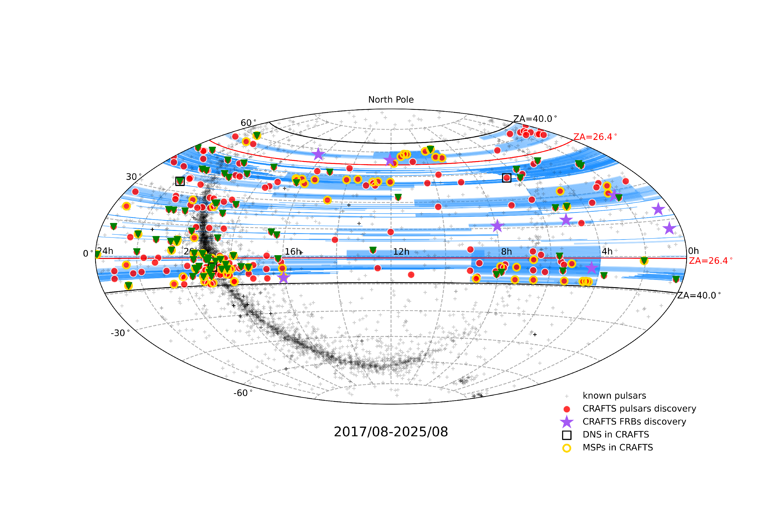
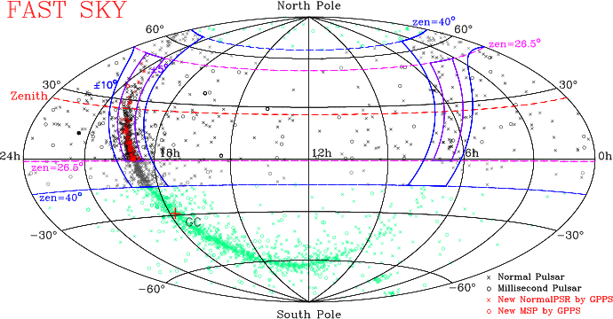

The Galactic Plane Pulsar Snapshot (GPPS) survey
Commensal Radio Astronomy FAST Survey (CRAFTS)
FAST 19 feed rotation angle
CRAFTS 23.4°
~ 35 % FAST Sky,
~ 26 % whole sky
~ 6397 deg²
^{Sensetivity ~ 0.1 mJy}
Spectral ~ 1 PB
Pulsar(2bit) ~ 2PB
(2bit compression W.W. Zhu)
Cedit: Pei Wang
2026 - AfAS- Conference
Kasane, Botswana| March 25, 2026

Slide 5
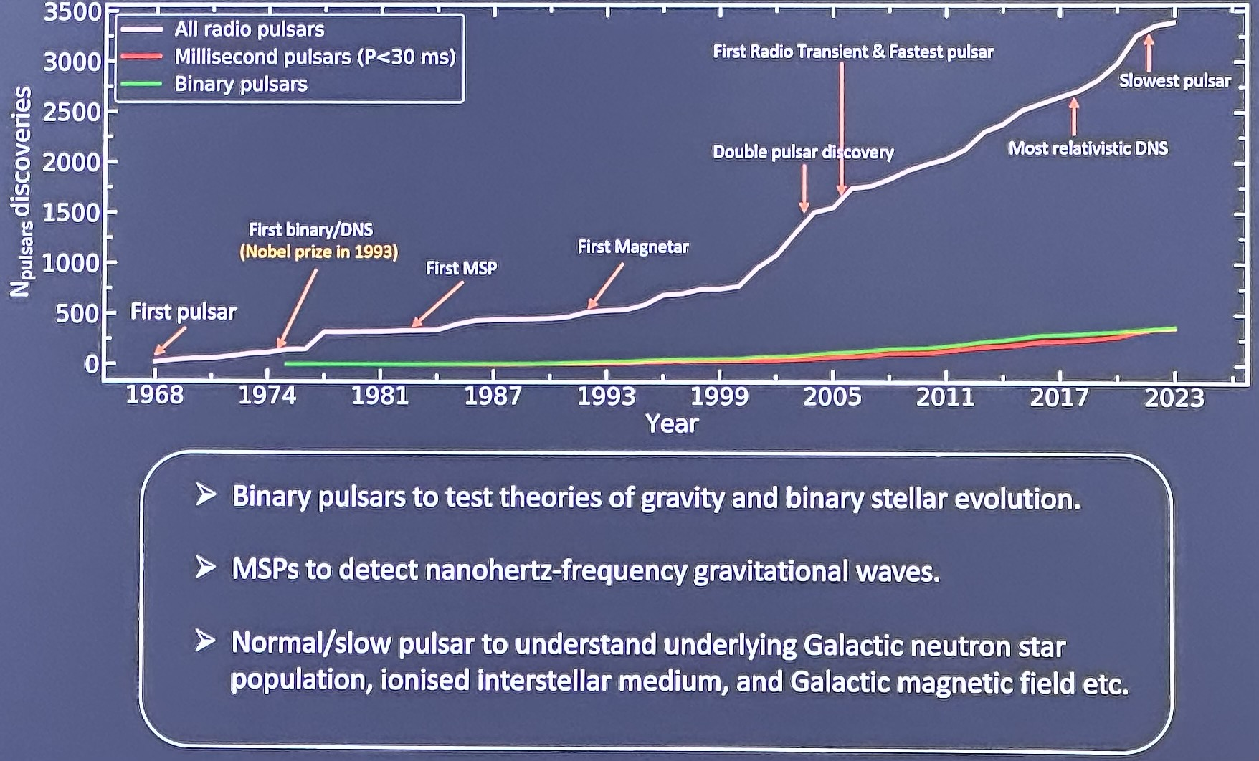
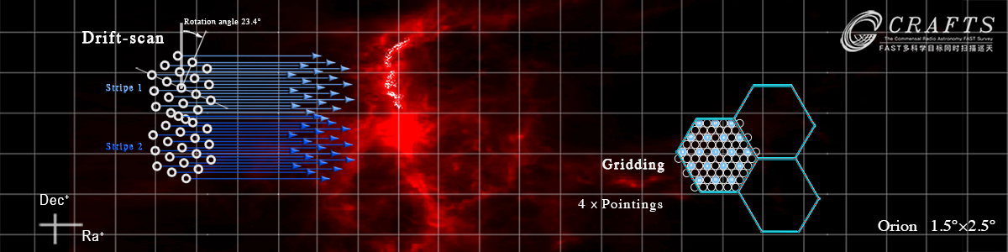
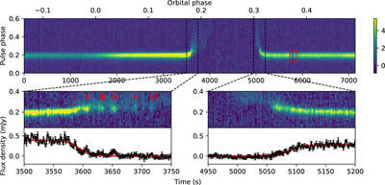


Pulsar discoveries from CRAFTS
Cedit: Pei Wang
Credit: Rahul Segal
Confirmed 222 New Pulsars Discovery
~80 Pulsars have full time solution
International collaborative pulsar timing
65 MSPs (21 Binary（including 3 DNS)）
~35 RRATs
~122 Pulsars were Published
CRAFTS Catalog & Data Release
http://crafts.bao.ac.cn/pulsar/
https://fastro.scidb.cn/en
86GB+，7 datasets
100,000 Views，5200+ Downloads
>200 Citation，from 20+ Countries
Eclipse of Black Widow Pulsar PSR J1720−0533
2026 - AfAS- Conference
Kasane, Botswana| March 25, 2026

Slide 6
2. Scientific Background and Motivation

Slide 7
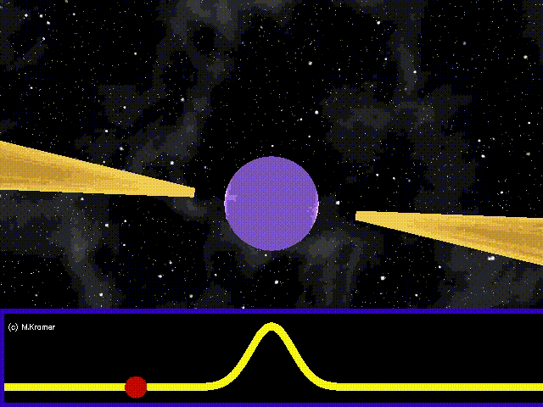
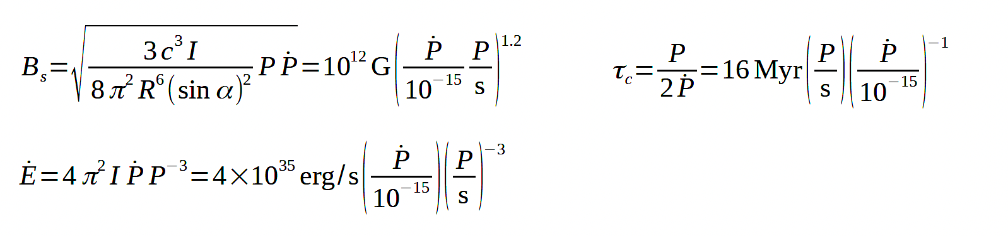
Canonical Pulsar properties
Pulsar rotation slows with time
In rotation power pulsars this is the primary source of energy
In magnetars magnetic field decay powers high energy emission
By assuming pulsars radiate like dipoles in a vacuum certain properties can be inferred
Credit: M. Kiramer
Harding, 2022
2026 - AfAS- Conference
Kasane, Botswana| March 25, 2026

Slide 8
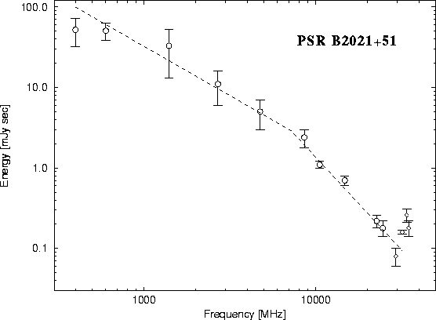

Pulsar emission
Pulsars emit continuously over wide bandwidths
Spectra generally follow a power law
$S_{v}$ $∝$ $v^{α}$ $α ≈$ −1.6
A Pulsars are fainter at higher frequencies
Most pulsar observations are performed from tens of MHz to few GHz
Atmospheric opacity fairly low.
Can tolerate larger surface, pointing,
and focusing errors than at higher frequencies
Credit: NRAO
2026 - AfAS- Conference
Kasane, Botswana| March 25, 2026

Slide 9
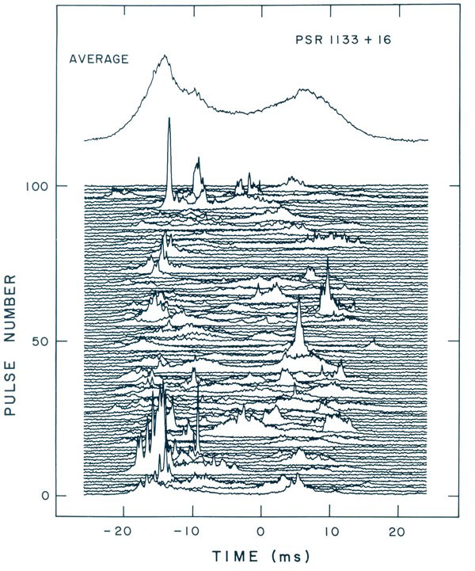
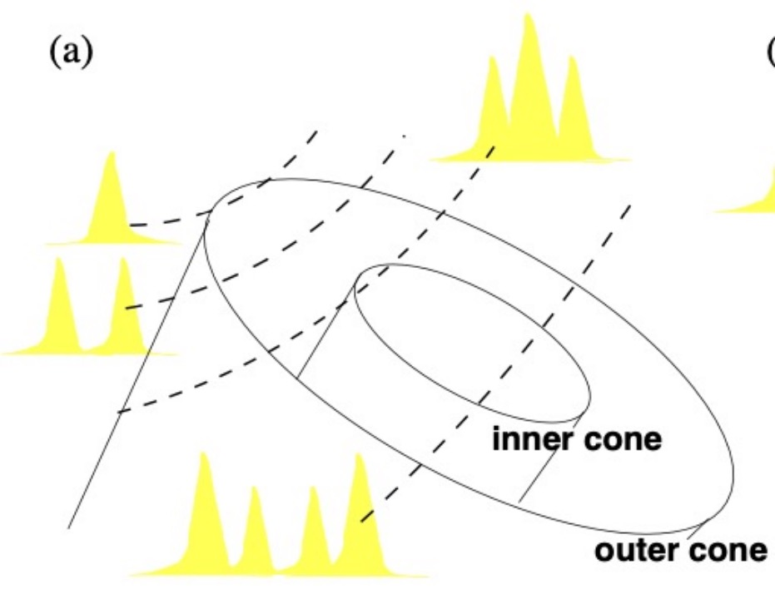
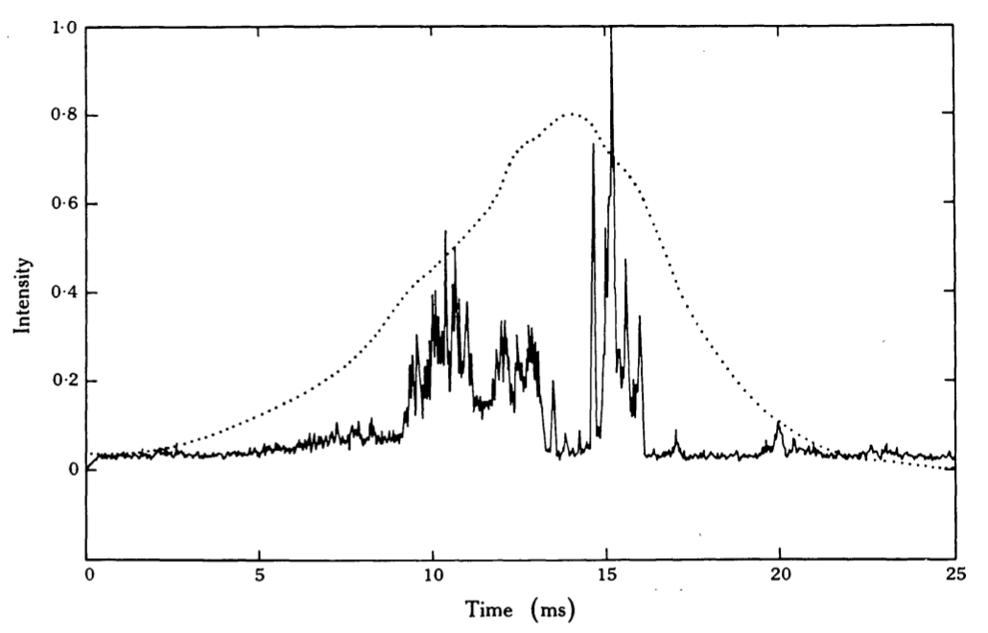
Pulsar emission
﻿Wide variety of pulse shapes are observed
Can be explained in hallow-cone emission beams model (Lyne et al., 2012)
Individual pulse shapes vary
﻿Averaged pulse profiles:
average over many single pulses.
stable over long time, and unique to the pulsar
Core-cone beam models, Rankin,1993
Microstructure pulses
Pranab Ghosh, 2006
2026 - AfAS- Conference
Kasane, Botswana| March 25, 2026

Slide 10
Open scientific questions
Why do long-period pulsars remain radio-loud?
What drives transitions between active emission states?
What do single-pulse structures reveal about magnetospheric plasma?
How do emission geometry and polarization constrain radio emission models?
How do scintillation and dynamic spectra shape observed pulsar emission?
2026 - AfAS- Conference
Kasane, Botswana| March 25, 2026

Slide 11
3. Key Results

Slide 12
PSR J2129+4119
Discovered: 2017 Oct 10 during CRAFTS pilot scans
Rotation period: 1.69 s; Age: 343 Myr:
DM = 31 pc cm⁻³, DM distance = 1.9 kpc (NE20001)
Near death line → laboratory for weak emission physics.
Single-pulse observation: 2024 Sep 29, 1 hr. at 1.25 GHz
Bandwidth: 400 MHz, 1024 channels
Resolution: 49.152 μs, 0.488 MHz
R = 89.19%
W = 2.68%
N = 8.13%
R = 89.19%
W = 2.68%
N = 8.13%
2026 - AfAS- Conference
Kasane, Botswana| March 25, 2026

Slide 13
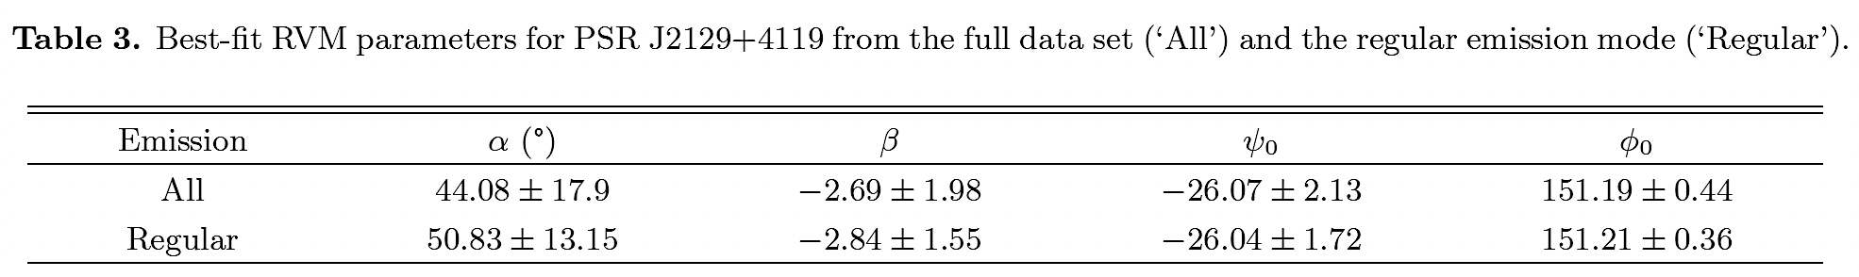
Bright pulses
The average polarimetric profiles
Peak intensity > 10× mean profile intensity
Two bright pulses detected at the trailing component.
Emission height ≈ 178 km (0.23% of light cylinder radius).
2026 - AfAS- Conference
Kasane, Botswana| March 25, 2026

Slide 14
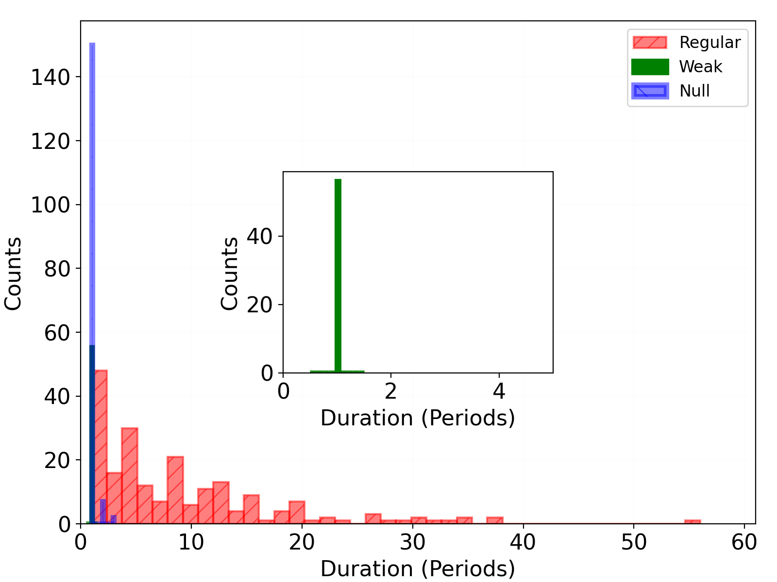
Pulse durations and waiting times
Dominant State:
Regular emission is persistent
Weak Emission:
Isolated single pulses
Nulls:
Mostly short sequences
Occasional longer intervals
2026 - AfAS- Conference
Kasane, Botswana| March 25, 2026

Slide 15
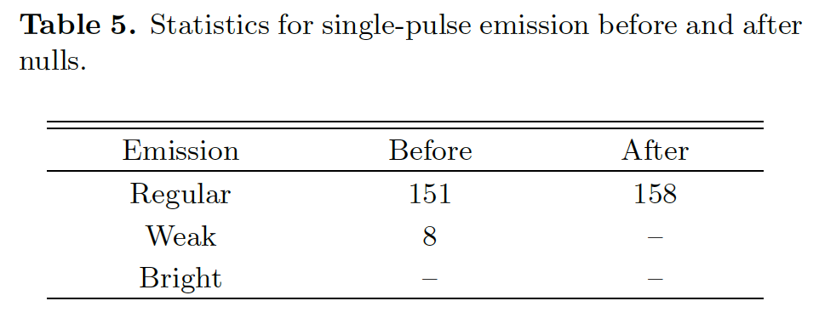
Emission variability near nulls
Regular pulses:
Strengthen after nulls (gradual magnetospheric reactivation)
Asymmetric profiles
Weak emission:
Fewer before-null events/no pulses pre-nulls.
Irregular profiles (variable magnetospheric conditions)
2026 - AfAS- Conference
Kasane, Botswana| March 25, 2026

Slide 16
Quasi-periodic microstructure
64% show microstructure
11.5% show quasi-periodicity
Microstructure:
Separation (P_{μ}): 4.57 ms
Width (τ_{μ}): 4.30 ms
Possible origins:
Wave-particle interactions
Coherent emission processes
2026 - AfAS- Conference
Kasane, Botswana| March 25, 2026

Slide 17
Frequency-dependent pulse profile variations
* These changes suggest that different emission regions within the pulsar magnetosphere may dominate at different frequencies
2026 - AfAS- Conference
Kasane, Botswana| March 25, 2026

Slide 18
Dynamic Spectrum
Strong intensity modulation across time & frequency,
Δν_{d} = 0.886 ± 0.015 MHz
Δt_{d} = 3.715 ± 0.062 minutes
Secondary spectrum
Clear parabolic arc.
Curvature η = 0.342 ± 0.072 μs/MHz².
Indicates thin scattering screen.
Interstellar Medium Interpretation
Screen distance d_{scr} ~ 0.1 kpc.
Likely at edge of Local Bubble.
Anisotropic small-scale ISM turbulence.
2026 - AfAS- Conference
Kasane, Botswana| March 25, 2026

Slide 19
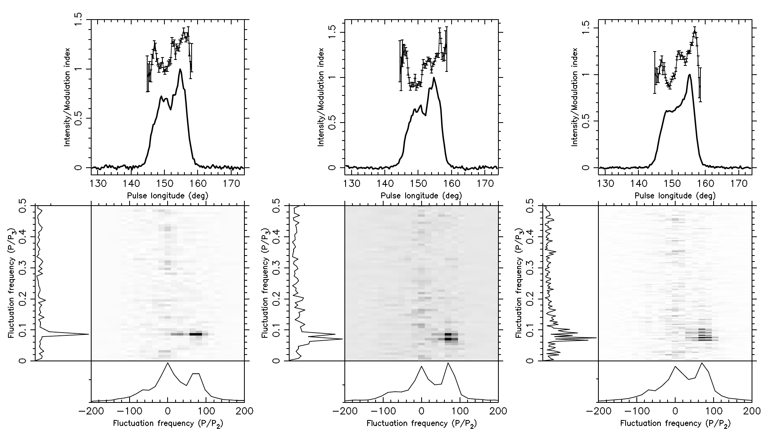
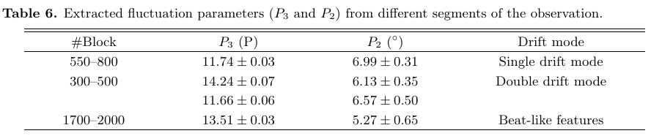
Subpulse drifting
The Sliding two-dimensional fluctuation spectrum (S2DFS)
• Regular drift bands imply a stable, organized magnetosphere.
• Carousel-like circulating sub-beams indicate sustained E×B drift above the polar cap.
The two-dimensional fluctuation spectrum (2DFS)
2026 - AfAS- Conference
Kasane, Botswana| March 25, 2026

Slide 20


PSR J2129+4119 and the Pulsar Population
Death lines: boundaries where pair cascades fail → radio quiet.
Traditional death line: $\dot{E}$ ≈ 1.53×10³⁰ erg s⁻¹ (vacuum gap model).
PSR J2129+4119 lies near/beyond this boundary → challenges traditional models.
Excludes: CR-V and ICS-V frameworks (Zhang et al. 2000).
Twisted polar-cap magnetic fields may also support radio emission (CR93, Szary & van Leeuwen 2017).
2026 - AfAS- Conference
Kasane, Botswana| March 25, 2026

Slide 21

4. Summary
PSR J2129+4119 challenges classical theory
- Rich multi-state emission
- Coherent emission persists near pair-production threshold.
FAST enables unprecedented insights
- Detects weak and extreme emission modes
https://doi.org/10.3847/1538-4357/ae230d,
habta125@gmail.com
habtamu.tedila@mcgill.ca
Thank you for your attentions!

