Slide 1
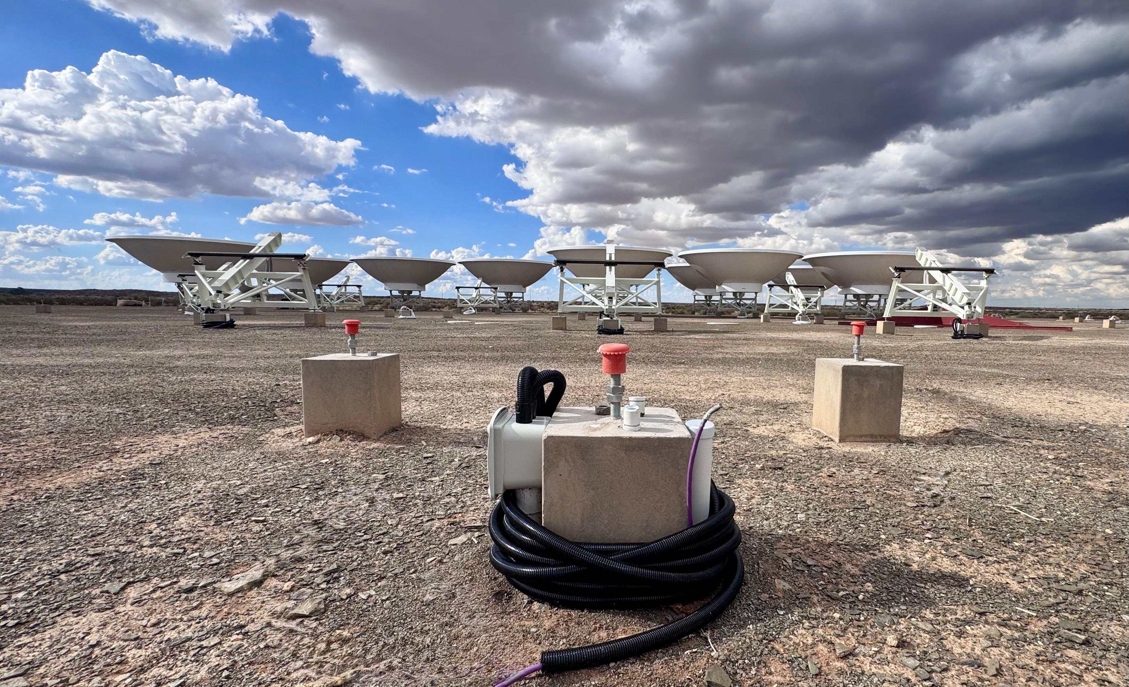


Dark Energy (and FRBs) with HIRAX 21cm Intensity Mapping
Kavilan Moodley
Astrophysics Research Centre, UKZN
African Astronomical Society 2026 Conference Kasane, Botswana
23 March 2026

Slide 2
Overview
Dark energy with baryon acoustic oscillations (BAOs)
Measuring BAOs via 21cm intensity mapping
The HIRAX telescope
HIRAX BAO cosmology forecasts
Fast radio burst detection and localisation with HIRAX

Slide 3
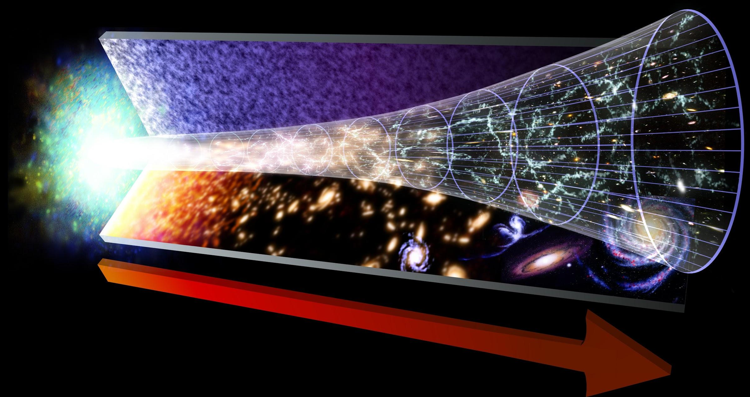
Cosmic History
RADIATION
DOMINATES
MATTER
DOMINATES
DARK ENERGY
DOMINATES
BIG
BANG
UNIVERSE
EXPANDS
STRUCTURE FORM AS
IRREGULARITIES GROW
EXPANSION
ACCELERATES

Slide 4
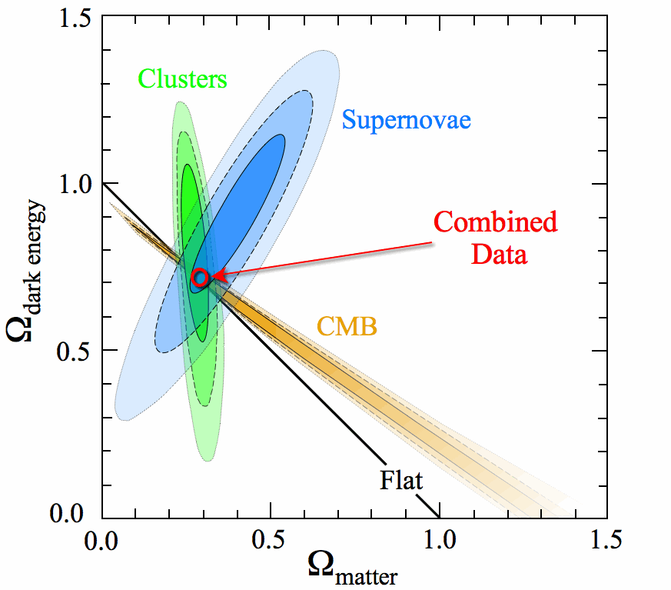
Cosmic Concordance

Slide 5
Cosmic Composition

Slide 6

The
cosmological
constant?

Slide 7
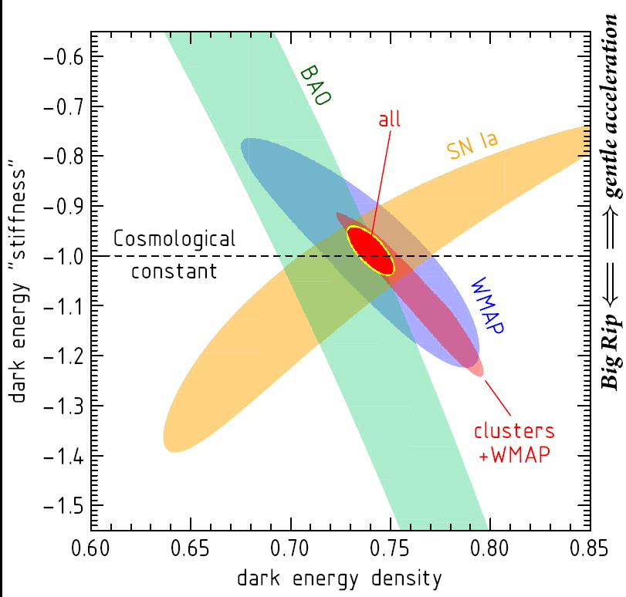
Dark Energy Key Probes
Type 1a supernovae: measure luminosity distance DL(z)
Cosmic lensing: measure growth factor G(z) in combination with angular diameter distance DA(z)
Galaxy clusters: measure growth factor G(z) and comoving volume dV(z) ~ DA²(z)/H(z)
Baryon acoustic oscillations: measure angular diameter distance DA(z) and Hubble parameter H(z)
Vikhlinin et al 2009

Slide 8
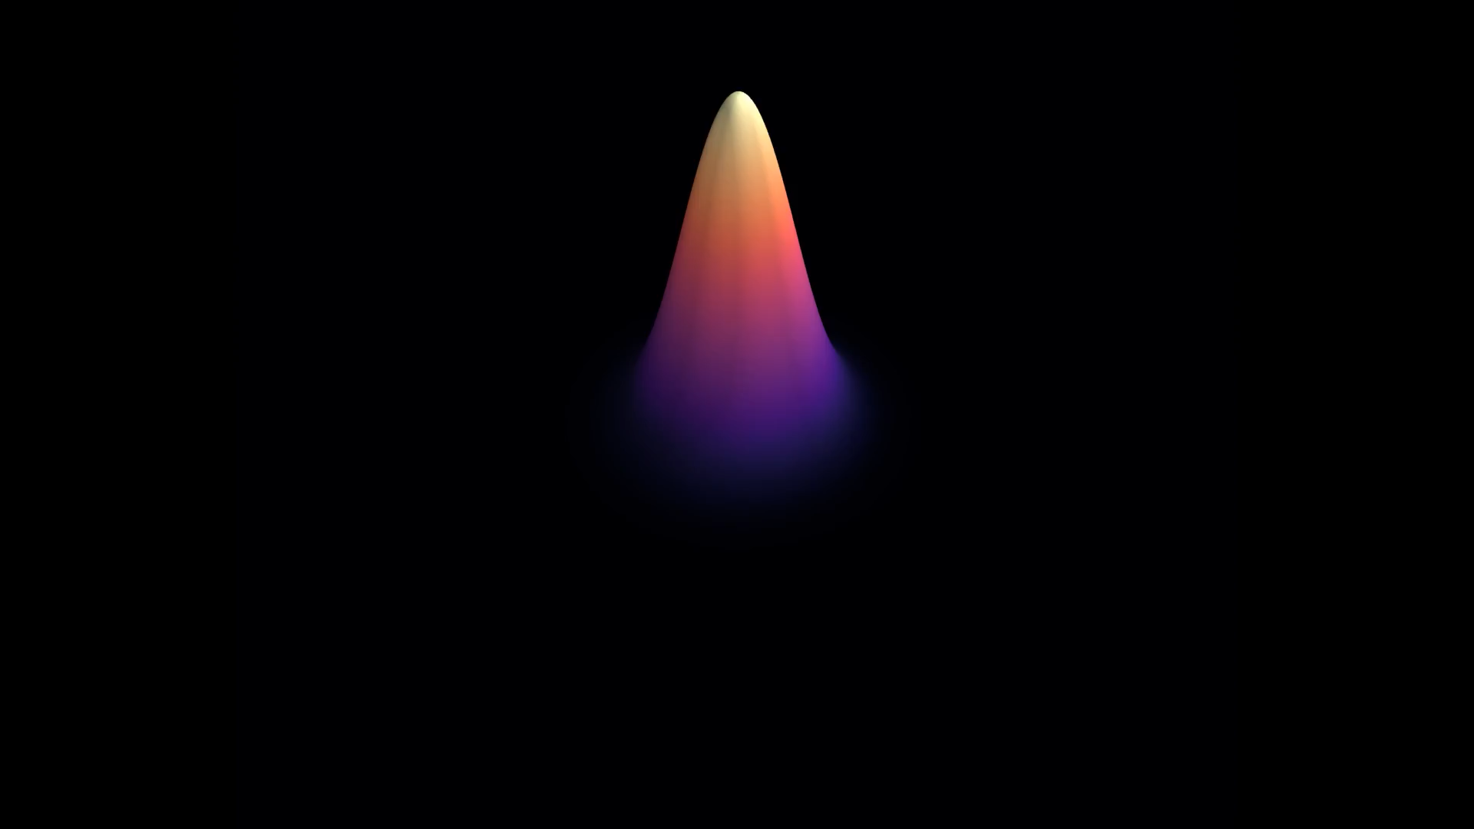
Baryon Acoustic Oscillations

Slide 9
Dark Energy with BAOs
Galaxy positions trace acoustic waves from the early universe: sound horizon sets characteristic 150 Mpc scale - standard ruler
Measure galaxy positions -> see ripples in the power spectrum, peak in the correlation function
DR12 release from SDSS-III shown below, redshift range 0.2 < z < 0.75

Slide 10
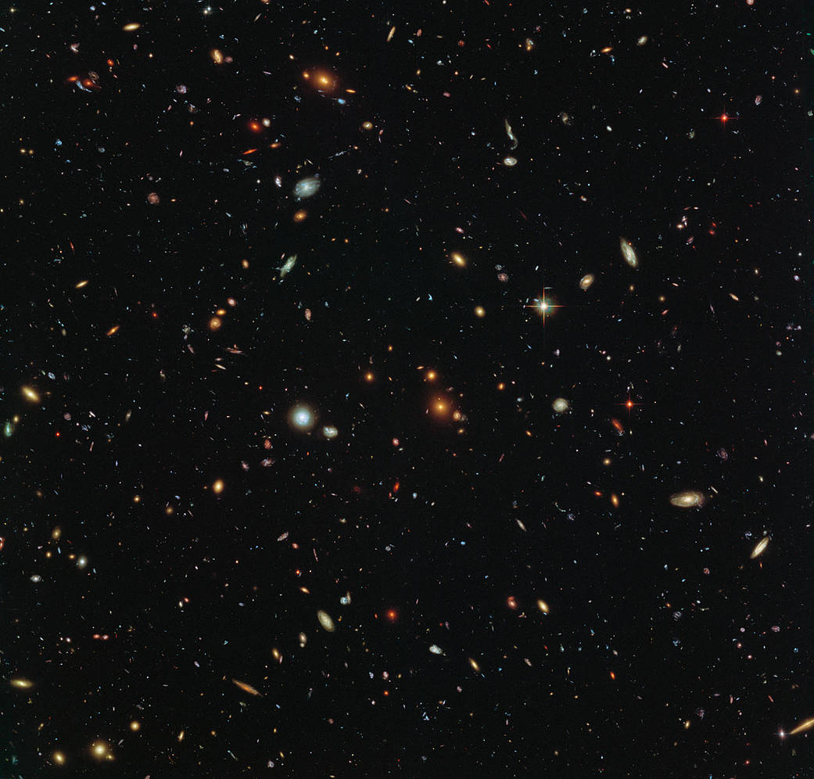
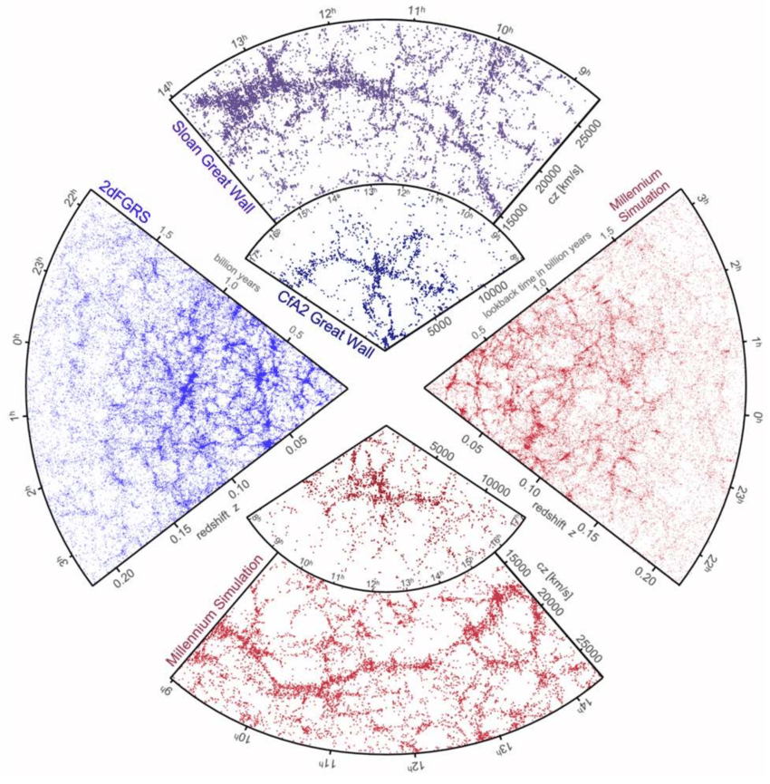
Galaxies trace Matter Distribution
Credit: Springel et al 2006
Credit: NASA

Slide 11
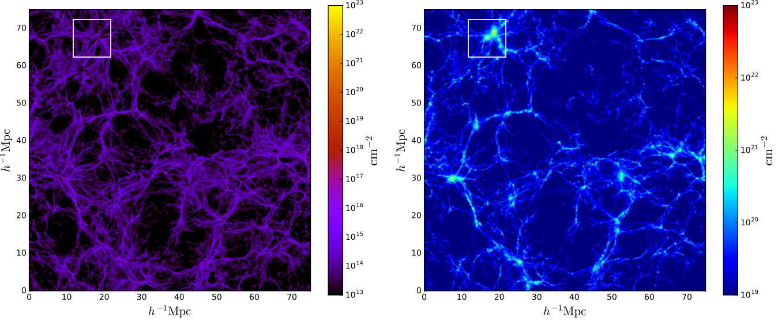
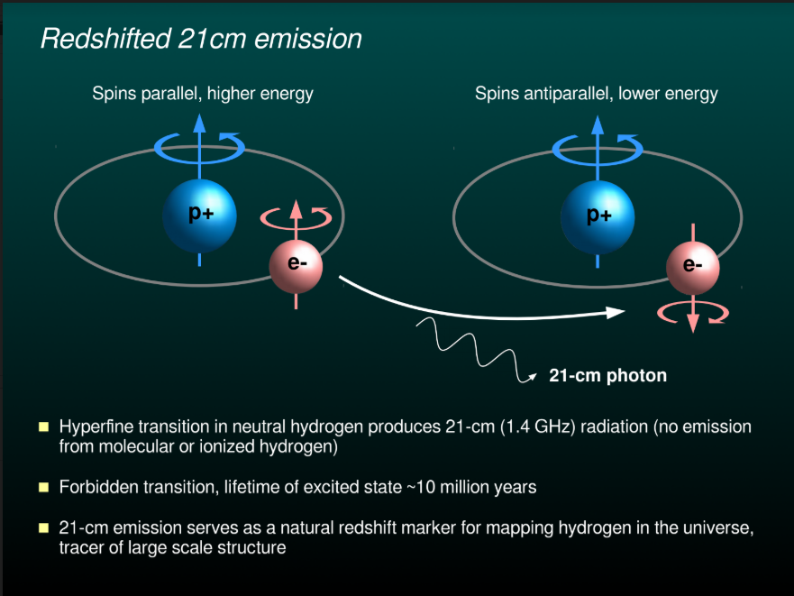
Hydrogen in Galaxies Traces Matter Distribution
TOTAL GAS
NEUTRAL HYDROGEN
Villaescusa Navarro
et al 2018
Track Hydrogen
via the 21cm Line

Slide 12

BAOs with 21cm Intensity Mapping
Sound wave imprint from recombination has a characteristic 150 Mpc scale (1 degree) - large
Require large volumes (large sky area and z range)
Counting individual galaxies & getting to high redshift is challenging
Throw away spatial resolution: use HI intensity mapping to measure matter distribution AND obtain redshift information.
Use the BAO peak as a standard ruler for charting the expansion history.

Slide 13
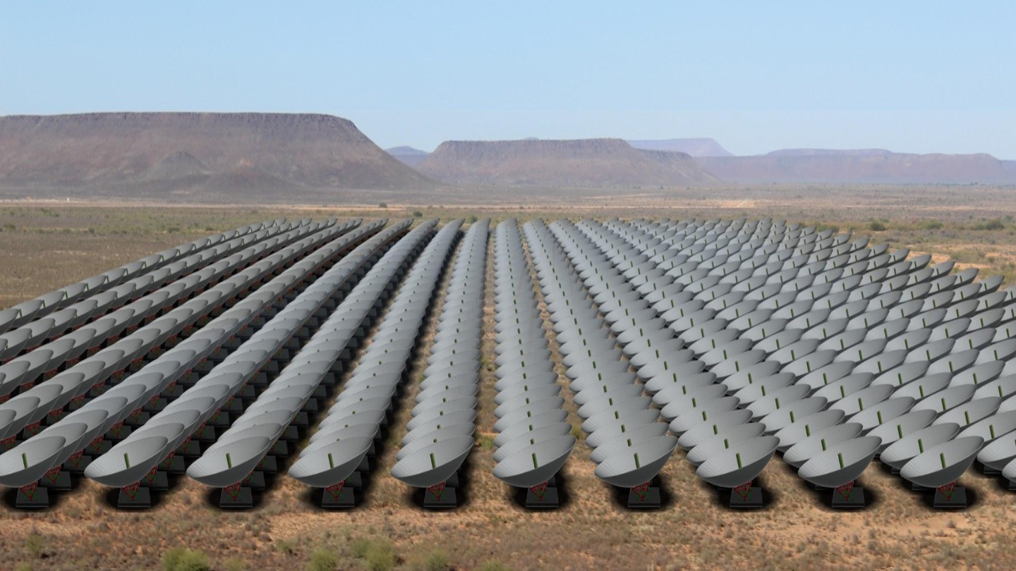
Designing a 21cm Intensity Mapping
Dark Energy Telescope
Maximise sensitivity on scales of interest -> Use compact array geometry
Redshift range: 0.8 < z < 2.5 to capture dark energy domination at z ~ 1 and sufficient volume -> Required frequencies: 400 - 800 MHz
BAO 150 Mpc angular scale: 3 - 1.3 degrees at 0.8 < z < 2.5 -> Required interferometer baseline lengths: 15 - 60 metres
BAO scale along line of sight: 20 - 12 MHz at 0.8 < z < 2.5 -> Required frequency resolution: 100 channels, more for foregrounds and higher order peaks
BAO signal level: ~ 0.1 mK -> Low system temperature, large collecting area (lots of elements)

Slide 14
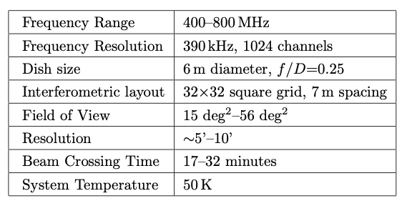
The Hydrogen Intensity mapping and Real time Analysis eXperiment (HIRAX)
→0.21
Newburgh et al (1607.02059)
A compact array of 1024 six metre dishes operating at 400-800 MHz
Scalable array built in stages: 2, 8, 128 (funded), 256 to retire key risks at each stage, then expand to 1024 dishes and operate full array for 4 years
Dishes stationary but can tilt for more sky area, fabrication in South Africa
Back-end: overlap with CHIME - channelize with FPGA ICE boards, correlation with GPUs

Slide 15

Collaboration and Funding
https://hirax.ukzn.ac.za/
UKZN and South African NRF flagship funding secured for site infrastructure and pathfinder array. SARAO providing site, power and data.
Swiss SNF funding secured for 512 channel X-engine (GPU correlator) and Science Data Processing system. McGill funding for F-engine up to 512 channels (ICE boards).
NRF strategic research equipment (SRE) funding secured to expand pathfinder array.
First phase with additional funding from the Simons Foundation to build up to 128 dishes.

Slide 16
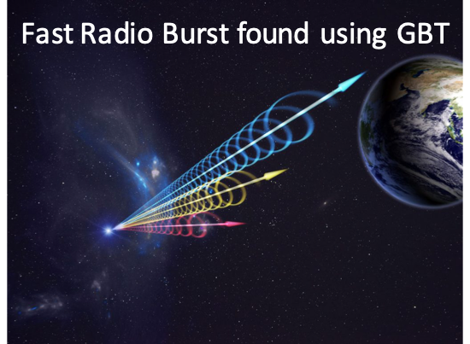
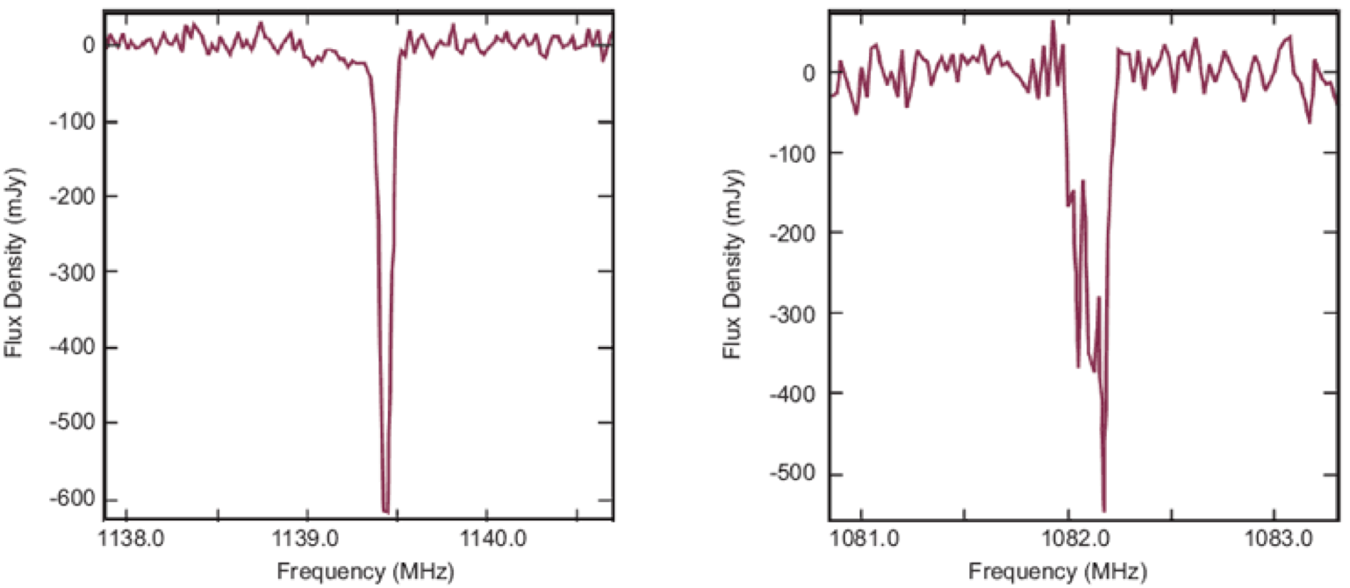
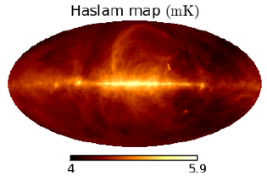
HIRAX Science Goals
Measure BAOs with 21cm intensity mapping: characterise dark energy
Cross-correlation with other cosmological surveys
Radio transient searches, slow and fast
Fast radio bursts (FRBs)
Pulsar searches: 15 uJy/scan - search in each of 10-20 beams, galactic centre searches
Neutral hydrogen absorbers: upres frequency in beam-formed data (FFTs on GPUs)
Diffuse galactic polarization
Credit: Jingchuan Yu
Credit: NRAO

Slide 17
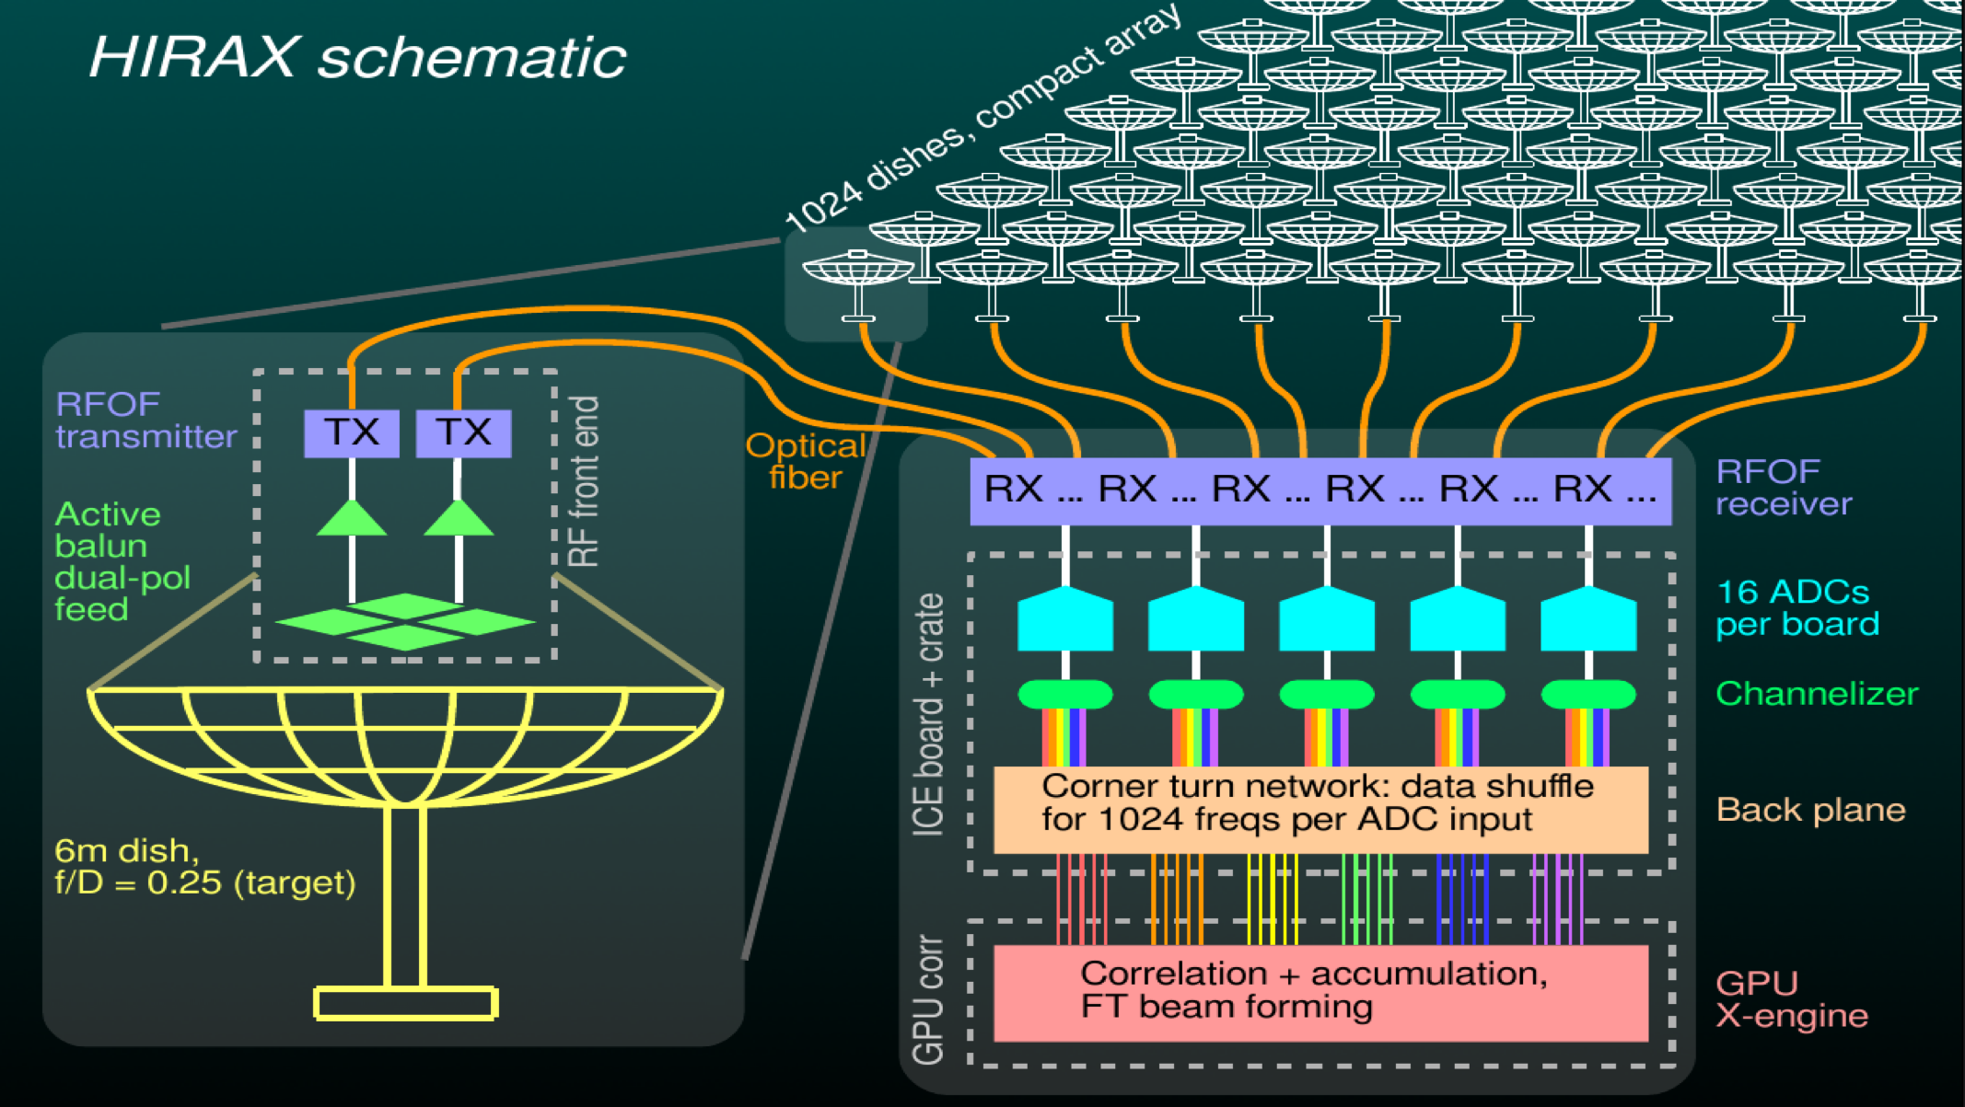
HIRAX Design Plan
Goal of 1024 close-packed 6m dishes. Fibre-glass fabrication in South Africa by AFF, design from NRC (Canada).
Cloverleaf dual-pol feed, RF over fibre
Operate between 400-800 MHz, 1000 channels
Channelizing on FPGA ICE boards
Correlation on GPUs

Slide 18
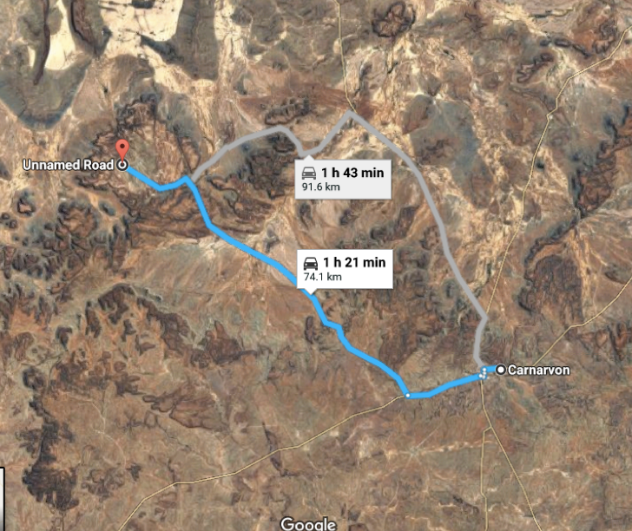
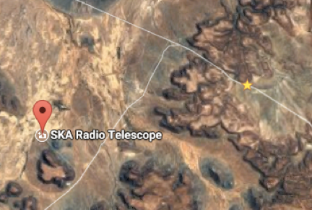
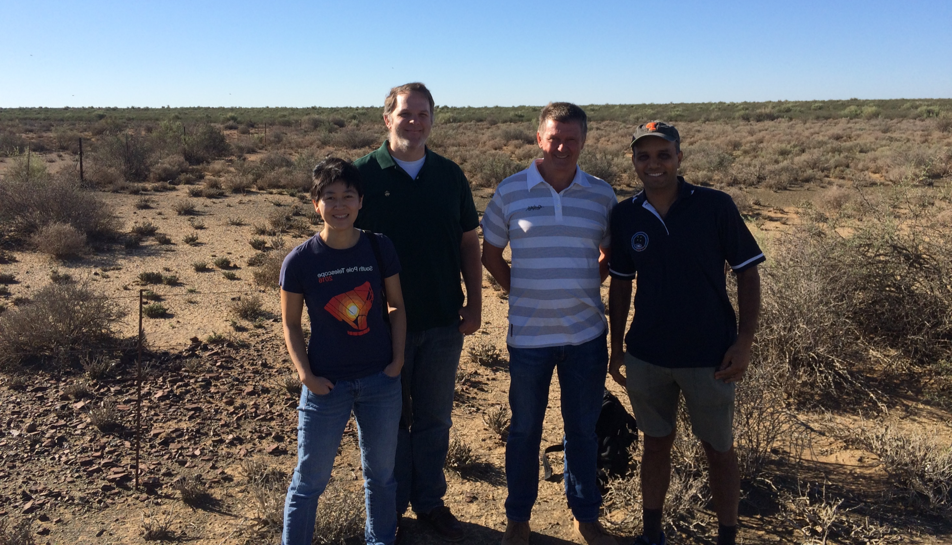


Location, Location, Location …
HIRAX
HIRAX
SKA South Africa Karoo site, MoA in place
Existing infrastructure (roads, power, data)
Low levels of RFI - site protected
Access to southern skies
RFI at HIRAX site

Slide 19
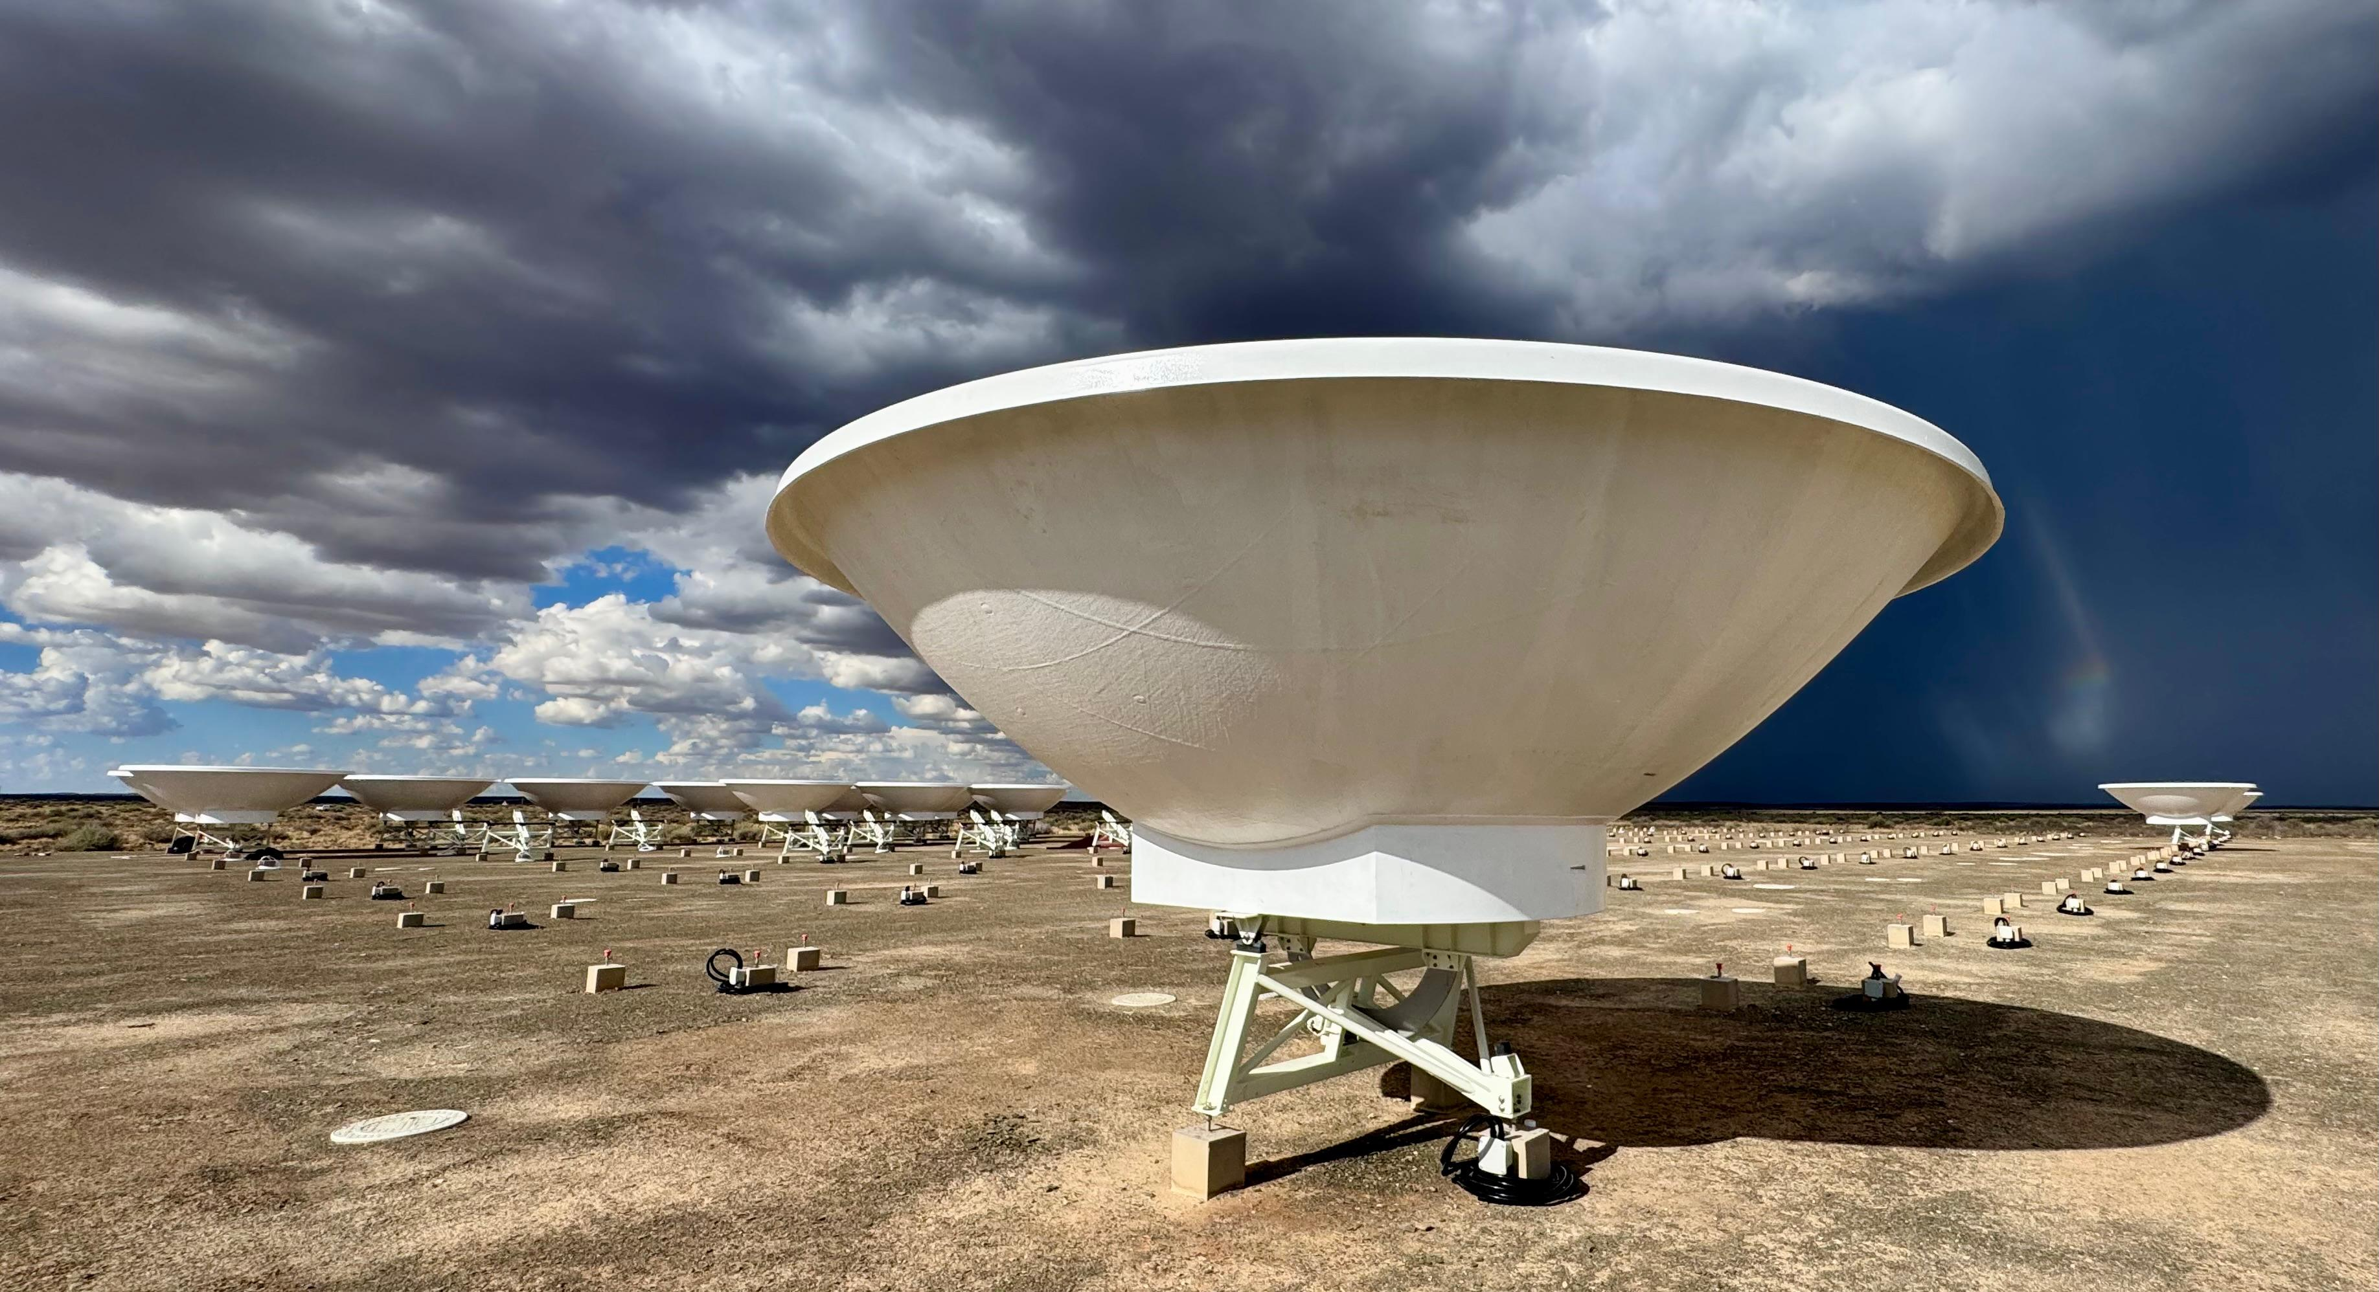
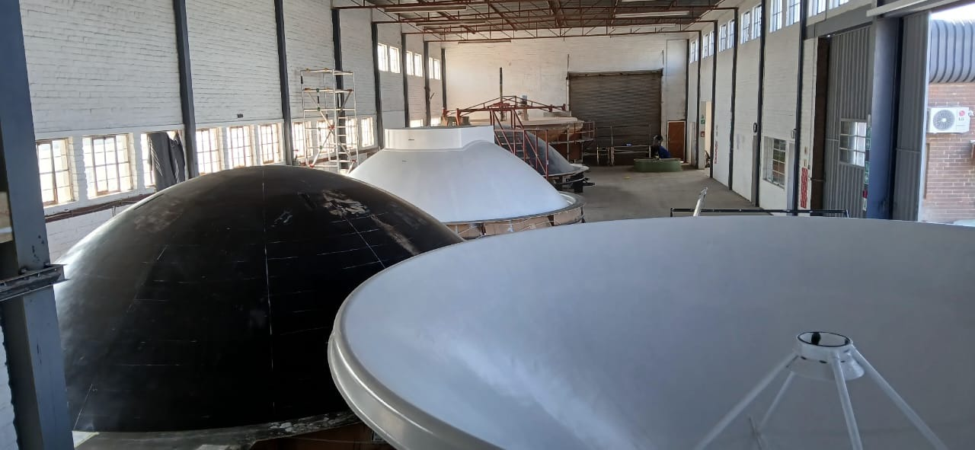
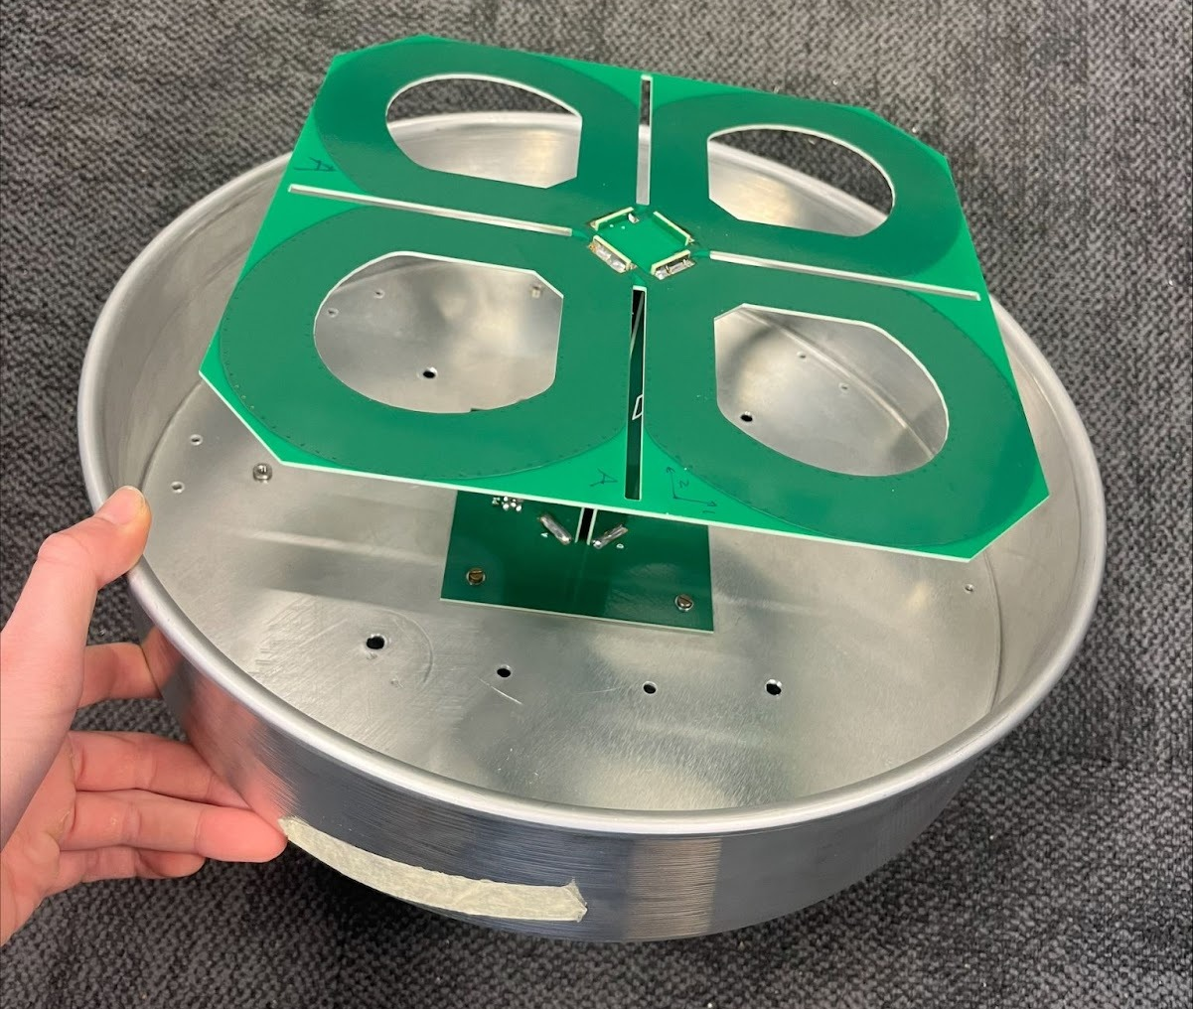
HIRAX Progress
Site: Civil, foundations, and electrical work completed. Fibre to be installed by May. Containers installed and RFI shielding verified; Cooling system by April.
Dishes: 19 TMAs installed at the main site, producing 8 per month.
Signal Chain: Developed and qualified new feed. Deploying two element array at main site.
Back-end Hardware: X-engine (correlator) installed in container. F-engine (digitiser, channeliser) currently being shipped. Commissioning back-ends by June.

Slide 20
Upcoming HIRAX Schedule
Site:
Develop HIRAX Karoo Swartfontein main site (Q2 2026)
Instrument (staged to mitigate risks):
Prototyping on 2-element array at Swartfontein site (Q2 2026): qualify signal chain, verify dish precision, measure telescope beams
Commission 8-element prototype at Swartfontein site (Q3 2026): verify RF performance and stability, preliminary study of redundancy & chromaticity
Commission 32-element prototype at Swartfontein site (Q4 2026-Q1 2027): verify RF performance and stability, detailed study of redundancy & chromaticity
Commission 128-element pathfinder array at Swartfontein site (Q2-3 2027): verify redundant calibration approach, constrain chromaticity

Slide 21
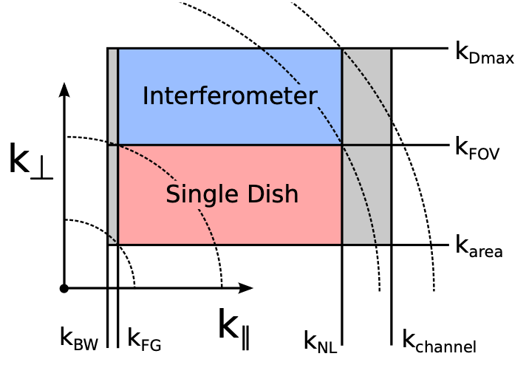
Cosmology with HIRAX
Wide redshift coverage: z ~ 0.8 - 2.5
Survey area: ~15,000 deg²
Angular coverage: l ~ 40 - 2000 gives kperp ~ [10⁻², 1] h Mpc⁻¹ at z~1 ; limited by primary beam and maximum baseline.
Frequency coverage: y ~ 20 - 20000 gives kpar ~ [10⁻³, 1] h Mpc⁻¹ ; limited by foregrounds and nonlinearities.
Sensitivity: 15 uJy/beam daily,1 uJy/beam full survey
MEASURE HI
POWER SPECTRUM P(k)
Bull et al (1405.1452)

Slide 22
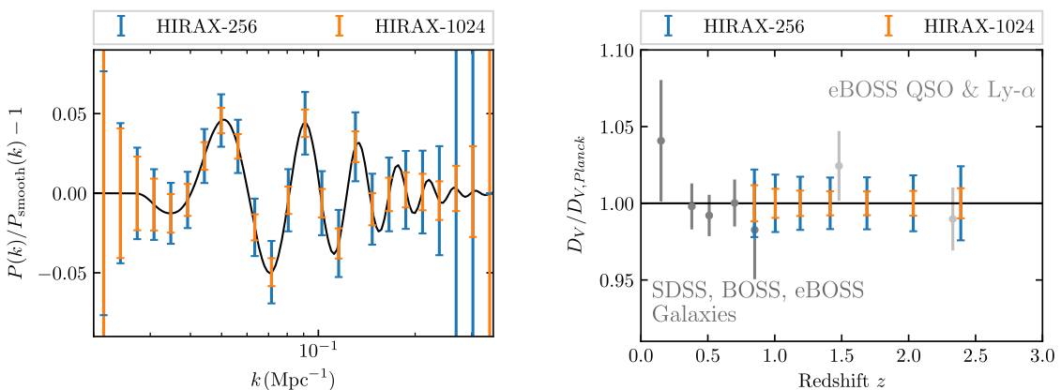
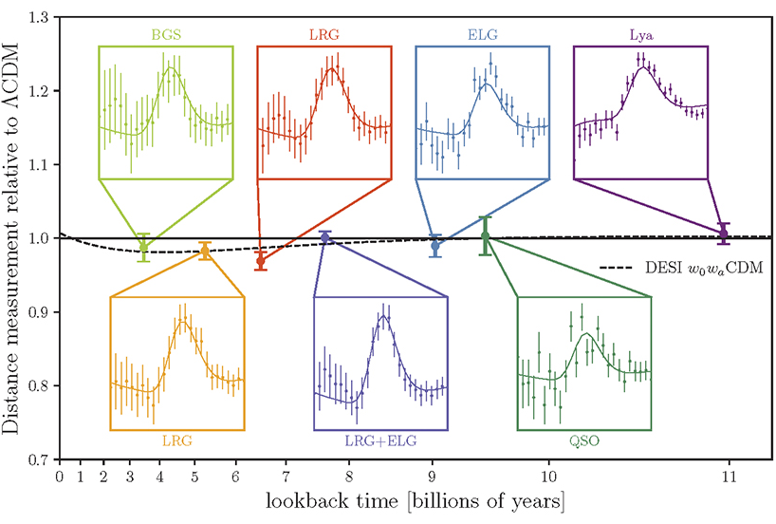
HIRAX BAO & Distance Scale Forecasts
DESI
YR 1
HIRAX will make a precise measurement of the matter power spectrum in the BAO regime in a number of redshift bins from z = 0.775 to 2.55
Convert power spectrum BAO constraints into constraints on DV in each redshift bin => constrain the BAO scale at the percent level out to high redshift with HIRAX-1024

Slide 23
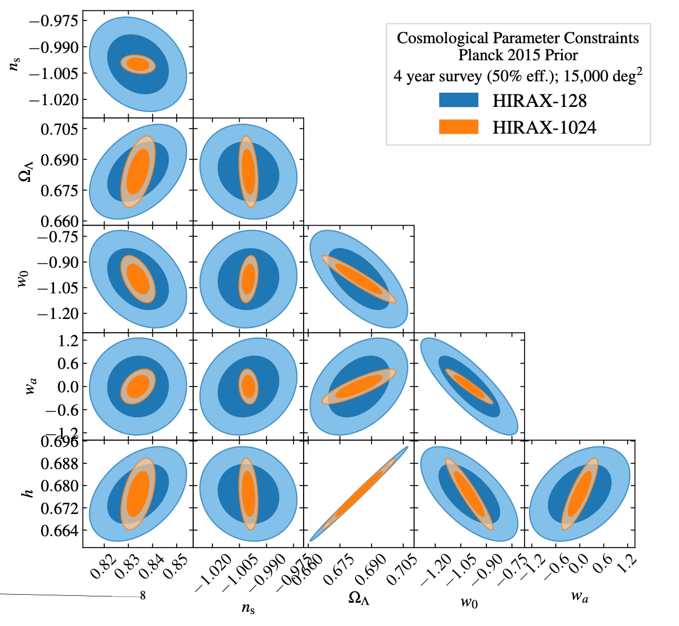
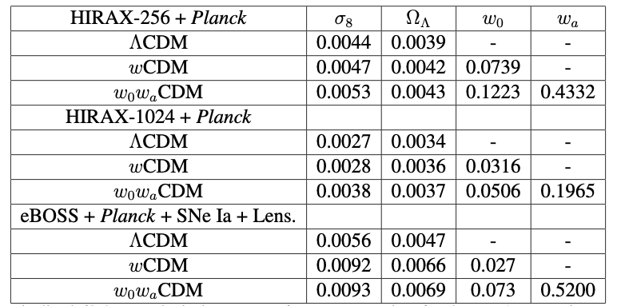
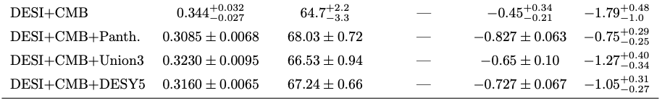
HIRAX Cosmology Forecasts
Crichton et al 2109.13755
FoM ~ 30 FoM ~ 300
Credit: D Crichton
DESI Year 1
HIRAX measurements of DV will provide tight constraints on cosmological parameters in combination with CMB data

Slide 24
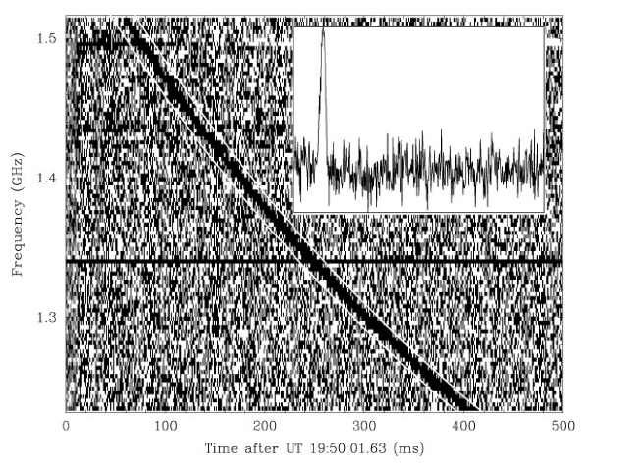
Fast Radio Bursts
FRBs are mysterious short duration (millisecond), bright (~Jy) radio bursts discovered a decade ago, and remain unexplained.

Slide 25
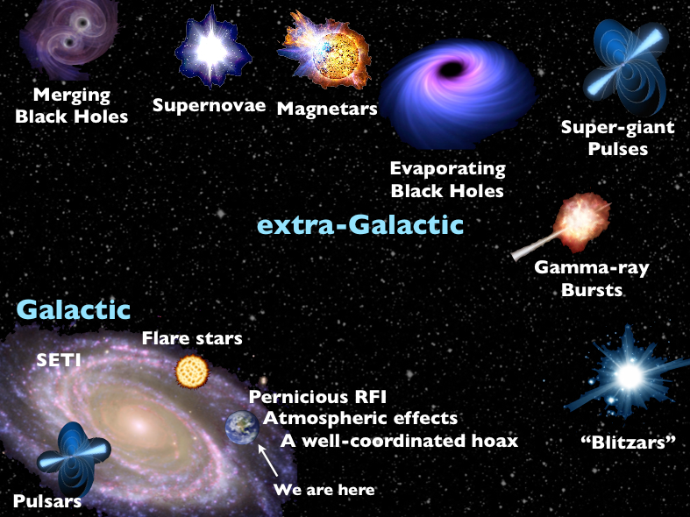
FRB Models
J Hessels

Slide 26
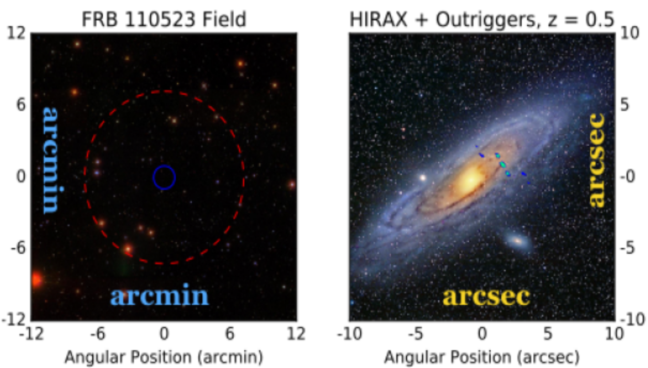
Localising FRBs with Outrigger Arrays
Localising FRBS will allow us to determine where they originate and shed insight into their nature
If standard objects then very useful for cosmology!

Slide 27
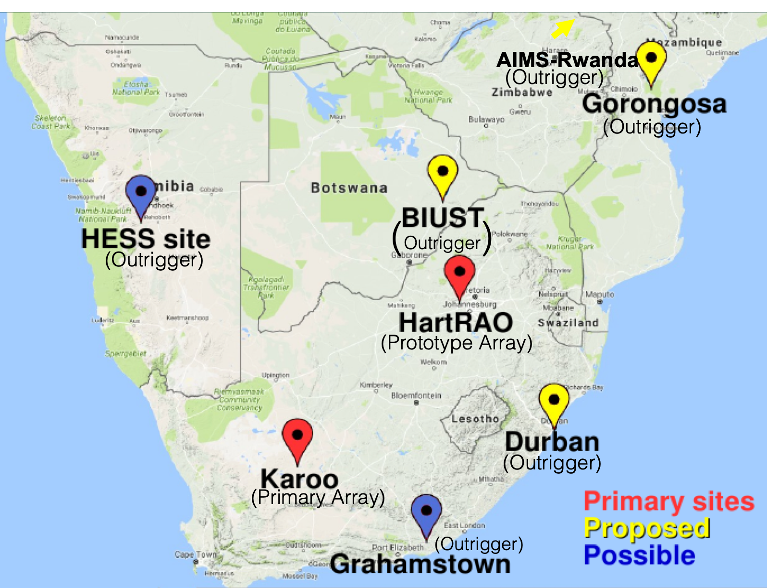
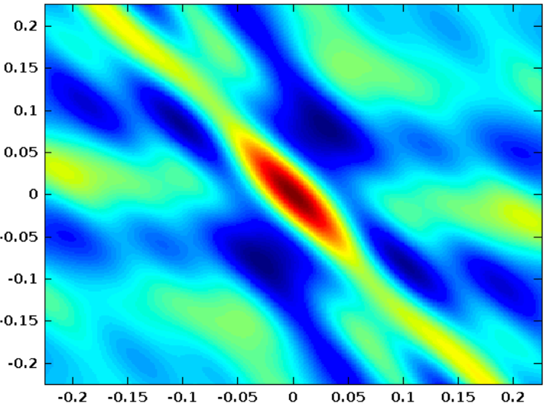
Localising FRBs with HIRAX Outriggers
Main site hosting the full array on the Swartfontein farm at the SKA Karoo site.
Outrigger arrays in African partner countries provide very long baselines for FRB sub-arcsec localisation

Slide 28
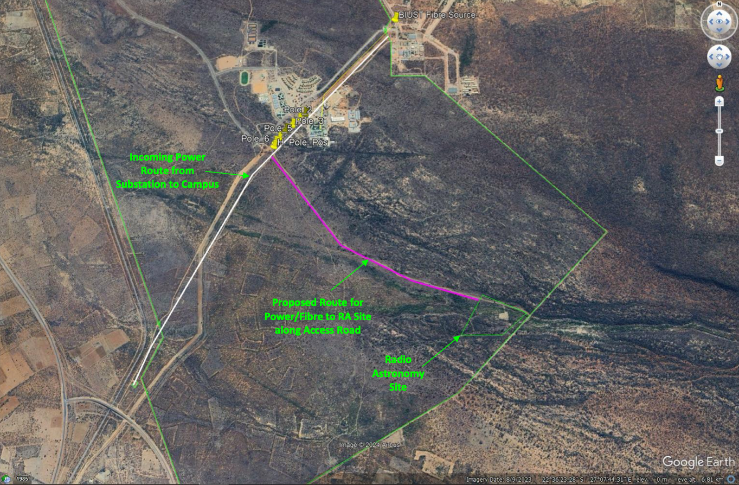
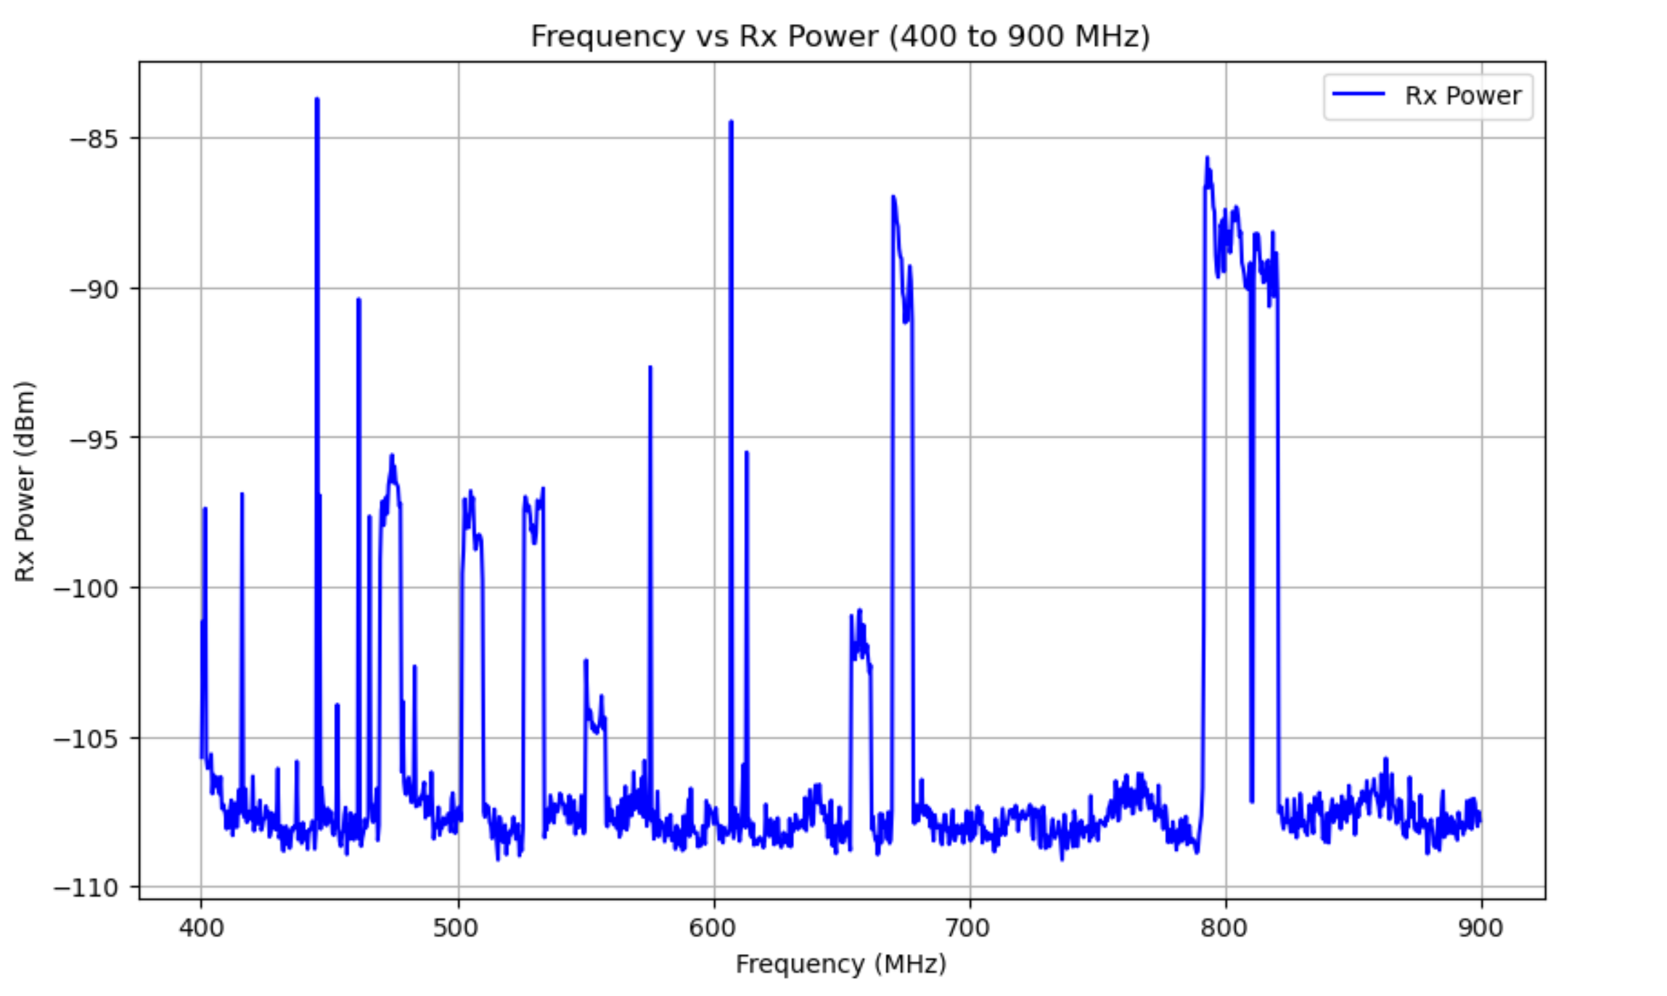
BIUST HIRAX Outrigger Array
Formal MoA being signed between UKZN, BIUST, AFF and McGill
Hardware funding from DSTI/SARAO; Site infrastructure funding from Botswana government
Site infrastructure: Requirements are set and at design stage; Expect site construction to be completed in 2026
RFI Site Scan
Site on BIUST Campus

Slide 29
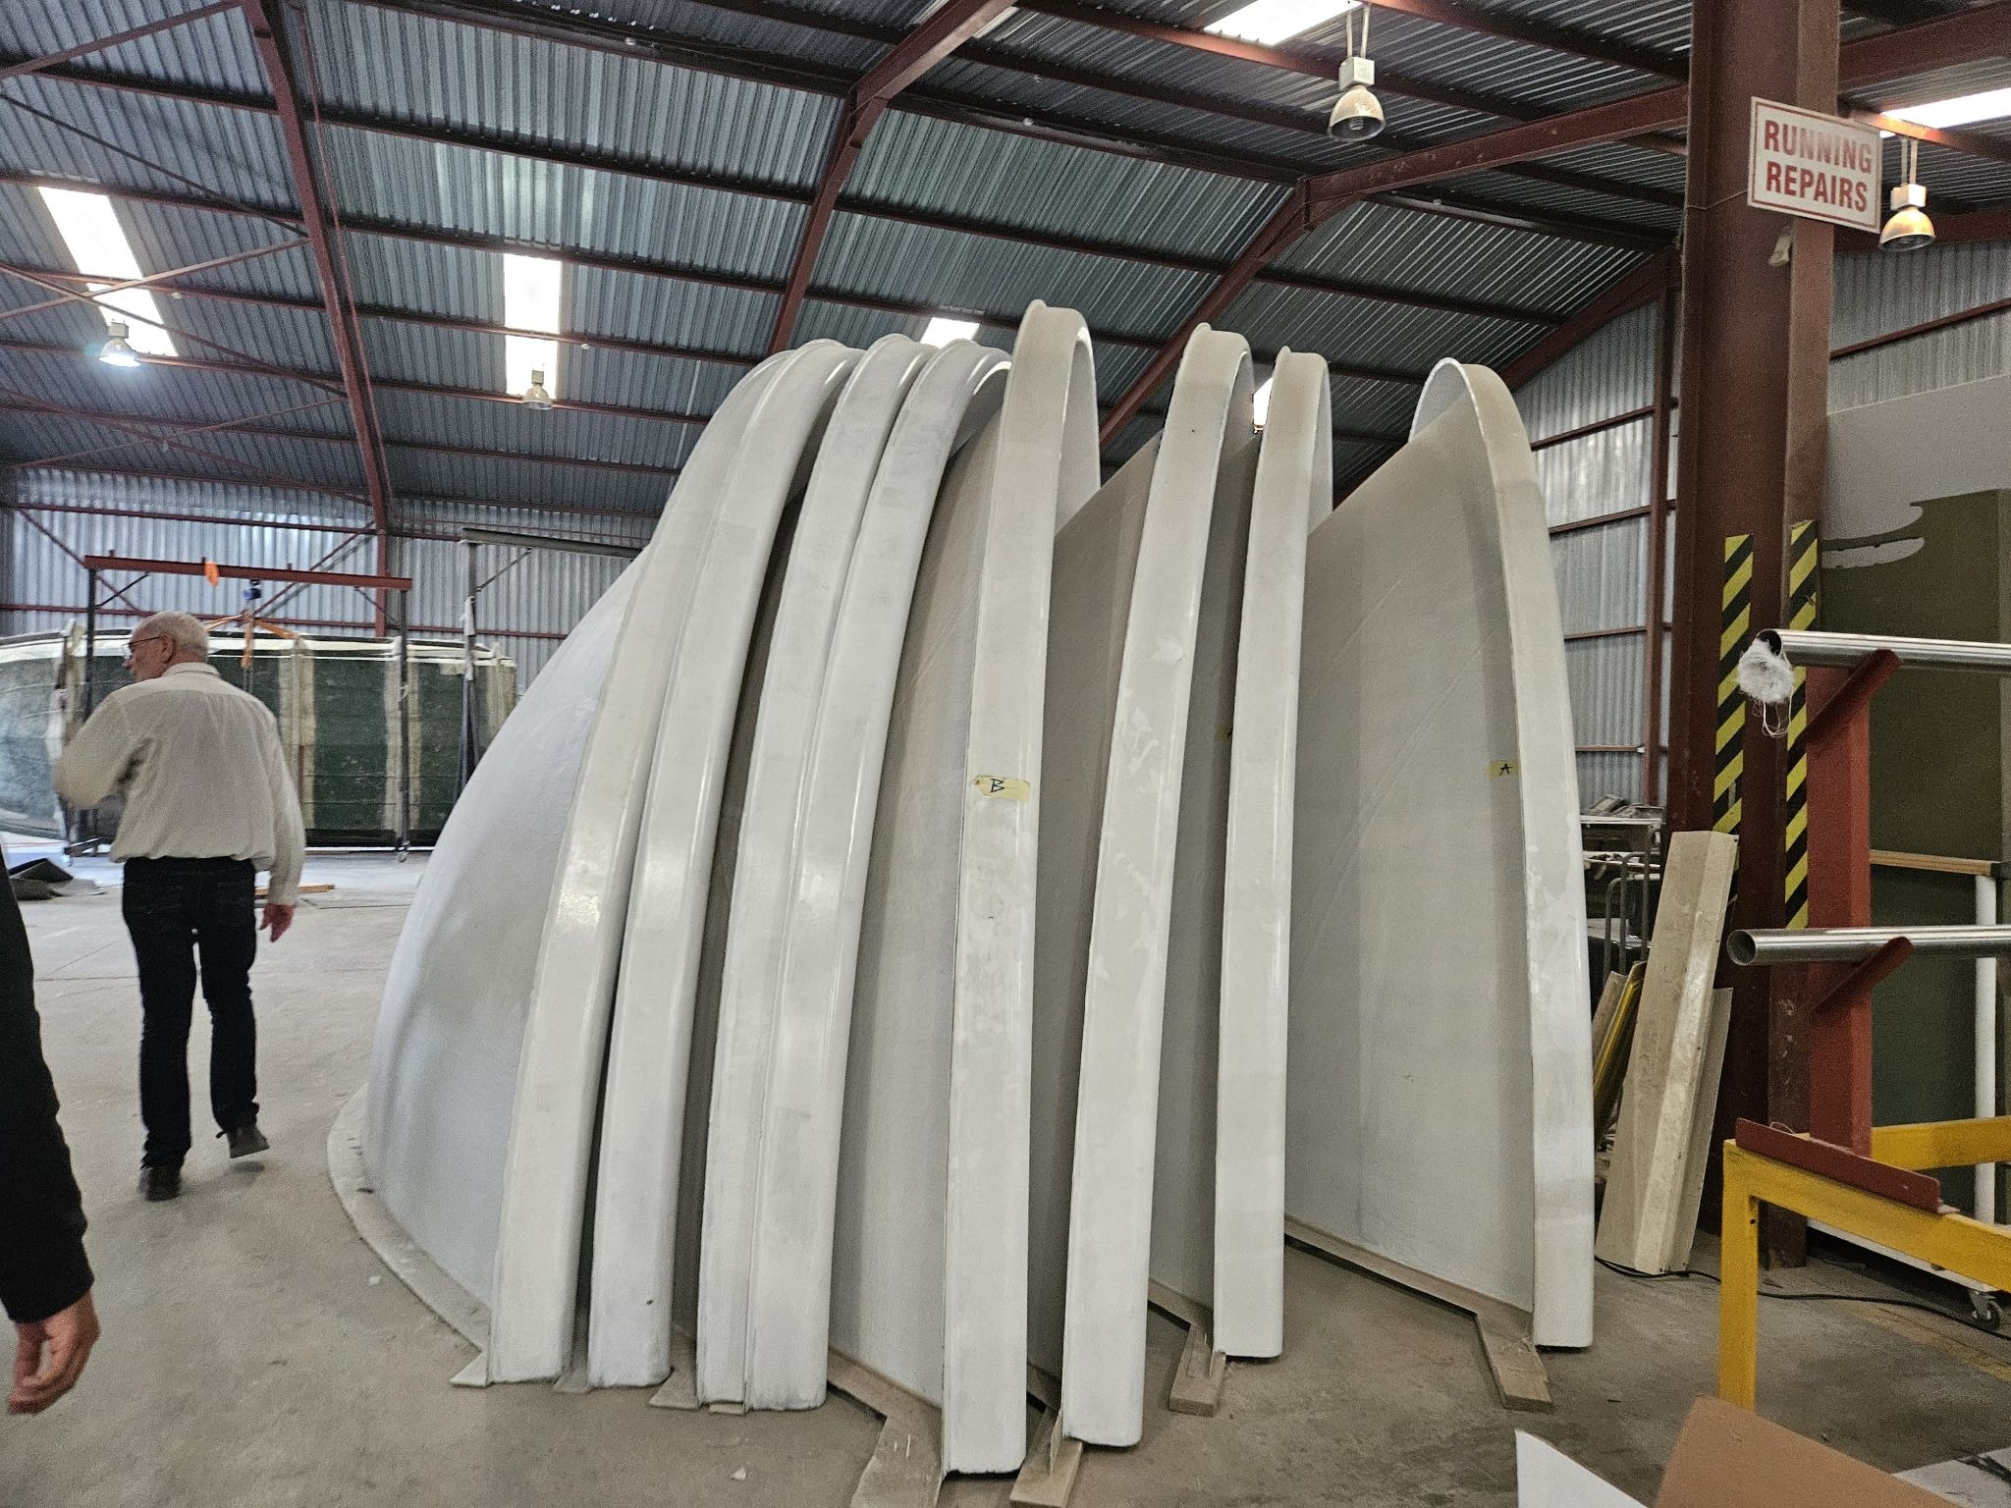
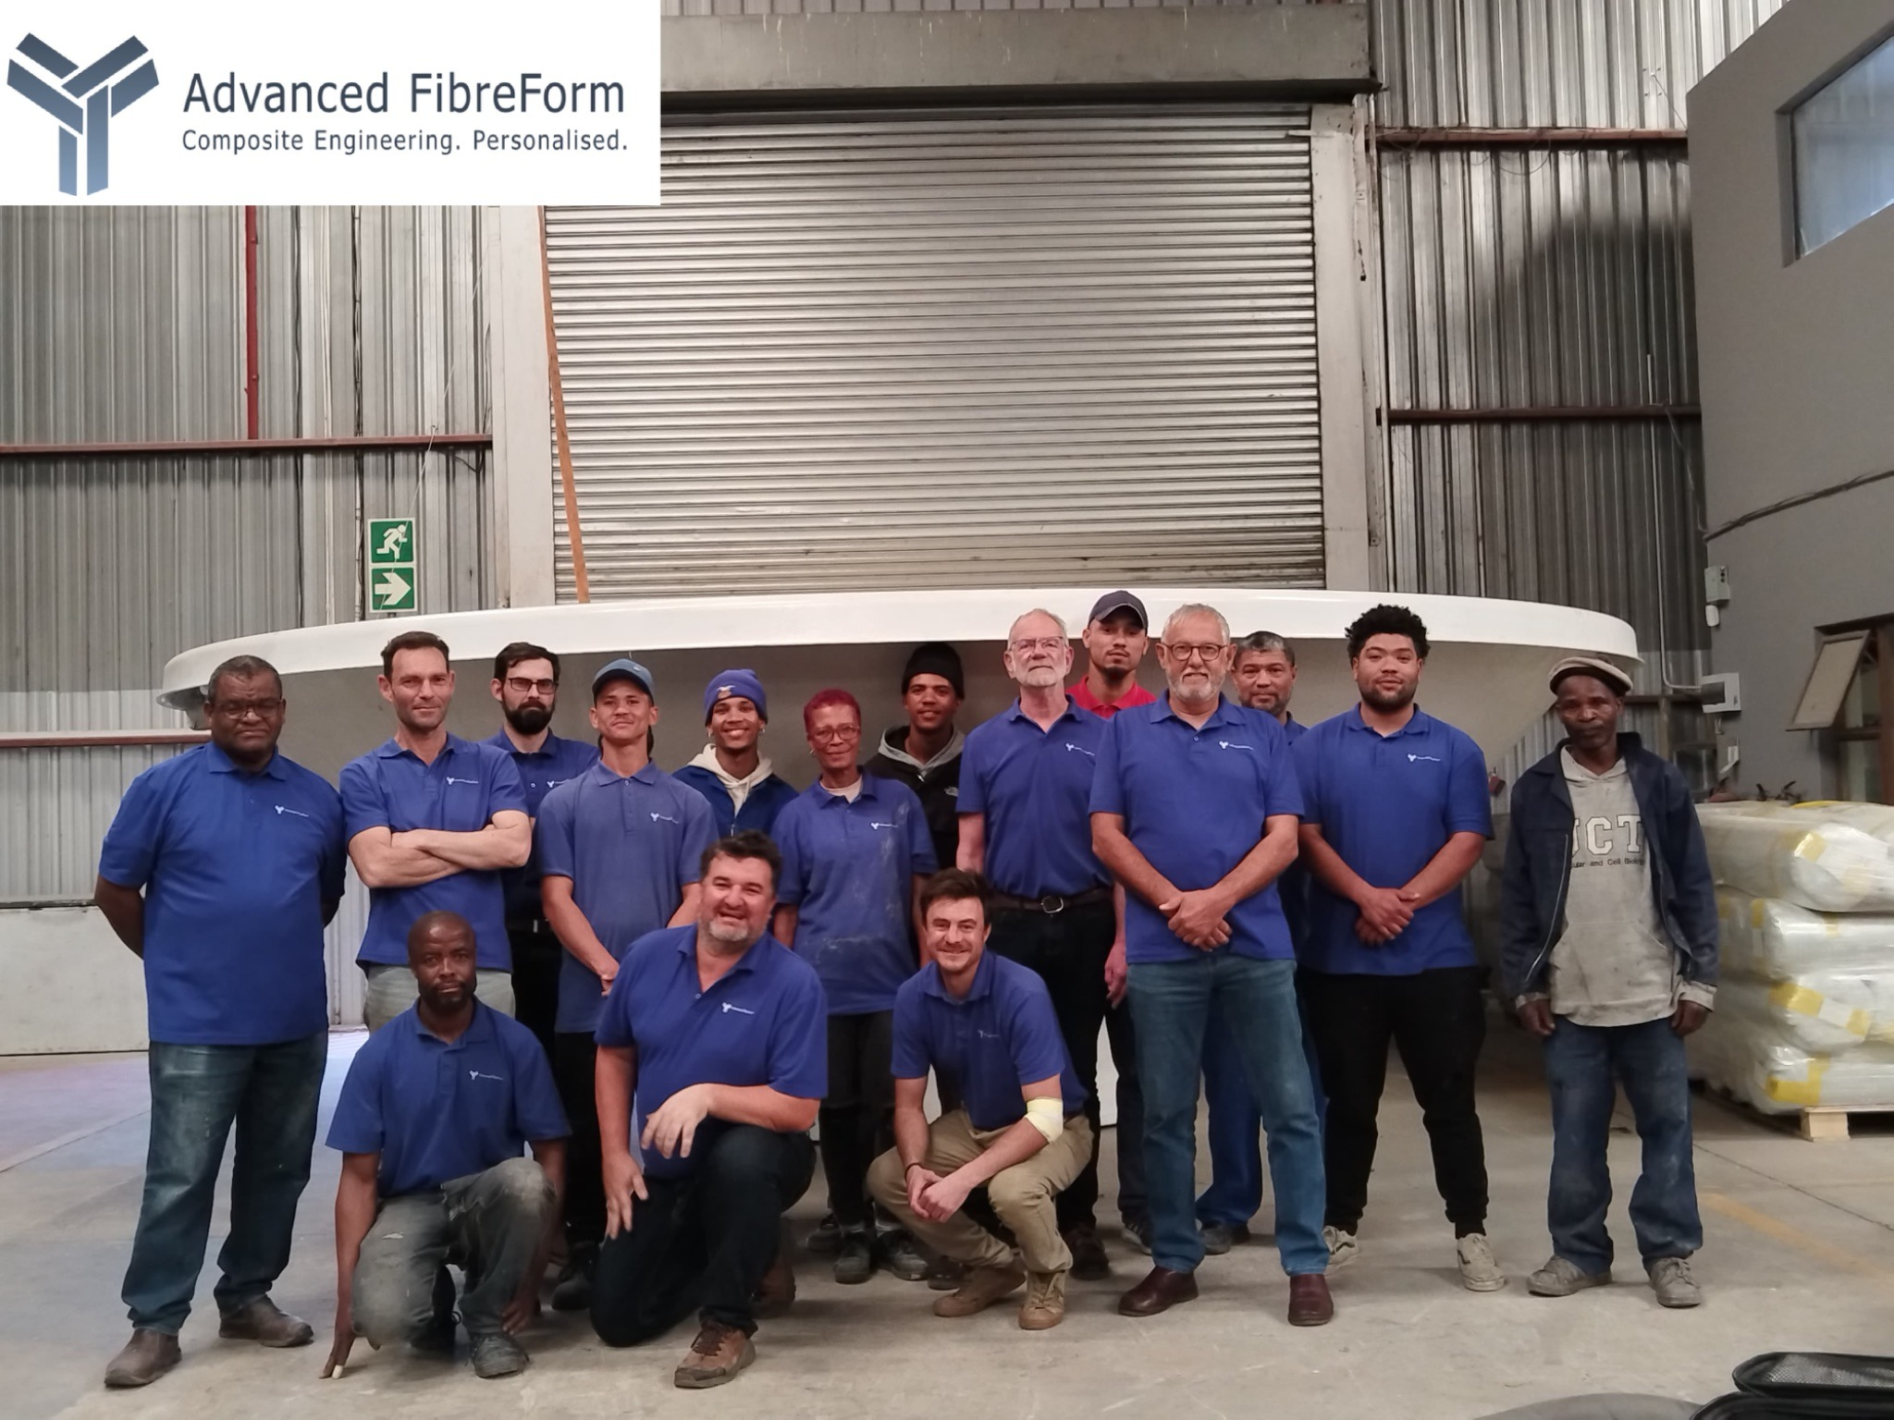
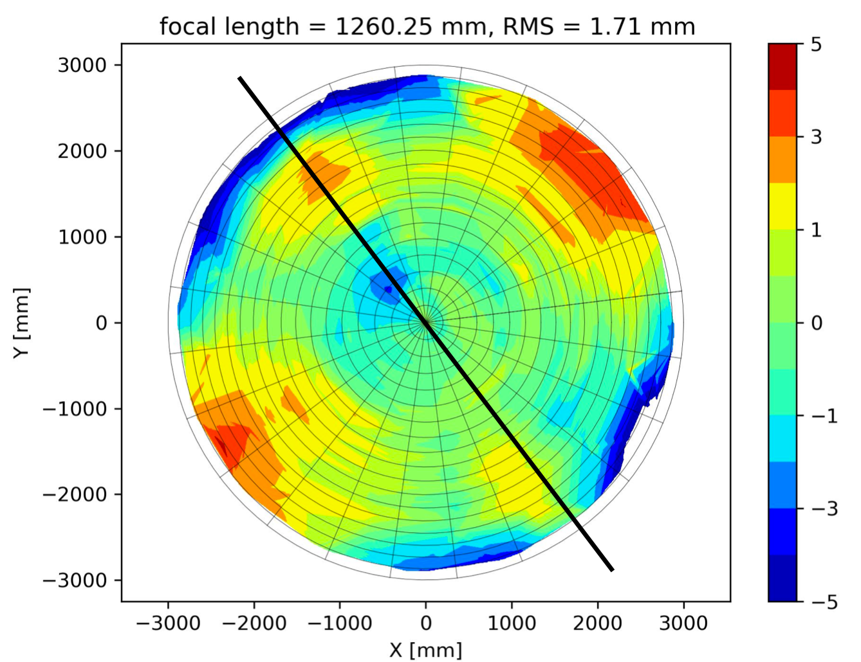
BIUST HIRAX Outrigger Array
Already built 16 split dishes (32 halves) for HIRAX BIUST outrigger with dish partners AFF and NRC
Assembled 1 split dish in Cape Town and 2 at Klerefontein site - well within spec (of 10mm)
Continuing with design and build of (manual) 16 az-el mounts and assembly heights
Same feeds and receiver as main array and similar but smaller back-end

Slide 30
Thank you!

