Slide 1
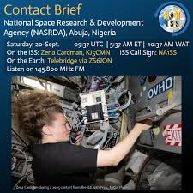
Connecting Classrooms to the Cosmos:
Democratising Space Communication Through The ARISS Contact Experience In Nigeria
Presented By:
Joy U. Olayiwola
(NASRDA)
The 6th Annual Conference of the African Astronomical Society,
Botswana International University of Science & Technology, March 22-27, 2026

Slide 2
Why this matters?
Space science has traditionally been accessible to only a few.
  Efforts are being made by different groups to create space science awareness
  Meeting with an astronaut
Another angle: Bring space communication directly into classrooms - making it more inclusive, engaging, and accessible.

Slide 3
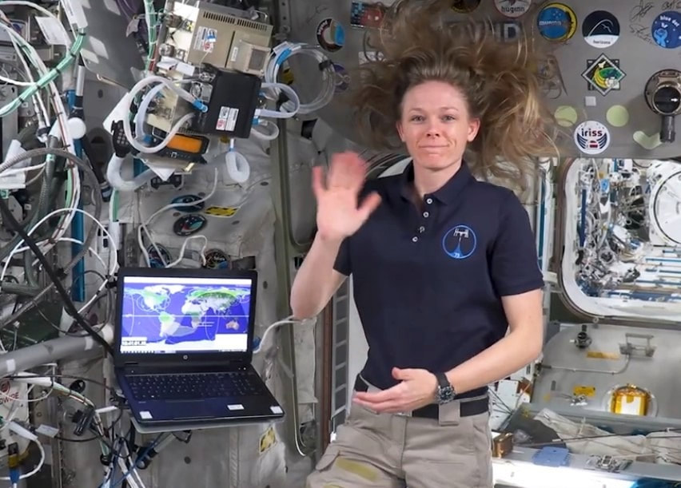
What is ariss?
Amateur Radio on the International Space Station is a global education initiative that enables students to communicate directly with astronauts aboard the International Space Station (ISS).
It combines space science, communication technology, and education outreach to inspire the next generation.
The program is divided into five regions—Canada, Europe, Japan, Russia, and the U.S.—which parallel the five space agencies involved in the ISS.

Slide 4
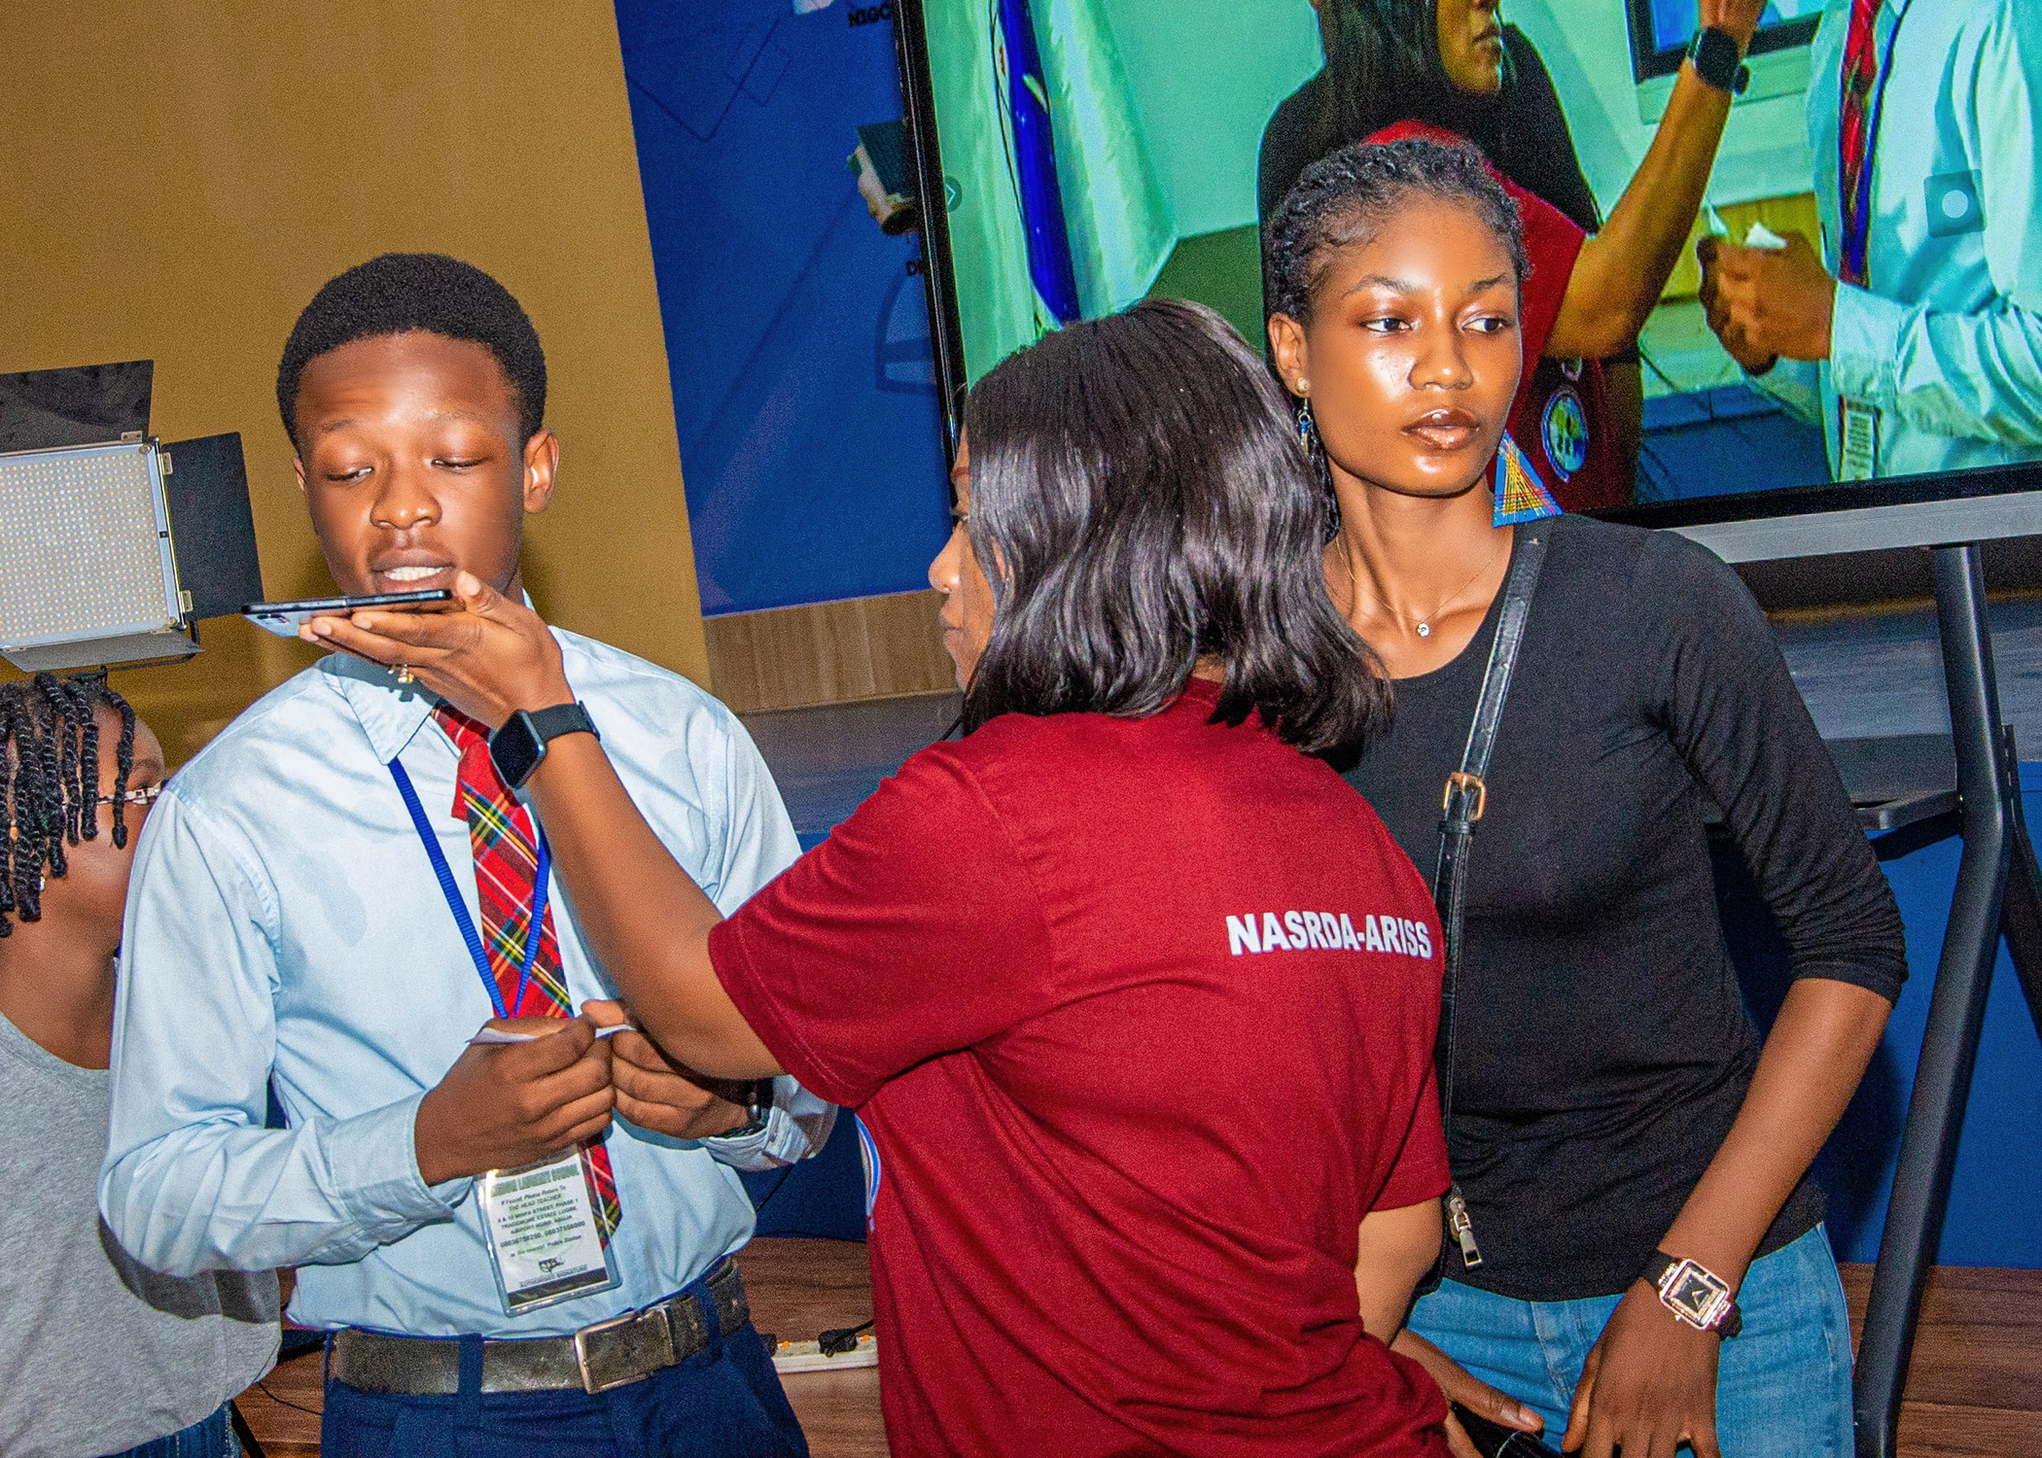
Nigeria’s first ariss contact
In September 2025, National Space Research and Development Agency coordinated Nigeria’s first physical ARISS contact event.
Students from selected schools in the FCT participated (public and private)
Supported by ARISS Telebridge network
Enabled direct communication with an astronaut aboard the ISS

Slide 5

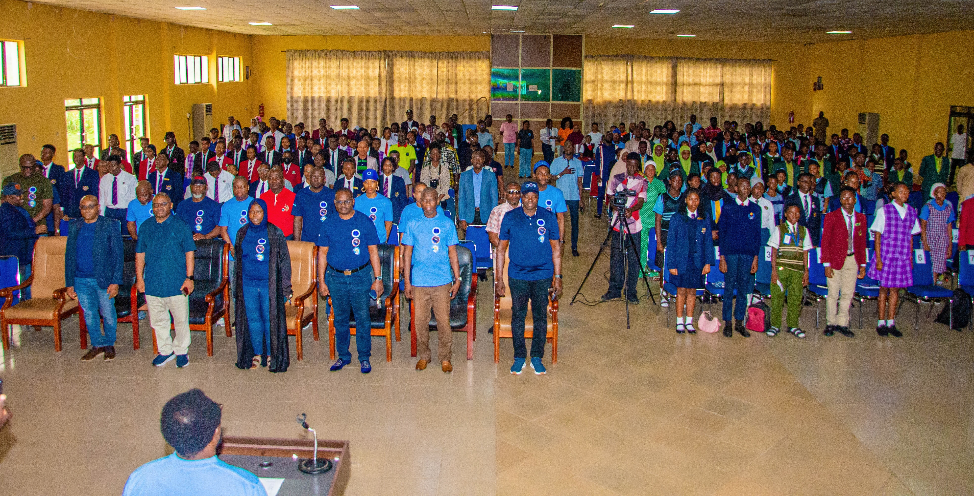

Slide 6
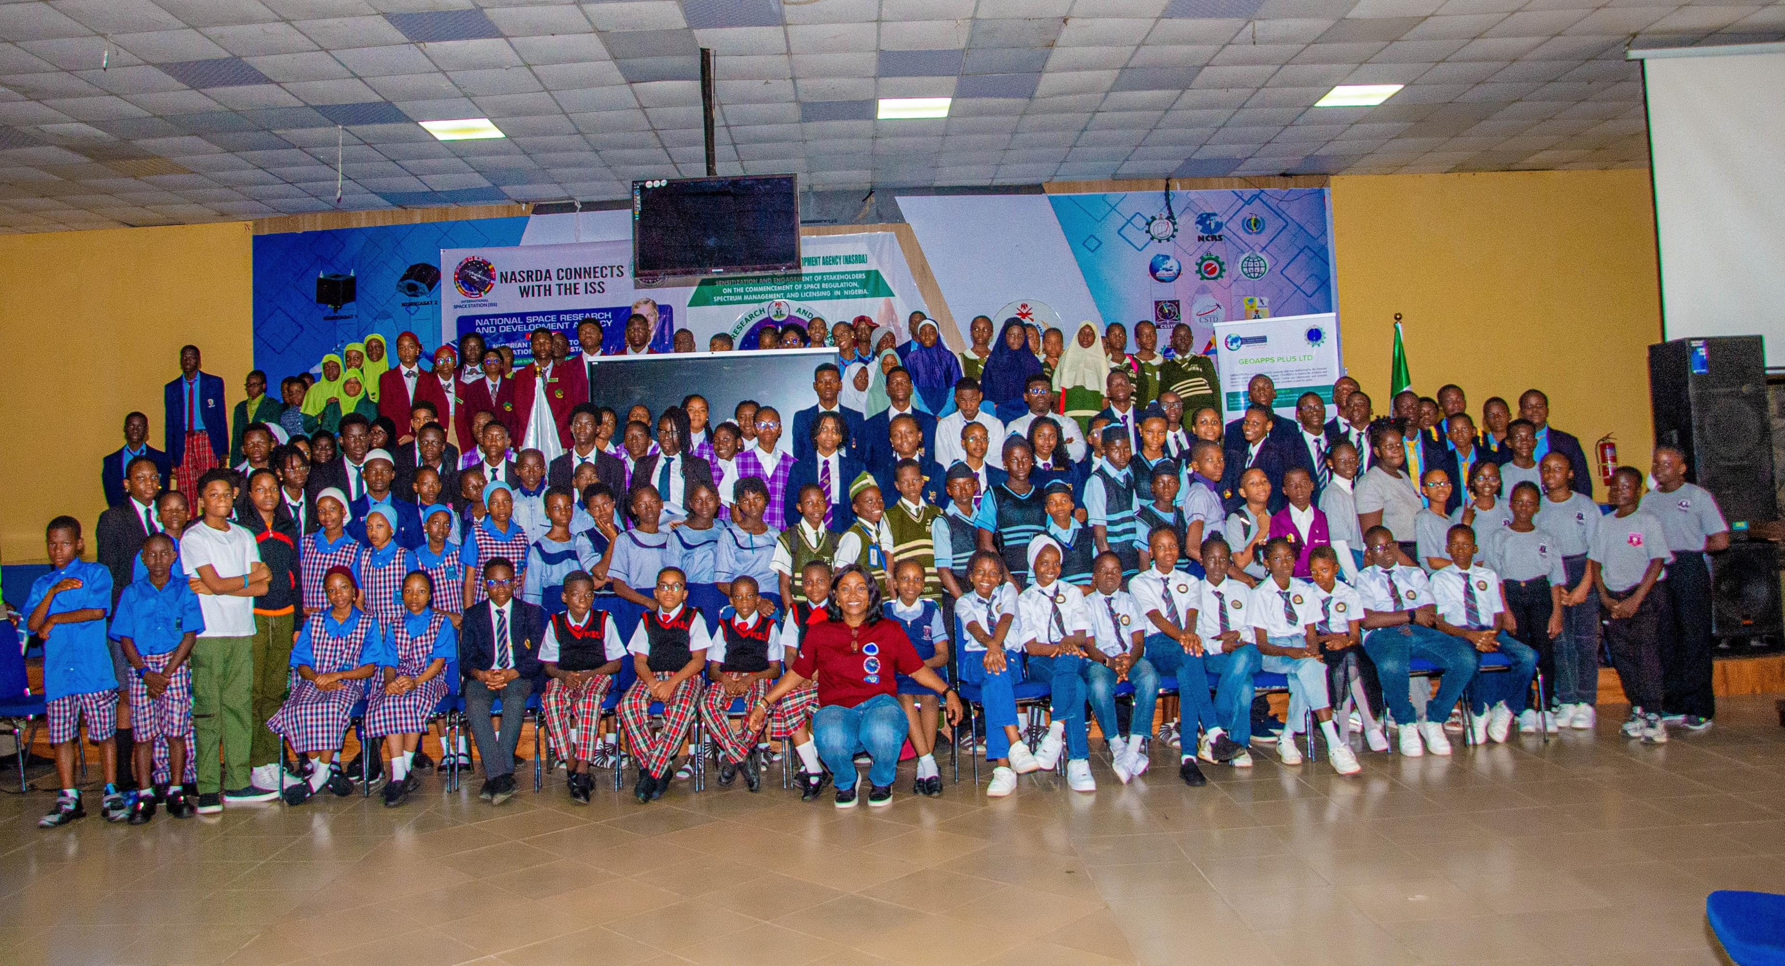

Slide 7
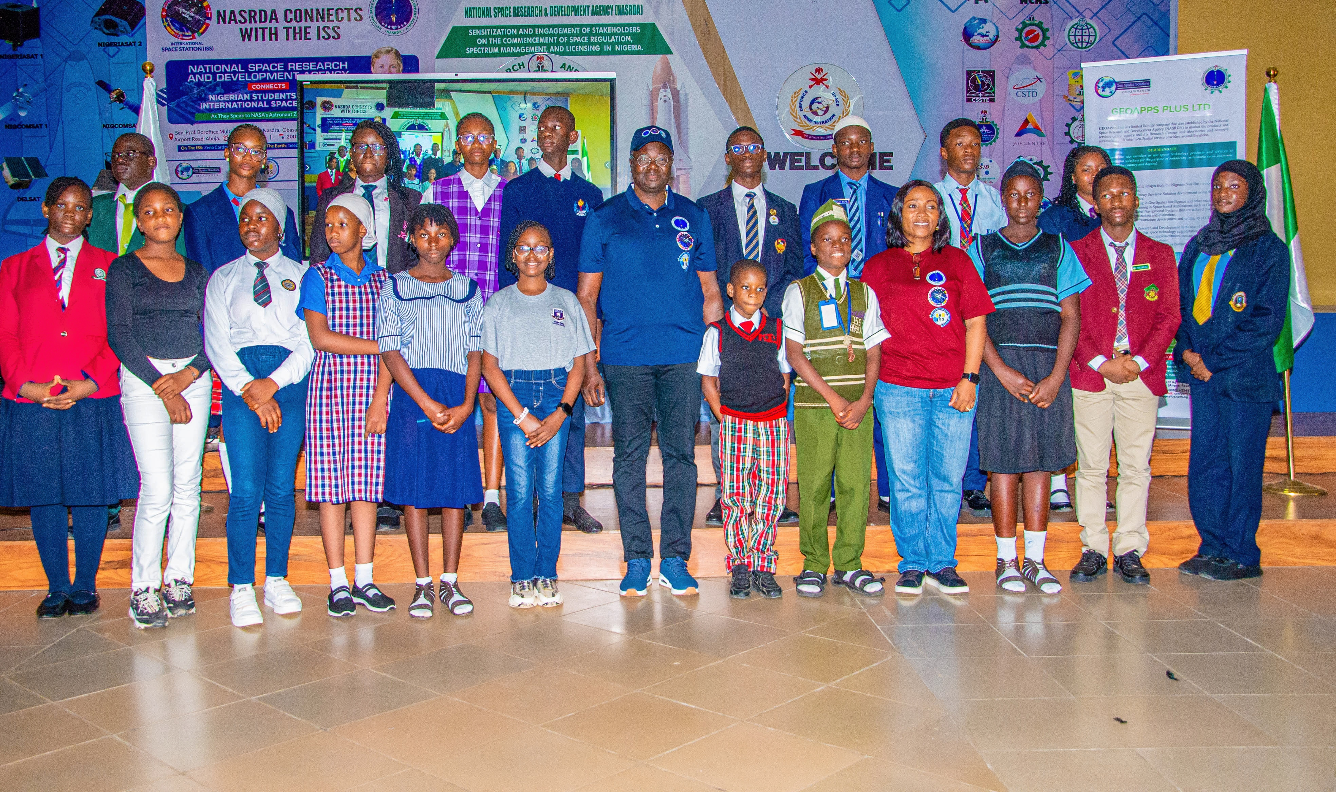
The experience
During the live contact:
Students engaged in real-time Q&A with an astronaut
Discussed life and science aboard the ISS
Connected classroom learning to real-world space applications

Slide 8
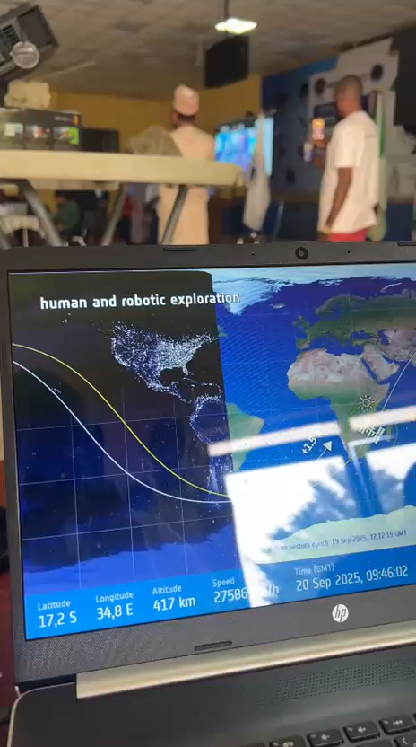

Short clips

Slide 9
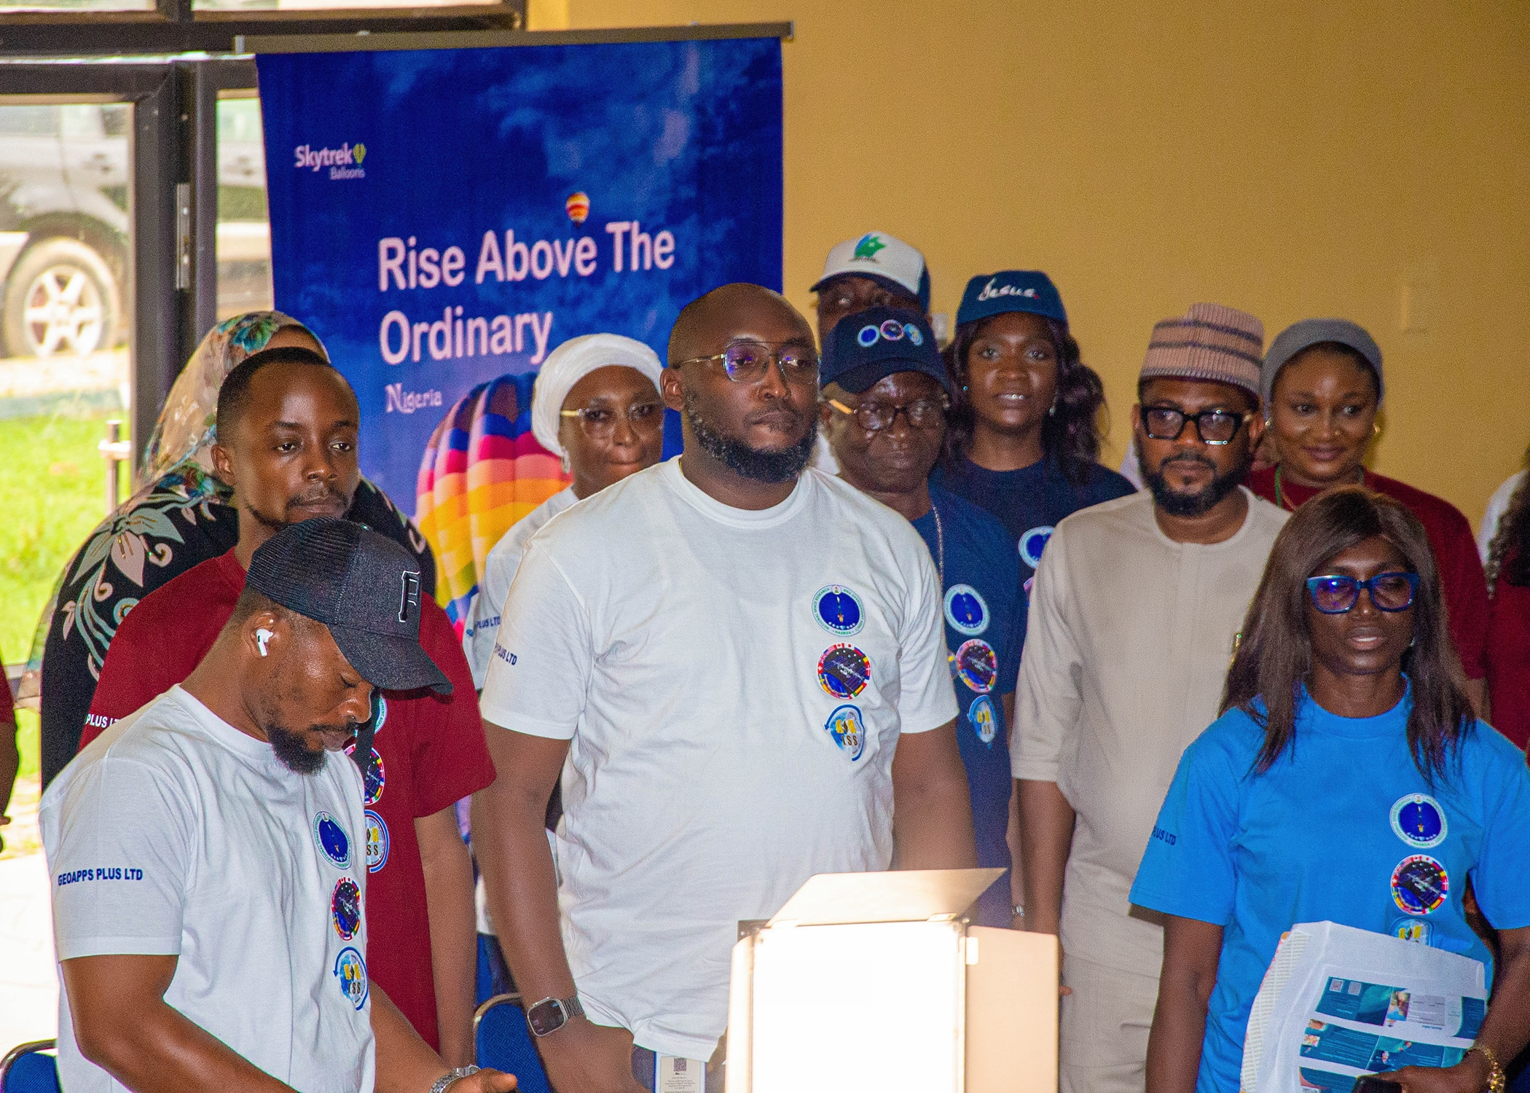
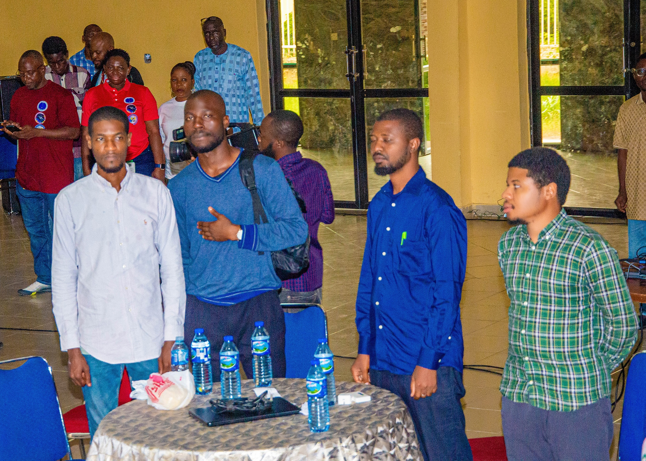
Our collaboration model
The success of the event relied on collaboration across:
NASRDA technical and outreach teams
Participating schools and educators
Media partners
The global ARISS community
  Stefan Dombrowski, our moderator
  John Sygo, Amateur Radio ground station operator
Creating a shared sense of achievement and curiosity.
Approximately 305 persons in attendance on the contact day

Slide 10
MEDIA LINKS COVERING THE EVENT
1. https://x.com/NTANewsNow/status/1969750322449944767?t=kIw09Trff5D-Lae7TXqCkg&s=09 (Nigeria Television Authority, NTA)
2. https://independent.ng/nigeria-makes-history-as-nasrda-connects-students-to-international-space-station/ (Independent Nigeria Newspaper)
3. https://techeconomy.ng/history-as-nasrda-connects-students-to-international-space-station/
4. https://www.vanguardngr.com/2025/09/nasrda-connects-nigerian-students-to-international-space-station/
5. https://thesun.ng/nigeria-charts-new-course-in-space-education-with-historic-iss-link-up/
6. https://gazettengr.com/nigerian-students-connect-with-nasa-astronaut-aboard-iss/
7. https://www.newsexpressngr.com/news/276660/nigerian-students-connect-with-nasa-astronaut-in-space-pose-questions
8. https://realnewsmagazine.net/nigerian-students-connect-with-nasa-astronaut-in-space-pose-questions/
9. https://businessday.ng/news/article/tinubus-science-push-spotlighted-as-nigerian-students-engage-nasa-astronaut/
10. https://guardian.ng/news/nasrda-connects-students-to-international-space-station/
11. The Channels TV Station

Slide 11
Challenge ADDRESSED
Key challenges addressed:
Limited access to hands-on astronomy experiences
  Live, real-time interaction with an astronaut aboard the ISS
  Created a unique experiential learning opportunity rarely available in traditional classrooms
Perception of space science as distant or inaccessible
  Brought space into the classroom environment
  Humanised space exploration through live conversation
  Allowed students to ask their own questions, making it personal and relatable
Infrastructure constraints in resource-limited environments
  Leveraged the ARISS Telebridge network to overcome local technical limitations
  Used existing communication systems creatively

Slide 12

Lessons learned
Strategic partnerships are essential
Creativity can overcome infrastructure limitations
Community engagement drives participation and ownership

Slide 13

Impact: expanding access to space science
Direct engagement with space professionals
  Lecture before contact
  Q & A sessions with Agency Directors
Increased curiosity and interest in STEM
Strengthened connection between education and real-world science
Reduced barriers between students and space science experiences

Slide 14

How do we sustain this impact?
School visits and space awareness campaigns
Educational tours to the NASRDA space museum
Hands-on demonstrations and learning activities
Expanding participation to more schools

Slide 15
AI AS AN ENABLER (STILL IN THOUGHT PROCESS)
• Interactive tools to simulate space communication experiences
• Personalised learning support for students
• Chat-based systems to extend engagement beyond physical events
The idea?
These approaches can help scale access and make learning more interactive.

Slide 16




Contribution to Sustainable Development goals

Slide 17
conclusion
• Nigeria successfully hosted its first ARISS school contact
• Demonstrated the impact of direct space communication in education
• Showed that meaningful engagement is possible even in resource-limited settings

Slide 18
Thank you

