Slide 1


A Strategic Manifesto
for Inclusive Astronomy in Africa
Jamal Mimouni
Physics Depart., Constantine Univ, LPMPS & CERIST, Algeria

Slide 2
What is ?
“On ne prete qu’aux riches”
Talent is universal; opportunity is not.
“No one is to be left behind”
The Future is bright, only if it shines for All
Has not AfAS become a big fat institutional Cow ?

Slide 3
Africa’s Two big Divides
1- Some countries faring (reasonably) well in Astronomy and most haven’t started yet!
Out of 55 countries, some 40 have no astronomy
2- Linguistically wise
- English speaking Versus French Speaking
- Some sub-ensembles: Lusitophone, Arabic speaking, Swahili speaking…

Slide 4

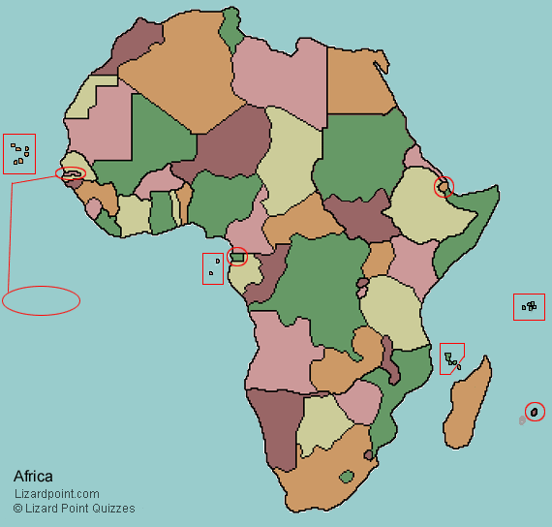

Slide 5
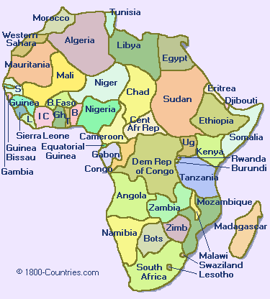

Slide 6
What is ?
AfAS is an organization of professional astronomers in Africa,
Vision: Create a globally competitive and collaborative astronomy community in Africa
Mission: To be the voice of astronomy in Africa and to contribute to addressing the challenges faced by Africa through the promotion and advancement of astronomy

Slide 7
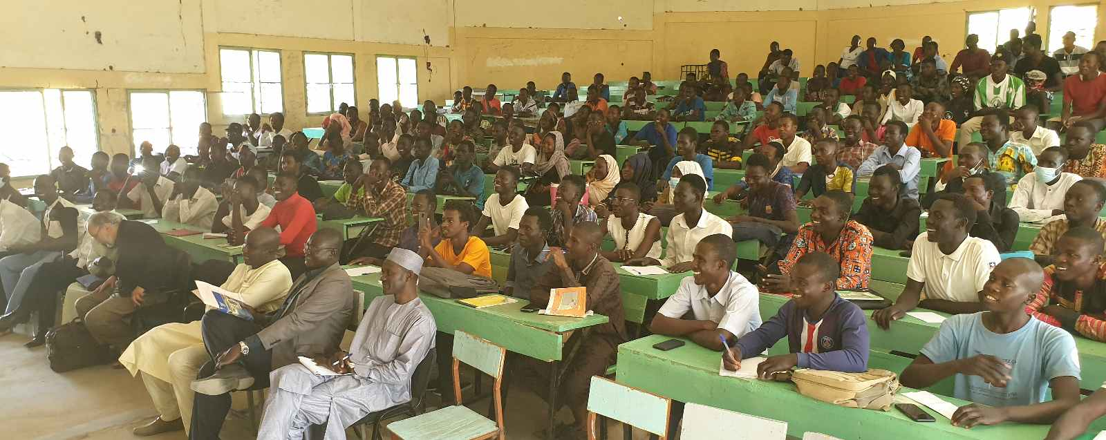
A Strategic Manifesto for Inclusive Astronomy in Africa
GAO Concepts and the Framework for Inclusion
  To fulfill a vision
  Astronomy as a Science Lever
The Ground Work
  Chad & Niger
  Mali & Guinée- Conakry
  Democratic Republic of Congo
  Tanzania
  Cameroon & Benin
Linguistic Zones and Continental Integration
  Adressing the big divide
Roadmap for Sustainability

Slide 8
Global Astronomy Outreach: GAO
Predicated on the "inclusive continental development" mandate.
Its manifesto:
"No African state to be left behind".
Target Demographic:
The GAO targets "unreached" nations—approximately 40 states lacking any formal astronomy or astrophysics programs.
Dual-Track Strategy:
Implementation both on academic institutionalization and general public/scientific literacy.
Linguistic Focus:
Focalize on French-speaking Africa due to historically lower levels of continental scientific connection.
Collaborative Support:
Benefitted from support from the IAU’s Office of Astronomy for Development (OAD) and various national stakeholders NOC,s , NAEC’s.

Slide 9
Global Astronomy Outreach: GAO
Astronomy as a Development Lever
Gateway to STEM: Astronomy is utilized as a comprehensive pedagogical tool to attract young minds to physics, mathematics, and exact sciences.
Multidisciplinary Engine: The field encompasses astrochemistry, planetary geology, astrobiology, and aerospace engineering to enhance overall technical capacity.
Generalization of Physics: Astrophysics is used to provide a broader context for fundamental laws such as electromagnetism and thermodynamics.
Continental Integration: Strategic development facilitates engagement with major projects like the Square Kilometre Array (SKA) and Southern African Large Telescope (SALT).
Scientific "Leaven": Awareness campaigns act as a "leaven" (levain) to elevate other sciences to higher academic levels in the future.

Slide 10
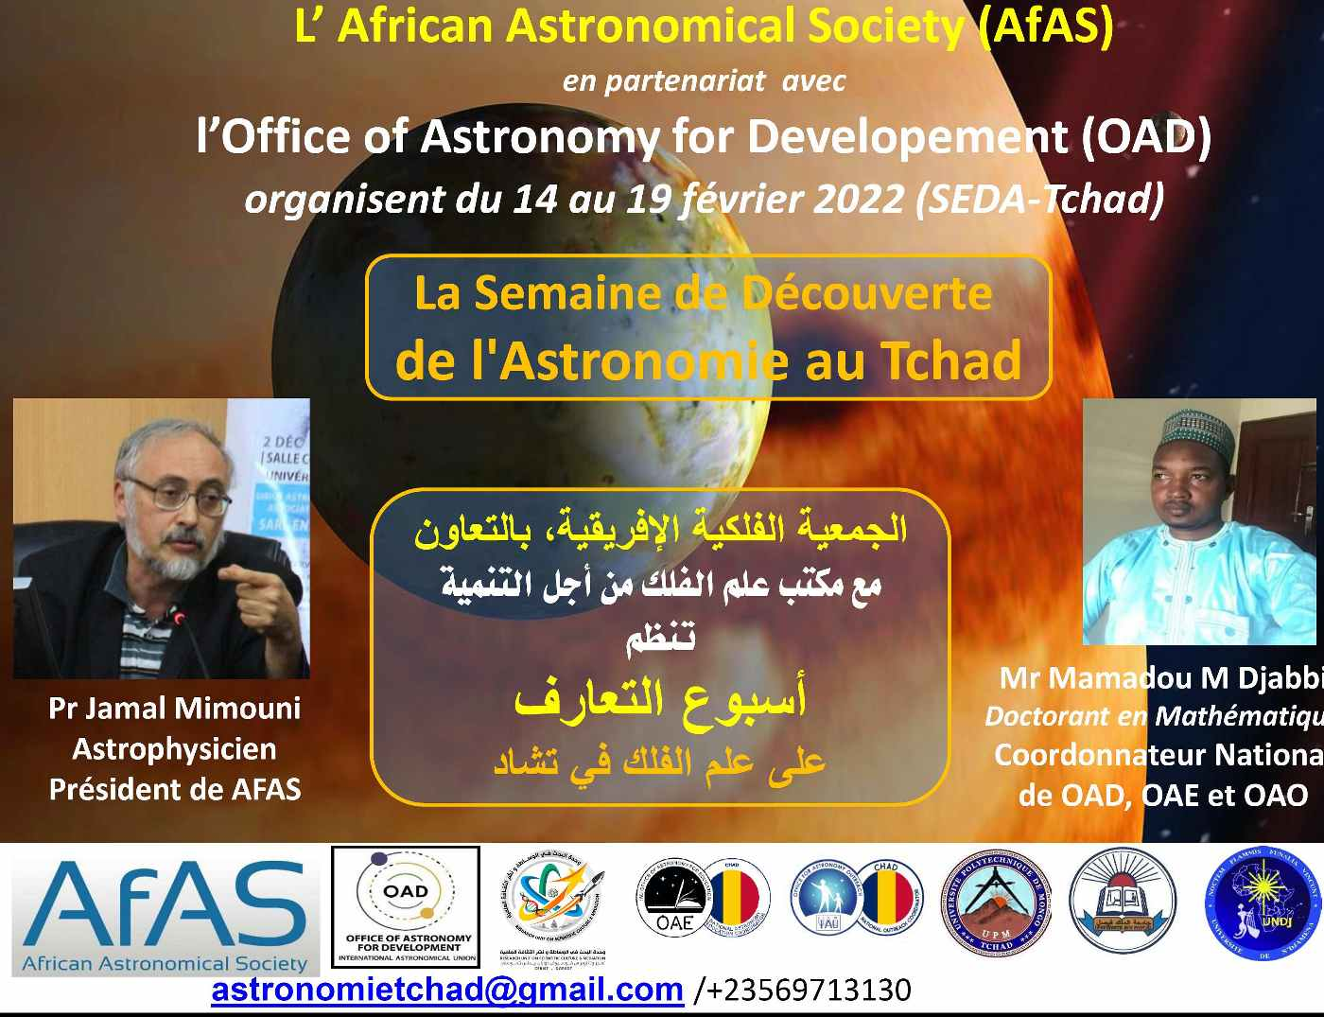
Outreach to Chad
Reaching out to the Universities, and Educational institutions and the public:

Slide 11
Outreach to Chad
Reaching out to the Universities and the Educational institutions
  18 activities including three Universities in the cities of Ndjamena and Mongo
  Conferences and meetings with faculty members
  Public lectures,
  - Meetings with various officials in the sector of education.
  - Radio and national TV appearances..

Slide 12
Program in Chad-I

Slide 13
Program in Chad II

Slide 14
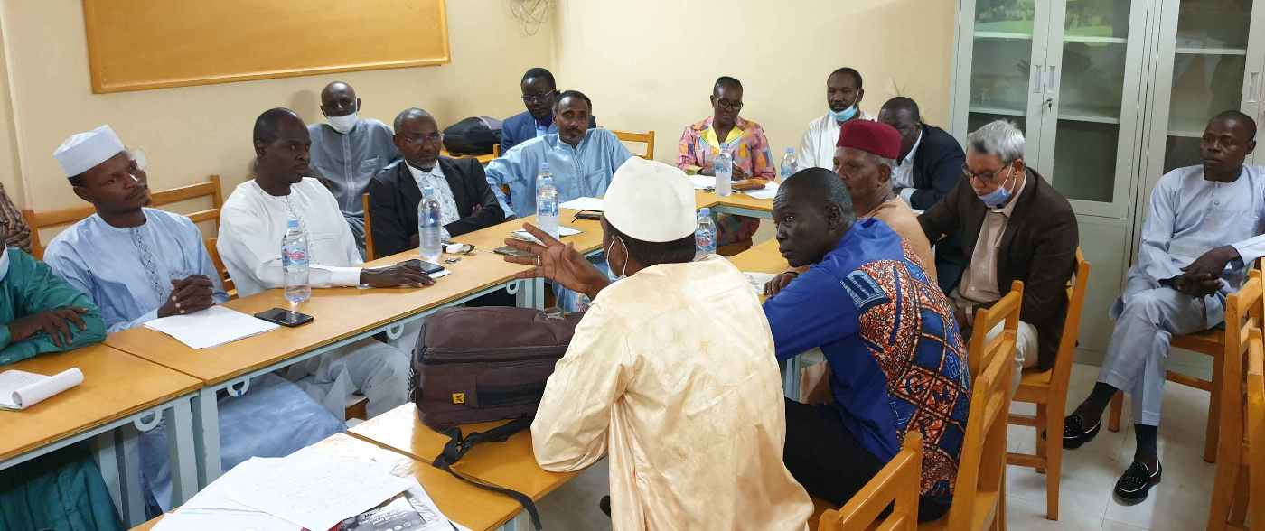
Outreach to Chad
University of Ndjamena, Faculté des Sciences

Slide 15
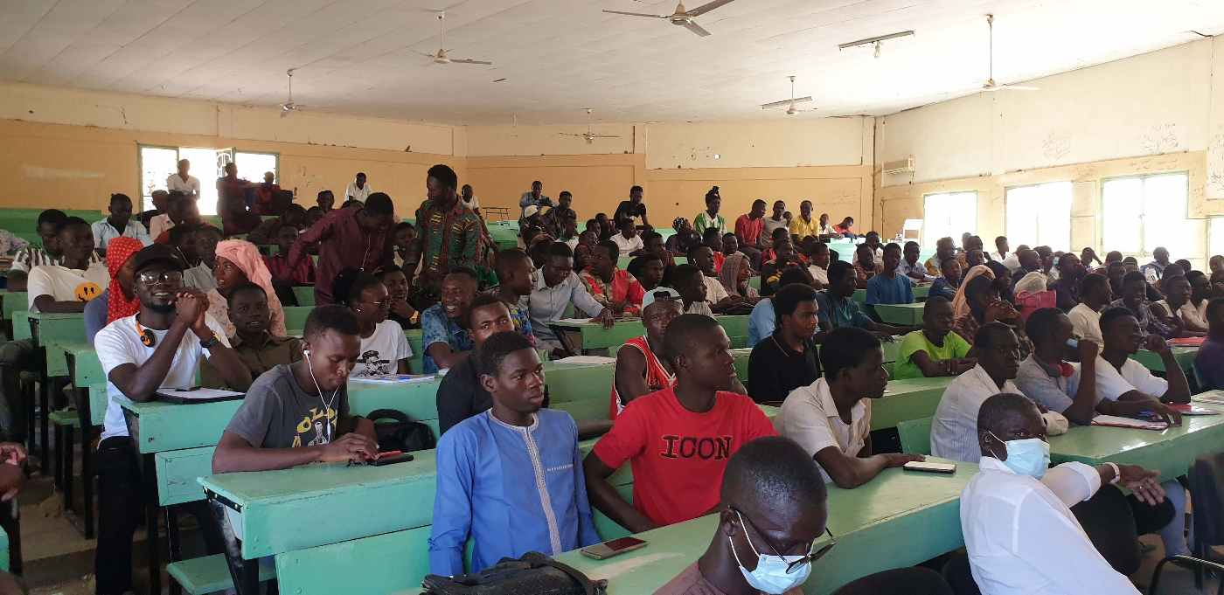
Outreach to Chad
University of Ndjamena

Slide 16
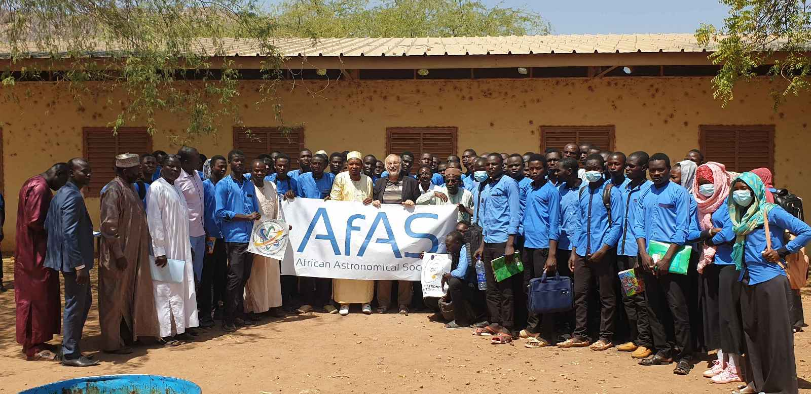
Outreach to Chad
Mongo Polytechnical University

Slide 17
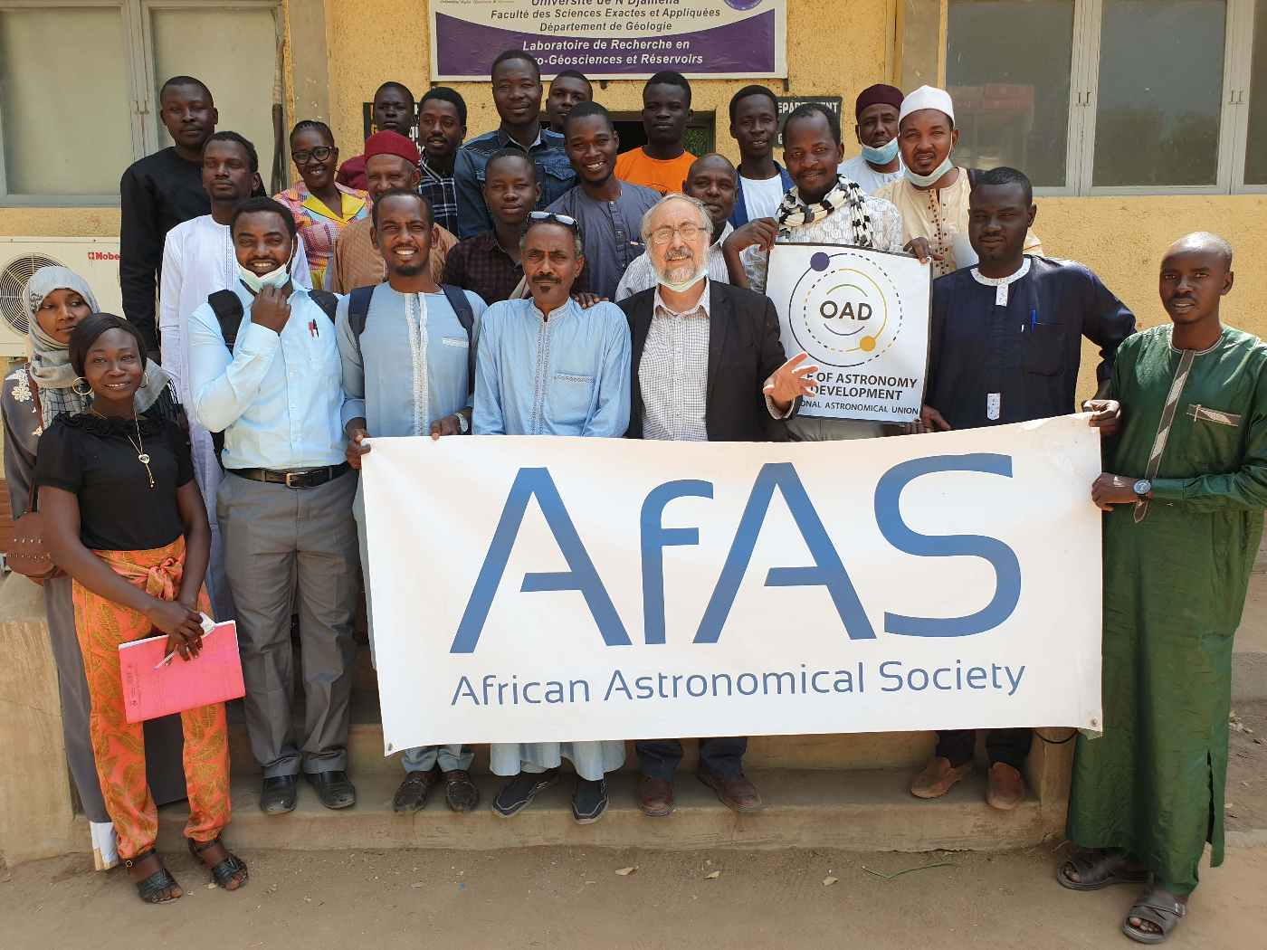
Outreach to Chad
High School in N’djamena

Slide 18
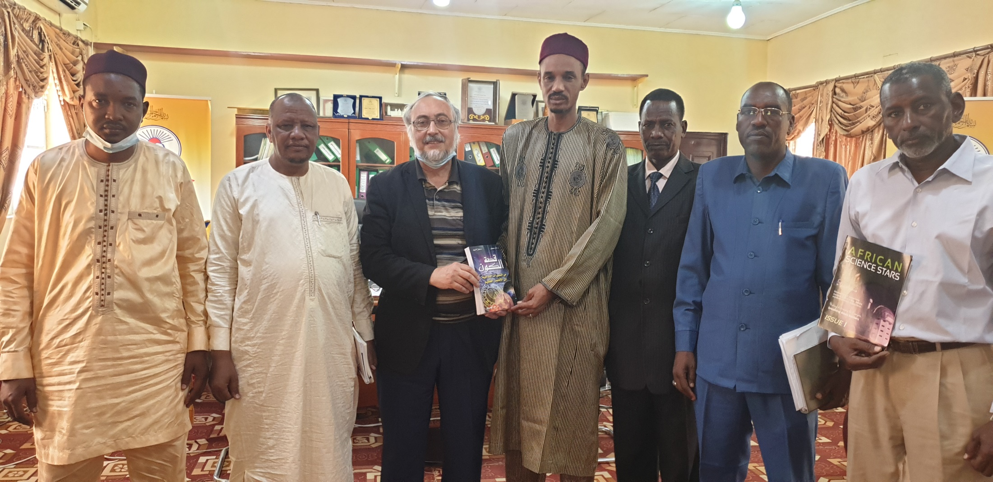
Outreach to Chad
King Faycal University

Slide 19
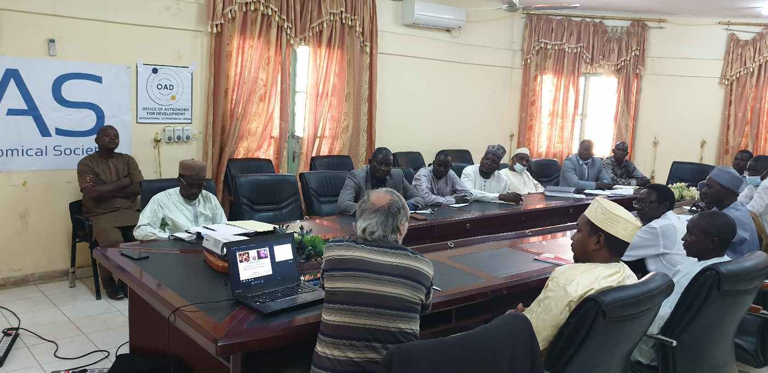
Outreach to Chad
Mongo Polytechnical University,
with the Faculty members

Slide 20
Outreach to Chad
Mongo Polytechnical University

Slide 21
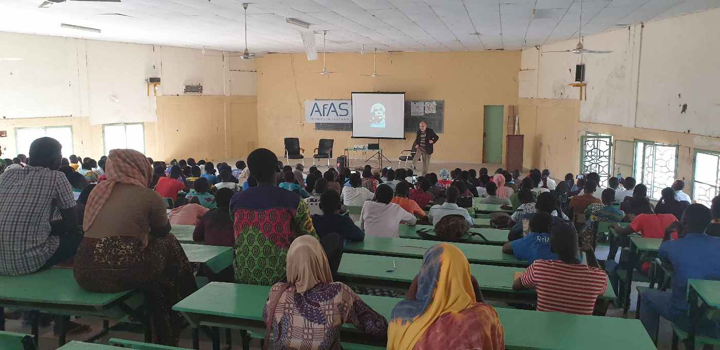
Outreach to Chad
Mongo Polytechnical University

Slide 22
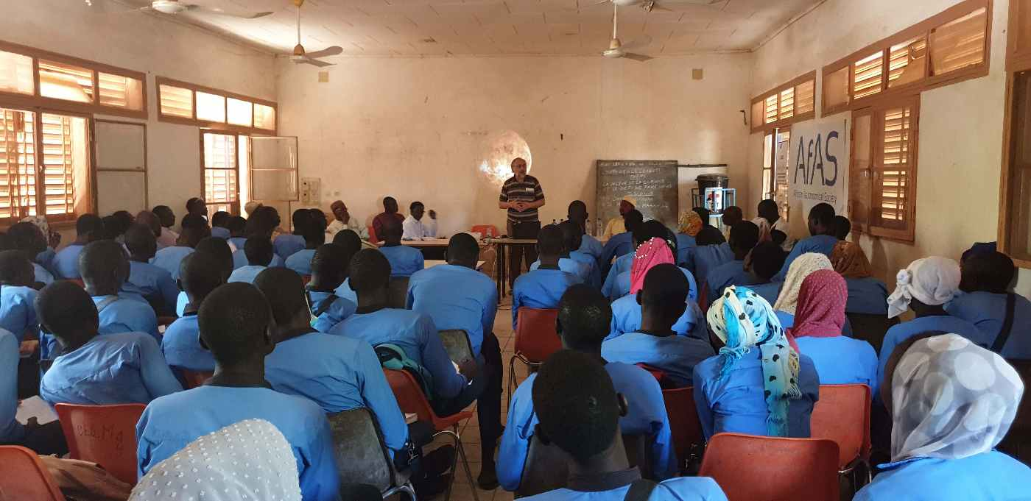
Outreach to Chad
High School

Slide 23
Outreach in Niger
Reaching out to the Universities and the Educational institutions

Slide 24
Outreach to Niger-I
Ten activities in Niamey and Niamey region
- public lectures,
- conferences and meeting with faculty members and a - - - meeting with the staff of the Ministry of Higher Education

Slide 25
Outreach to Niger-II
10 activities in Niamey and Niamey region

Slide 26
Outreach to Niger
Niamey King Faycal University

Slide 27
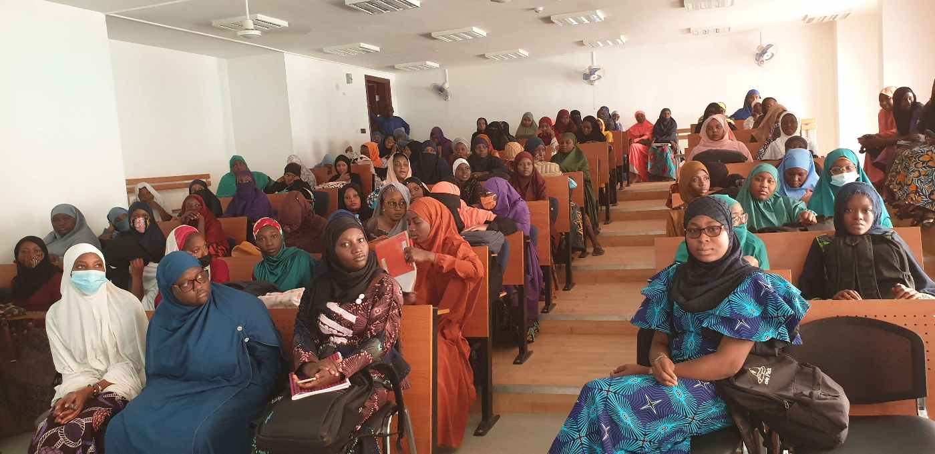
Outreach to Niger
Niamey, King Abdullah University

Slide 28
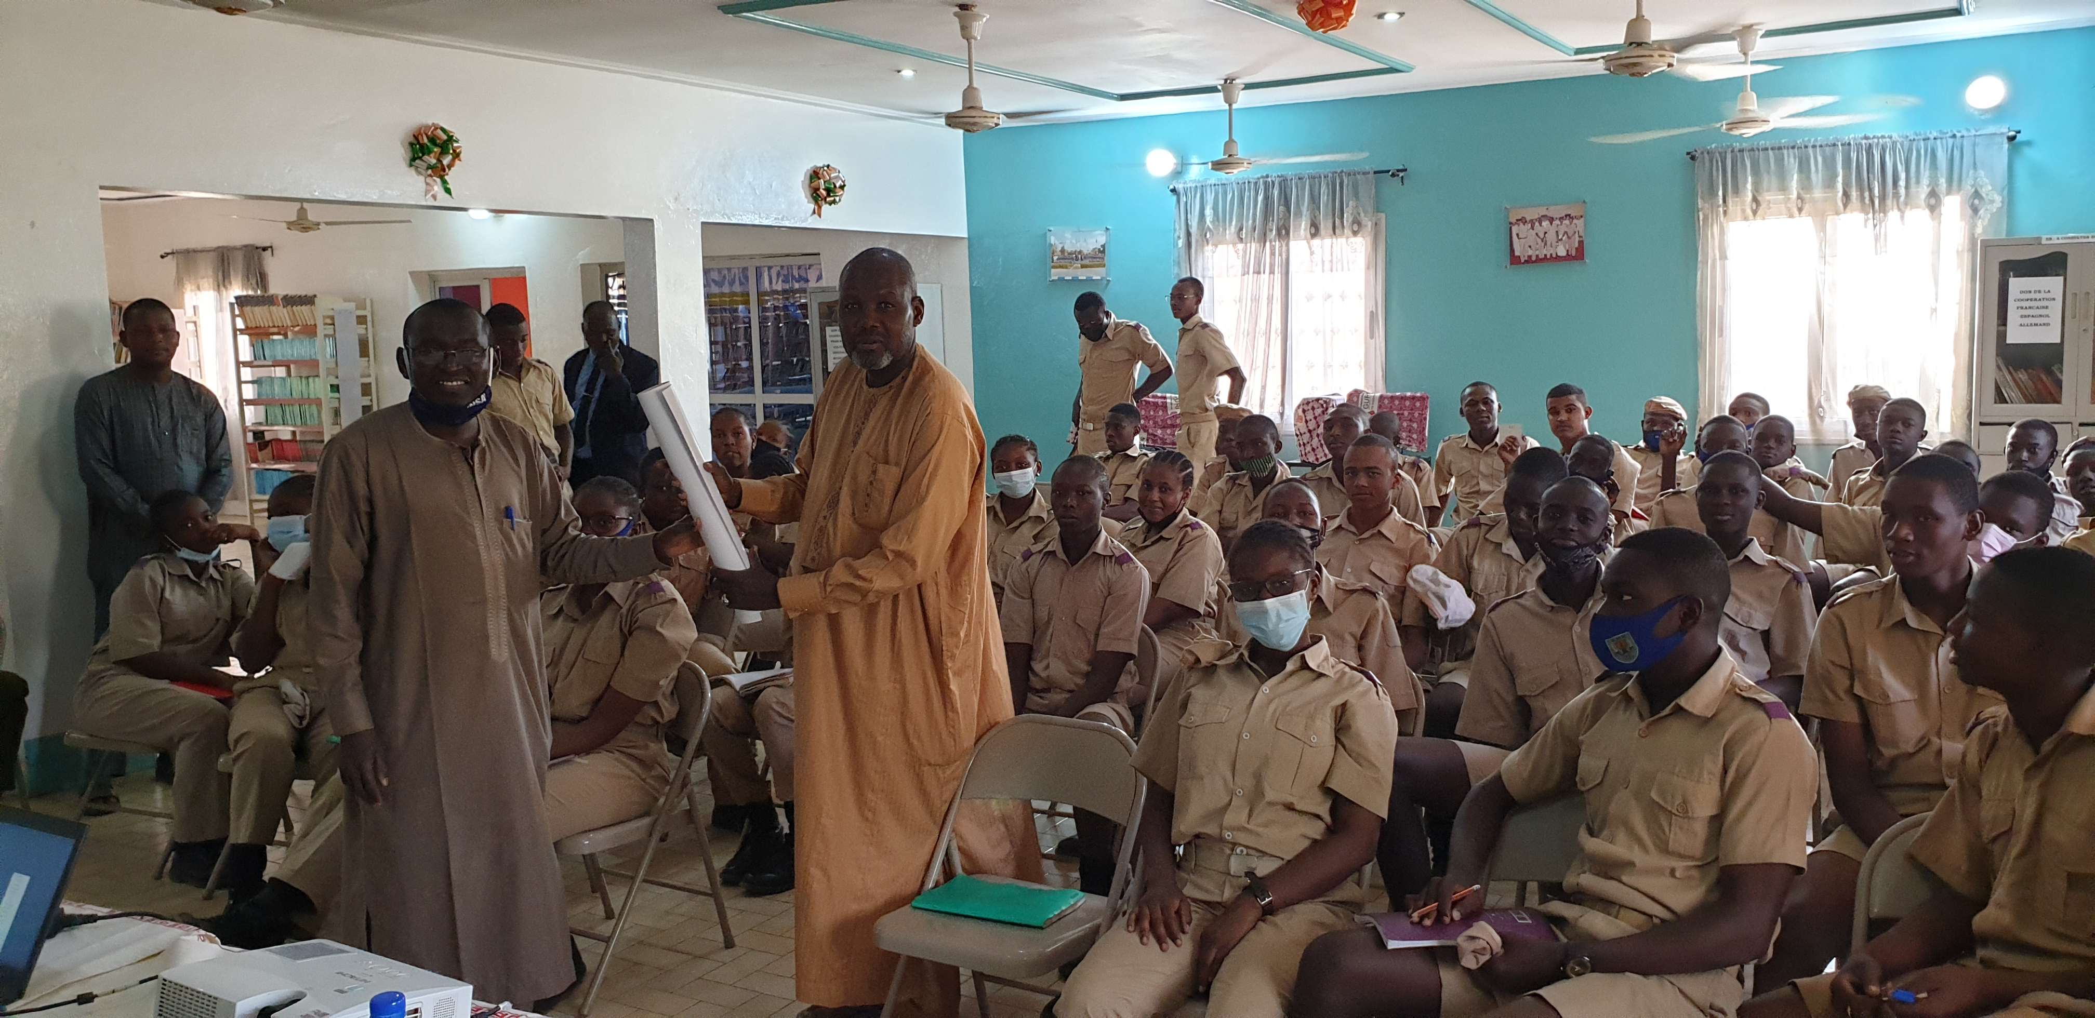
Outreach to Niger
Niamey, Military High School

Slide 29
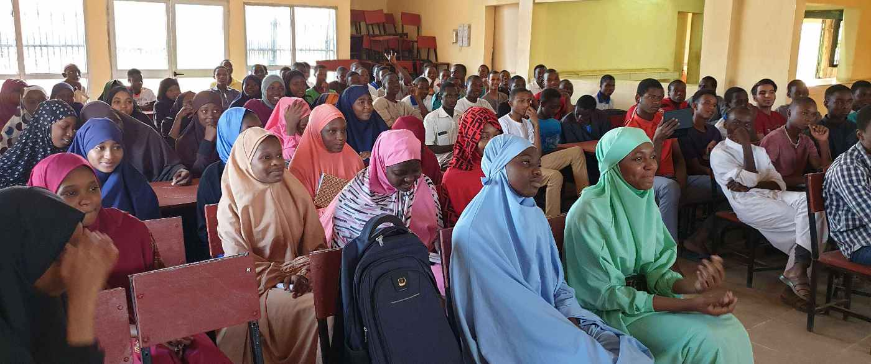
Outreach to Niger
Niamey, Lycée d’Excellence

Slide 30
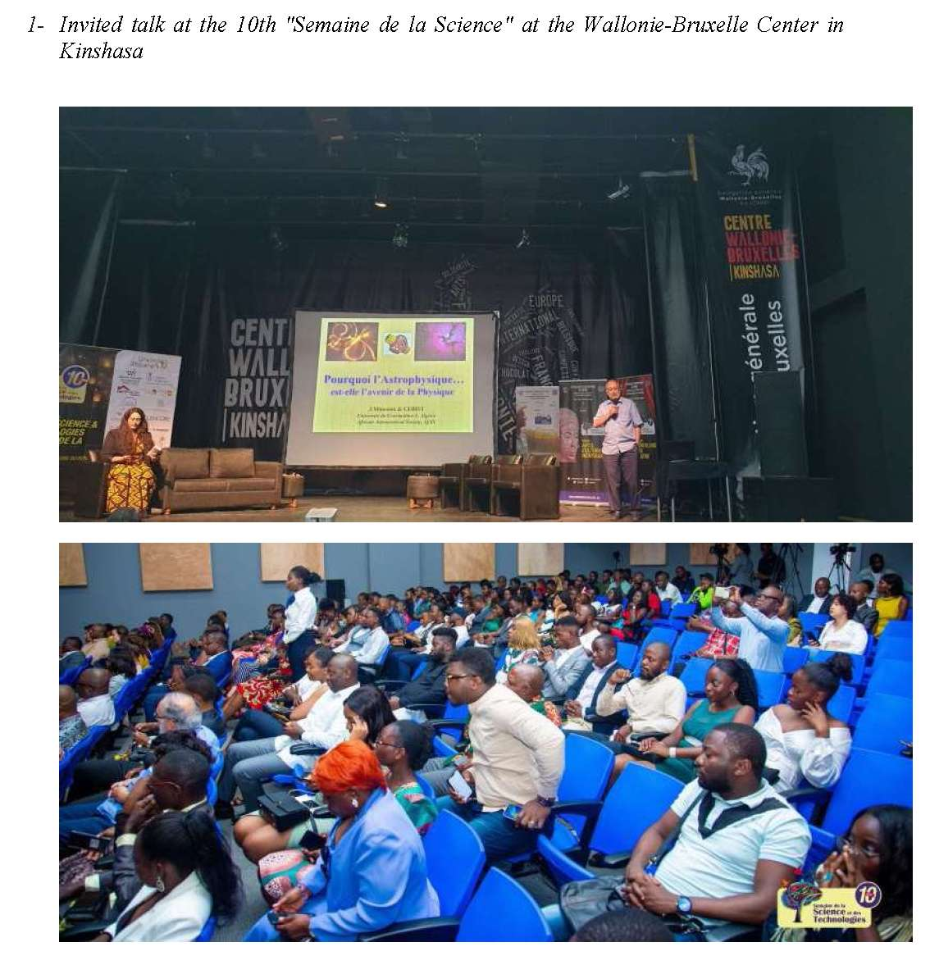
GAO to RDC-Congo April 2023

Slide 31
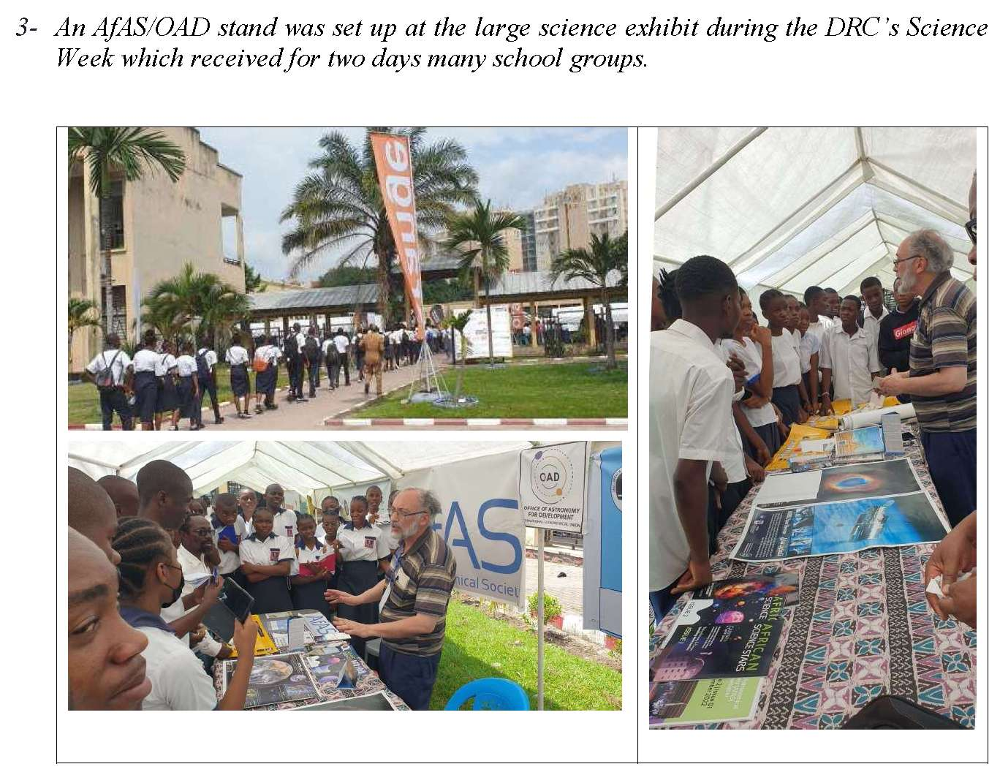
Outreach to RDC-Congo April 2023

Slide 32
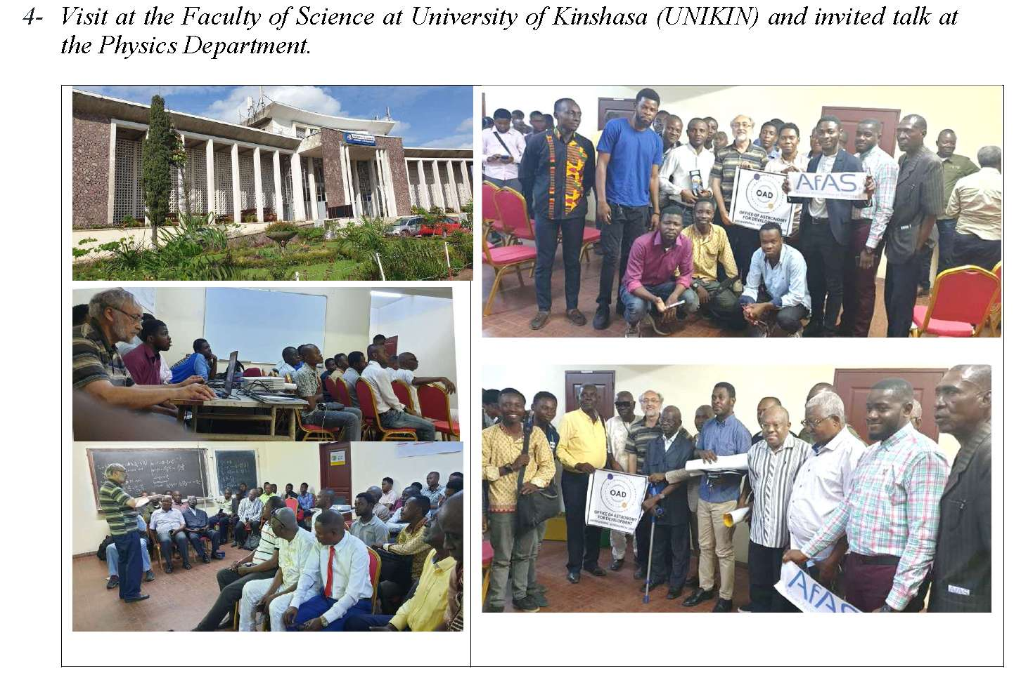

Slide 33
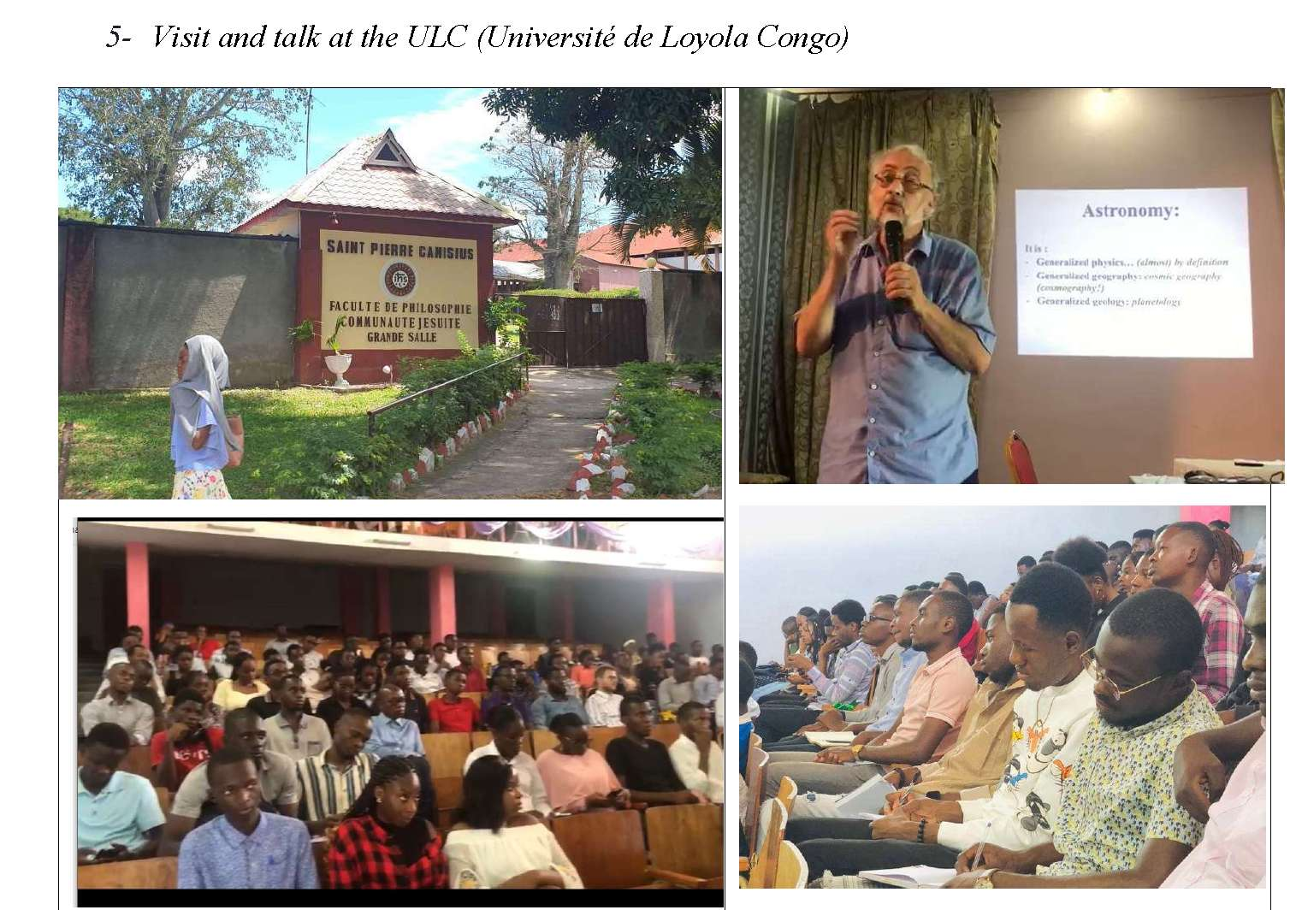

Slide 34
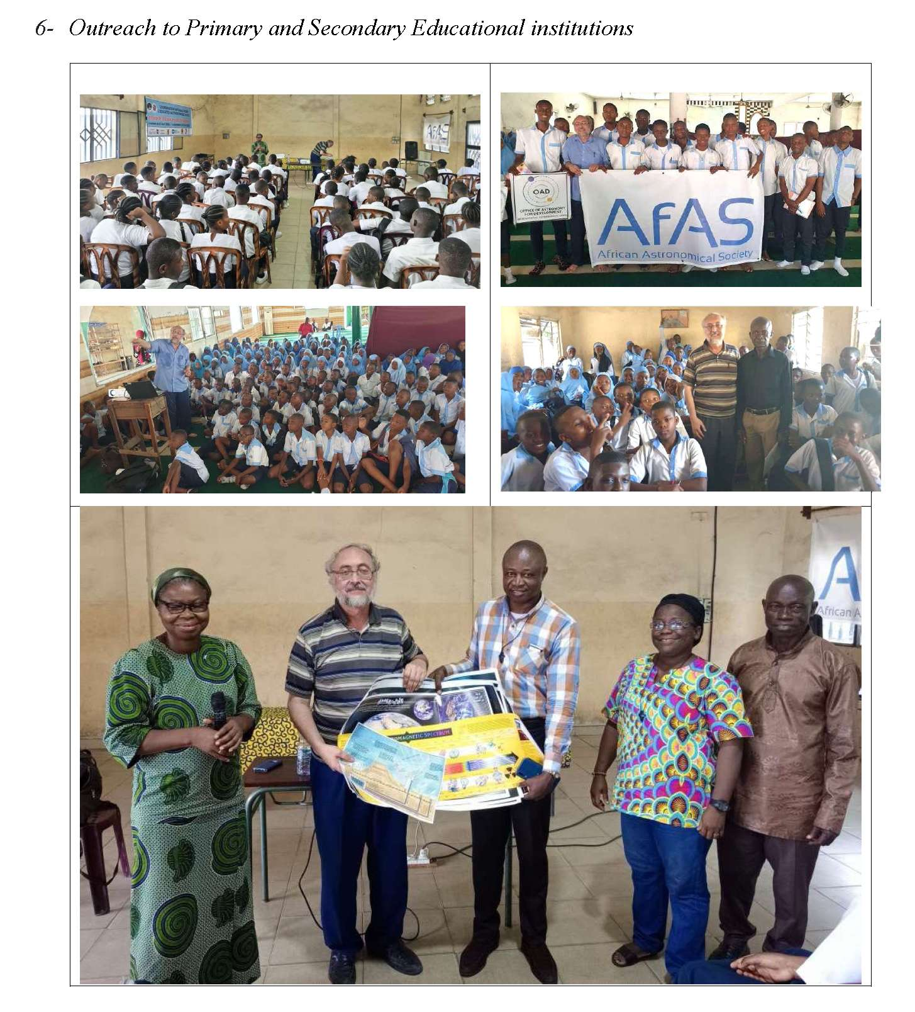

Slide 35
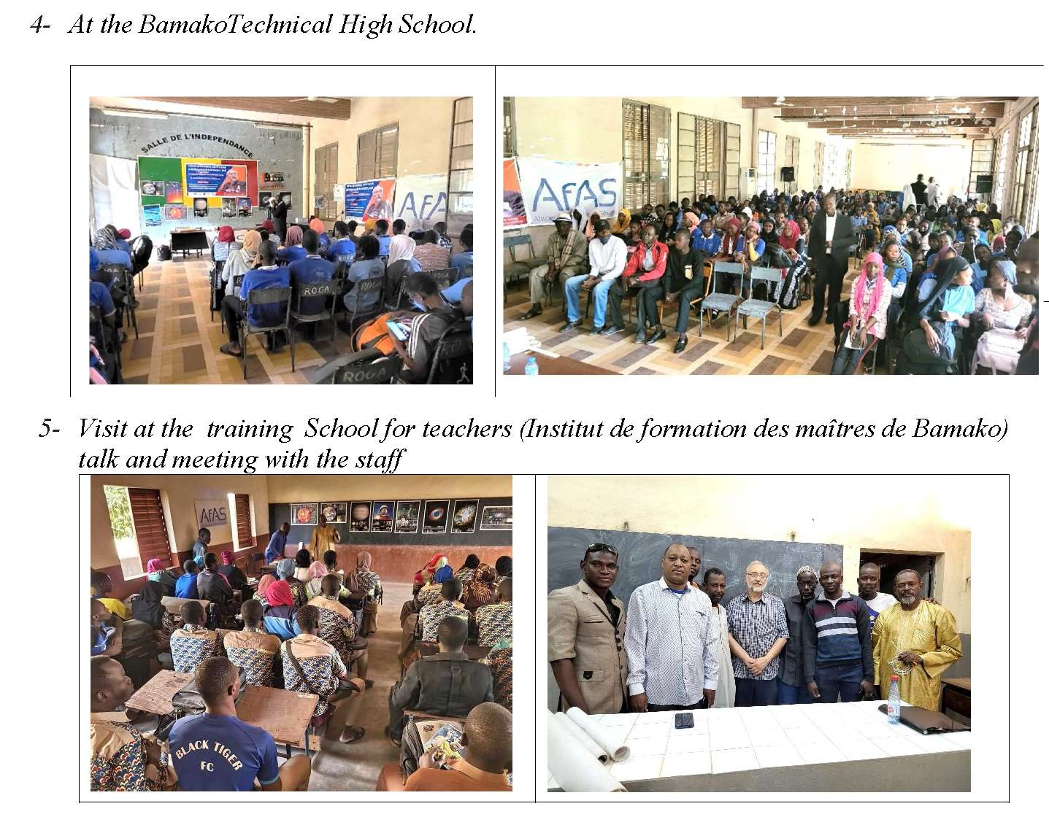
GAO to Mali & Guinea
February 2024

Slide 36
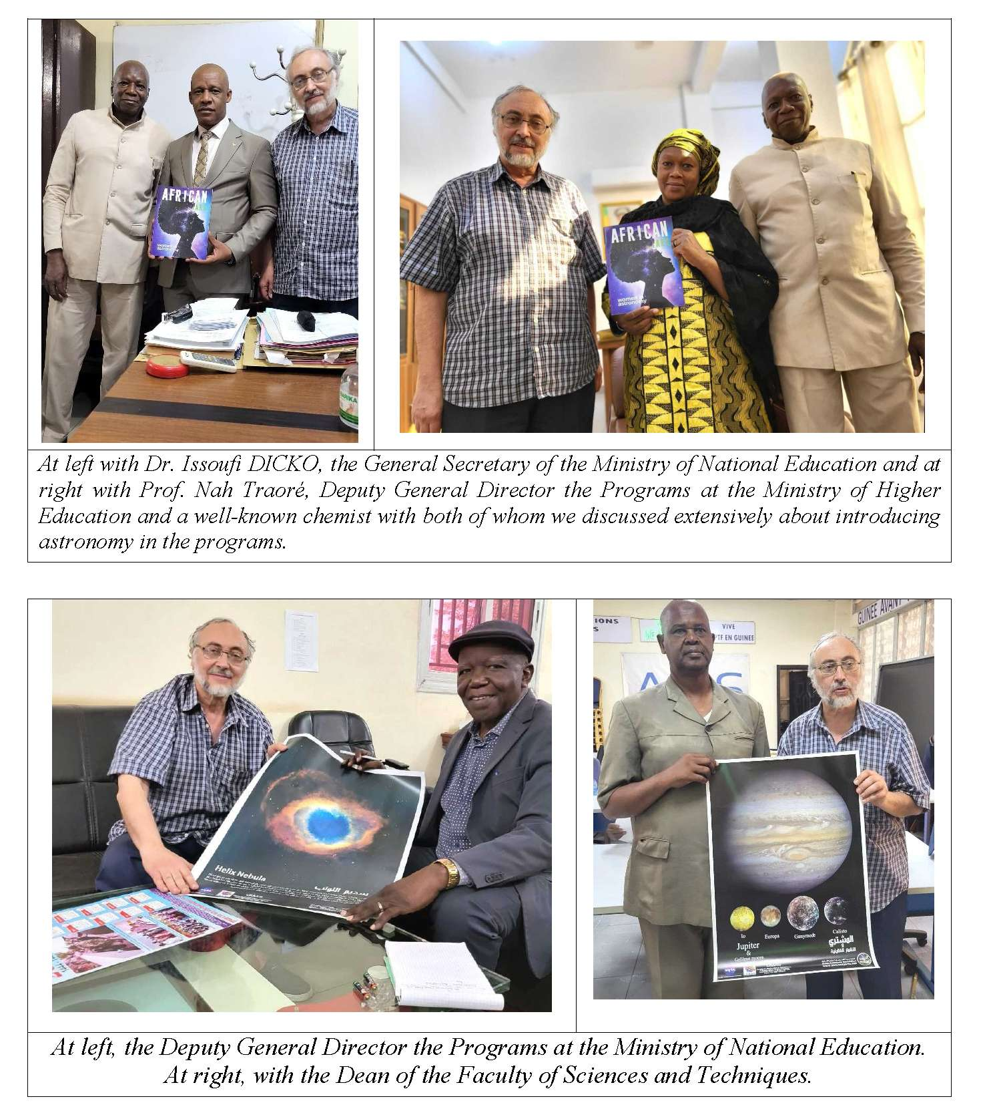
GAO to Mali & Guinea
February 2024

Slide 37
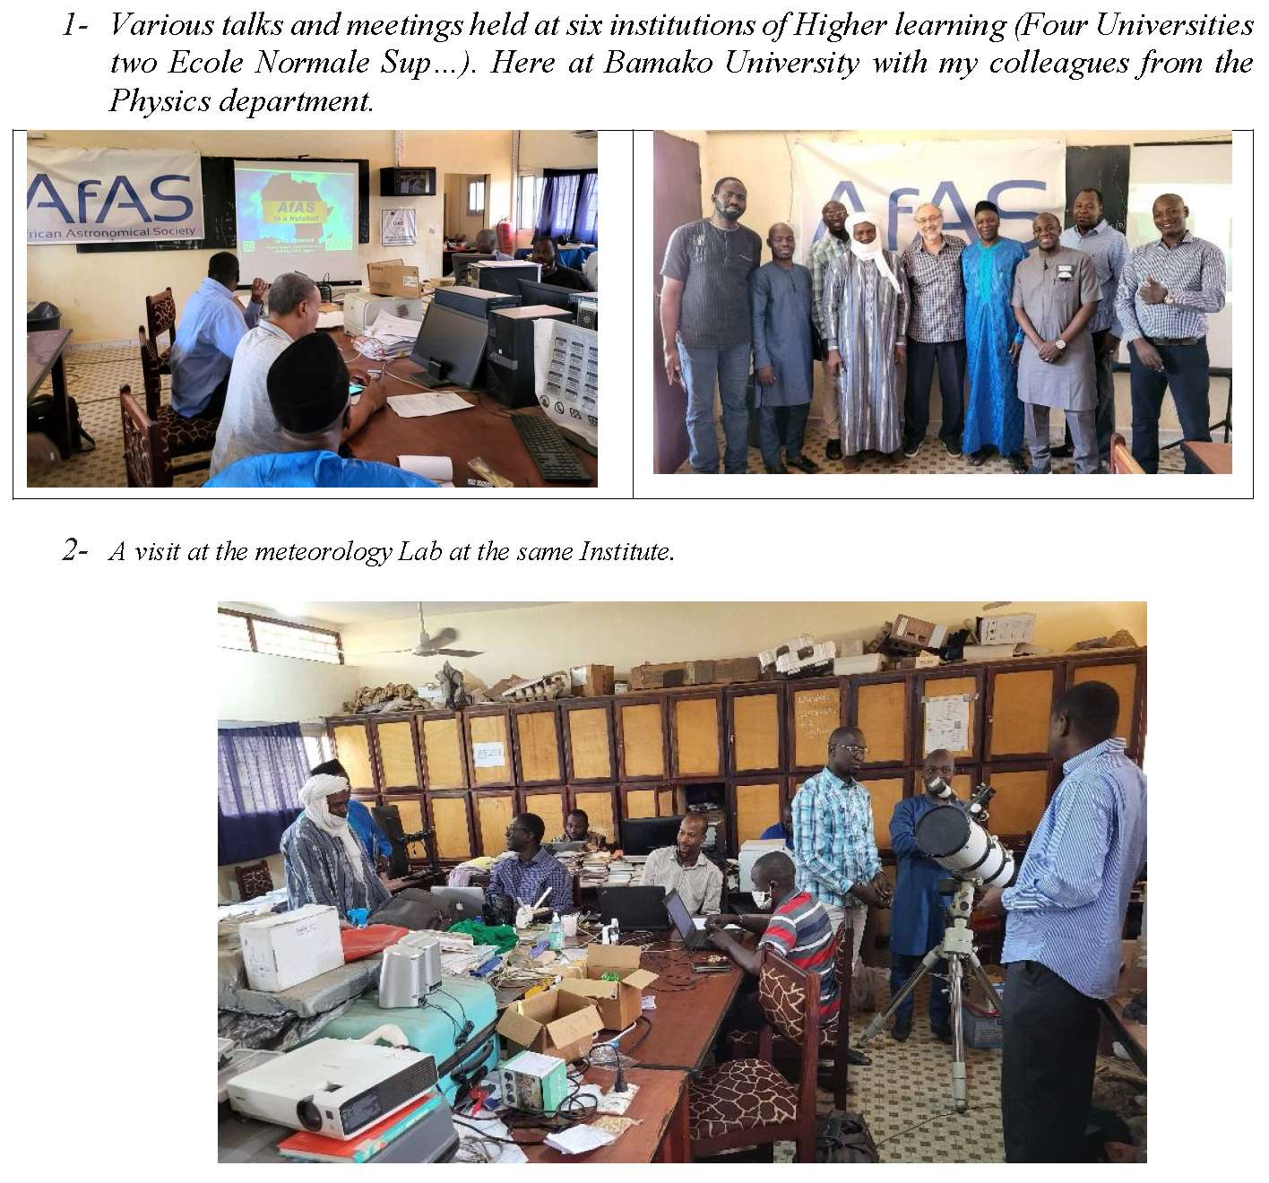
GAO to Mali & Guinea
February 2024

Slide 38
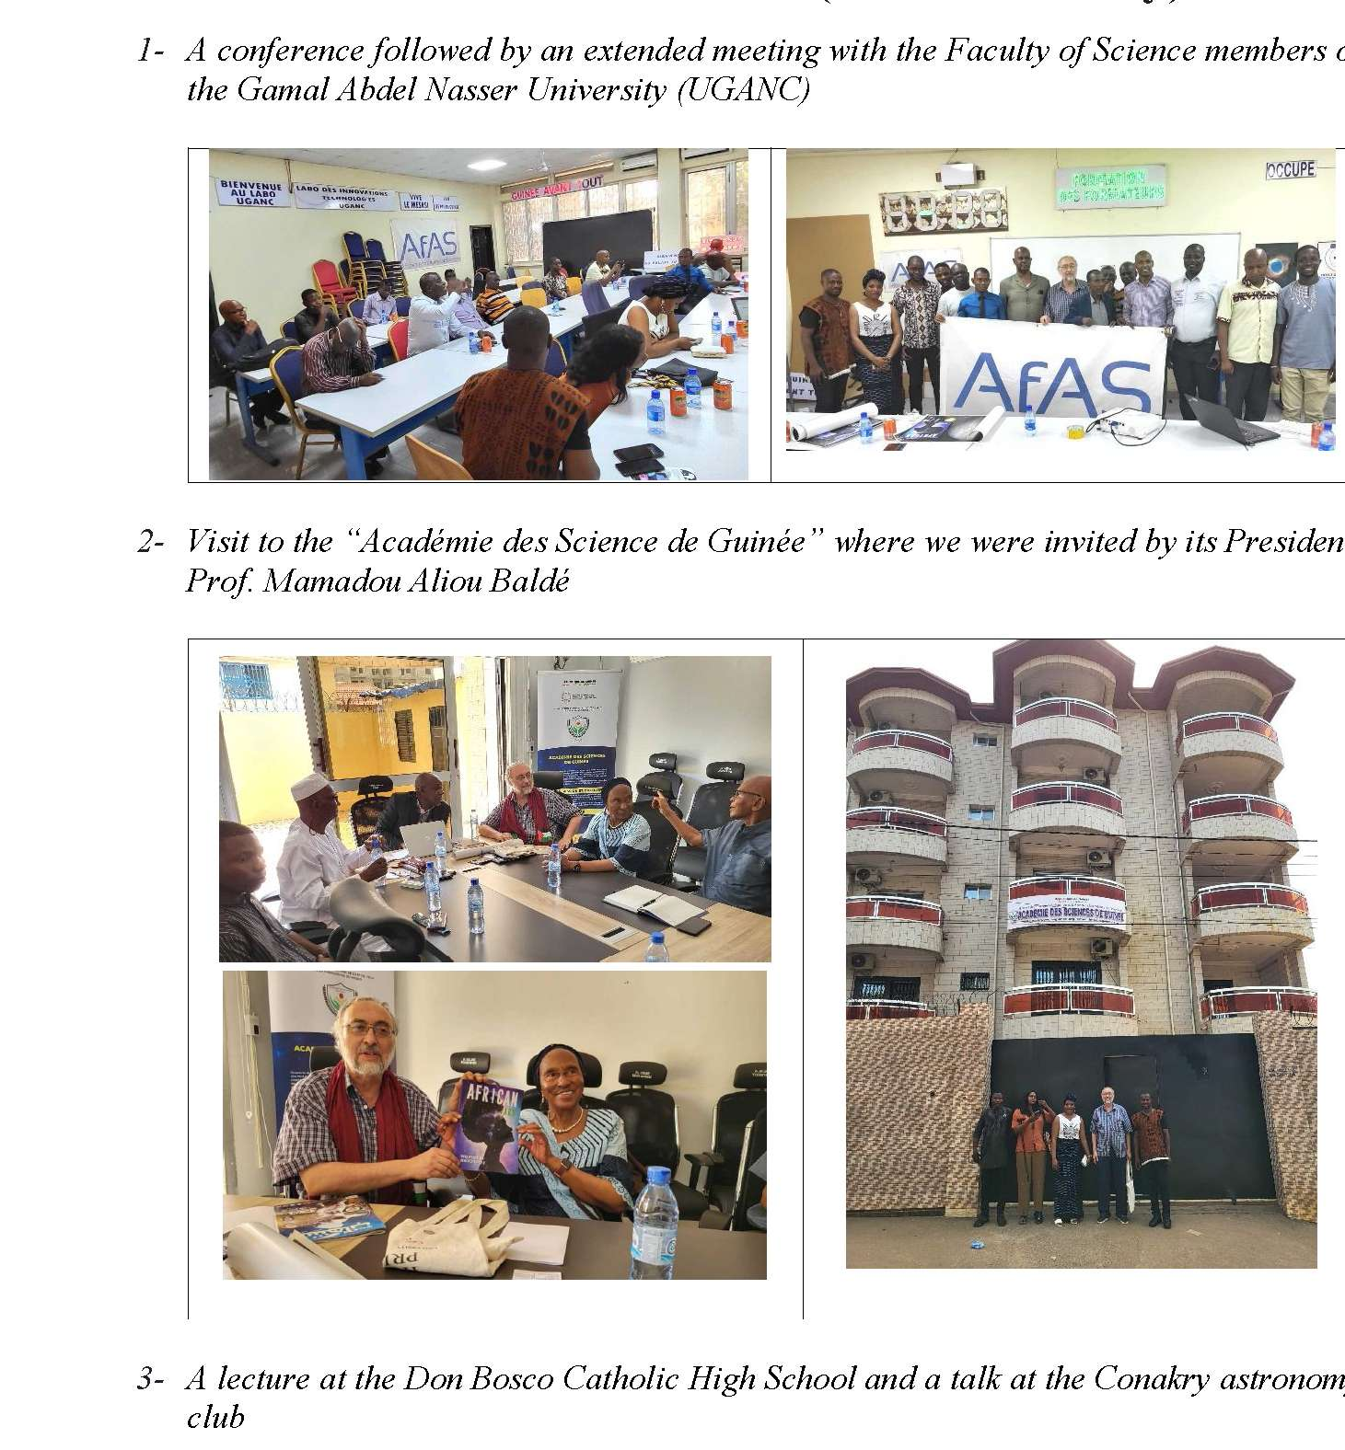
GAO to Mali & Guinea
February 2024

Slide 39
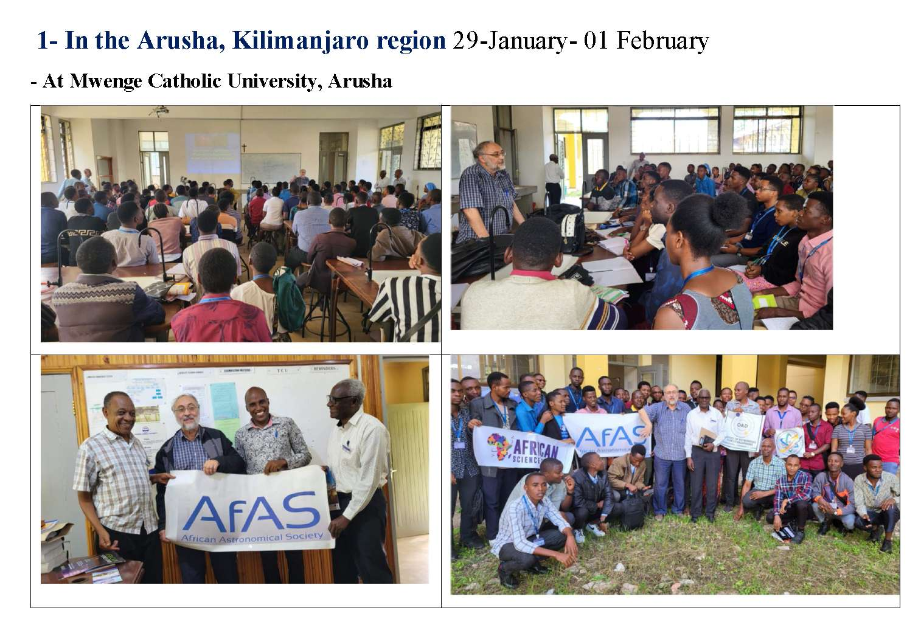
GAO to Tanzania
February 2025

Slide 40
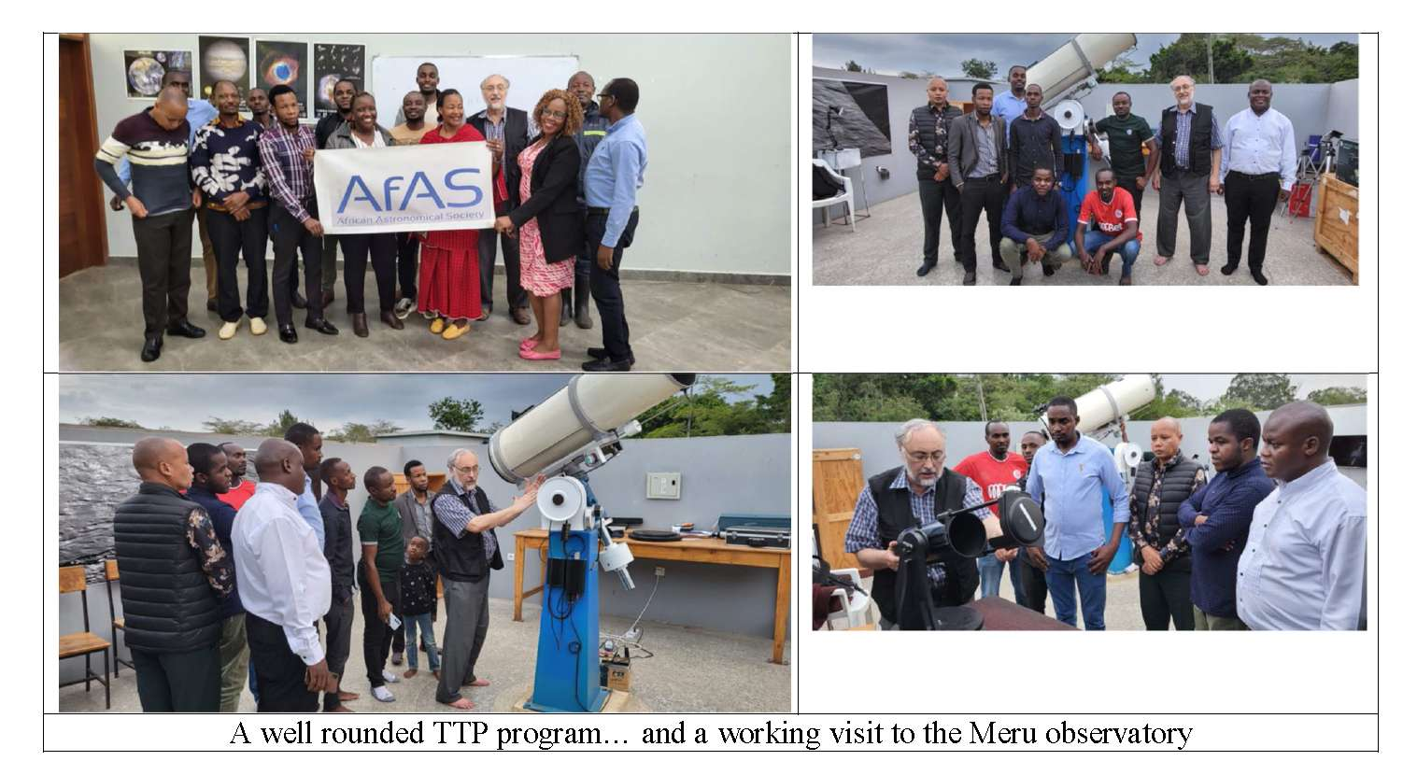

Slide 41
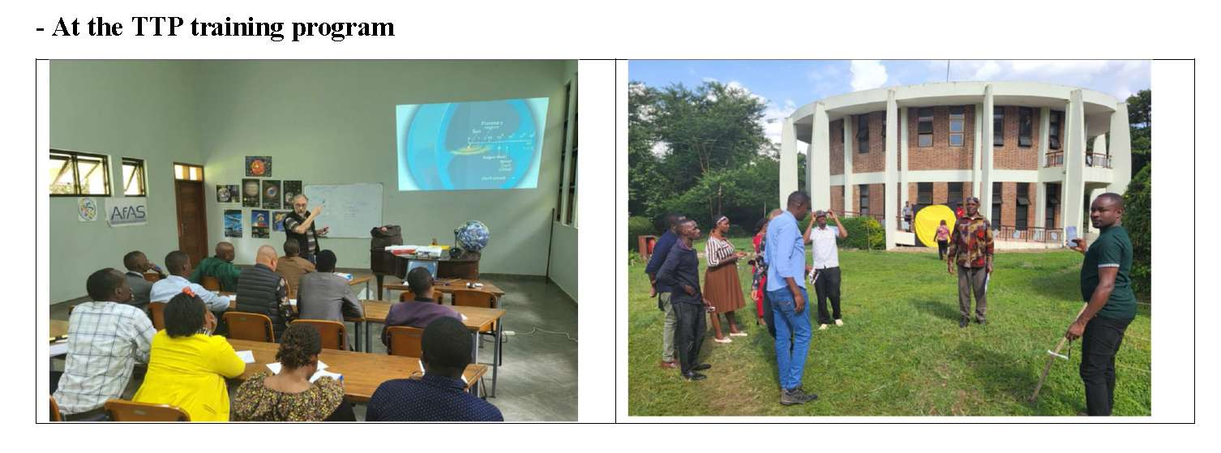

Slide 42
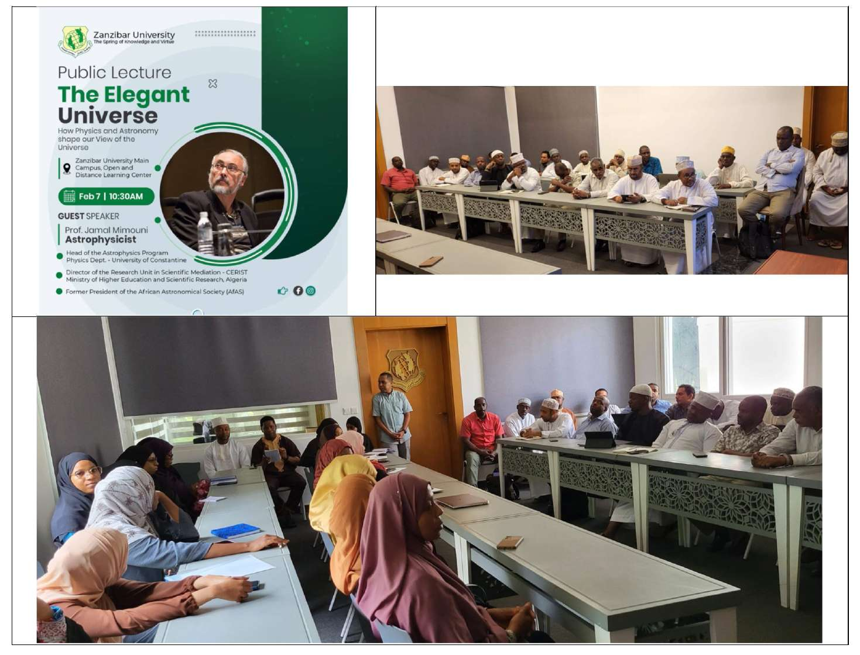

Slide 43
GAO to Cameroon & Benin
February 2026
Institutional Engagement:
Meetings at the University of Douala focused on academic requirements for integrating astrophysics into existing physics frameworks.
Technical Lectures:
Presentations characterized astrophysics as a "generalization of physics" to make research windows available for undergraduate students.
Advanced Mathematics:
Engagement at AIMS-Cameroon targeted students with advanced mathematical backgrounds to discuss cosmology and the physics landscape.
National Roadmap:
High-level discussions with the Ministry of Higher Education addressed the long-term institutionalization of astronomy in the national system.
Secondary Outreach:
Lecturing sessions at major institutions, such as the High School of Buea, complemented official physics and mathematics curricula.

Slide 44
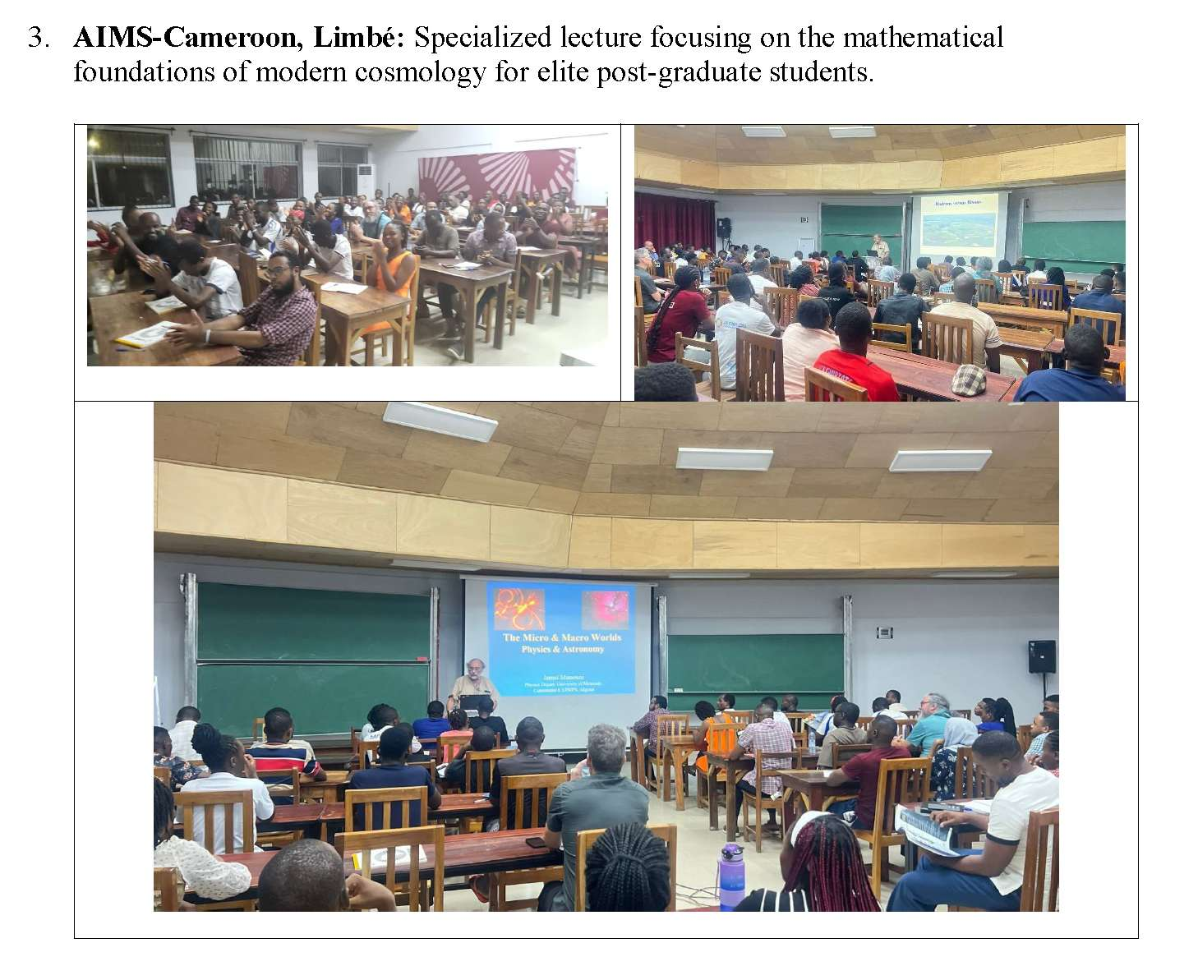
GAO to Cameroon & Benin
February 2026

Slide 45
GAO to Cameroon & Benin
April 2026

Slide 46
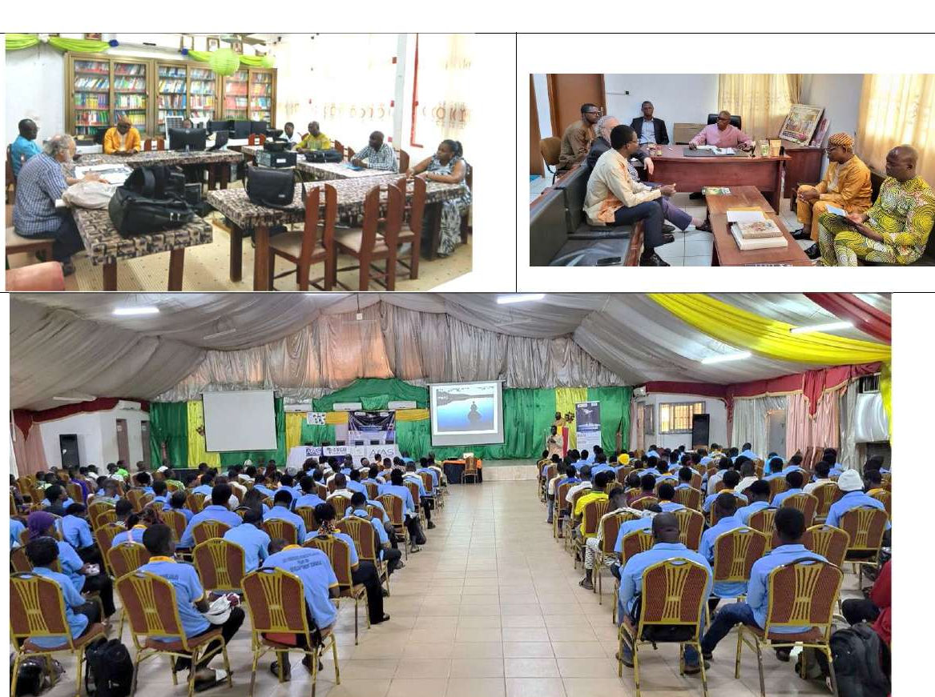

Slide 47
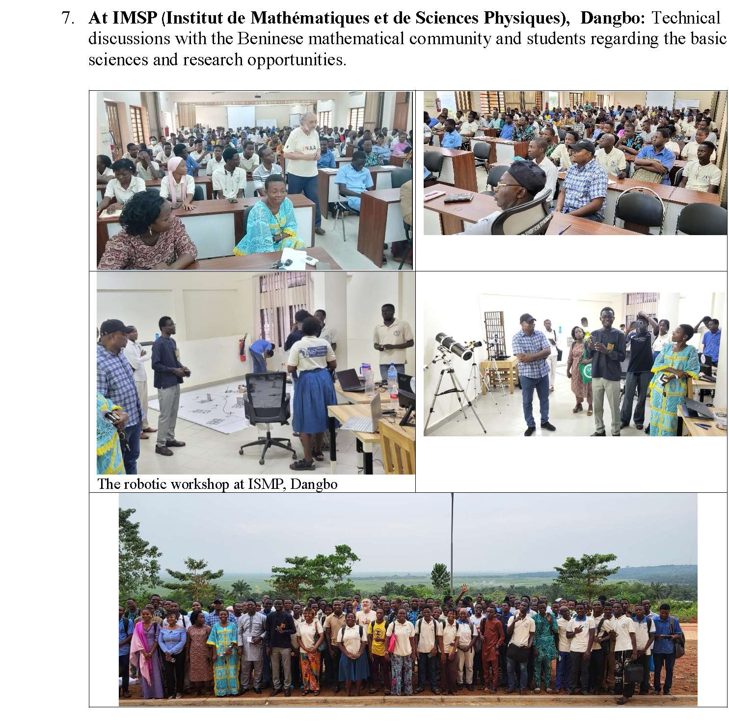

Slide 48
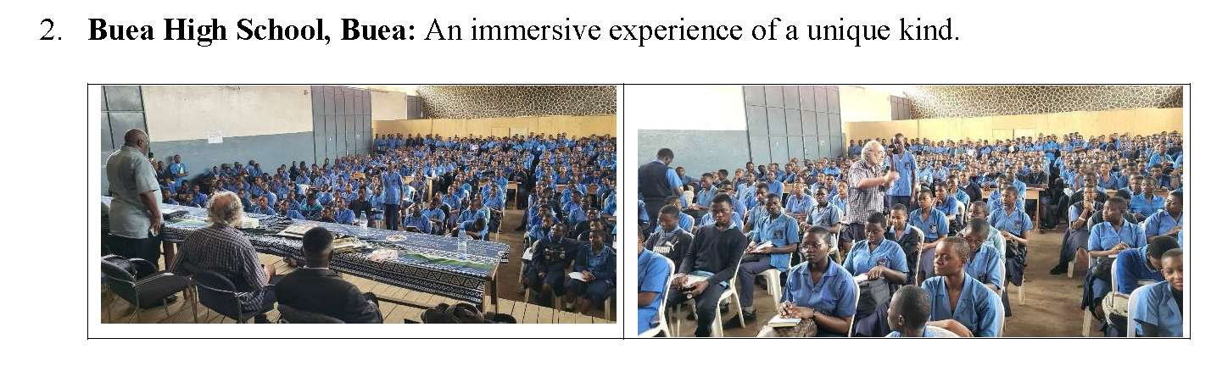

Slide 49
Pedagogical Challenges in Unreached Nations
Education of Educators:
A critical need to train teachers at Normal Schools to incorporate astronomy into national physics and chemistry programs.
LMD Integration:
Missions advocate for introducing anastronomy course as an optional offering within the LMD system at major universities.
Interface with Culture:
Astronomy provides scientific bases for some social practices, such as lunar calendar calculations for religious months.
Mathematical Foundations:
Mathematics as a foundation for GR and computational research.

Slide 50
Linguistic Zones
Francophone Coverage:
GAO missions have successfully reached about 70% of Sub-Saharan French-speaking Africa.
Infrastructure Gaps:
Severe operational constraints include chronic electricity shortages and a lack of administrative follow-up within AfAS.
Political Volatility:
Civil unrest and general strikes in regions like Guinea, Cameroon can limit academic activities.
Linguistic Isolation: Countries in linguistically illusory self-sufficiency () remain a challenge for continental mesh-up.
Future Frontiers:
Portuguese and Spanish-speaking African nations remain the most "left out" and require future missions with dedicated speakers.

Slide 51
Technical Recommendations for Sustainability
MSc and PhD Tracks:
Provide scholarships to bright students through the NASSP program in South Africa or the AU-EU science program.
Instrument Provision:
Supply physics departments with "advanced amateur" reflector telescopes (approx. 2000 euros) and CCD cameras.
Science Materials:
Continue the extensive distribution of sky maps, high-quality posters, and African Science Stars magazines.
Portable Planetariums:
Implement schemes to donate portable planetariums to African institutions for public and school outreach.
Institutional Support:
Local institutions must be assisted in securing government support to integrate astronomy into national development plans.

Slide 52
Linguistic Zones
Awareness raising vs. Programs:
The greatest challenge : the transition from temporary sensitization to permanent academic programs.
Resource Prioritization:
Implementation of follow-up strategies requires a more robust commitment of resources on the AfAS executive agenda.
Inclusive Future:
The ultimate goal is ensuring that "No African state is to be left behind" from the broader African scientific community.

Slide 54
Technical Recommendations for Sustainability
MSc and PhD Tracks:
Provide scholarships to bright students through the NASSP program or equivalent in South Africa or the AU-EU science program.
Instrument Provision:
Supply physics departments with (almost) Research grade or "advanced amateur" reflector telescopes (approx. 3000 euros) and CCD cameras. PANOPTES could be one … or entry-level radiotelescope…
Portable Planetariums:
Donated or purchased affordable portable planetariums to African institutions for public and school outreach.
Institutional Support:
Local institutions must be assisted in securing government support to integrate astronomy into national development plans.

Slide 55
Conclusion
A Strategic plan for the unreached Countries in Africa
Some 40 countries in Africa have no astronomy at any level…
Next decade of African astronomy should be defined not by isolated excellence, but by intentionally inclusive, continent-wide growth.
AfAS is devoted 1% or less of its budget for 40 countries : It should do better!
The future is bright, but only if it shines for all.

Slide 56
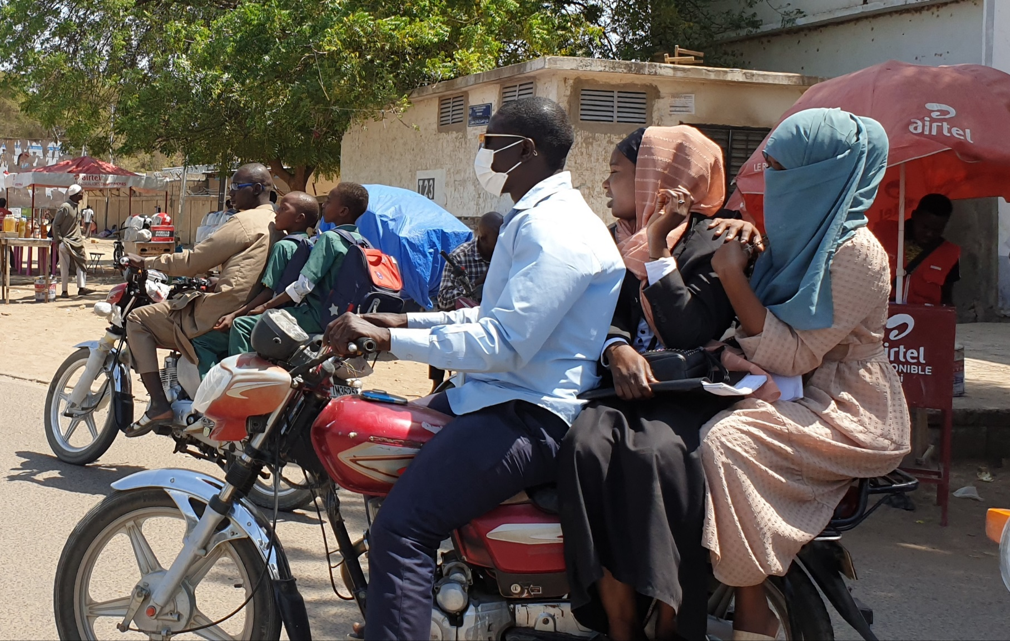
The Thirst of learning…

Slide 57
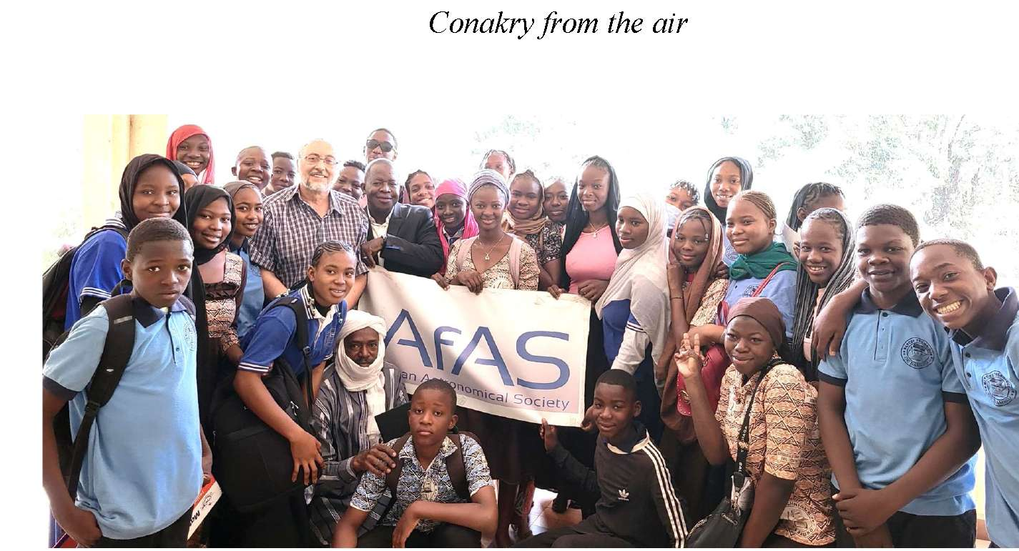
The Thirst of learning…

