Slide 1
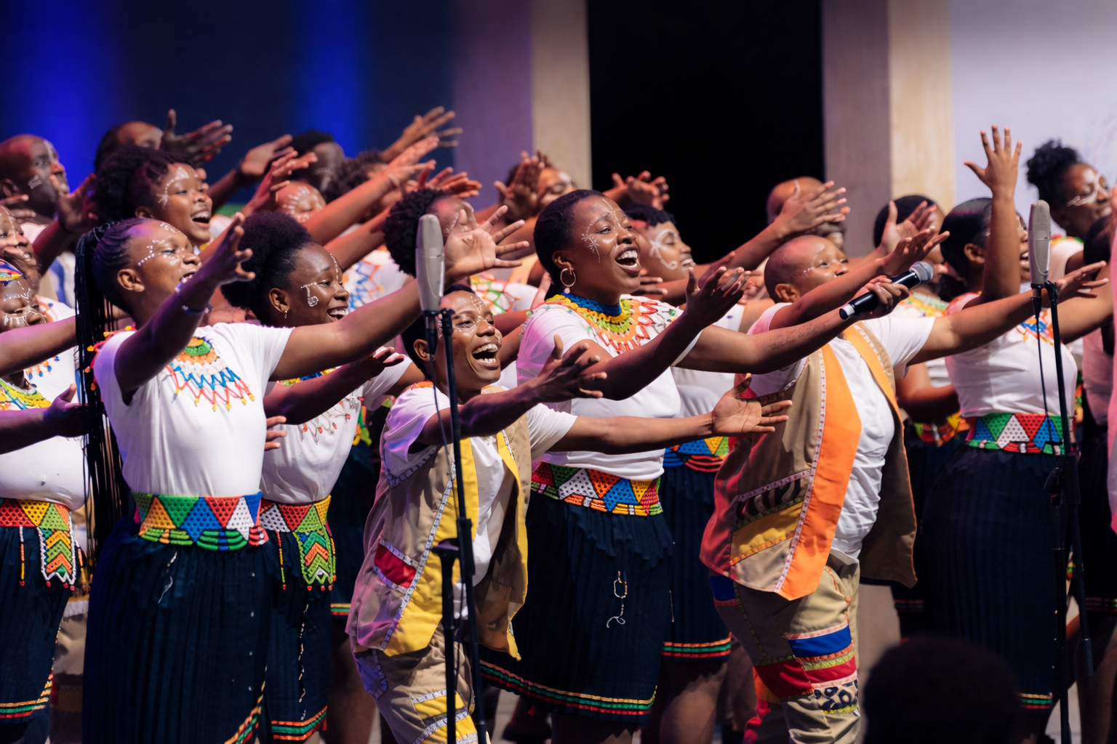





Singing the Skies of Africa: Music as a Tool for African Astronomy, Identity, and Impact
S. Sottie, N. Asabre Frimpong, K. Govender, C. Takalani, D. Kubheka, E. Proven-Adzri, B. Woode, A. Forson, J. Kwakuyi, R. Venugopal, V. Samboco
AfAS 2026 – Kasane, Botswana; March 22-27, 2026
Notes:
Introduce yourself. Briefly explain the dual identity as astronomer and musician. Frame the talk as an exploration of how music can function as a scientific communication tool.

Slide 2
What if Astronomy did not only publish papers… but also sang?
Notes:
What if astronomy didn’t only publish papers… but also sang?”
“Today, I’ll show how music can function as a tool for science communication, identity, and measurable impact in African astronomy.”

Slide 3
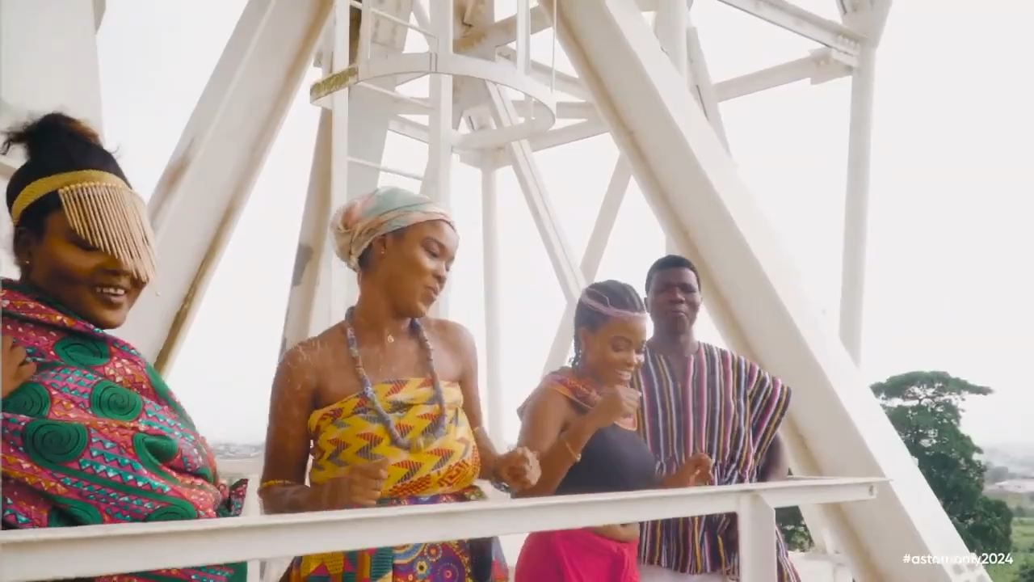

THE BIG IDEA
Africa’s astronomy is rising
But science communication must also evolve
Introducing Go Africa—The Astronomers’ Anthem
Notes:
Africa’s astronomy is rising rapidly — in infrastructure, data, and collaboration.
“But science communication has not evolved at the same pace.”
Duduzile????
“So the question we asked was simple:
Can music carry science?”

Slide 5





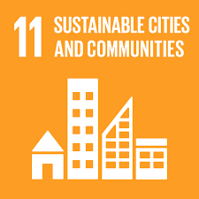

Why?
Why should we care?
The SDGs

Slide 6
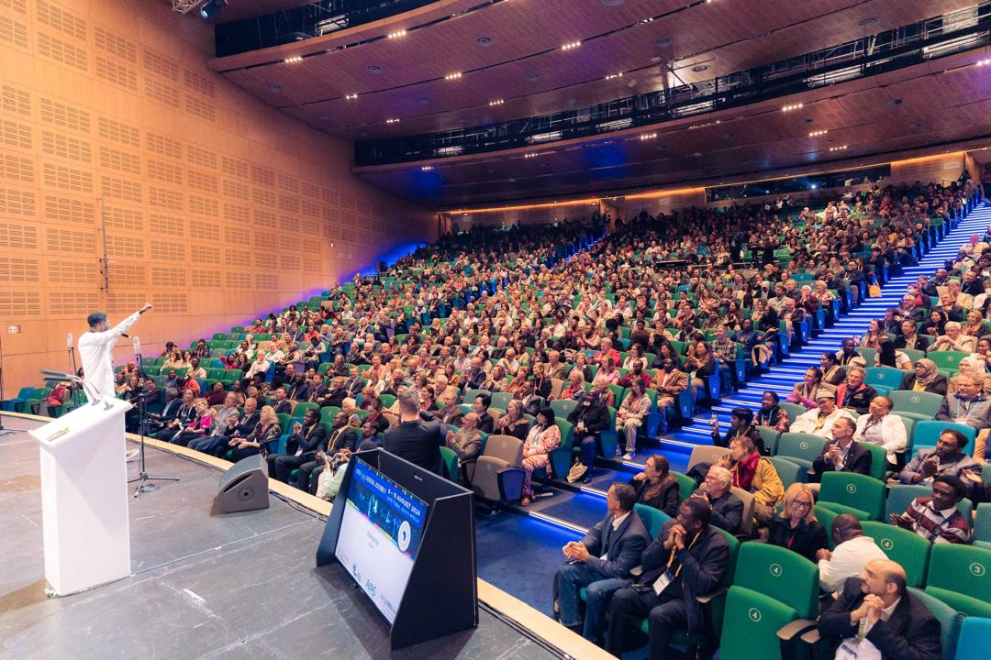
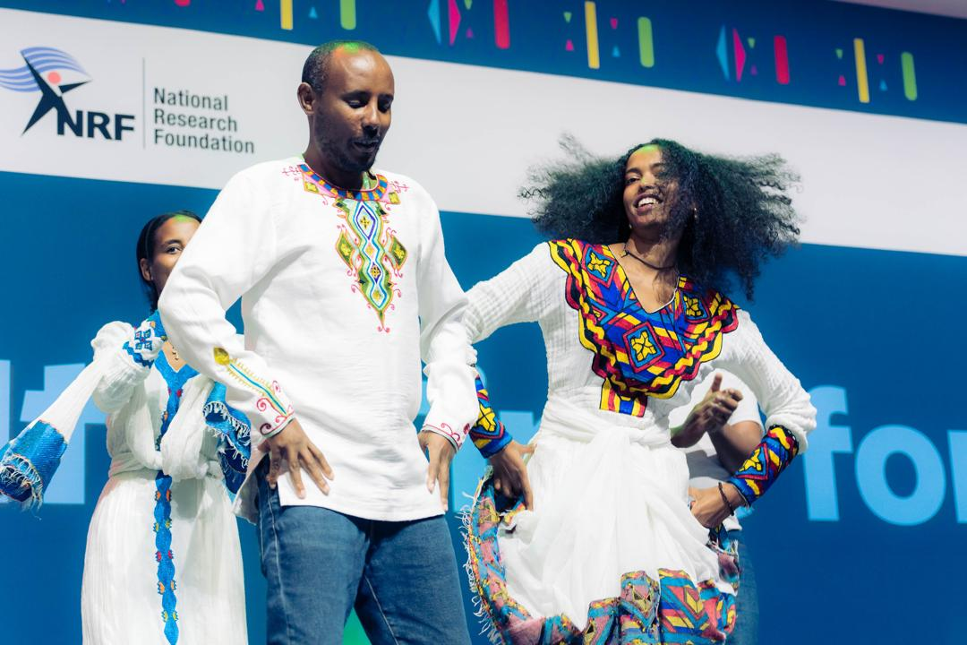
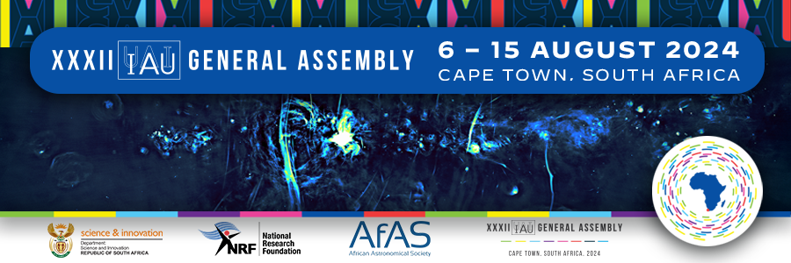
Historic Context
First IAU General Assembly hosted in Africa
XXXII GA held in Cape Town, 2024
Anthem commissioned as official musical identity
Claimed as the first ever produced and sung anthem about our Galaxy and any other in the Universe (MC. Bob, IAU-GA)
Notes:
In 2024, the International Astronomical Union General Assembly was hosted for the first time on African soil, in Cape Town.”
“We used that moment to introduce something new — a scientific anthem.” (guess what?)
Claimed as the first ever produced and sung anthem about our Galaxy and any other in the Universe

Slide 7
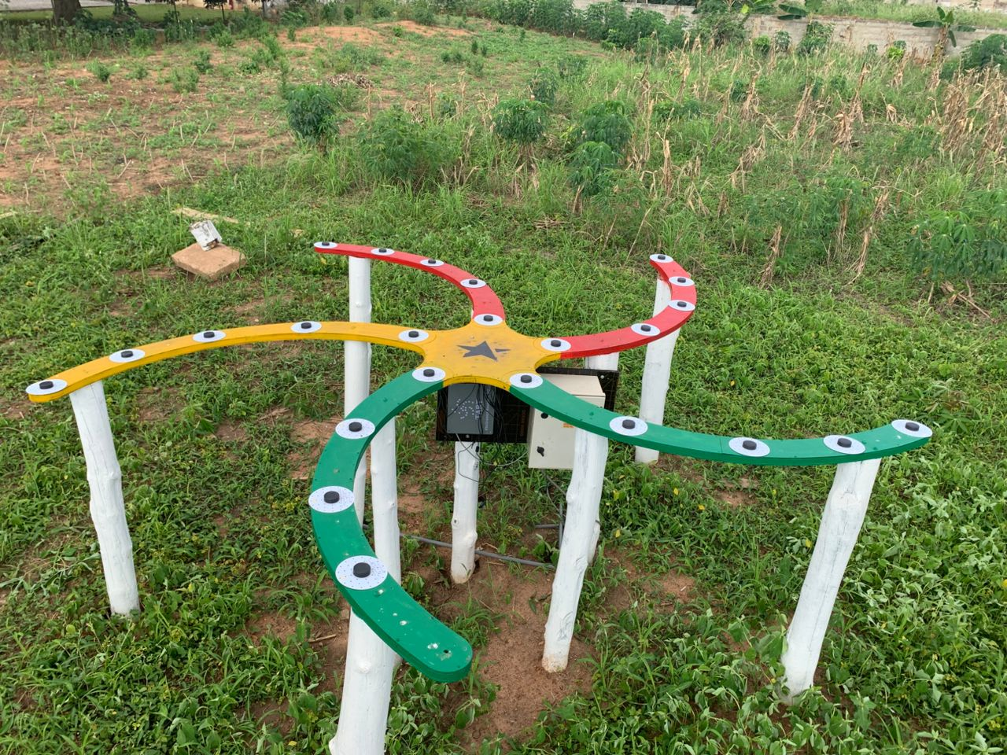
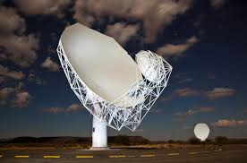
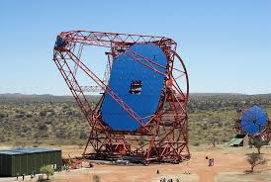
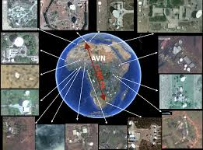
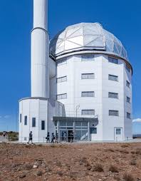
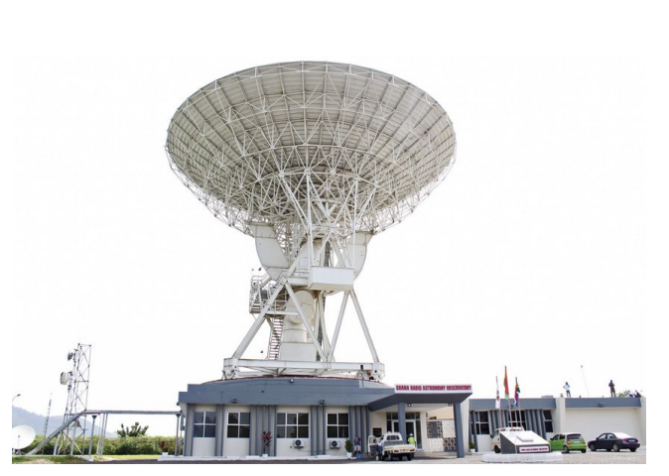
Africa’s Astronomical Renaissance
Africa is no longer emerging. It is leading!
Free to highlight a few:
The highly resolute and sensitive MeerKAT
Southern African Large Telescope
Ghana Radio Astronomy Observatory
African VLBI Network
Continental collaboration
Notes:
indeed, Africa is no longer emerging — it is leading.
We have built world-class instruments like MeerKAT, SALT, the African VLBI Network…
Shift tone -- folks!
But infrastructure alone is not enough. Quite rhetorical huh?

Slide 8



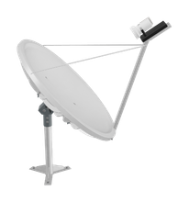
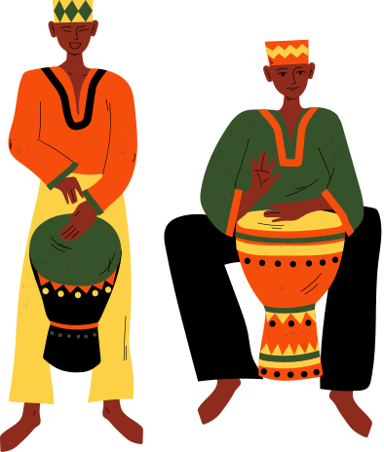
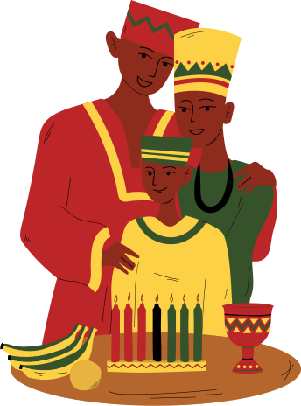

But here is the question!
We have built:
  Telescopes
  Data pipelines
  Human capacity
  Have we built?
  Cultural ownership?
  Emotional connection?
  A scientific identity rooted in Africa?
  This is where music enters!
Notes:
Have we built cultural ownership?
Emotional connection?
A scientific identity rooted in Africa?
Pause
This is where music enters.

Slide 9
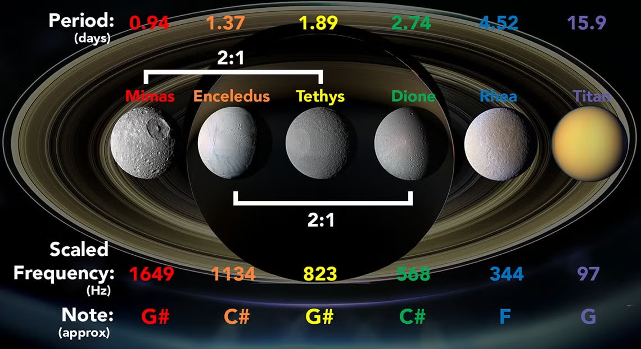
Music of the Spheres: From Pythagoras to Modern Astronomy
Ancient Foundations Scientific Development Modern Astronomical Evidence
Image credit: https://www.utoronto.ca/news/u-t-astrophysicists-make-music-moons-and-rings-saturn
Notes:
“The connection between music and astronomy is not new.”
Then compress:
“From Pythagoras… to Kepler… to modern orbital resonances…”
Then bridge:
“At a fundamental level — both describe wave behaviour.”
Ancient Foundations
Pythagoras (569–490 BCE): discovered that musical harmony follows simple ratios (octave = 2:1).
Proposed that planetary motions follow harmonic ratios, creating the Music of the Spheres.
Scientific Development
Johannes Kepler (1571–1630):
Mysterium Cosmographicum & Harmonices Mundi
Suggested that planetary orbits follow geometric and harmonic relationships.
Modern Astronomical Evidence
Orbital resonances are common, caused by gravitational interactions e.g.
Jupiter – Saturn (~5:2)
Venus – Earth (~13:8)
Exoplanets: TRAPPIST-1 planetary system shows strong synchronization

Slide 10
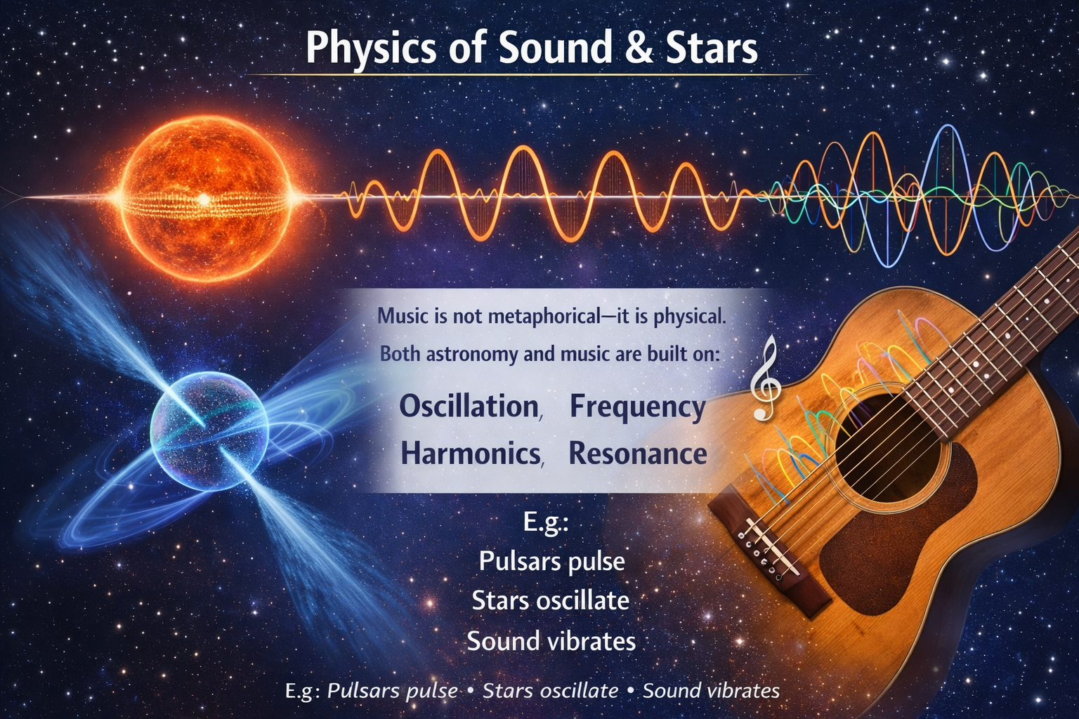

Slide 11
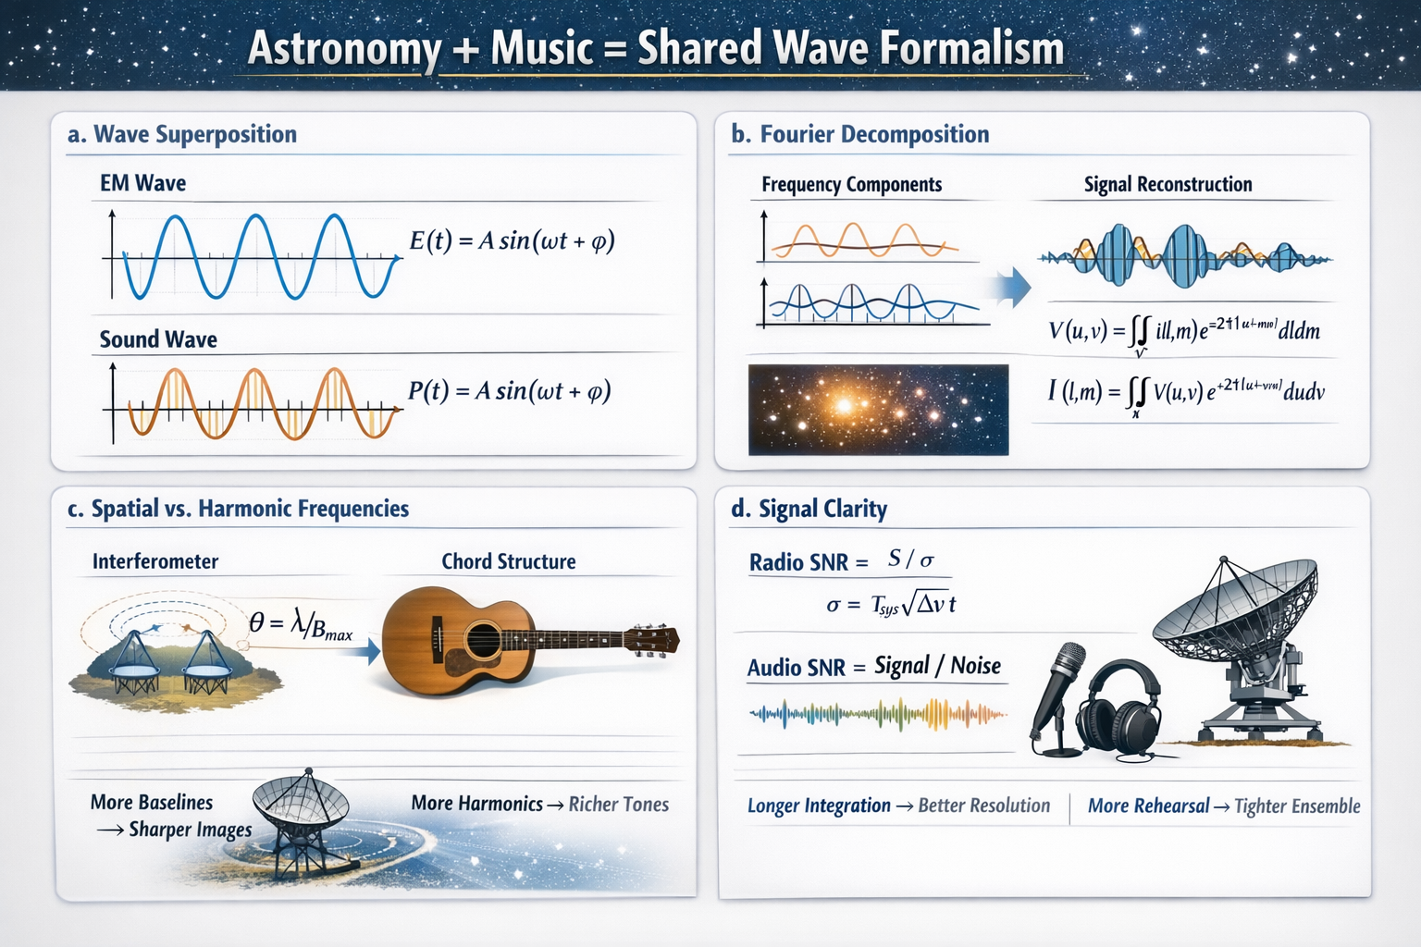
Astronomy + Music = Shared Wave Formalism
Obeys wave superposition
EM wave: E(t)=A sin(ωt+ ϕ)
Acoustic wave: P(t)=A sin(ωt+ ϕ)
Fourier synthesis decomposes signals into frequency space.
Interferometric Image Reconstruction
V(u,v) = ∬ I(l,m) e^{-2πi(ul+vm)} dldm
I(l,m) = ∬ V(u,v) e^{+2πi(ul+vm)} dudv, where V(u,v) = measured visibilities
I(l,m) = sky brightness
Harmonic Decomposition of Sound
x(t) = Σc_ne^{inω₀ t}
X(f) = ∫ x(t) e^{-2πift}dt
C. Spatial vs. harmonic frequencies
An interferometer: θ ≈ λ/Bmax.
Chord structure: x(t) = A1 sin(ωt) + A2 sin(2ωt) + A3 sin(3ω)
More baselines → better spatial fidelity.
More harmonics → richer tonal fidelity.
D. Signal clarity
Radio SNR = S / σ
with radiometer eq: σ = T_sys / √(Δν t)
Audio SNR = Signal Power / Noise Power
Integration time improves radio sensitivity. Rehearsal time improves ensemble clarity.
Notes:
“Astronomy and music are not separate worlds.”
“They both speak the language of waves.”
(Say simply, don’t read equations)
“In radio astronomy, we combine signals to form an image.”
“In music, we combine notes to form harmony.”
“An interferometer… is like a choir.”
“More telescopes → clearer image
More voices → richer sound”
(Pause, smile)
“Science… is already musical.”

Slide 12
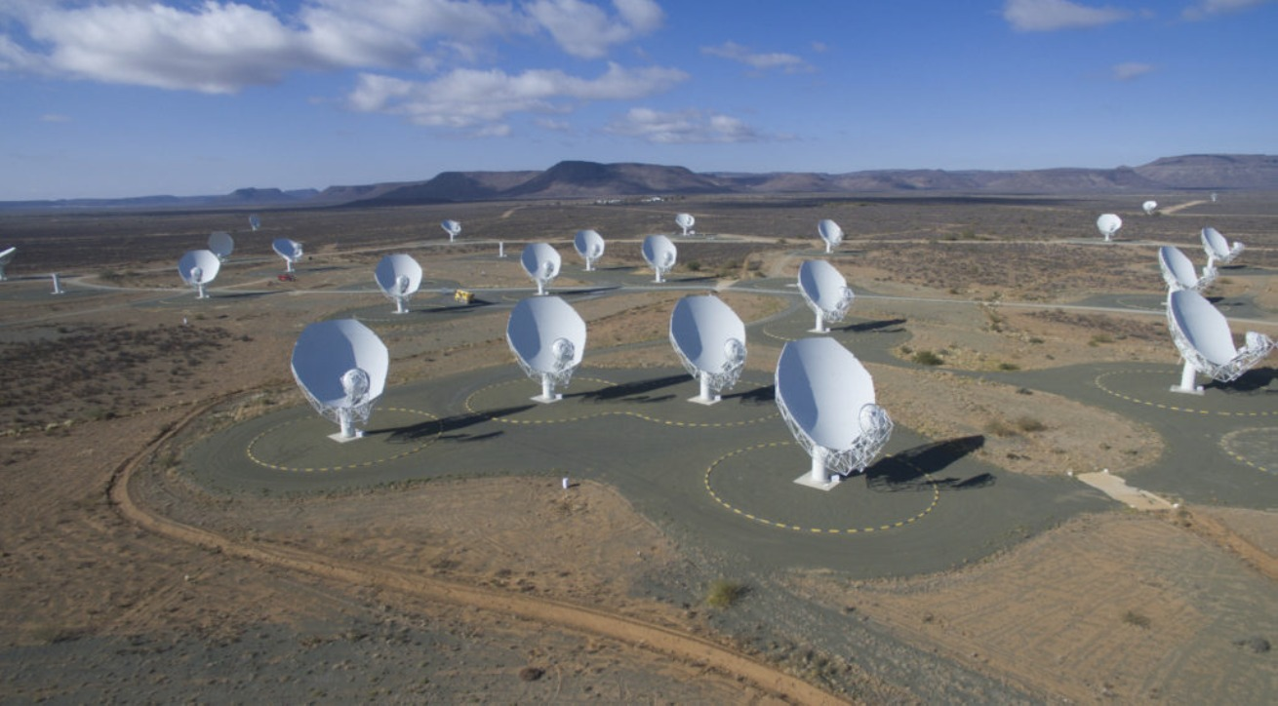
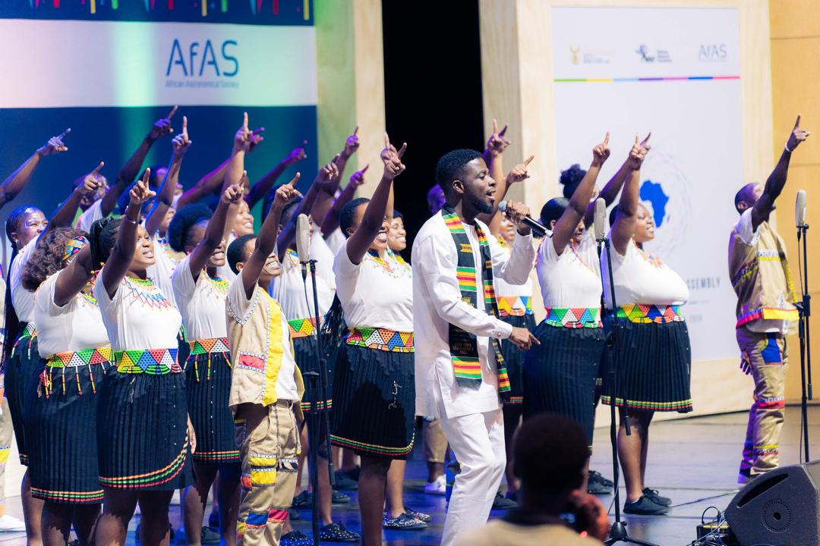
Interferometry & Polyphony
MeerKAT:
64 dishes combine signals → one highly resolute image
Choir:
Multiple voices → one harmonic sounds
Synthesis imaging = Vocal layering
Notes:
Tone: Engaging, visual
“Take MeerKAT — 64 dishes working together.”
“Individually, each sees a little.
Together, they create one powerful image.”
“Now think of a choir.”
“One voice is beautiful…
but many voices? That is power.”
“That is synthesis imaging…
That is polyphony.”
MeerKAT combines 64 dishes to produce one high-resolution image.
A choir combines multiple voices to produce one harmonic sound.
This is synthesis — in science and in music.
Emphasize: We call this cultural interferometry.

Slide 13
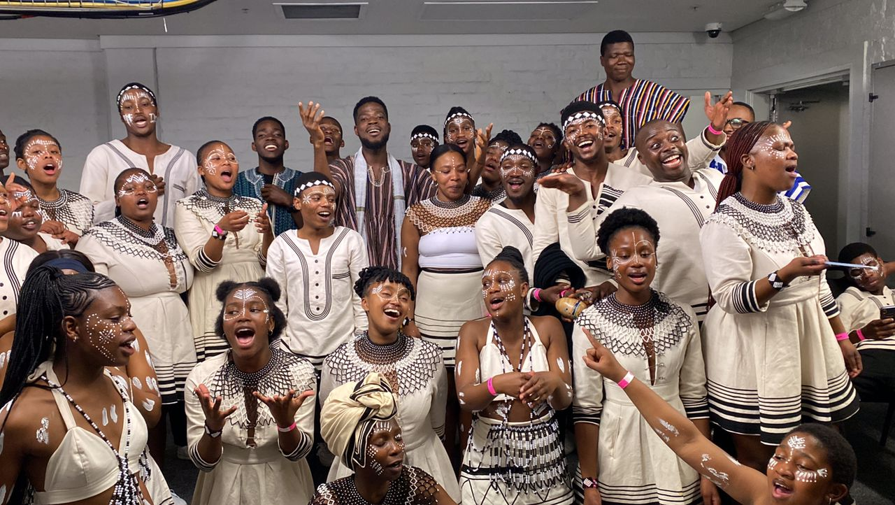
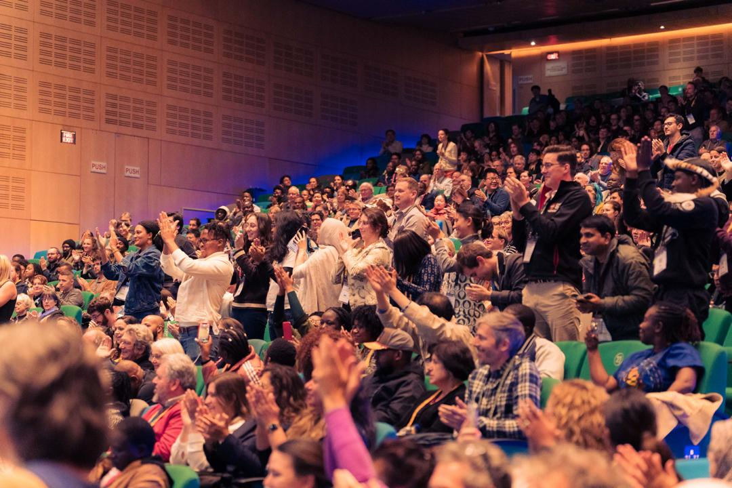
Multilingual Scientific Identity & live debut
Live Debut:
Cape Town International Convention Centre
Ithemba Youth Choir collaboration
Multilingual, choreographed performance
Anthem’s languages:
Zulu/Xhosa
Twi
Ga-Adangme
Swahili
Hausa
This was not entertainment. It was symbolic ownership of science
Notes:
The anthem uses multiple African languages…: (In COMM&Edu, it foster participation & inclusivity)
Then:
Not for diversity — but for structure.
Many voices forming one scientific identity.
This was performed at the Cape Town International Convention Centre.
What we observed was not just engagement…
slight pause
It was ownership.

Slide 14
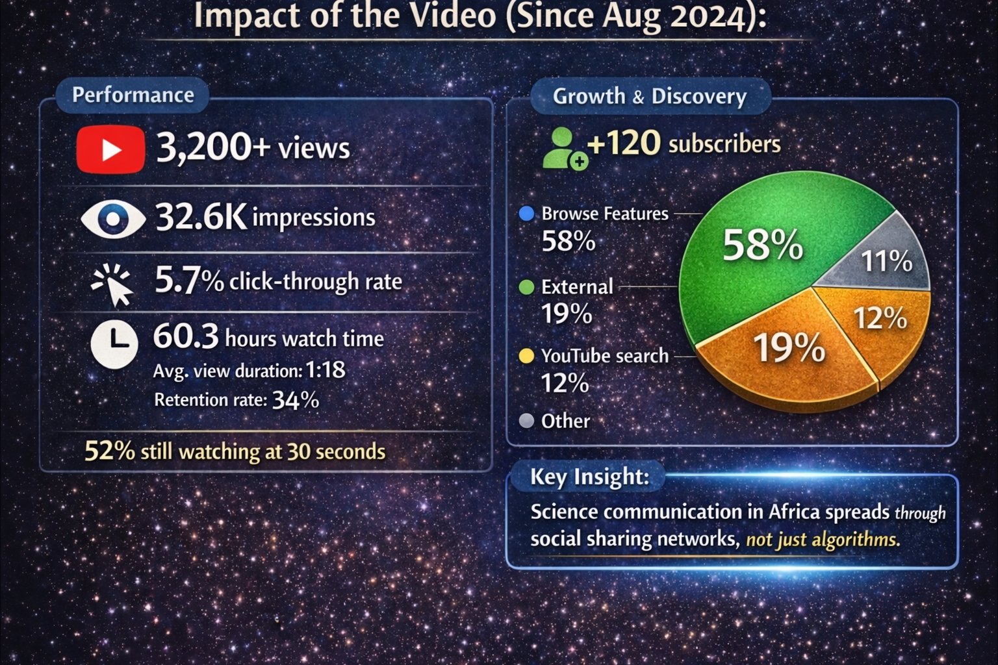
Digital Impact Metrics
Since release (Aug 2024):
2,527 YouTube views
53 hours total watch time
31.4K impressions
18% traffic from external apps
Most traffic from:
WhatsApp (~37%)
Insight:
Science communication in Africa spreads peer-to-peer.
Notes:
Tone: Evidence-based but light
“The impact extended beyond performance.”
“It spread through WhatsApp… through communities…”
“Not top-down communication… but peer-to-peer Africa.”
“Even in schools — students learned astronomy through rhythm.”
“And something powerful happened…”
(Pause)
“They remembered.”

Slide 15
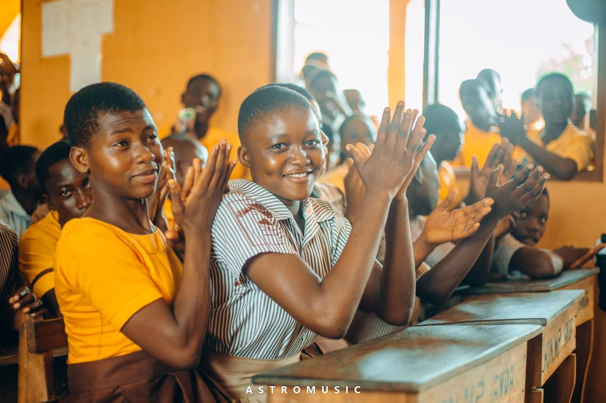
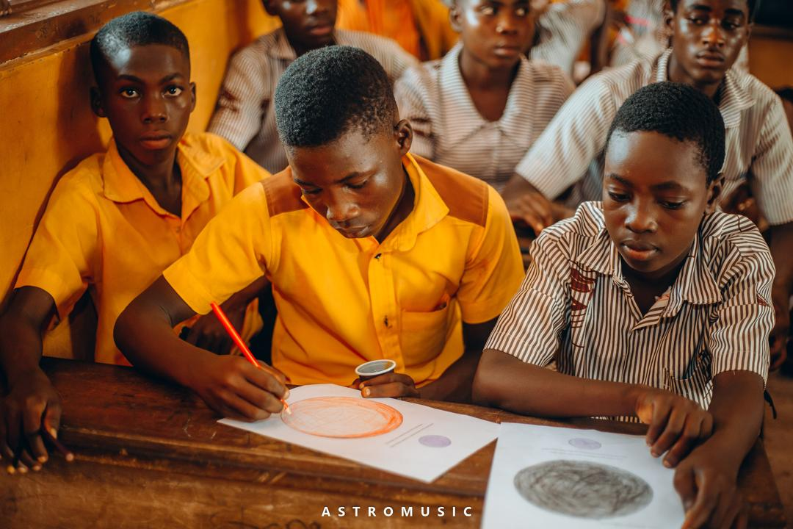
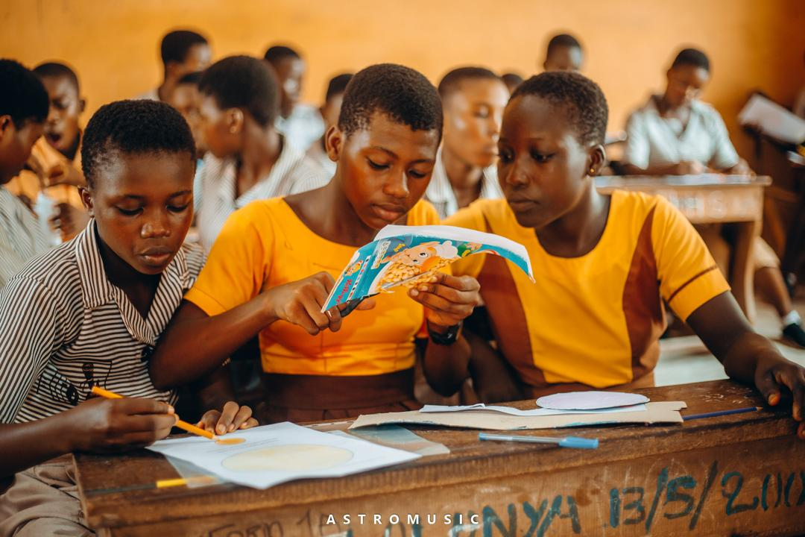
Educational Impact I
Case study: Lolonya Basic School
Activities:
Singing + astronomy lessons. Music lowers cognitive barriers.
Rhythm-based learning
Concept retention through melody
Notes:
We tested this in a classroom setting.
Music-supported learning improved engagement, enthusiasm, and recall.
Music lowers cognitive barriers to abstract concepts.

Slide 16
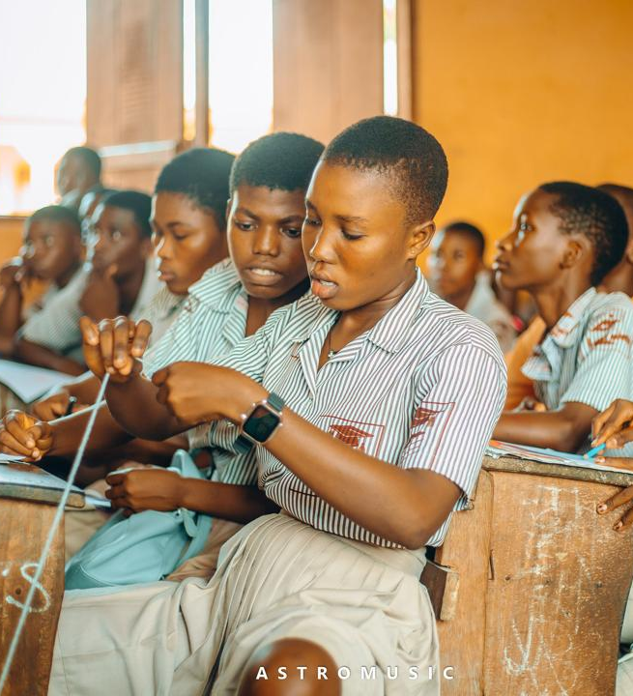
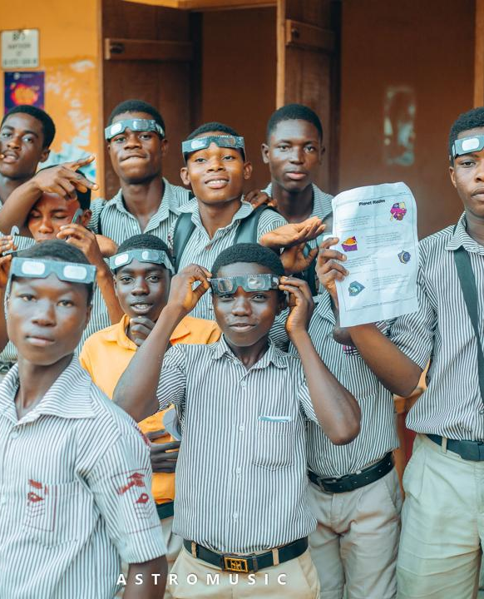
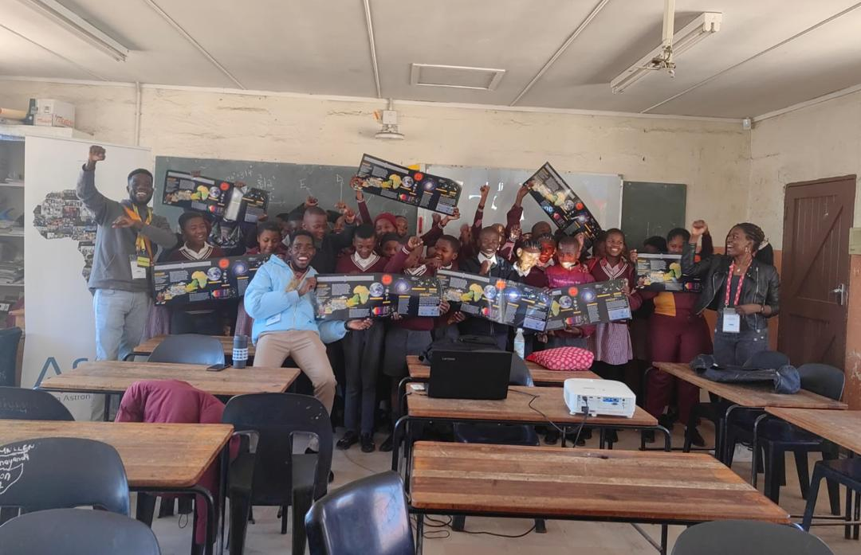
Educational Impact II
Case study: Lolonya Basic School
Teacher feedback:
Increased enthusiasm
Higher engagement
Improved recall
Notes:
We tested this in a classroom setting.
Music-supported learning improved engagement, enthusiasm, and recall.
Music lowers cognitive barriers to abstract concepts.

Slide 17
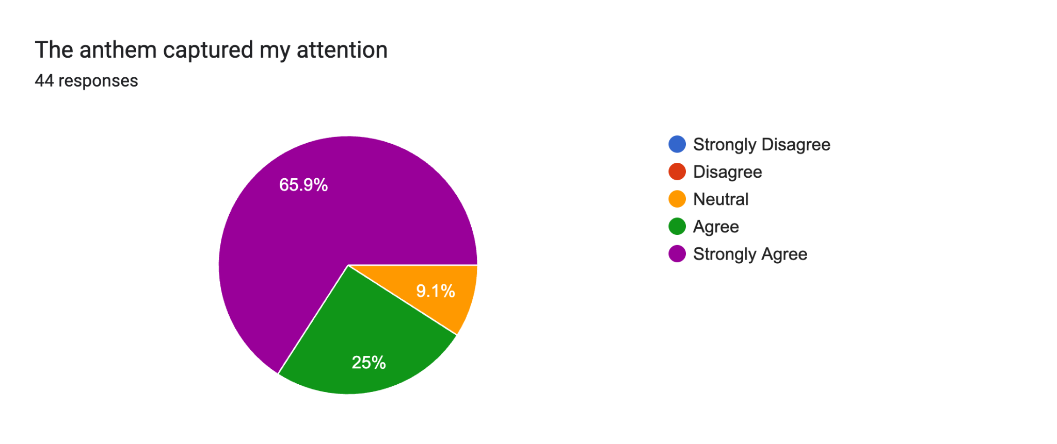
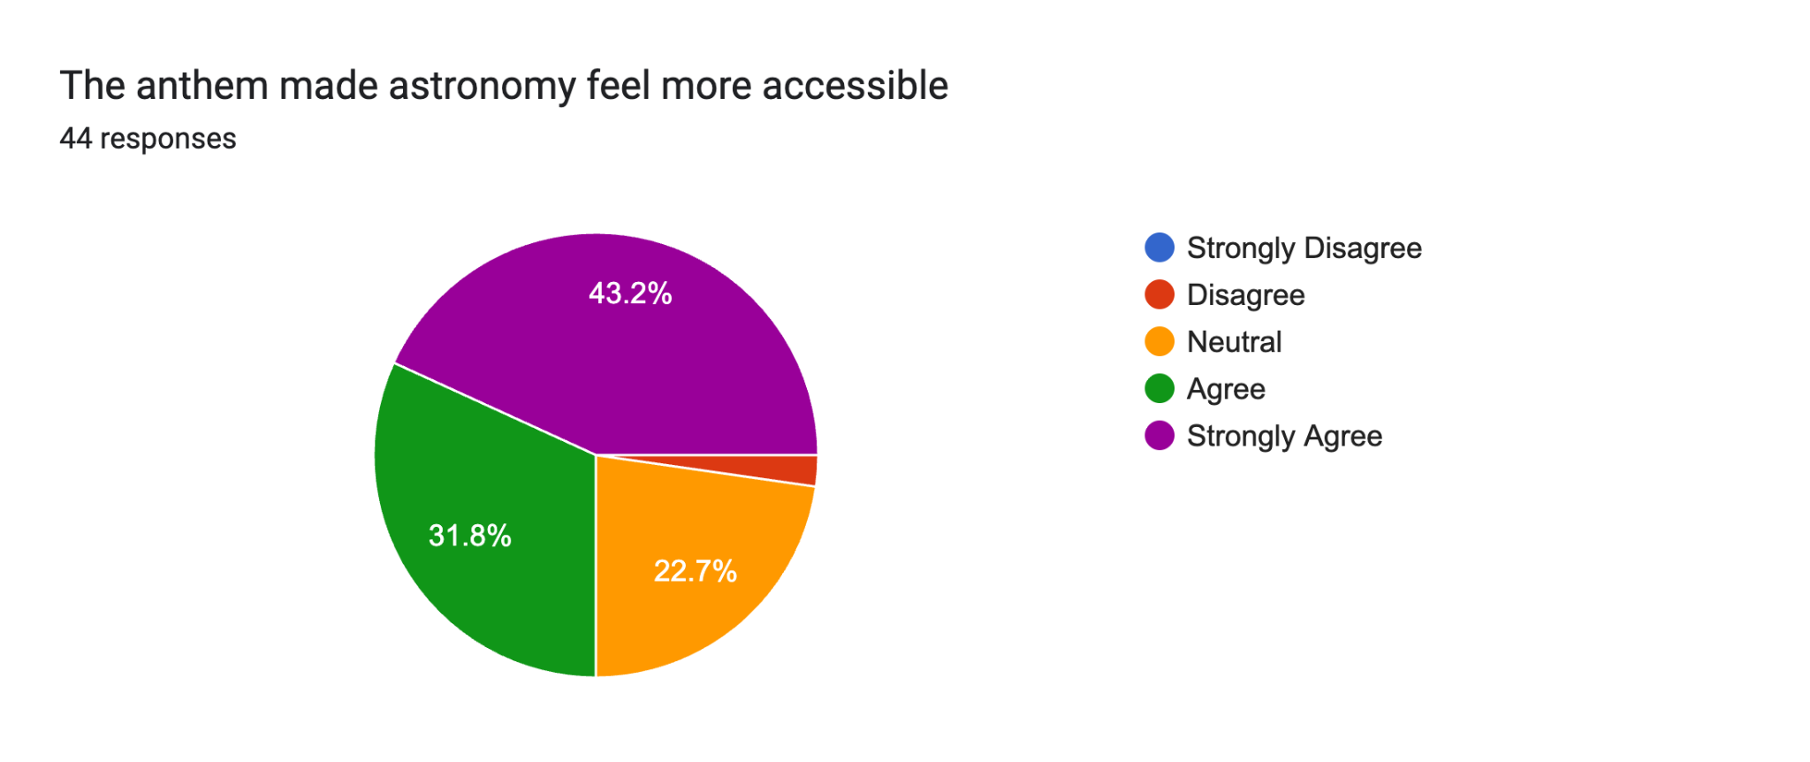
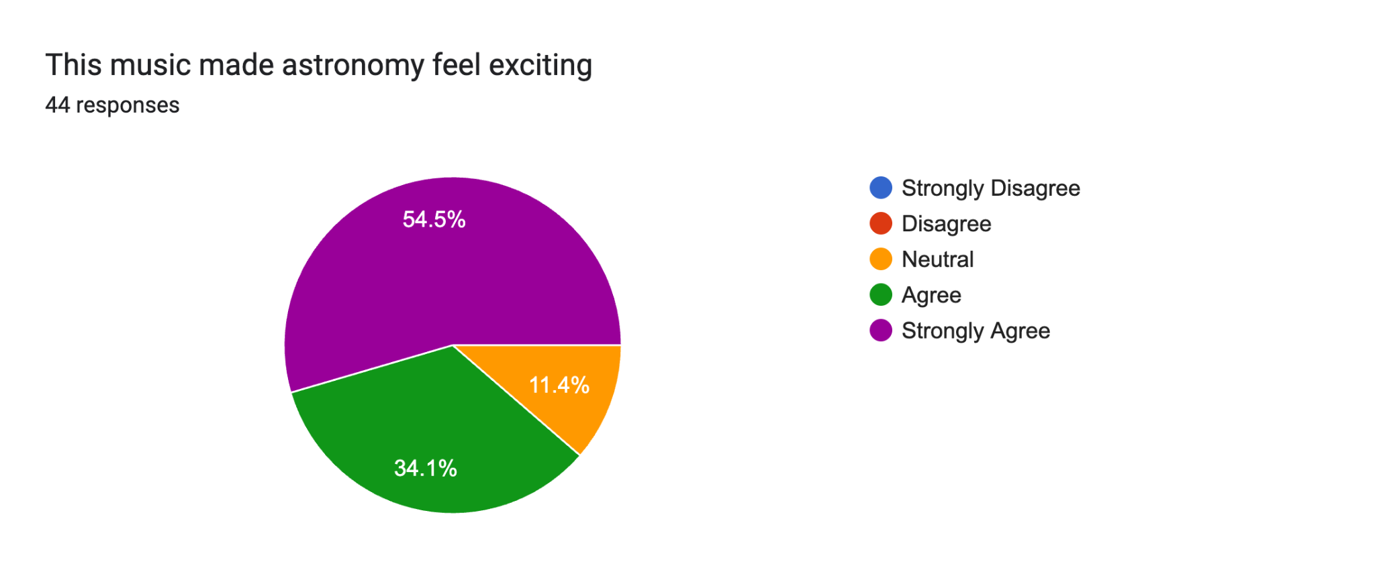
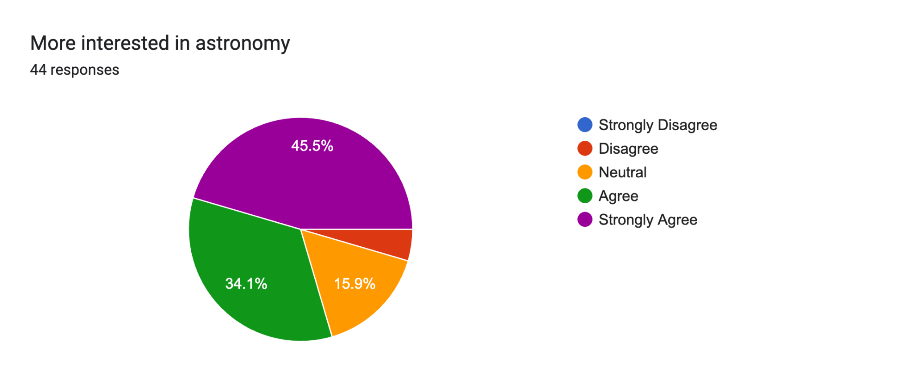
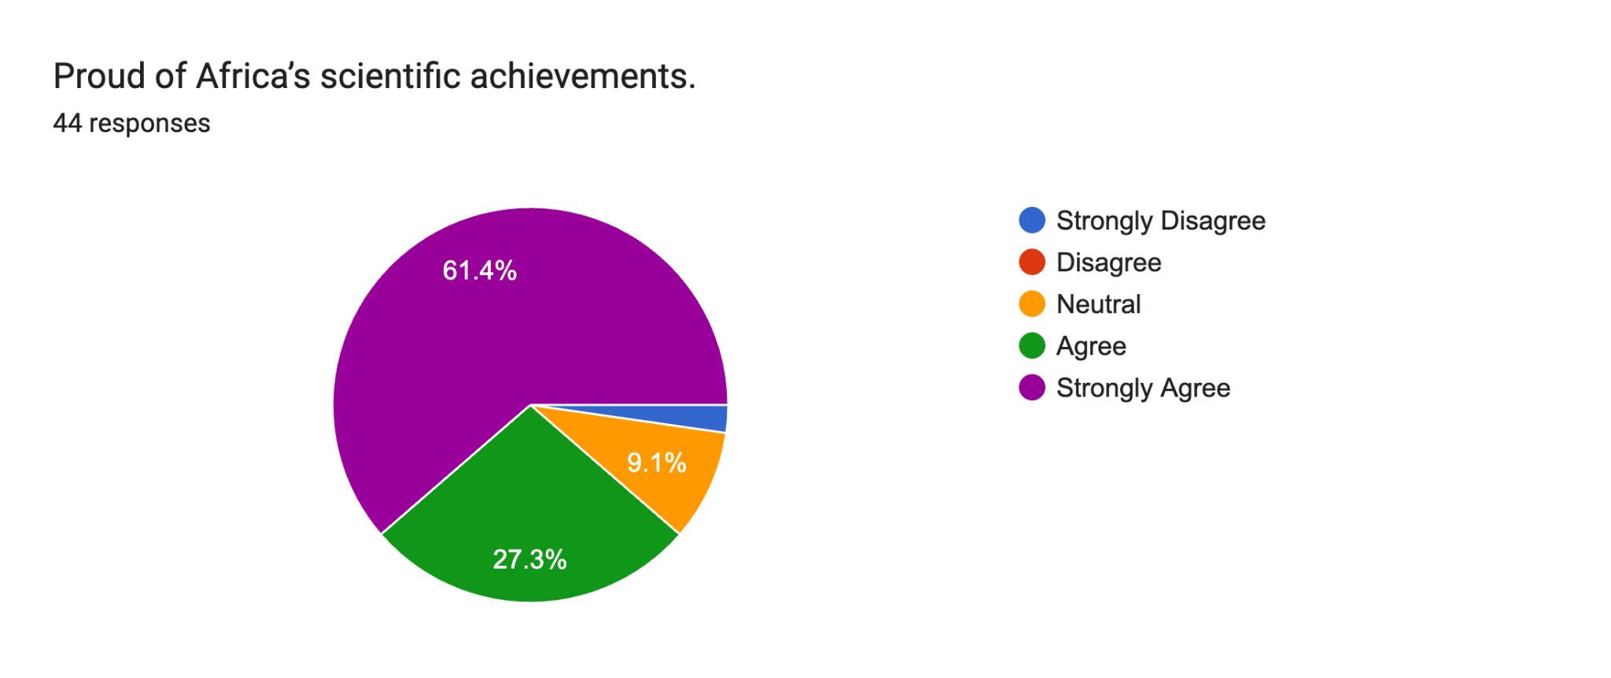
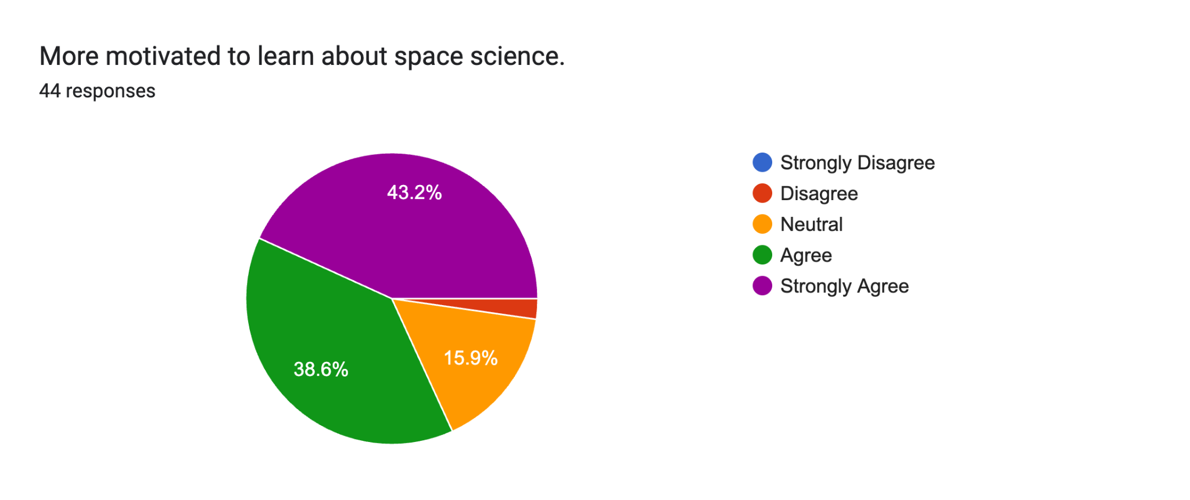
Anthem’s Impact Evaluation Survey Results I
Participants evaluated the anthem across dimensions:
Emotional & Cognitive Engagement
65.9%
54.5%
43.2%
31.8%
25%
34.1%
45.5%
43.2%
61.4%
34.1%
38.6%
27.3%
STEM Interest & Motivation
Notes:
a researcher, not ajust a performer.
We conducted a structured evaluation using survey data.
Three key constructs emerged:
Engagement
Cultural connection
Identity
These were statistically validated and internally consistent.
And importantly — they strongly predict increased interest in astronomy.
Pause
This is the core result.

Slide 18
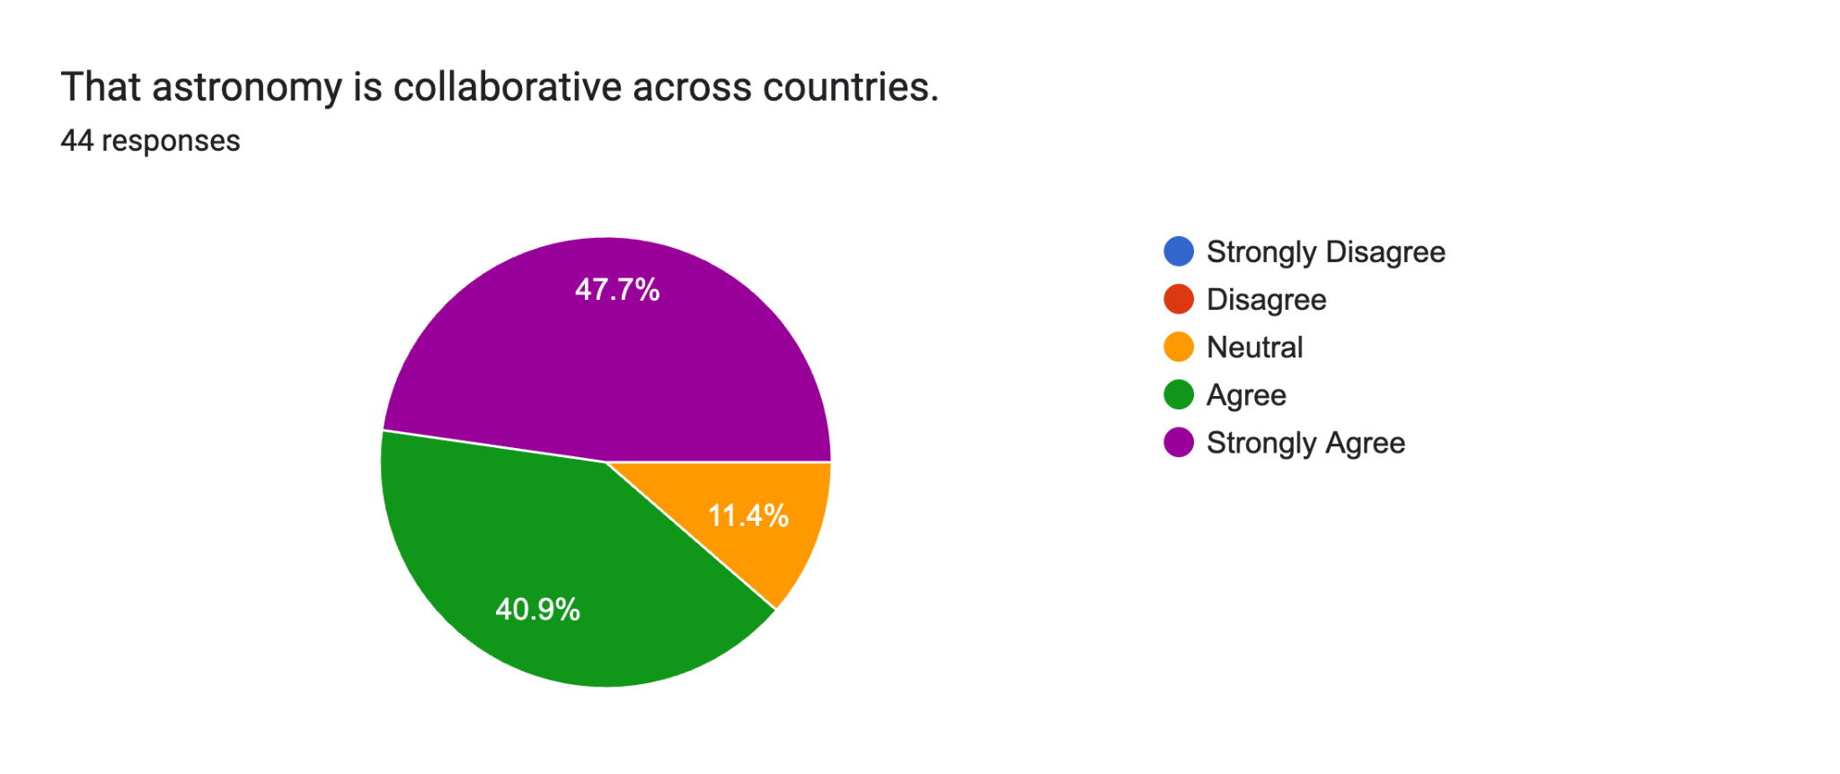
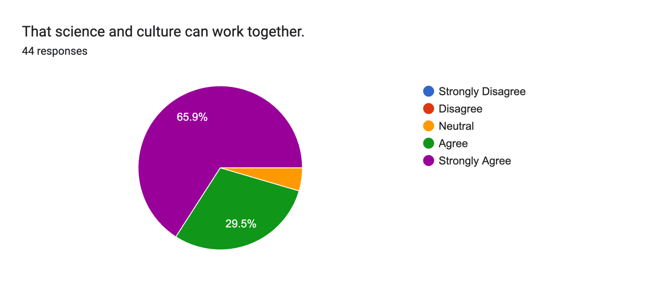
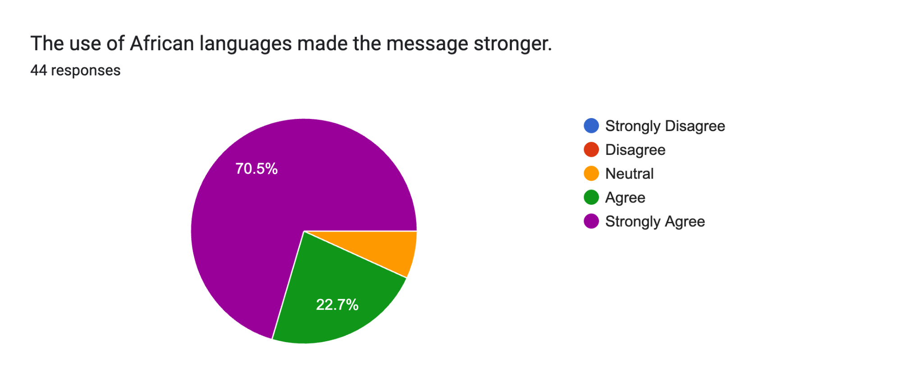
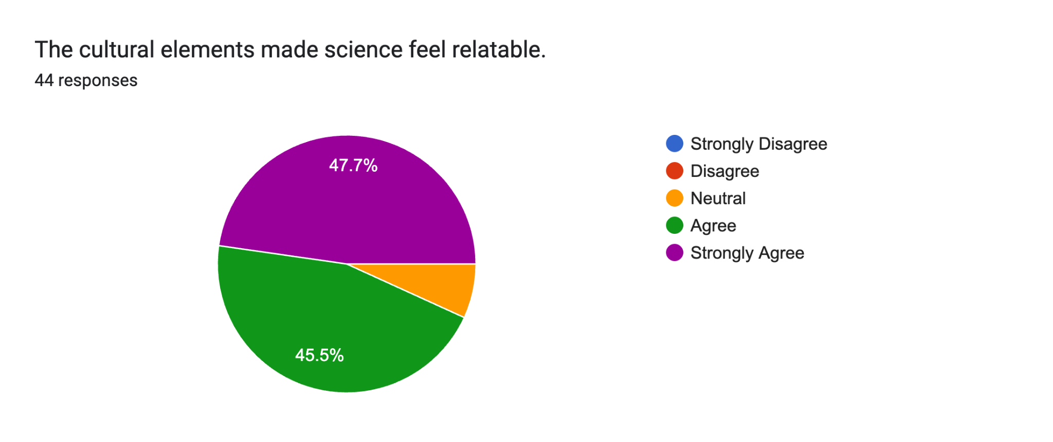
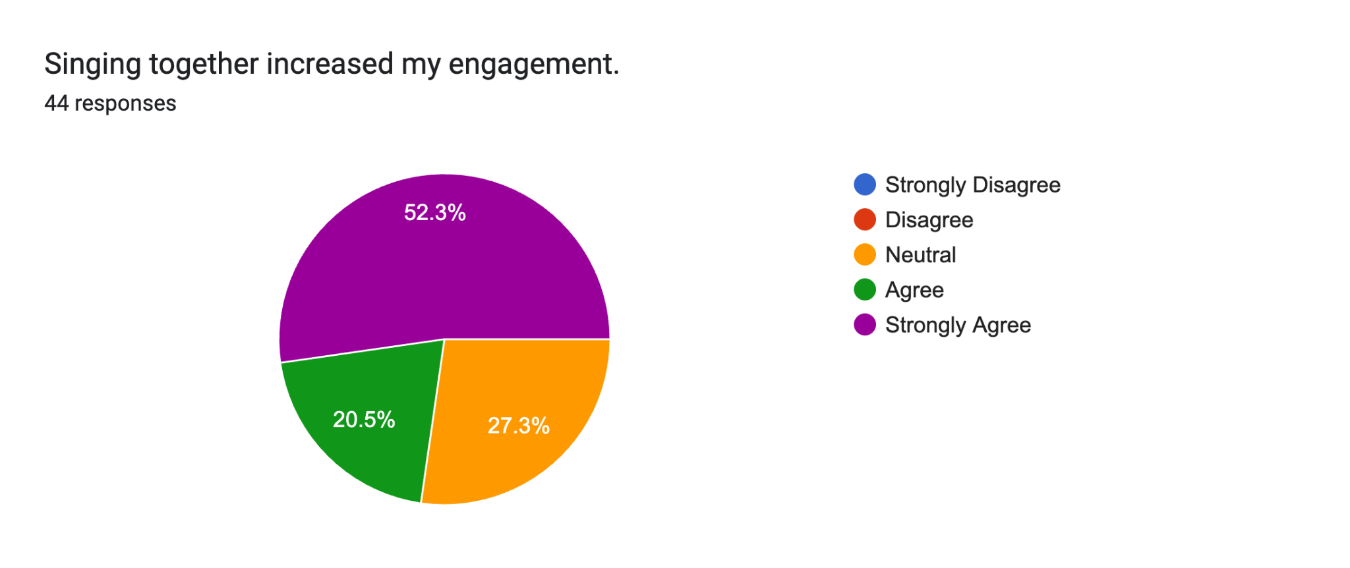
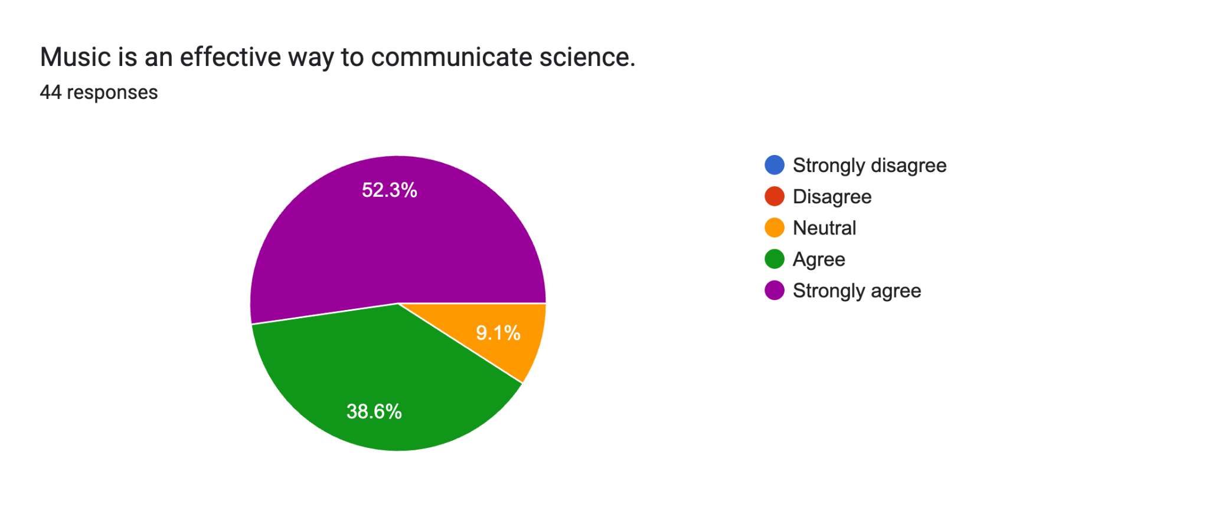
Survey Results II
47.7%
65.9%
Conceptual Understanding
40.9%
29.5%
Cultural Relevance
70.5%
47.7%
Conceptual Understanding
22.7%
40.9%
Social & Collective Experience
52.3%
52.3%
20.5%
27.3%
38.6%
Notes:
We conducted a structured evaluation using survey data.
Three key constructs emerged:
Engagement
Cultural connection
Identity
These were statistically validated and internally consistent.
And importantly — they strongly predict increased interest in astronomy.
Pause
This is the core result.

Slide 19

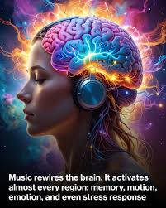
Why It Works (Research Basis)
Music strengthens learning
Astronomy evokes
Deeper learning
Memory encoding
Emotional engagement
Group cohesion
Cognitive retention
Perspective
Wonder
Curiosity
Chen et al. 2008 | Thompson et al. 2004 |Keltner & Haidt 2003 | Dahlstrom 2014
credit:
Notes:
Music enhances emotional encoding and memory.
Astronomy evokes awe, curiosity, and perspective.
Together, they produce deeper learning.
like twinkle little starv -- Active learning ---- prior -- known to unknown

Slide 20

Music, Astronomy & Well-being (Ɛba vibe song)
Music regulates stress
Collective singing strengthens bonding
Awe experiences reduce self-focused anxiety
Astronomy shifts perspective:
“You are small, but part of something vast.”
Psychological elevation.
Notes:
There is also a psychological dimension.
Music reduces stress. Astronomy expands perspective.
Together, they create psychological elevation.

Slide 21
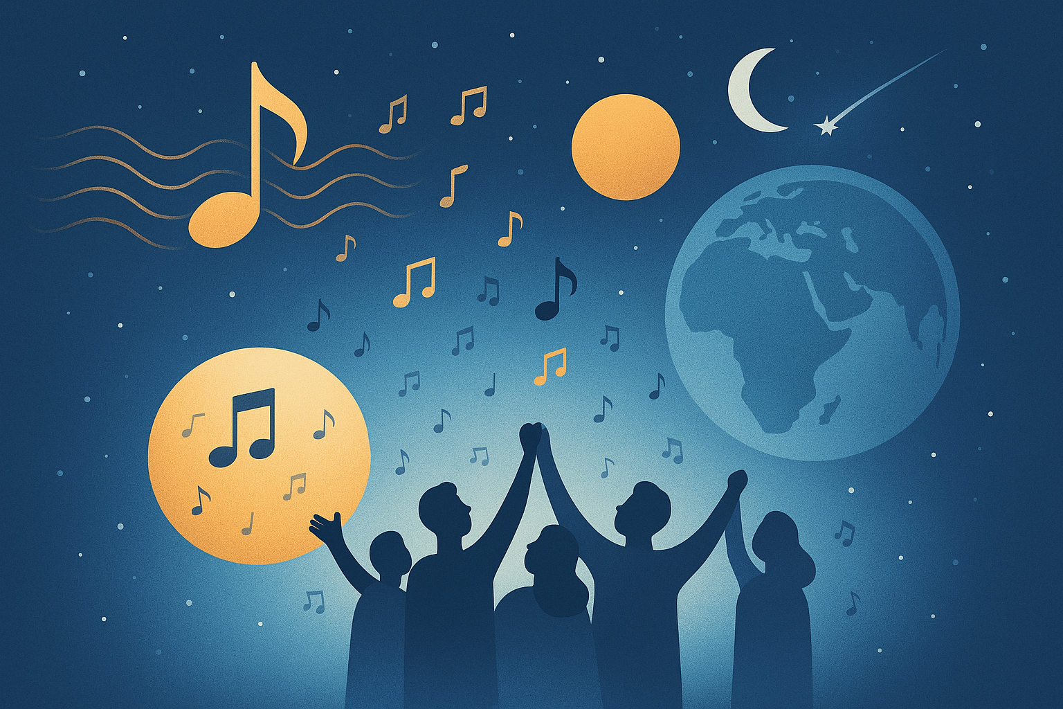
A new model for Science Communication
What Does This Anthem Represent?
This anthem demonstrates that:
Science can be sung.
Data can have rhythm.
Infrastructure can have identity.
Africa can define its own scientific voice
Inclusive esp. persons with disabilities
Notes:
“We propose an astro-musical model.”
Then:
“Infrastructure + Culture + Education + Well-being…”
pause
“…equals sustainable engagement.”
👉 This is your framework — let it breathe.

Slide 22
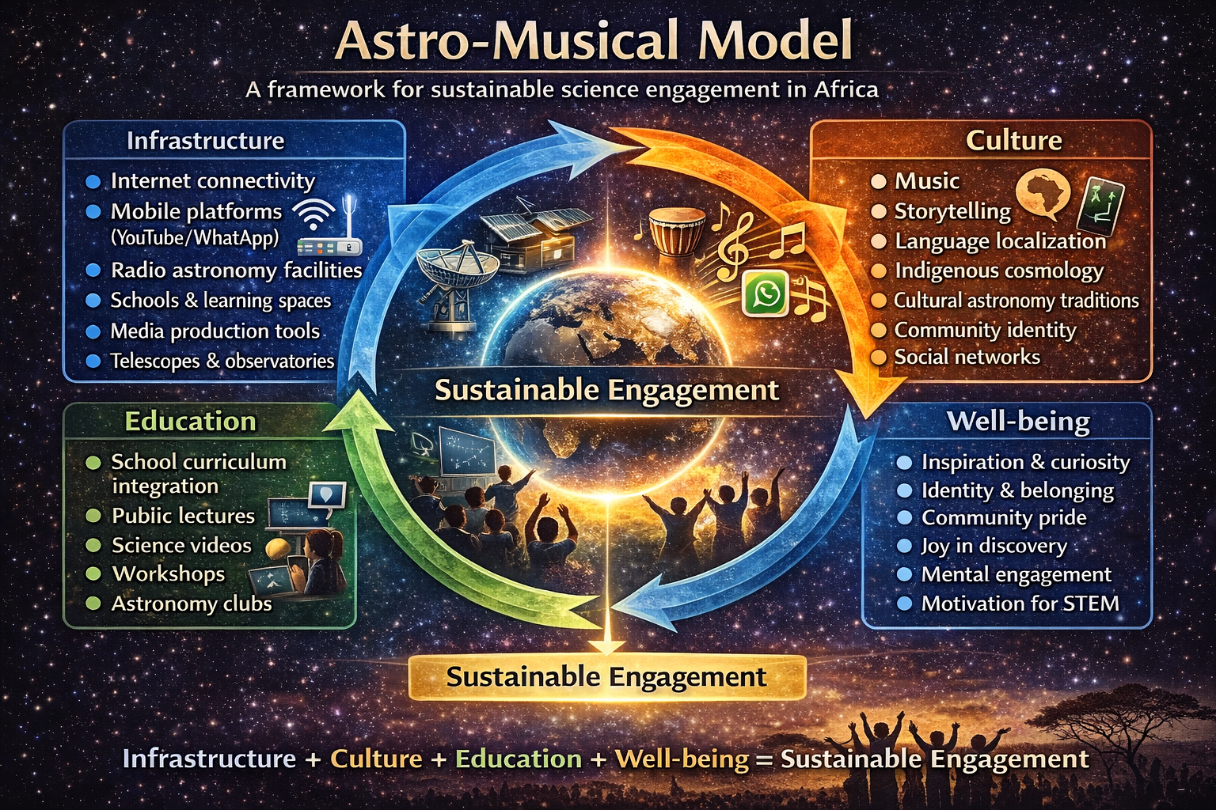
What is this model?
Astro-musical Model
Infrastructure
+
Culture
+
Education
+
Well-being
=
Sustainable Engagement
Notes:
“We propose an astro-musical model.” A simple additional model
Then:
“Infrastructure + Culture + Education + Well-being…”
pause
“…equals sustainable engagement.”
👉 This is your framework — let it breathe.

Slide 23
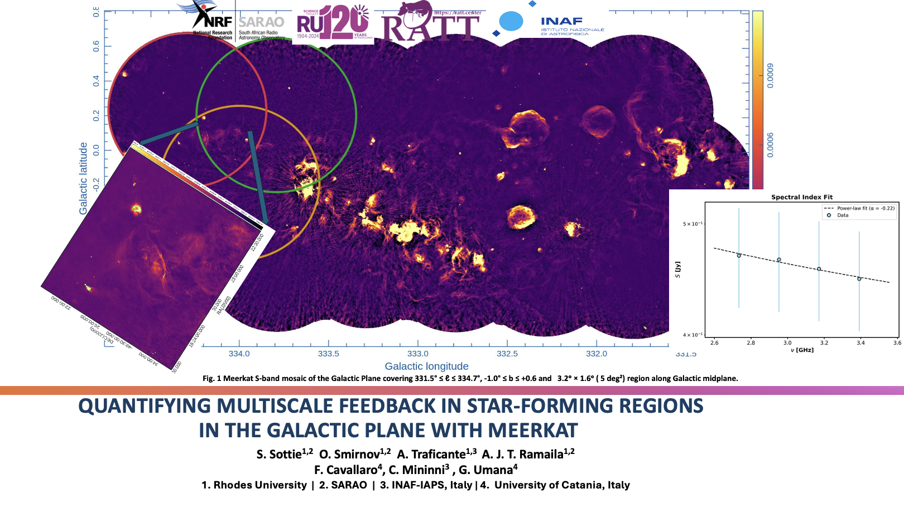
Let’s sing this! 🎤🎵👏🏿

Slide 24

Our next phase
Scale research
Integrate into education
Expand public engagement
Build institutional partnerships

Slide 25

Final Message
Africa is not only building telescopes.
We are building:
- Identity
- Confidence
- Collaboration
- Soundtracks for our scientific future
It aligns with SDGs 3, 4, 9, 10, 11, and 16
Culturally relevant science communication
Notes:
Deliver this slowly and powerfully as closing remarks.
Africa is not only building telescopes.
We are building identity, confidence, and voice.
And that voice can be scientific — and musical.

Slide 26
Thank you!!
Notes:
Deliver calmly:
No one person can do it — but together, we can.
Thank you.

