Slide 1

AfAS Constitution & By-Laws
Strengthening Governance for Pan-African Astronomy
African Astronomical Society Constitution Working Group
Notes:
Our goal is to ensure that astronomy and Africa help each other. A thriving astronomy community in Africa should support broader scientific development and encourage international collaboration.

Slide 2
Working Group Members
Patricia Whitelock
Alshaimaa Hassanin
Manasse Mbonye
South Africa – Chair
Egypt
Rwanda
Bonaventure Okere
Prospery Simpemba
Nigeria
Zambia
Supported By
Meryem Guennoun • Yunus Manjoo • Thembela Mantungwa
Notes:
set up by the AfAS ExCo to consult widely and propose revisions to our current constitution. please feel free to share your views with any of them. Prospery Simpemba and I.
Working closely with members of the secretariate, extremely helpful. Yunus Manjoo, in particular, invaluable due to his deep knowledge of AfAS.

Slide 3
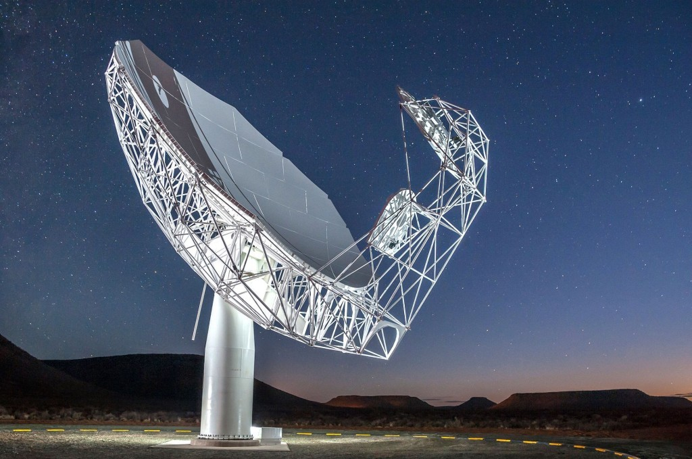
Why Governance Matters for AfAS
Building on Our Foundation
The African Astronomical Society has established itself as a pan-African organisation uniting professional astronomers across the continent. Our constitution provides the essential framework for this collaboration.
As we grow and evolve, robust governance structures become increasingly vital to ensure transparency, accountability, and effective decision-making for all members.
Notes:
current constitution, approved at last GA, available new website.
Provides excellent framework for professional astronomers & others interested subject to advance astronomy on continent
through research, education, tourism, outreach, and broader inspiration.

Slide 4
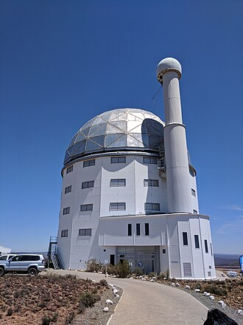
The Constitution: Our Foundation
Established Framework
AfAS already possesses a constitution that defines our fundamental principles, objectives, and organisational structure.
Core Principles
Our constitution outlines membership criteria, governance bodies, and the society's mission to advance astronomy across Africa.
Legal Standing
The constitution provides AfAS with formal recognition and legal framework for operations across multiple African nations. It should not need frequent revisions
Notes:
The constitution sets out our core principles, objectives and organizational structure.
also provides the essential legal framework for operating across multiple African counties, while being headquartered in South Africa and therefore subject to South Arican law.
it should not require frequent changes,
yet revisions have been needed at every GA to date, including the most recent one in Johannesburg.

Slide 5
By-Laws: The Missing Piece
Current Gap
Operational Clarity
Implementation Path
Whilst AfAS has a constitution, detailed by-laws remain under development. These operational rules translate constitutional principles into practical procedures.
By-laws can be changed more easily.
By-laws will provide specific guidance on elections, meetings, committees, and day-to-day governance, including the ethics documents introduced at last GA
– ensuring consistency and fairness.
The Working Group is drafting comprehensive by-laws that align with constitutional principles whilst addressing practical governance needs. Involves moving various things: Constitution-> by-laws
Notes:
main change-> introduce at next GA, is by-laws to guide the day-to-day operations of AfAS.
provide detailed guidance on elections, meetings and governance.
Include ToR for the ExCO & generic ToR for committees that the ExCO set up.
Also include ethics document approved at last GA, outlining how members of AfAS and its structures should behave & what to do problems arise.
By-laws cover financial policies, membership fees & selection of hosts for Annual Meeting.
Drafting will be primary focus of WG in Some material new, some moved current constitution.

Slide 6
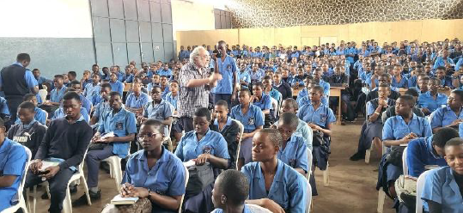
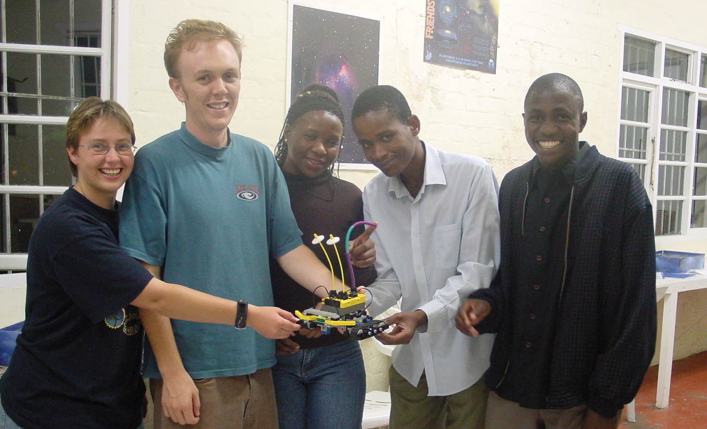
Key Benefits of Comprehensive By-Laws
Transparency
Accountability
Clear procedures for all governance processes build trust amongst members and stakeholders.
Defined roles and responsibilities ensure proper oversight of leadership and decision-making.
Consistency
Sustainability
Standardised processes prevent confusion and ensure fair treatment across all governance activities.
Robust structures support long-term organisational stability and effective succession planning.
Notes:
Comprehensive governance documents will benefit AfAS in several ways. should build trust among members by providing clarity on decision-making and participation. strengthen our credibility as a well-managed organisation with sound financial practices, which is essential for fundraising. They will also support continuity and effective succession planning.

Slide 7
Some items to be moved from the
constitution others newly developed
By-Laws: What They Will Cover
01
02
03
Membership Procedures
Governance Bodies
Election Processes
Clear criteria for reviewing and accepting membership applications , fees according to membership category.
Roles, composition, and operational procedures for Executive, other committees, and working groups
Transparent procedures for nominating and electing leadership positions including the nominations committee
04
05
06
Meeting Protocols
Financial Oversight
Ethics
Rules for convening meetings, quorum requirements, and decision-making procedures
Guidelines for budgeting, financial reporting, travel policy and audit processes
Code of conduct, conflicts of interest, procedures for investigating disputes, complaints etc.
Currently in ”Ethics document” approved in 2025
Notes:
[1]...full associate or student members. [2] They will define the roles, composition, and procedures of ExCO, as well as other committees and WGs set up by ExCO. Importantly, they must also clarify how non-performing members can be removed from committees, as unfortunately this seems to be a problem shared by many committees.
[3] Election procedures explicitly defined, rules governing meetings, quorum, and decision-making. [5] Financial oversight will be clearly specified. [6] should be straightforward.
Some material exists in current constitution; some exists in internal documents and will be made public; some still need to be developed.

Slide 8

Membership Criteria
Candidates for full membership shall be persons who satisfy at least one of the following criteria:
successfully completed a PhD or DSc Degree in astronomy or a related field
successfully completed a Master’s Degree in astronomy or a related field and has thereafter, for at least two years, been engaged in activities related to astronomy
successfully completed a Bachelors and/or Honours degree in astronomy or related field and has thereafter for at least five years been engaged in activities related to astronomy
have presented proof of independent authorship or co-authorship of accepted, or published, refereed astronomy paper(s) that has been accepted by the Membership Committee of the Society.
Changes
“Related field:” Membership Committee generally interpreted this as physics or mathematics
Other considerations for background training:
(i) Geology for people involved in lunar or planetary science
(ii) Biology for those involved in astro-biology
“Boundaries are meant to be transcended” Amare Abebe (President of AfAS)
However, broader criteria should only be adopted once members are paying fees.
Notes:
specific issue we considering, with Membership Committee: qualification for membership. We anticipate allowing greater flexibility in defining “related fields,” particularly for students. E.g., someone with background in geology may wish to work in lunar or planetary science. We should also recognise the growing importance of interdisciplinary areas, e.g. astrobiology. At same time, avoid attracting those who join only to list AfAS on their CV. Any broadening of criteria should therefore be considered alongside the introduction of membership fees.

Slide 9
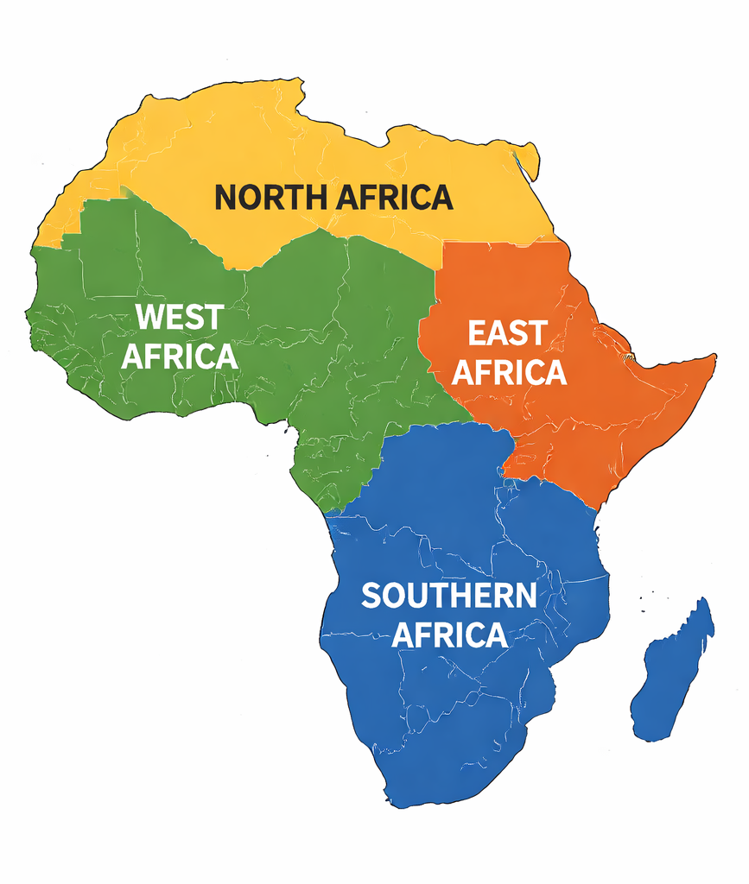
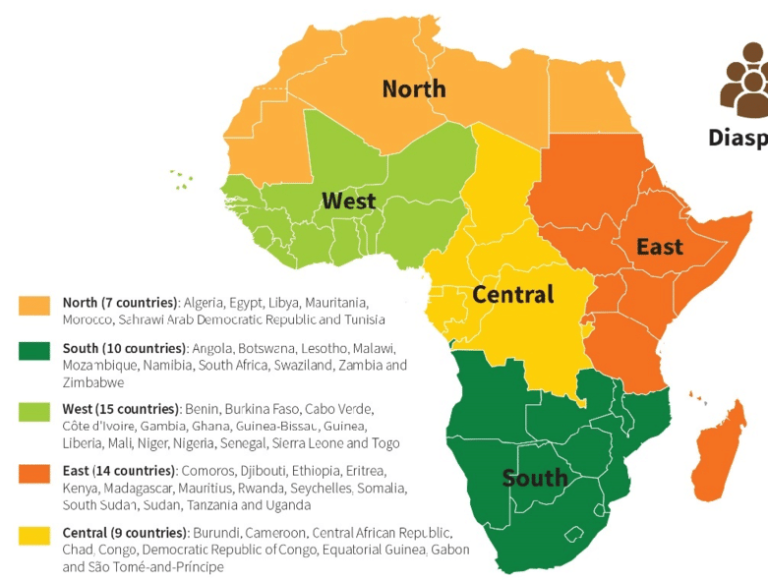
Geographic Distribution of AfAS Members
Analysis (pre-2026 fee introduction):
~50 members from each of
North, East & West Africa
~100 from Southern Africa
<10 Central Africa
~50 elsewhere (Europe, USA, Asia …)
.
Notes:
We have also been considering a regional representative model for the Executive Committee. A preliminary analysis of the place of work of our members indicated we had about 50 from north, east and west Africa, very few from central Africa; about 100 from southern Africa and about 50 from outside of Africa.

Slide 10
New AfAS Executive Committee:
possible voting arrangements
1. President and Vice President from anywhere in Africa,
2. Young (<35) representative,
3. Five senior representatives from anywhere in Africa
Proposed change to 3:
3a. One representative from each of North, East & West Africa
3b One (or two) representatives from Southern Africa
Votes for 3a and 3b according to region
Members decide on their region when they pay their annual fee
Only vote for one region, but choice would be yours. Everyone votes for 1 and 2 above.
Possibly implement in 2028 or maybe in 2031
Possibly change regional representation every 6 years so as not to change entire ExCo every 3 years
.
Notes:
that in mind one possible model illustrated. P & VP elected as at present: candidate with most votes P Young Rep also elected by full membership.
proposed change applies to remaining members of ExCo. Instead of selecting the top five candidates overall,... Members vote only for rep from their chosen region. Choice would be made when paying annual fees, could be changed once/year. Members outside Africa select a region same way.
practical considerations, not proceed understanding how members distributed when fees are paid , and how feasible the system is to implement.
To avoid a complete turnover of the Executive Committee every three years, one option would be to elect representatives from three regions at one General Assembly and the remaining two at the next. However, this adds complexity and would need careful thought. That said, replacing all elected members of the Executive Committee every three years is clearly not ideal.

Slide 11
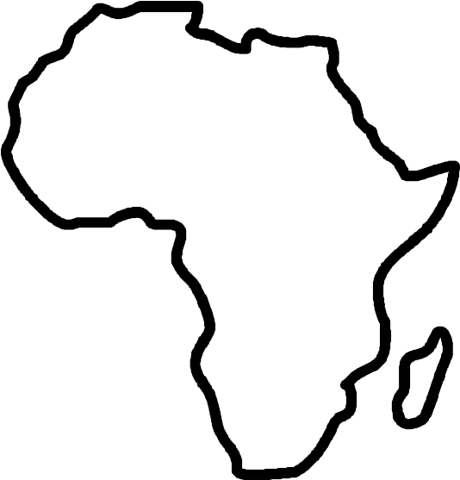
New AfAS Executive Committee:
alternative voting arrangements
1. President and Vice President
2. Young (<35) representative (Chair: Early-Career Committee)
3. Five senior representatives from anywhere in Africa
Nominated to hold key portfolios as Chairs of Committees:
Science
Outreach & Education
Membership
Fundraising
Other
Pros: emphasis on what we do and not where we come from
Cons: finding people with skills and time will be a challenge
.
Please note that NOTHING DECIDED, not even drafted yet
Must be 3 ExCO Directors resident in SA, if 3 are not elected they must be appointed

Slide 12
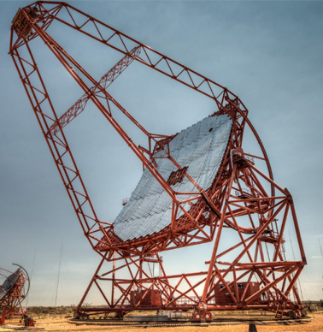
Current Status: Development Underway
Working Group Progress
Next Steps
Constitution Working Group (WG) invite input from members regarding the constitution, the terms of reference for committees and other matters for the by-laws. E-mail will go out after this meeting.
WG will draft by-laws and adjustments to the constitution.
Review draft by-laws with ExCo then with membership
Address feedback and finalise documents
Prepare for formal adoption by membership at GA in Ethiopia in 2028

Slide 13
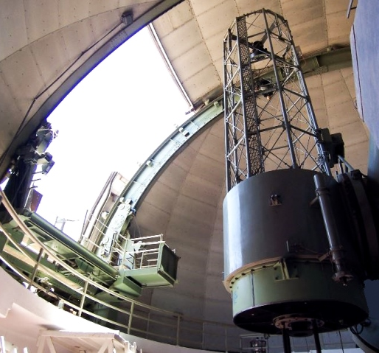



The Road Ahead
Draft Review
Circulate proposed by-laws for member feedback
Finalise Documents
Incorporate feedback and prepare final versions
Formal Adoption
Present to membership for approval

Slide 14
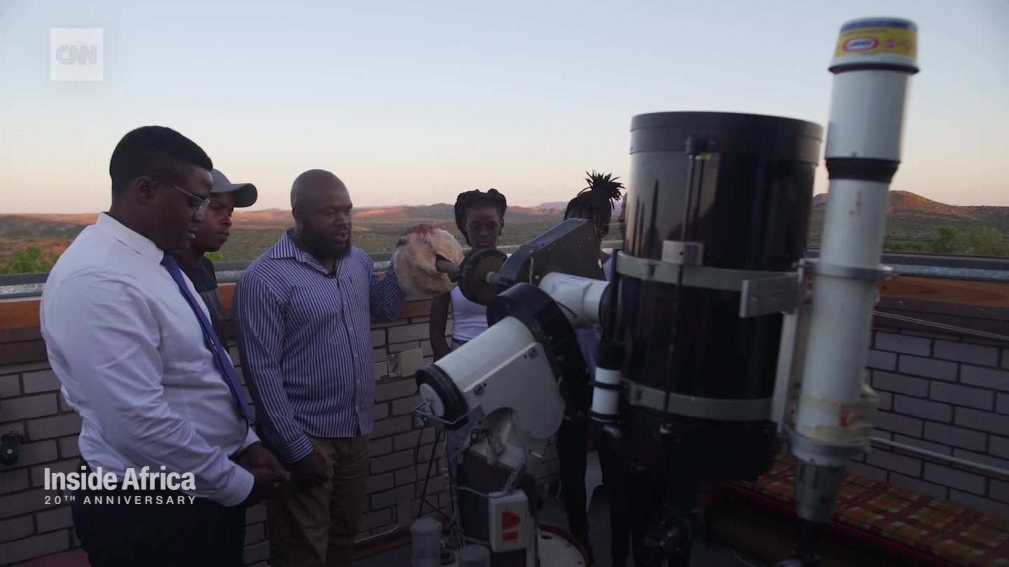
Strengthening African Astronomy Together
Our Commitment
Comprehensive by-laws will ensure AfAS continues to serve African astronomers effectively, transparently, and inclusively.
The Constitution Working Group invites all AfAS members to engage with this important governance development.

