Slide 1
Three-Tracer Approach
Multi-Tracer Power Spectrum Formalism
for Large-Scale Structure Analysis
Simthembile Dlamini, PhD
Department of Astronomy · University of Cape Town
AfAS Conference 2026
Kasane, Botswana · March 2026
Cosmological Parameters · Fourier Power Spectrum · Cosmic Variance · Redshift-Space Distortions · Fisher Matrix

Slide 2
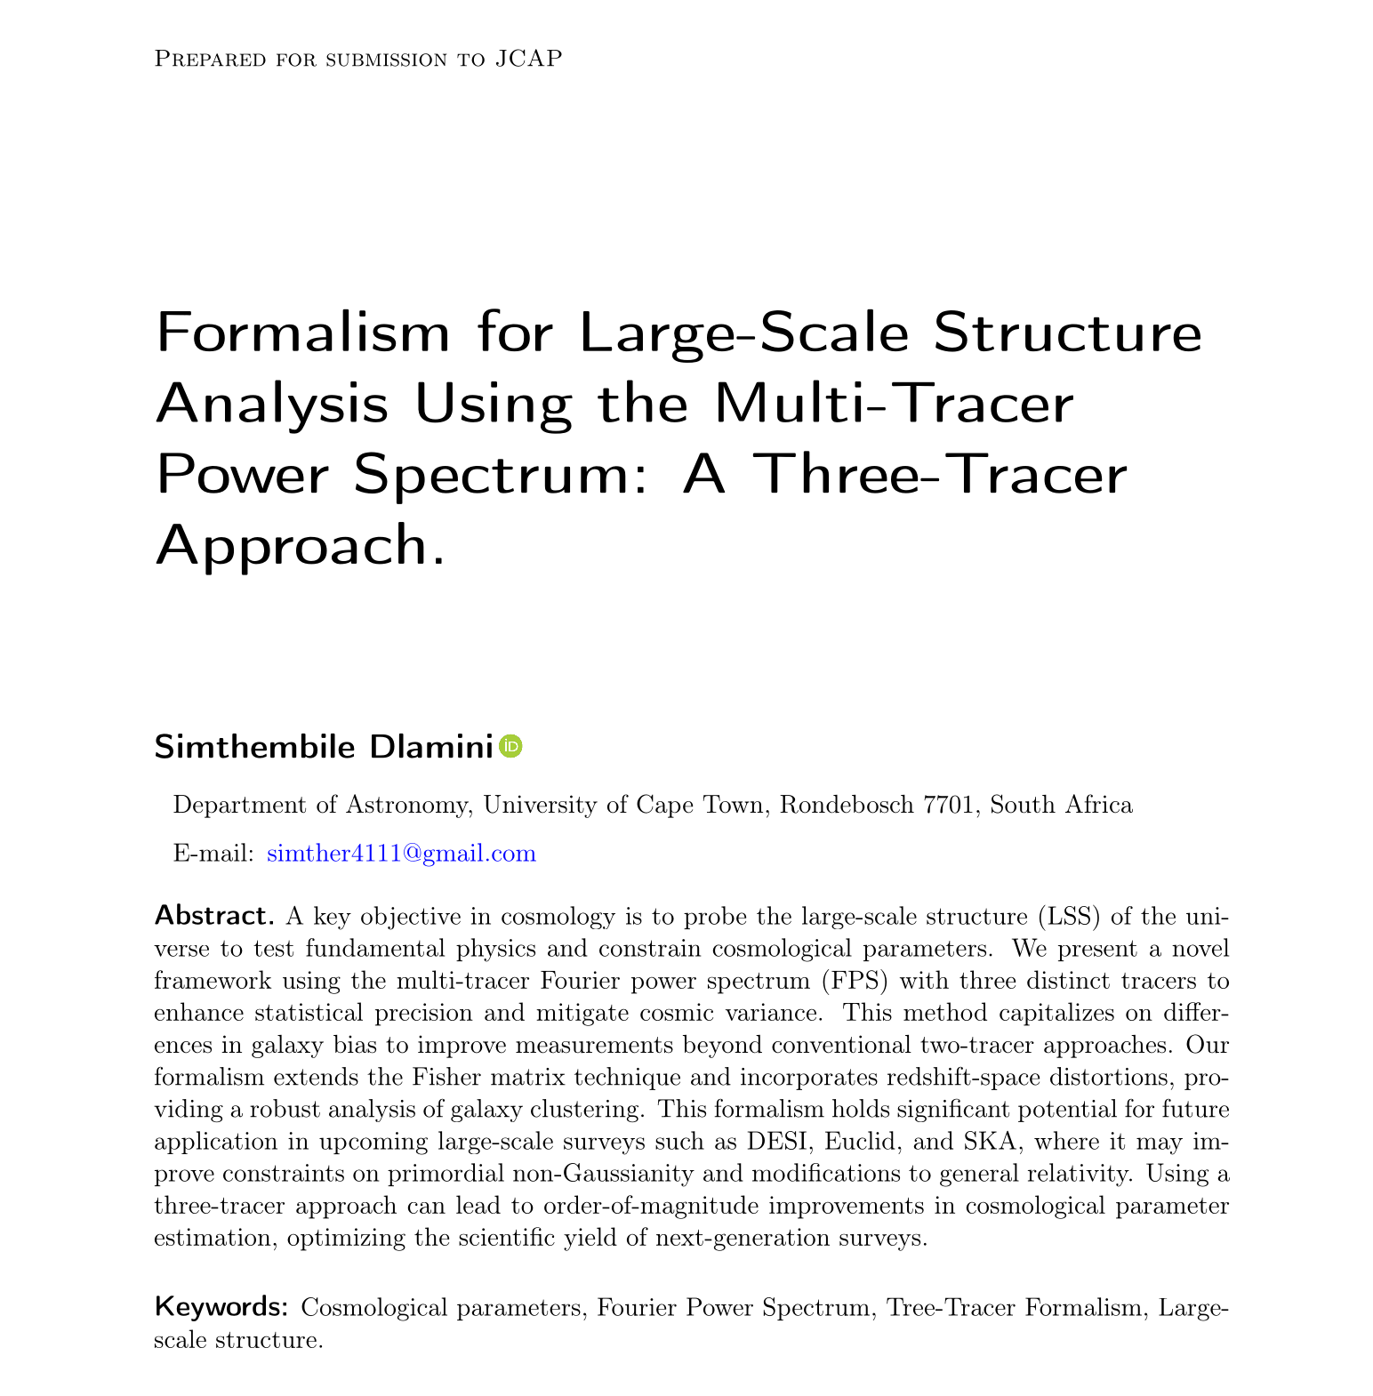

Slide 3
Motivation & Background
Large-Scale Structure (LSS)
WHY
MULTI-TRACER?
Encodes fundamental physics — dark energy, gravity, primordial conditions — via the power spectrum and correlation function.
The Cosmic Variance Problem
Galaxy surveys are limited by sample variance, shot noise, and observational bias, hindering precise cosmological constraints.
Pushing beyond
cosmic variance
Multi-Tracer Technique
Combining distinct galaxy populations reduces cosmic variance by exploiting differences in their biasing properties.
Beyond Two Tracers
Three-tracer analysis has not been studied in detail, despite its potential to further suppress variance and reveal subtle effects.

Slide 4
Theoretical Framework
Power Spectra · Redshift-Space Distortions · Covariance Matrix
Power Spectrum Data Vector
Redshift-Space Distortions
Fisher Information Matrix
P = (P₁₁, P₁₂, P₁₃, P₂₂, P₂₃, P₃₃)
δᵢ(z,k) = [bᵢ(z) + f(z)μ²] δ(z,k)
Fαβ = Σₖ ∂ₐP · Cov(P,P)⁻¹ · ∂βPᵀ
3 auto-spectra + 3 cross-spectra
Kaiser effect amplifies line-of-sight clustering
6×6 covariance matrix (vs 3×3 two-tracer)
Captures all tracer pair correlations
bᵢ = linear bias, f = growth rate
Inverse gives parameter covariance
Encodes bias differences between populations
μ = cosine of angle to line of sight
Quantifies precision of parameter estimates

Slide 5
Covariance Matrix Expansion
Two-Tracer
Three-Tracer
3 × 3 Covariance Matrix
6 × 6 Covariance Matrix
P₁₁
P₁₂
P₂₂
P₁₁
P₁₂
P₁₃
P₂₂
P₂₃
P₃₃
P₁₁
P₁₁
2P̃²₁₁
2P̃₁₁P̃₁₂
2P̃²₁₂
→
P₁₂
P₁₂
2P̃₁₁P̃₁₂
P̃²₁₂+P̃₁₁P̃₂₂
2P̃₁₂P̃₂₂
P₁₃
P₂₂
2P̃²₁₂
2P̃₁₂P̃₂₂
2P̃²₂₂
P₂₂
P₂₃
P₃₃

Slide 6
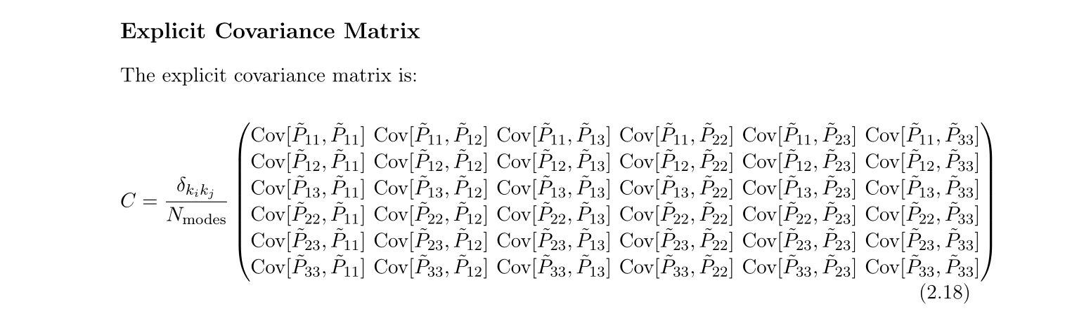

Slide 7
Signal-to-Noise Ratio Results
desiBGS ⊗ HIgalaxySurvey ⊗ SKA1-Band2
z | SNR Full | SNR Auto | SNR Cross
0.1 | 25.5 | 19.4 | 16.6
0.2 | 52.4 | 40.0 | 33.9
0.3 | 75.5 | 57.9 | 48.4
0.4 | 105.2 | 80.9 | 67.3
0.5 | 109.7 | 66.7 | 87.2
Key finding: SNR_full > SNR_auto at ALL redshifts — cross-correlations add statistically independent information beyond each survey alone.

Slide 8
Three-Tracer vs Two-Tracer
➊
➋
Richer Covariance Structure
Refined Bias Probing
Expands from 3×3 to 6×6, encoding all auto- and cross-power spectra among three tracer populations for a more information-rich statistical framework.
Additional cross-correlations probe tracer-dependent bias parameters more accurately, improving modeling of the tracer-matter relationship.
➌
➍
Enhanced Cosmic Variance Suppression
Order-of-Magnitude Improvements
Greater inter-tracer redundancy enables optimal combination of three independently biased tracers, efficiently disentangling noise from cosmological signal.
We expect significantly improved constraints on f (growth rate), b (bias), and σ₈ without requiring additional survey volume.
Notable: at z ≈ 0.45 cross-correlation SNR exceeds auto-correlation — demonstrating cross-spectra are immune to individual tracer noise.

Slide 9
Application to Large-Scale Surveys
SKAO
DESI
Euclid
Radio / 21cm HI
Spectroscopic
Weak Lensing + Clustering
Maps HI fluctuations across cosmic time; combined with galaxy & radio continuum surveys enhances structure growth constraints.
Multiple biased tracers (LRGs, ELGs, quasars) enable tighter constraints on dark energy and the matter power spectrum.
Tests dark matter, dark energy, and alternative gravity models; multiple tracers enhance LSS probing.
HIRAX
Rubin / LSST
SPHEREx
21cm / z=0.8–2.5
Deep Optical Imaging
Near-IR Spectroscopy
BAO from large volumes; three-tracer analysis reduces cosmic variance and breaks parameter degeneracies.
Billions of galaxies combined with spectroscopic and 21cm data enables a powerful multi-tracer approach.
All-sky survey for inflationary physics; multiple galaxy populations improve primordial non-Gaussianity constraints.

Slide 10
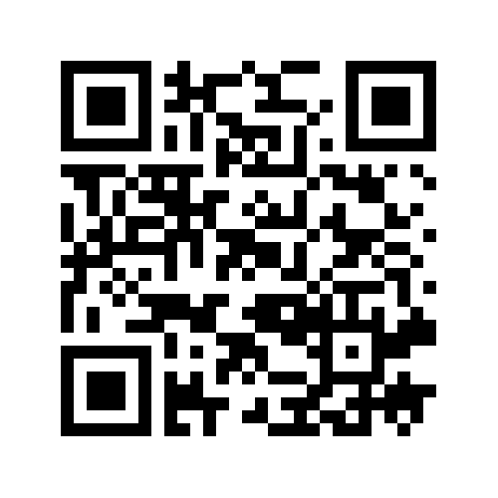
Conclusion
Novel Three-Tracer Formalism
Derived covariance and Fisher matrices for three tracers with redshift-space distortions - a rigorous extension of the multi-tracer framework.
6x6 Covariance Matrix
Expands from 3x3 to capture all auto- and cross-power spectra, enabling efficient separation of tracer bias, shot noise, and cosmological signal.
Multi-Survey Synergy
Tested on DESI-BGS, HI Galaxy Survey, and SKA1-Band2. Cross-correlations stay robust even when individual tracers become noise-dominated.
Future Outlook
Integration with DESI, Euclid, SKAO, HIRAX, Rubin LSST, and SPHEREx; validation via mock catalogs, simulations, and ML-enhanced inference.
Simthembile Dlamini · UCT Department of Astronomy · Funded by SARChI/SARAO ·

Slide 11
